Slide 1

Ibrahim Butt 24043 Muhammad Tahir Ahmed 24151 Ammara Khan 24133 Sara Abid 24112 Israr Hussain 24045

Slide 2
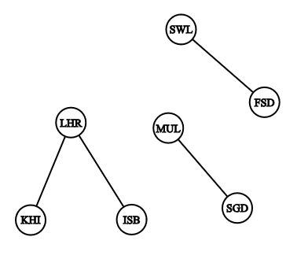
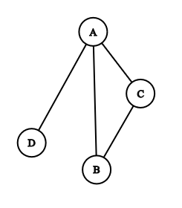
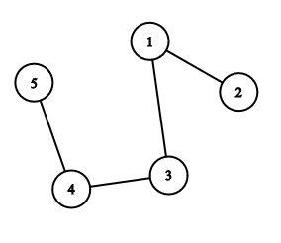
GRAPH : a list of pairs of “things” called vertex/vertices, and lines between those points, called edges
𝐴 = {(1, 2), (1, 3), (3, 4), (4, 5)}
𝐵 = {(A, B), (B, C), (A, C), (A, D)}
𝐶 = {(LHR,KRA), (LHR,ISB), (FSD,SWL), (STD,MUL)}

Slide 3
GRAPH : a list of pairs of “things” called vertex/vertices, and lines between those points, called edges
𝐴 = {(1, 2), (1, 3), (3, 4), (4, 5)}
𝐵 = {(A, B), (B, C), (A, C), (A, D)}
𝐶 = {(LHR,KRA), (LHR,ISB), (FSD,SWL), (STD,MUL)}

Slide 4
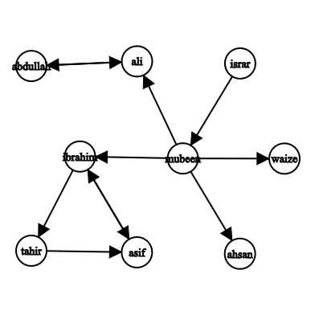
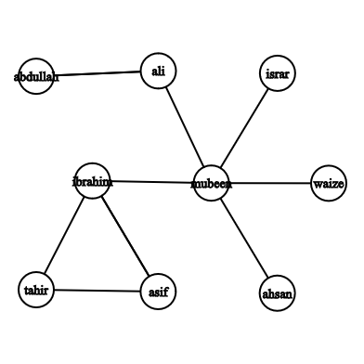
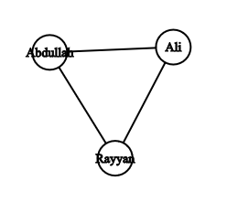
Difference between Directed and undirected graphs?
Instagram followers
Siblings Relation

Slide 5
Difference between Directed and undirected graphs?
Instagram followers
Siblings Relation

