Slide 1
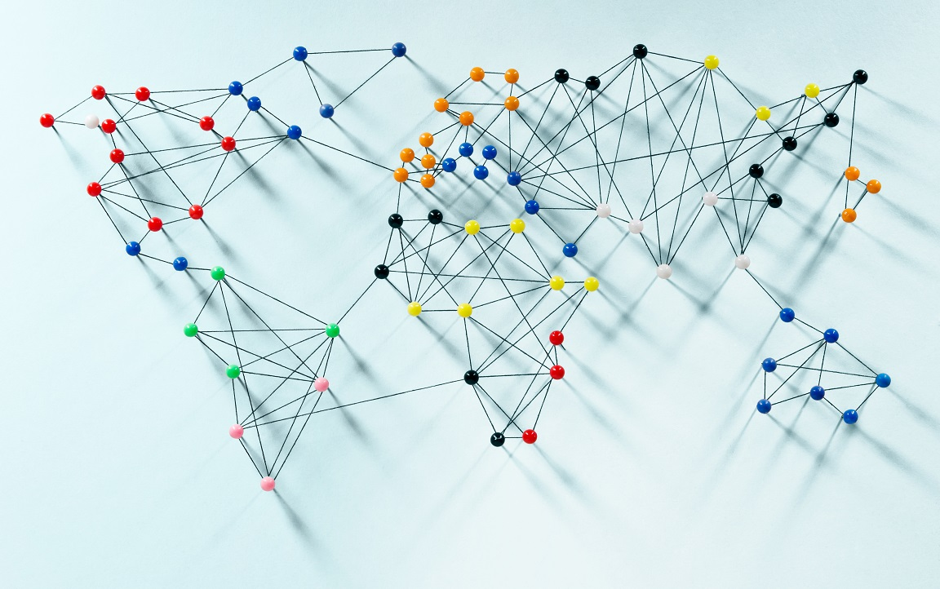
Ibrahim Butt 24043 Muhammad Tahir Ahmed 24151 Ammara Khan 24133 Sara Abid 24112 Israr Hussain 24045

Slide 2
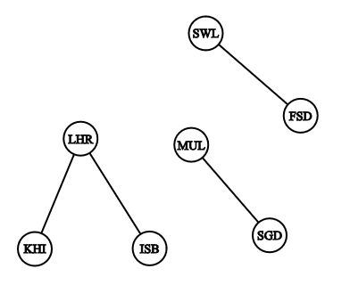
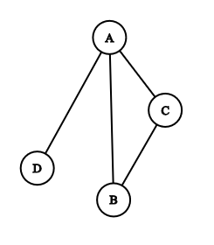
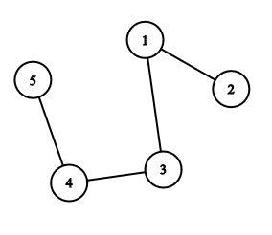
GRAPH : a list of pairs of “things” called vertex/vertices, and lines between those points, called edges
𝐴 = {(1, 2), (1, 3), (3, 4), (4, 5)}
𝐵 = {(A, B), (B, C), (A, C), (A, D)}
𝐶 = {(LHR,KRA), (LHR,ISB), (FSD,SWL), (STD,MUL)}

Slide 3
GRAPH : a list of pairs of “things” called vertex/vertices, and lines between those points, called edges
𝐴 = {(1, 2), (1, 3), (3, 4), (4, 5)}
𝐵 = {(A, B), (B, C), (A, C), (A, D)}
𝐶 = {(LHR,KRA), (LHR,ISB), (FSD,SWL), (STD,MUL)}
edges
vertex

Slide 4
GRAPH : a list of pairs of “things” called vertex/vertices, and lines between those points, called edges
𝐴 = {(1, 2), (1, 3), (3, 4), (4, 5)}
𝐵 = {(A, B), (B, C), (A, C), (A, D)}
𝐶 = {(LHR,KRA), (LHR,ISB), (FSD,SWL), (STD,MUL)}
edges
Total edges:
(n(n-1))/2
vertex

Slide 5
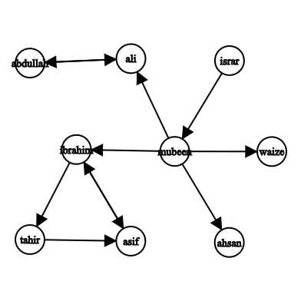
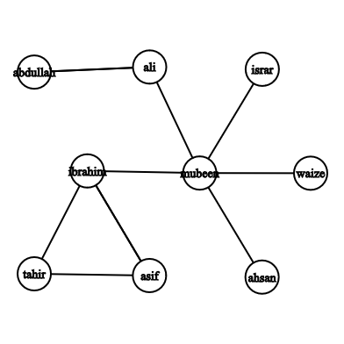
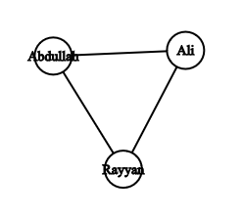
Difference between Directed and undirected graphs?
Instagram followers
Siblings Relation

Slide 6
Difference between Directed and undirected graphs?
Instagram followers
Siblings Relation

Slide 7
GRAPH REPRESENTATION
Edge List
Individual track of all edges
Need to check all edges
Adjacency List
Track of all adjacent to a particular edge
Need to check relevant list of adjacent
Adjacency Matrix
Table in form of rows and columns that keep track of all possible edges in terms of YES/NO
Only need to check one cell.

Slide 8
Things we need for our area of research:
How to traverse a graph
Count neighbors of a vertex
Count degree of a vertex(number of edges meeting at that vertex)
Deleting and inserting edges
Path and cycle of vertices

Slide 9
Graph in Board Games
Most board games are played two-dimensional grid.
• Nodes represent the cells where game pieces are placed.
• Winning conditions involve finding paths (edges) with consecutive stones.

Slide 10
Implementation
Topics like graph theory, and recursion play crucial roles in modeling and solving the game.

