Slide 1

Ibrahim Butt 24043 Muhammad Tahir Ahmed 24151 Ammara Khan 24133 Sara Abid 24112 Israr Hussain 24045

Slide 2
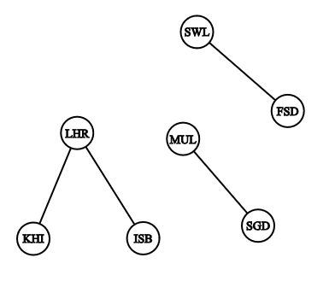
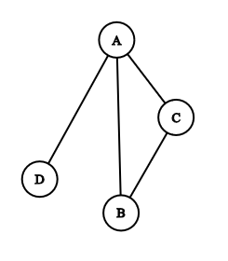
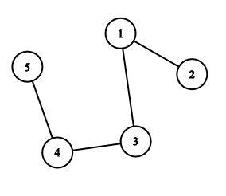
A list of pairs of “things” called vertex/vertices, and lines between those points, called edges
GRAPH
𝐴 = {(1, 2), (1, 3), (3, 4), (4, 5)}
𝐵 = {(A, B), (B, C), (A, C), (A, D)}
𝐶 = {(LHR,KRA), (LHR,ISB), (FSD,SWL), (STD,MUL)}
GRAPH THEORY IN BOARD GAMES

Slide 3
GRAPH : a list of pairs of “things” called vertex/vertices, and lines between those points, called edges
𝐴 = {(1, 2), (1, 3), (3, 4), (4, 5)}
𝐵 = {(A, B), (B, C), (A, C), (A, D)}
𝐶 = {(LHR,KRA), (LHR,ISB), (FSD,SWL), (STD,MUL)}
edges
vertex

Slide 4
GRAPH : a list of pairs of “things” called vertex/vertices, and lines between those points, called edges
𝐴 = {(1, 2), (1, 3), (3, 4), (4, 5)}
𝐵 = {(A, B), (B, C), (A, C), (A, D)}
𝐶 = {(LHR,KRA), (LHR,ISB), (FSD,SWL), (STD,MUL)}
edges
Total edges:
(n(n-1))/2
vertex

Slide 5
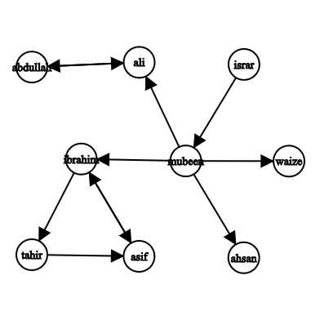
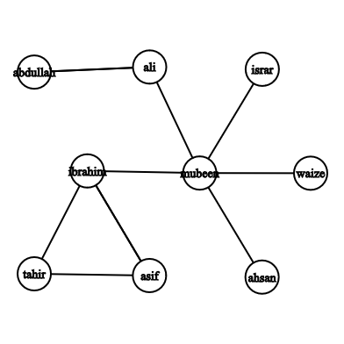
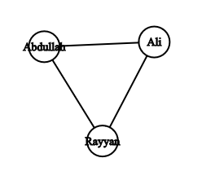
Difference between Directed and undirected graphs?
Instagram followers
Siblings Relation

Slide 6
Difference between Directed and undirected graphs?
Instagram followers
Siblings Relation

Slide 7
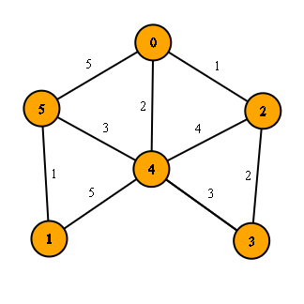
Weighted Graphs
Many graphs can have edges that contain a certain weight to represent an arbitrary value such as cost, distance, quantity, etc.
This suggests that all edges cannot be treated equally in certain cases.
USE IN GAME:
to represent the potential impact or strategic value of certain moves.
Weights could represent how close a sequence is to completion
In more advanced AI implementations, weighted graphs can help find paths that maximize player's advantage while minimizing the opponent’s.

Slide 8
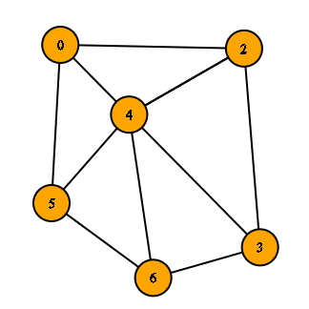
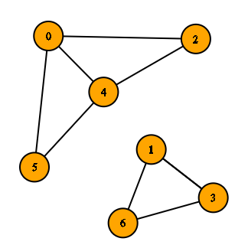
Connected vs Disconnected Graphs
A graph is called connected when a path exist between all of its vertices.
A graph is called disconnected when a path doesn’t exist between all of its vertices.

Slide 9
GRAPH REPRESENTATION
Edge List
Individual track of all edges
Need to check all edges
Adjacency List
Track of all adjacent to a particular edge
Need to check relevant list of adjacent
Adjacency Matrix
Table in form of rows and columns that keep track of all possible edges in terms of YES/NO
Only need to check one cell.

Slide 10
Things we need for our area of research:
How to traverse a graph
Count neighbors of a vertex
Count degree of a vertex(number of edges meeting at that vertex)
Deleting and inserting edges
Path and cycle of vertices

Slide 11
Graph in Board Games
Most board games are played two-dimensional grid.
• Nodes represent the cells where game pieces are placed.
• Winning conditions involve finding paths (edges) with consecutive stones.

Slide 12
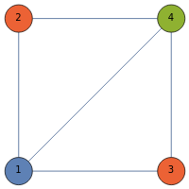
Graph Coloring in Board Games
involves assigning different colors to the vertices of a graph such that no two adjacent vertices share the same color.
Simplifies game design by managing player interactions and organizing regions.
Territory Colouring: Assigning different colours to neighbouring territories.
Player moves: Useful in multiplayer games to minimize conflicts.
Puzzle Solving: No two adjacent players have the same colours.

Slide 13
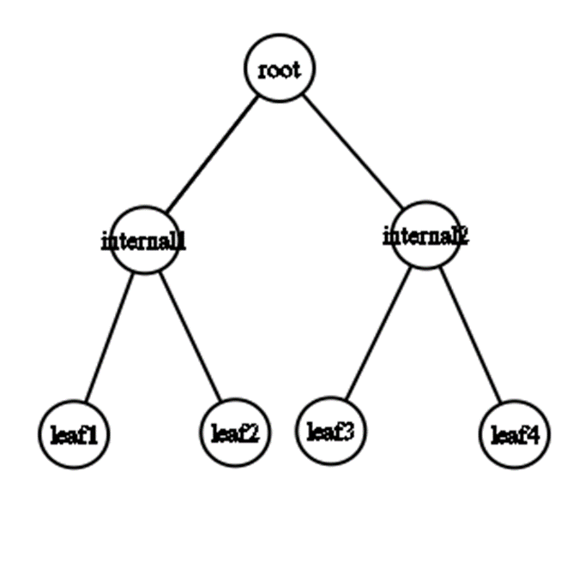
TREES AND SPANNING TREES
Tree is a simple, connected ,undirected ,acyclic(having a unique path between any two vertices) graph.
A spanning tree of a graph is a subgraph that includes all vertices of the graph and is a tree.
- Spanning trees connect all vertices with the minimum possible edges.
In games, spanning trees can help create unique paths with no loops.

Slide 14
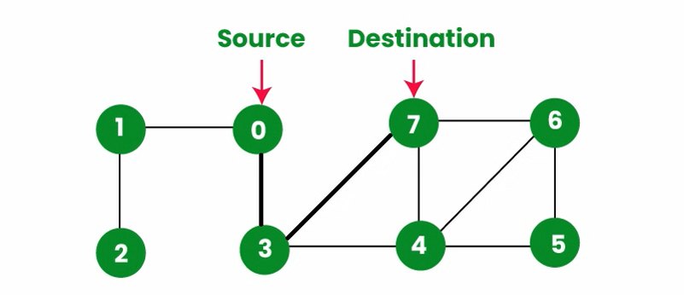
Path finding
Definition:
“Pathfinding refers to the process of finding a path from one point (vertex) to another in a graph.”
A path in a graph is a sequence of edges that connects a series of vertices.
It can be represented as a list of vertices starting from a source node and ending at a destination node, with each consecutive vertex connected by an edge.

Slide 15
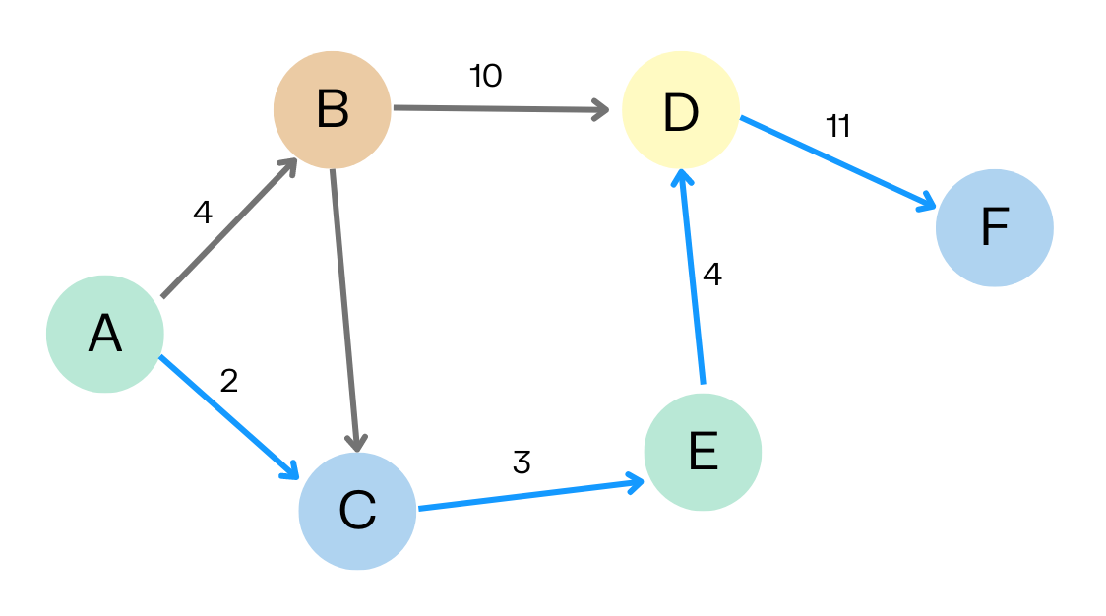
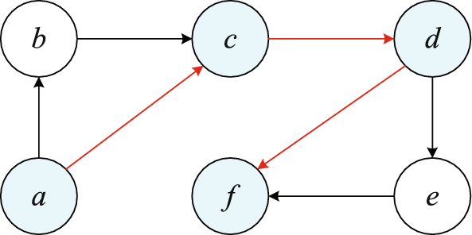
Shortest Path
Definition:
“The shortest path is a path between two vertices such that the sum of the weights of the edges in the path is minimized.”
In unweighted graphs, the shortest path is simply the path with the least number of edges.
In weighted graphs, it’s the path with the minimum total weight.

Slide 16
Some Algorithms Used for Path Finding
Dijkstra’s Algorithm
A* Algorithm
Bellman-Ford Algorithm
Floyd-Warshall Algorithm
Breadth-First Search (BFS)
Depth-First Search (DFS)
Johnson’s Algorithm

Slide 17
Some Algorithms Used for Path Finding
Dijkstra’s Algorithm
A* Algorithm
Bellman-Ford Algorithm
Floyd-Warshall Algorithm
Breadth-First Search (BFS)
Depth-First Search (DFS)
Johnson’s Algorithm
We have used Breadth-First Search (BFS) in our code..

Slide 18
Breadth-First Search Algorithm
BFS is the best algorithm used for path finding in unweighted graphs.
This BFS implementation explores close moves first and extends outward, efficiently finding potential moves for the AI to play based on nearby pieces.

Slide 19
RECURSION:
BASE CASE: a condition that allows an algorithm stops further recursive calls and return a result.
Recursive case: It is the part of a recursive function that breaks down a problem into smaller subproblems, which moves the problem closer to the base case. RECURSIVE FUNCTION: Recursive function is a function that values at any point can be calculated from the values of the function at some previous points

Slide 20
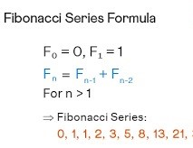
HOW RECURSION WORKS :
Step By Step :
Step 2: Step 1 + lowest step.
Step 3: Step 2 + Step 1 + lowest step.
Step 4: Step 3 + step 2 + step 1+ lowest step, and so on.
The smallest argument is donated by f(0) or f(1) .
The nth argument is donated by f(n).
Example: fibonacci sequence.

Slide 21
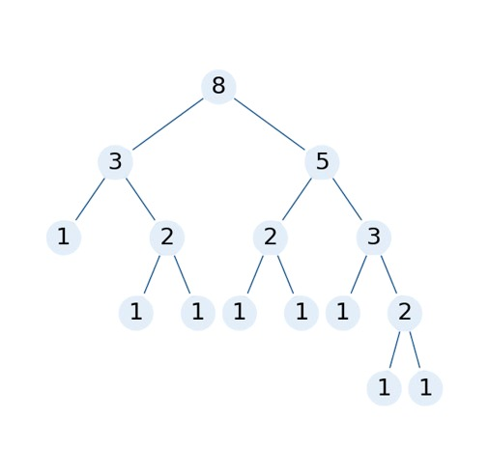
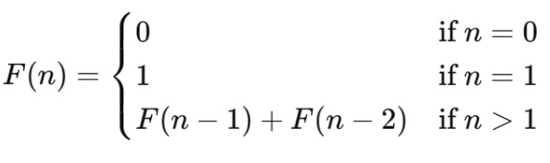
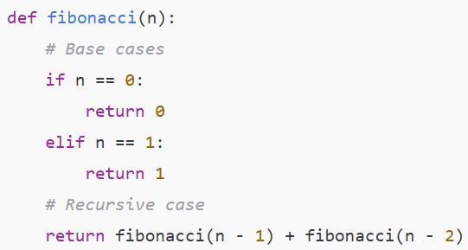
Recursive function:
Fibonacci(5) calls → Fibonacci(4) + Fibonacci(3)
Fibonacci(4) calls → Fibonacci(3) + Fibonacci(2)
Fibonacci(3) calls → Fibonacci(2) + Fibonacci(1)
Fibonacci(2) calls → Fibonacci(1) + Fibonacci(0)
Base case: Fibonacci(1) returns 1 Fibonacci(0) returns 0

Slide 22
Implementation
Topics like graph theory, and recursion play crucial roles in modeling and solving the game.

Slide 23
Introduction to Gomoku
Gomoku rules and win condition
Graph Model: Gomoku’s grid can be represented as a graph where:
Vertices (Nodes) represent each board position.
Edges (Connections) represent possible moves between adjacent positions (up, down, left, right, or diagonally).
Significance: This representation enables the game to leverage graph algorithms to analyze the board for optimal moves and winning patterns.
Recursion in Gomoku:
Exploring Moves Recursively: AI can use recursion to evaluate multiple future moves, creating a game tree structure. Each recursive call simulates a potential move, building layers of possible future game states.
AI Strategy:
Block Opponent Moves: The AI recursively checks potential moves that could lead to an opponent's victory, blocking these to defend.
Find Winning Paths: It evaluates sequences of moves to identify paths where it can form five in a row.

Slide 24
Graph Theory: By modeling the board as a graph, the AI can:
Track connections between moves.
Evaluate clusters of pieces that could lead to potential wins.
Recursion: Recursively explores all potential moves, simulating different sequences and choosing the path that maximizes the chance of winning.
Python: Recommended for ease of use and development speed, especially with libraries that simplify board representation and recursive functions.
Basic Algorithm for AI Move Selection
Recursive Evaluation:
Start with an empty board state, checking all valid moves.
For each move, recursively simulate possible opponent responses.
Limit recursive checks

Slide 25
CONCLUSION
Graph Theory:
Helps us map and understand game boards and other complex structures by showing connections and paths, making strategic planning easier.
Recursion:
A flexible tool for solving repetitive tasks and layered challenges, especially useful in game logic to solve problems efficiently.
AI in Board Games
AI can be enhanced for games like Gomoku by using graph theory and recursion to develop smarter, more adaptable strategies.
Final Thought:
Graph theory and recursion deepen our understanding of mathematical structures while transforming practical areas like game development. These concepts enable smarter AI, richer game mechanics, and effective problem-solving, bridging gap between theoretical knowledge and real-world applications.

Slide 26

Thank you for your attention!
Feel free to ask any questions, share thoughts or discuss further.
Looking forward to insightful discussions!

