Slide 1

Ibrahim Butt 24043 Muhammad Tahir Ahmed 24151 Ammara Khan 24133 Sara Abid 24112 Israr Hussain 24045

Slide 2
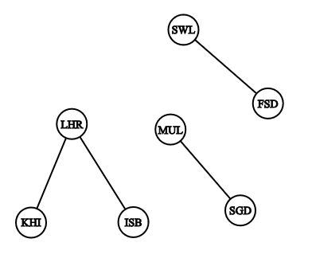
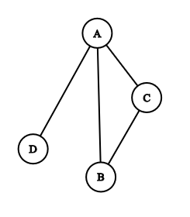
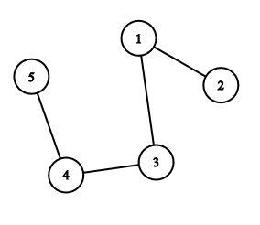
A list of pairs of “things” called vertex/vertices, and lines between those points, called edges
GRAPH
𝐴 = {(1, 2), (1, 3), (3, 4), (4, 5)}
𝐵 = {(A, B), (B, C), (A, C), (A, D)}
𝐶 = {(LHR,KRA), (LHR,ISB), (FSD,SWL), (STD,MUL)}
GRAPH THEORY IN BOARD GAMES

Slide 3
A list of pairs of “things” called vertex/vertices, and lines between those points, called edges
GRAPH
𝐴 = {(1, 2), (1, 3), (3, 4), (4, 5)}
𝐵 = {(A, B), (B, C), (A, C), (A, D)}
𝐶 = {(LHR,KRA), (LHR,ISB), (FSD,SWL), (STD,MUL)}
edges
vertex
GRAPH THEORY IN BOARD GAMES

Slide 4
A list of pairs of “things” called vertex/vertices, and lines between those points, called edges
GRAPH
𝐴 = {(1, 2), (1, 3), (3, 4), (4, 5)}
𝐵 = {(A, B), (B, C), (A, C), (A, D)}
𝐶 = {(LHR,KRA), (LHR,ISB), (FSD,SWL), (STD,MUL)}
edges
Total edges:
(n(n-1))/2
vertex
GRAPH THEORY IN BOARD GAMES

Slide 5
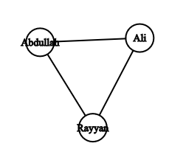
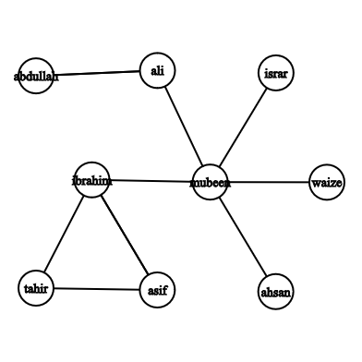
Difference between Directed and undirected graphs?
Siblings Relation (undirected graph)
Instagram followers
Israr follows Mubeen
Mubeen follows Ibrahim
Does Mubeen follows back Israr?
We don’t know!
Because
Israr follows Mubeen
does not implies
Mubeen follows Israr
Order of edges doesn’t matter
Abdullah is the brother of Rayyan
implies
Rayyan is the brother of Abdullah
GRAPH THEORY IN BOARD GAMES

Slide 6
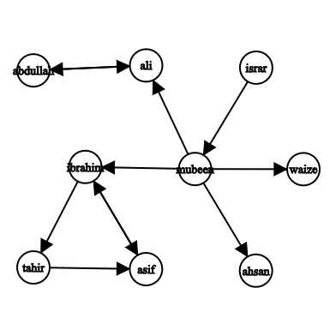
Difference between Directed and undirected graphs?
Siblings Relation (undirected graph)
Instagram followers (Directed Graphs)
Israr follows Mubeen
Mubeen follows Ibrahim
Does Mubeen follows back Israr?
We don’t know!
Because
Israr follows Mubeen
does not implies
Mubeen follows Israr
Order of edges doesn’t matter
Abdullah is the brother of Rayyan
implies
Rayyan is the brother of Abdullah
That’s why we need Directions!!!
GRAPH THEORY IN BOARD GAMES

Slide 7
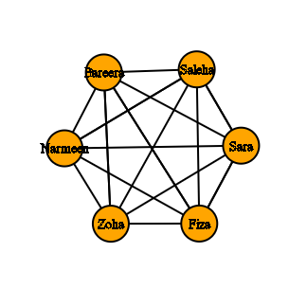
Hand Shaking Theorem
How many total handshakes do we have ?
It’s hard to count one by one.
Graph Theory gives us amazing tools!
Theorem:
2m = Summation of degrees of all Vertices
2m = 30
m = 15
Total Hand Shakes = 15
G(V,E) having m edges

Slide 8
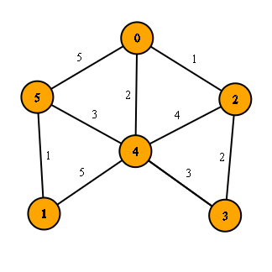
Weighted Graphs
Many graphs can have edges that contain a certain weight to represent an arbitrary value such as cost, distance, quantity, etc.
This suggests that all edges cannot be treated equally in certain cases.
USE IN GAME:
to represent the potential impact or strategic value of certain moves.
Weights could represent how close a sequence is to completion.
In more advanced AI implementations, weighted graphs can help find paths that maximize player's advantage while minimizing the opponent’s.
GRAPH THEORY IN BOARD GAMES

Slide 9
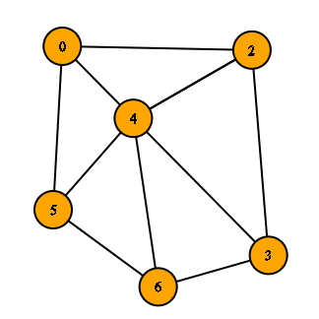
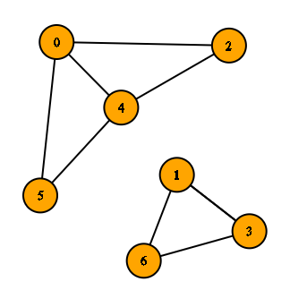
Connected vs Disconnected Graphs
A graph is called connected when a path exist between all of its vertices.
A graph is called disconnected when a path doesn’t exist between all of its vertices.
GRAPH THEORY IN BOARD GAMES

Slide 10
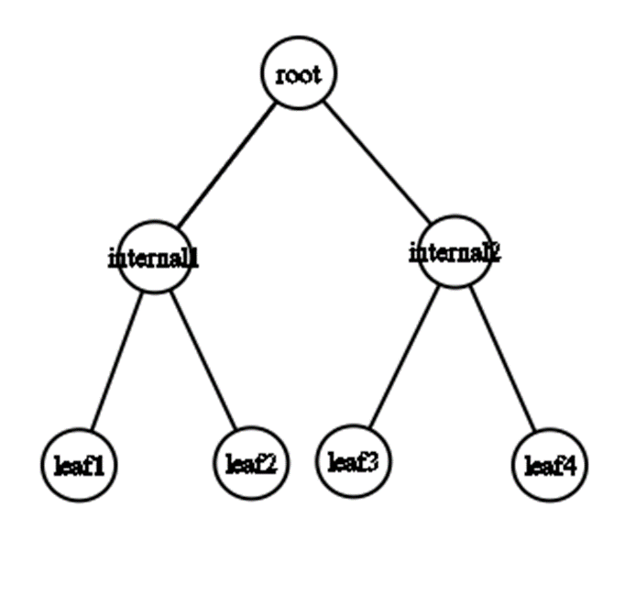
TREES AND SPANNING TREES
Tree is a simple, connected ,undirected ,acyclic(having a unique path between any two vertices) graph.
A spanning tree of a graph is a subgraph that includes all vertices of the graph and is a tree.
- Spanning trees connect all vertices with the minimum possible edges.
In games, spanning trees can help create unique paths with no loops.
GRAPH THEORY IN BOARD GAMES

Slide 11
GRAPH REPRESENTATION
Edge List
Individual track of all edges
Need to check all edges
Adjacency List
Track of all adjacent to a particular edge
Need to check relevant list of adjacent
Adjacency Matrix
Table in form of rows and columns that keep track of all possible edges in terms of YES/NO
Only need to check one cell.
GRAPH THEORY IN BOARD GAMES

Slide 12
Things we need for our area of research:
How to traverse a graph
Count neighbors of a vertex
Count degree of a vertex(number of edges meeting at that vertex)
Deleting and inserting edges
Path and cycle of vertices
GRAPH THEORY IN BOARD GAMES

Slide 13
RECURSION:
BASE CASE: a condition that allows an algorithm stops further recursive calls and return a result.
Recursive case: It is the part of a recursive function that breaks down a problem into smaller subproblems, which moves the problem closer to the base case. RECURSIVE FUNCTION: Recursive function is a function that values at any point can be calculated from the values of the function at some previous points
GRAPH THEORY IN BOARD GAMES

Slide 14
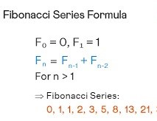
HOW RECURSION WORKS :
Step By Step :
Step 2: Step 1 + lowest step.
Step 3: Step 2 + Step 1 + lowest step.
Step 4: Step 3 + step 2 + step 1+ lowest step, and so on.
The smallest argument is donated by f(0) or f(1) .
The nth argument is donated by f(n).
Example: fibonacci sequence.
GRAPH THEORY IN BOARD GAMES

Slide 15
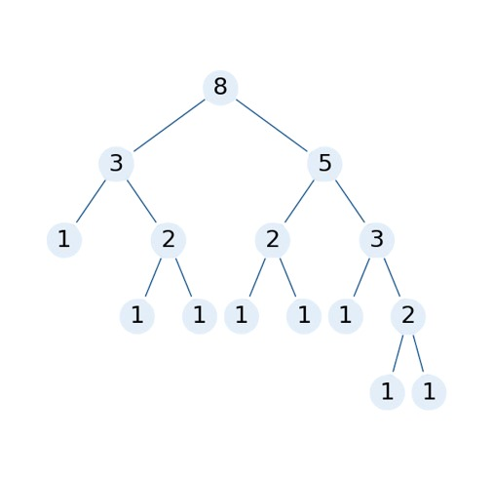
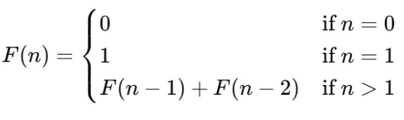
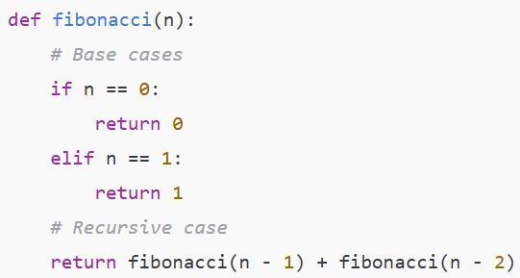
Recursive function:
Fibonacci(5) calls → Fibonacci(4) + Fibonacci(3)
Fibonacci(4) calls → Fibonacci(3) + Fibonacci(2)
Fibonacci(3) calls → Fibonacci(2) + Fibonacci(1)
Fibonacci(2) calls → Fibonacci(1) + Fibonacci(0)
Base case: Fibonacci(1) returns 1 Fibonacci(0) returns 0
GRAPH THEORY IN BOARD GAMES

Slide 16
Graph in Board Games
Most board games are played two-dimensional grid.
• Nodes represent the cells where game pieces are placed.
• Winning conditions involve finding paths (edges) with consecutive stones.
GRAPH THEORY IN BOARD GAMES

Slide 17
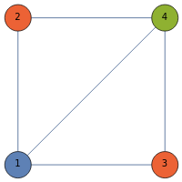
Graph Coloring in Board Games
involves assigning different colors to the vertices of a graph such that no two adjacent vertices share the same color.
Simplifies game design by managing player interactions and organizing regions.
Territory Colouring: Assigning different colours to neighbouring territories.
Player moves: Useful in multiplayer games to minimize conflicts.
Puzzle Solving: No two adjacent players have the same colours.
GRAPH THEORY IN BOARD GAMES

Slide 18
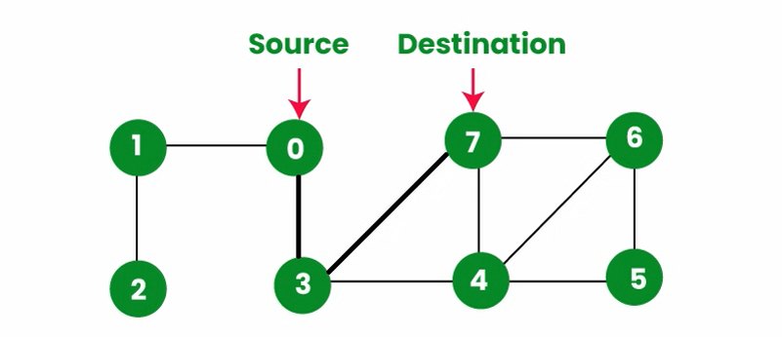
Path finding
Definition:
“Pathfinding refers to the process of finding a path from one point (vertex) to another in a graph.”
A path in a graph is a sequence of edges that connects a series of vertices.
It can be represented as a list of vertices starting from a source node and ending at a destination node, with each consecutive vertex connected by an edge.
GRAPH THEORY IN BOARD GAMES

Slide 19
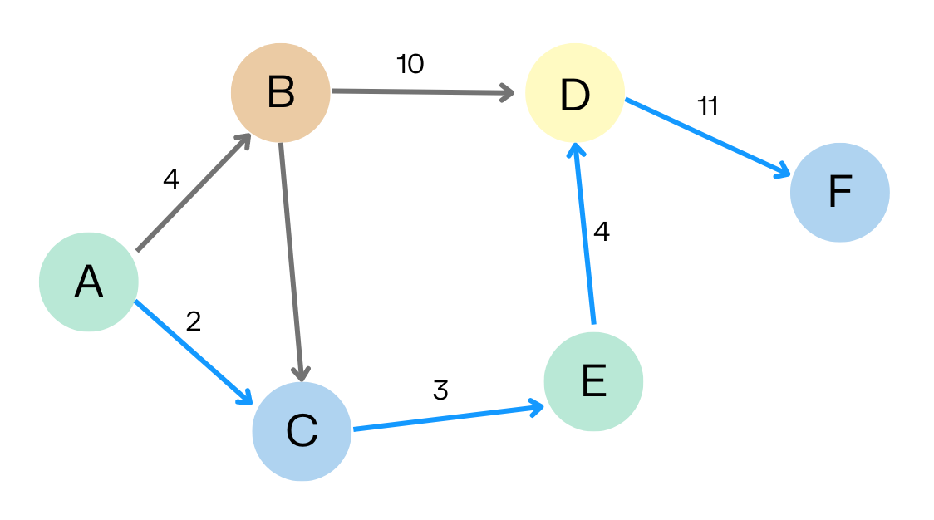
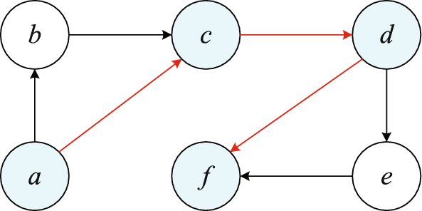
Shortest Path
Definition:
“The shortest path is a path between two vertices such that the sum of the weights of the edges in the path is minimized.”
In unweighted graphs, the shortest path is simply the path with the least number of edges.
In weighted graphs, it’s the path with the minimum total weight.
GRAPH THEORY IN BOARD GAMES

Slide 20
Some Algorithms Used for Path Finding
Dijkstra’s Algorithm
A* Algorithm
Bellman-Ford Algorithm
Floyd-Warshall Algorithm
Breadth-First Search (BFS)
Depth-First Search (DFS)
Johnson’s Algorithm
GRAPH THEORY IN BOARD GAMES

Slide 21
Some Algorithms Used for Path Finding
Dijkstra’s Algorithm
A* Algorithm
Bellman-Ford Algorithm
Floyd-Warshall Algorithm
Breadth-First Search (BFS)
Depth-First Search (DFS)
Johnson’s Algorithm
We have used Breadth-First Search (BFS) in our code..
GRAPH THEORY IN BOARD GAMES

Slide 22
Breadth-First Search Algorithm
BFS is the best algorithm used for path finding in unweighted graphs.
This BFS implementation explores close moves first and extends outward, efficiently finding potential moves for the AI to play based on nearby pieces.
GRAPH THEORY IN BOARD GAMES

Slide 23
Recursive Algorithms in Board Games
Recursion is often used in board games to explore all the possible game states or moves to determine which one’s the best for you.
Minimax Algorithm
Alpha-Beta Pruning
Monte Carlo Tree Search (MCTS)
Negamax
Depth-First Search (DFS)
Breadth-First Search (BFS)
A* Search Algorithm
Minimax with Heuristics
GRAPH THEORY IN BOARD GAMES

Slide 24
Minimax Algorithm
It is commonly used in two-player games like chess which helps to make the best decisions by assuming that both players play optimally.
GRAPH THEORY IN BOARD GAMES

Slide 25
How It Works
The game is represented as a tree, where each node represents a game state.
Edges represent moves.
The algorithm alternates between two players:
Maximizer: Tries to maximize the score (e.g., their chance of winning).
Minimizer: Tries to minimize the score (e.g., their opponent's chance of winning).
It recursively evaluates all possible game states down to the terminal states (e.g., win, lose, or draw).
Backtracking from the terminal states, it assigns a score to each move by choosing the best option for the player whose turn it is.
GRAPH THEORY IN BOARD GAMES

Slide 26
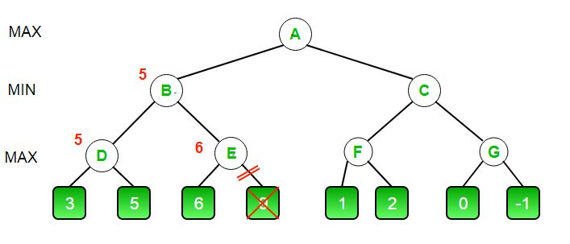
Alpha-Beta Pruning
Alpha-Beta Pruning is an optimization technique for the minimax algorithm. It reduces the number of nodes evaluated in the game tree by pruning or eliminating branches that cannot influence the final decision.
GRAPH THEORY IN BOARD GAMES

Slide 27
How it Works
Alpha (α): The best value the maximizer currently can guarantee.
Beta (β): The best value the minimizer currently can guarantee.
During the traversal:
If a branch's potential outcome is worse than an already evaluated branch for either player, that branch is pruned (skipped).
The order in which nodes are explored determines the effectiveness of pruning.
Good move ordering can significantly reduce the number of nodes evaluated.
(There may be cases where no pruning occurs but it is faster most of the times.)
GRAPH THEORY IN BOARD GAMES

Slide 28
Implementation
Topics like graph theory, and recursion play crucial roles in modeling and solving the game.
GRAPH THEORY IN BOARD GAMES

Slide 29
Introduction to Gomoku
Gomoku rules and win condition
Graph Model: Gomoku’s grid can be represented as a graph where:
Vertices (Nodes) represent each board position.
Edges (Connections) represent possible moves between adjacent positions (up, down, left, right, or diagonally).
Significance: This representation enables the game to leverage graph algorithms to analyze the board for optimal moves and winning patterns.
Recursion in Gomoku:
Exploring Moves Recursively: AI can use recursion to evaluate multiple future moves, creating a game tree structure. Each recursive call simulates a potential move, building layers of possible future game states.
AI Strategy:
Block Opponent Moves: The AI recursively checks potential moves that could lead to an opponent's victory, blocking these to defend.
Find Winning Paths: It evaluates sequences of moves to identify paths where it can form five in a row.
GRAPH THEORY IN BOARD GAMES

Slide 30
Graph Theory: By modeling the board as a graph, the AI can:
Track connections between moves.
Evaluate clusters of pieces that could lead to potential wins.
Recursion: Recursively explores all potential moves, simulating different sequences and choosing the path that maximizes the chance of winning.
Python: Recommended for ease of use and development speed, especially with libraries that simplify board representation and recursive functions.
Basic Algorithm for AI Move Selection
Recursive Evaluation:
Start with an empty board state, checking all valid moves.
For each move, recursively simulate possible opponent responses.
Limit recursive checks
GRAPH THEORY IN BOARD GAMES

Slide 31
CONCLUSION
Graph Theory:
Helps us map and understand game boards and other complex structures by showing connections and paths, making strategic planning easier.
Recursion:
A flexible tool for solving repetitive tasks and layered challenges, especially useful in game logic to solve problems efficiently.
AI in Board Games
AI can be enhanced for games like Gomoku by using graph theory and recursion to develop smarter, more adaptable strategies.
Final Thought:
Graph theory and recursion deepen our understanding of mathematical structures while transforming practical areas like game development. These concepts enable smarter AI, richer game mechanics, and effective problem-solving, bridging gap between theoretical knowledge and real-world applications.
GRAPH THEORY IN BOARD GAMES

Slide 32

Thank you for your attention!
Feel free to ask any questions, share thoughts or discuss further.
Looking forward to insightful discussions!
GRAPH THEORY IN BOARD GAMES

