Slide 1
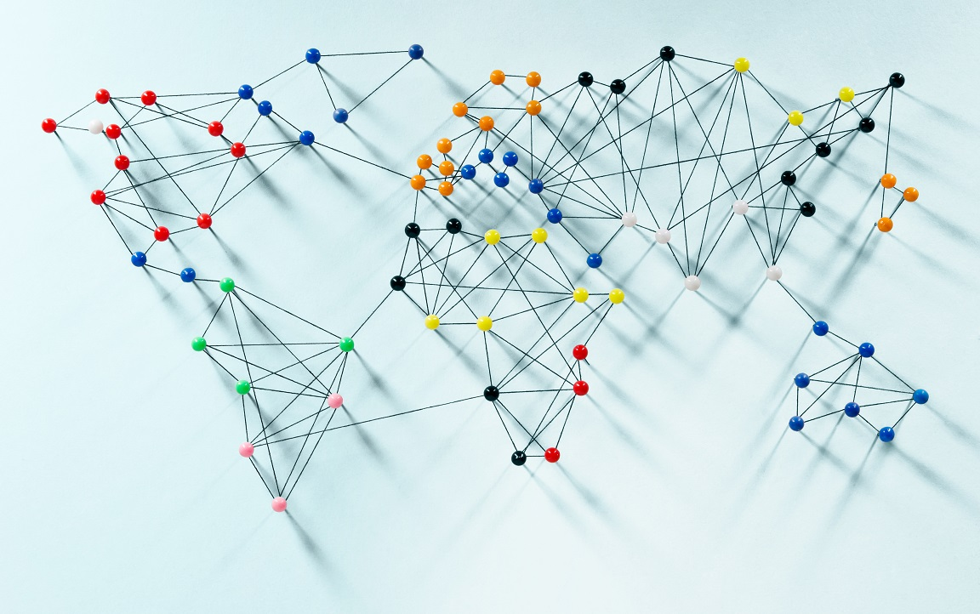
Ibrahim Butt 24043 Muhammad Tahir Ahmed 24151 Ammara Khan 24133 Sara Abid 24112 Israr Hussain 24045

Slide 2
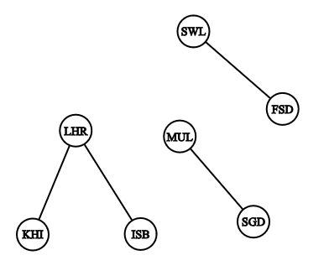
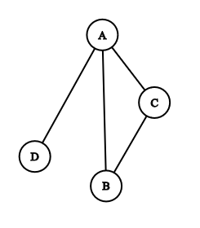
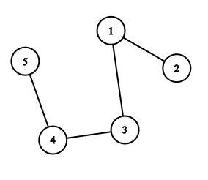
A list of pairs of “things” called vertex/vertices, and lines between those points, called edges
GRAPH
𝐴 = {(1, 2), (1, 3), (3, 4), (4, 5)}
𝐵 = {(A, B), (B, C), (A, C), (A, D)}
𝐶 = {(LHR,KRA), (LHR,ISB), (FSD,SWL), (STD,MUL)}
GRAPH THEORY IN BOARD GAMES

Slide 3
GRAPH : a list of pairs of “things” called vertex/vertices, and lines between those points, called edges
𝐴 = {(1, 2), (1, 3), (3, 4), (4, 5)}
𝐵 = {(A, B), (B, C), (A, C), (A, D)}
𝐶 = {(LHR,KRA), (LHR,ISB), (FSD,SWL), (STD,MUL)}
edges
vertex

Slide 4
GRAPH : a list of pairs of “things” called vertex/vertices, and lines between those points, called edges
𝐴 = {(1, 2), (1, 3), (3, 4), (4, 5)}
𝐵 = {(A, B), (B, C), (A, C), (A, D)}
𝐶 = {(LHR,KRA), (LHR,ISB), (FSD,SWL), (STD,MUL)}
edges
Total edges:
(n(n-1))/2
vertex

Slide 5
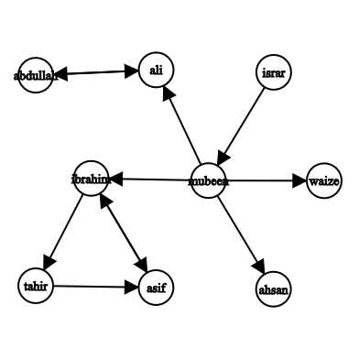
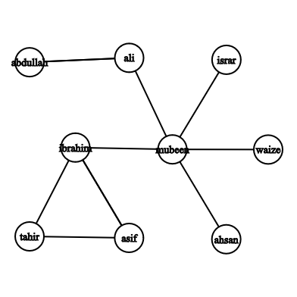
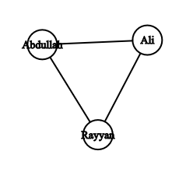
Difference between Directed and undirected graphs?
Instagram followers
Siblings Relation

Slide 6
Difference between Directed and undirected graphs?
Instagram followers
Siblings Relation

Slide 7
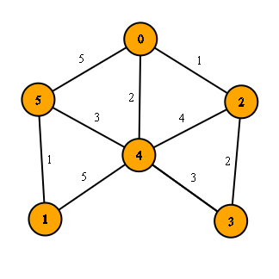
Weighted Graphs
Many graphs can have edges that contain a certain weight to represent an arbitrary value such as cost, distance, quantity, etc.
This suggests that all edges cannot be treated equally in certain cases.
USE IN GAME:
to represent the potential impact or strategic value of certain moves.
Weights could represent how close a sequence is to completion
In more advanced AI implementations, weighted graphs can help find paths that maximize player's advantage while minimizing the opponent’s.

Slide 8
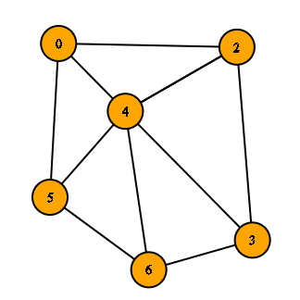
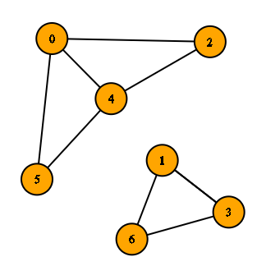
Connected vs Disconnected Graphs
A graph is called connected when a path exist between all of its vertices.
A graph is called disconnected when a path doesn’t exist between all of its vertices.

Slide 9
GRAPH REPRESENTATION
Edge List
Individual track of all edges
Need to check all edges
Adjacency List
Track of all adjacent to a particular edge
Need to check relevant list of adjacent
Adjacency Matrix
Table in form of rows and columns that keep track of all possible edges in terms of YES/NO
Only need to check one cell.

Slide 10
Things we need for our area of research:
How to traverse a graph
Count neighbors of a vertex
Count degree of a vertex(number of edges meeting at that vertex)
Deleting and inserting edges
Path and cycle of vertices

Slide 11
Graph in Board Games
Most board games are played two-dimensional grid.
• Nodes represent the cells where game pieces are placed.
• Winning conditions involve finding paths (edges) with consecutive stones.

Slide 12
Implementation
Topics like graph theory, and recursion play crucial roles in modeling and solving the game.

Slide 13
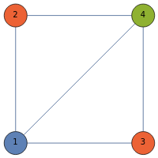
Graph Coloring in Board Games
involves assigning different colors to the vertices of a graph such that no two adjacent vertices share the same color.
Simplifies game design by managing player interactions and organizing regions.
Territory Colouring: Assigning different colours to neighbouring territories.
Player moves: Useful in multiplayer games to minimize conflicts.
Puzzle Solving: No two adjacent players have the same colours.

Slide 14
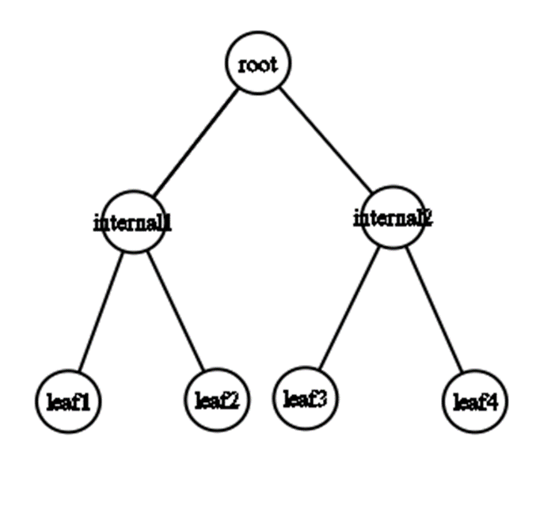
TREES AND SPANNING TREES
Tree is a simple, connected ,undirected ,acyclic(having a unique path between any two vertices) graph.
A spanning tree of a graph is a subgraph that includes all vertices of the graph and is a tree.
- Spanning trees connect all vertices with the minimum possible edges.
In games, spanning trees can help create unique paths with no loops.

Slide 15
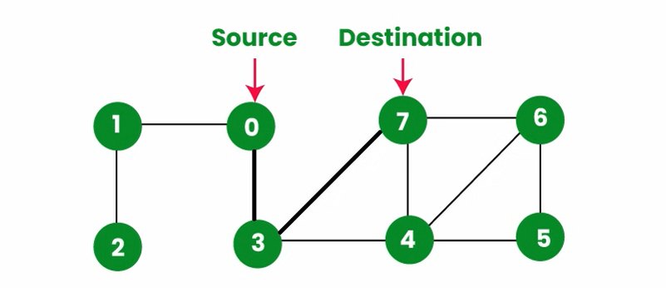
Path finding
Definition:
“Pathfinding refers to the process of finding a path from one point (vertex) to another in a graph.”
A path in a graph is a sequence of edges that connects a series of vertices.
It can be represented as a list of vertices starting from a source node and ending at a destination node, with each consecutive vertex connected by an edge.

Slide 16
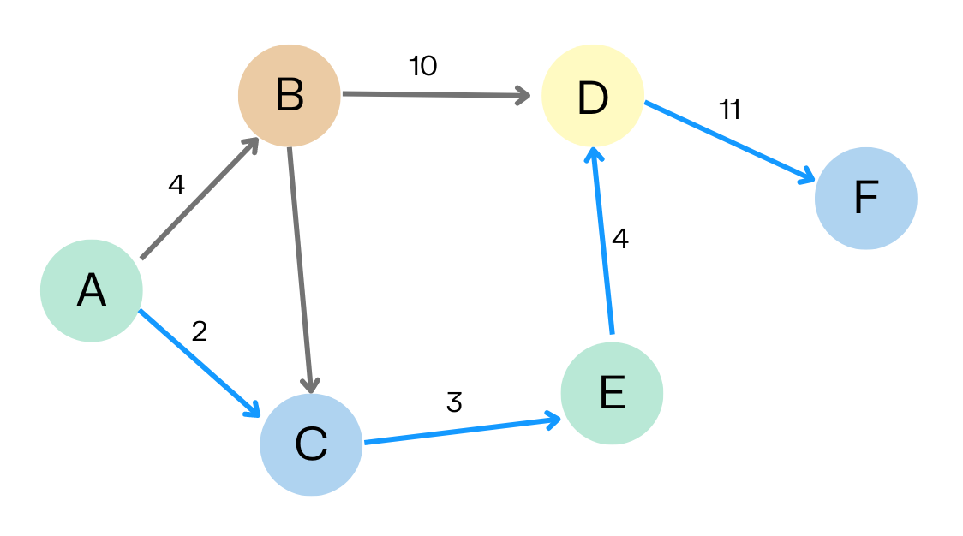
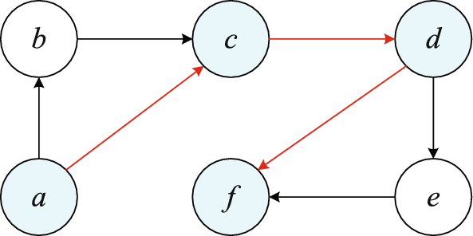
Shortest Path
Definition:
“The shortest path is a path between two vertices such that the sum of the weights of the edges in the path is minimized.”
In unweighted graphs, the shortest path is simply the path with the least number of edges.
In weighted graphs, it’s the path with the minimum total weight.

Slide 17
Some Algorithms Used for Path Finding
Dijkstra’s Algorithm
A* Algorithm
Bellman-Ford Algorithm
Floyd-Warshall Algorithm
Breadth-First Search (BFS)
Depth-First Search (DFS)
Johnson’s Algorithm

Slide 18
Some Algorithms Used for Path Finding
Dijkstra’s Algorithm
A* Algorithm
Bellman-Ford Algorithm
Floyd-Warshall Algorithm
Breadth-First Search (BFS)
Depth-First Search (DFS)
Johnson’s Algorithm
We have used Breadth-First Search (BFS) in our code..

Slide 19
Breadth-First Search Algorithm
BFS is the best algorithm used for path finding in unweighted graphs.

Slide 20
RECURSION:
BASE CASE: a condition that allows an algorithm stops further recursive calls and return a result.
Recursive case: It is the part of a recursive function that breaks down a problem into smaller subproblems, which moves the problem closer to the base case. RECURSIVE FUNCTION: Recursive function is a function that values at any point can be calculated from the values of the function at some previous points

Slide 21
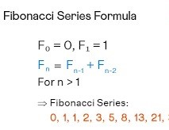
HOW RECURSION WORKS :
Step By Step :
Step 2: Step 1 + lowest step.
Step 3: Step 2 + Step 1 + lowest step.
Step 4: Step 3 + step 2 + step 1+ lowest step, and so on.
The smallest argument is donated by f(0) or f(1) .
The nth argument is donated by f(n).
Example: fibonacci sequence.

Slide 22
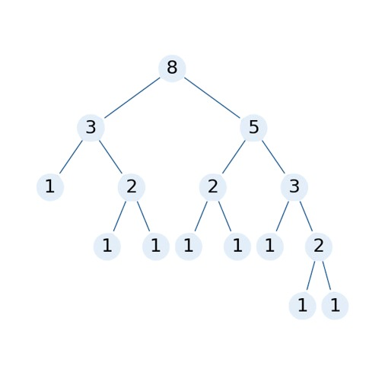
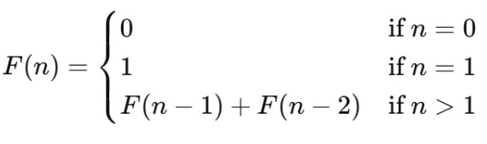
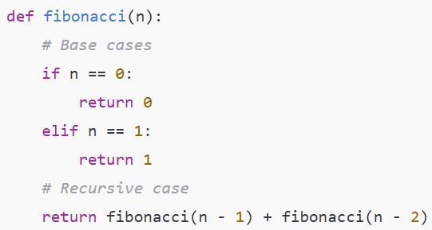
Recursive function:
Fibonacci(5) calls → Fibonacci(4) + Fibonacci(3)
Fibonacci(4) calls → Fibonacci(3) + Fibonacci(2)
Fibonacci(3) calls → Fibonacci(2) + Fibonacci(1)
Fibonacci(2) calls → Fibonacci(1) + Fibonacci(0)
Base case: Fibonacci(1) returns 1 Fibonacci(0) returns 0

