Slide 1

Ibrahim Butt 24043 Muhammad Tahir Ahmed 24151 Ammara Khan 24133 Sara Abid 24112 Israr Hussain 24045

Slide 2
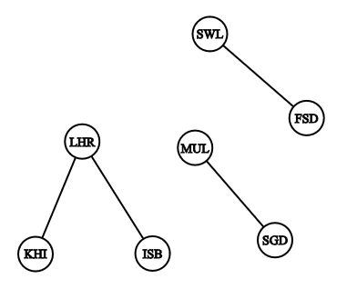
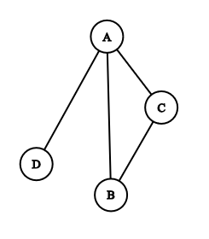
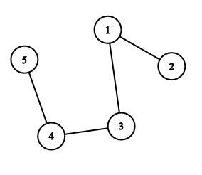
GRAPH : a list of pairs of “things” called vertex/vertices, and lines between those points, called edges
𝐴 = {(1, 2), (1, 3), (3, 4), (4, 5)}
𝐵 = {(A, B), (B, C), (A, C), (A, D)}
𝐶 = {(LHR,KRA), (LHR,ISB), (FSD,SWL), (STD,MUL)}

Slide 3
GRAPH : a list of pairs of “things” called vertex/vertices, and lines between those points, called edges
𝐴 = {(1, 2), (1, 3), (3, 4), (4, 5)}
𝐵 = {(A, B), (B, C), (A, C), (A, D)}
𝐶 = {(LHR,KRA), (LHR,ISB), (FSD,SWL), (STD,MUL)}
edges
vertex

Slide 4
GRAPH : a list of pairs of “things” called vertex/vertices, and lines between those points, called edges
𝐴 = {(1, 2), (1, 3), (3, 4), (4, 5)}
𝐵 = {(A, B), (B, C), (A, C), (A, D)}
𝐶 = {(LHR,KRA), (LHR,ISB), (FSD,SWL), (STD,MUL)}
edges
Total edges:
(n(n-1))/2
vertex

Slide 5
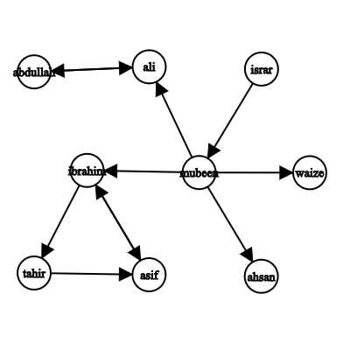
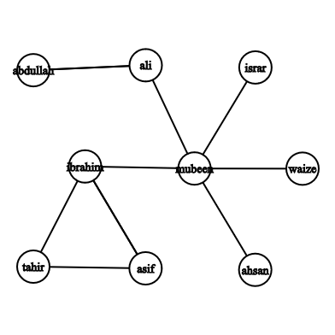
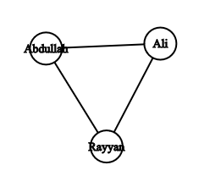
Difference between Directed and undirected graphs?
Instagram followers
Siblings Relation

Slide 6
Difference between Directed and undirected graphs?
Instagram followers
Siblings Relation

Slide 7
GRAPH REPRESENTATION
Edge List
Individual track of all edges
Need to check all edges
Adjacency List
Track of all adjacent to a particular edge
Need to check relevant list of adjacent
Adjacency Matrix
Table in form of rows and columns that keep track of all possible edges in terms of YES/NO
Only need to check one cell.

Slide 8
Things we need for our area of research:
How to traverse a graph
Count neighbors of a vertex
Count degree of a vertex(number of edges meeting at that vertex)
Deleting and inserting edges
Path and cycle of vertices

Slide 9
Graph in Board Games
Most board games are played two-dimensional grid.
• Nodes represent the cells where game pieces are placed.
• Winning conditions involve finding paths (edges) with consecutive stones.

Slide 10
Implementation
Topics like graph theory, and recursion play crucial roles in modeling and solving the game.

Slide 11
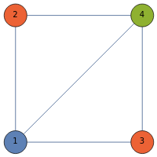
Graph Coloring in Board Games
involves assigning different colors to the vertices of a graph such that no two adjacent vertices share the same color.
Simplifies game design by managing player interactions and organizing regions.
Territory Colouring: Assigning different colours to neighbouring territories.
Player moves: Useful in multiplayer games to minimize conflicts.
Puzzle Solving: No two adjacent players have the same colours.

Slide 12
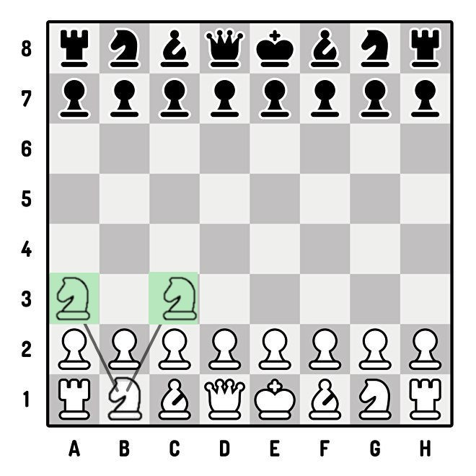
GRAPH THEORY IN BOARD GAMES
Adjacency List:
Board Games as Graphs:
Each position (like squares in chess or intersections in Go) is represented as a vertex.
The possible moves between these vertices are represented as edges.
Network of Connections:
This creates a network of connections which can be used for strategy development.
Tools like adjacency matrices and adjacency lists help map these relationships.
Represents each position and lists possible moves.
Example (Chess - Knight Moves):
B1 -> A3, C3
G1 -> F3, H3

