Slide 1
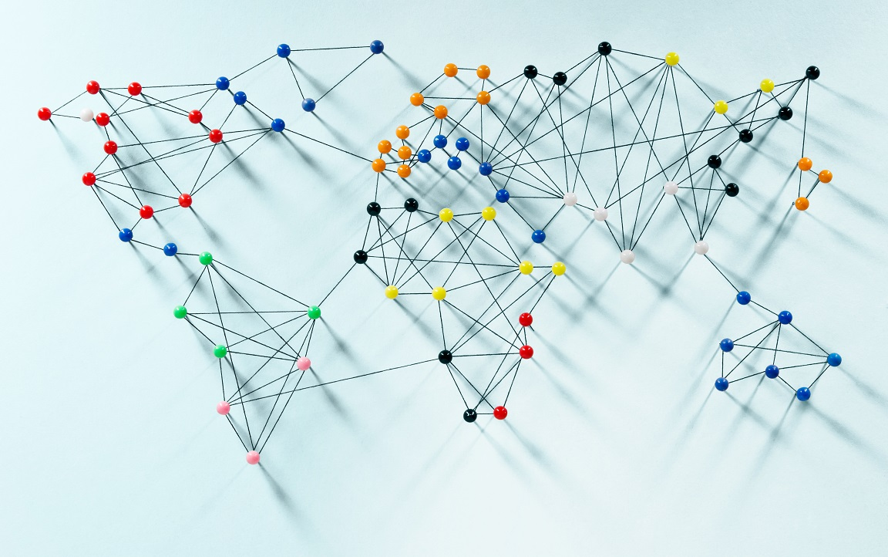
Ibrahim Butt 24043 Muhammad Tahir Ahmed 24151 Ammara Khan 24133 Sara Abid 24112 Israr Hussain 24045

Slide 2
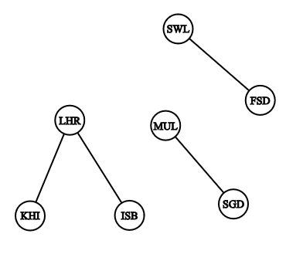
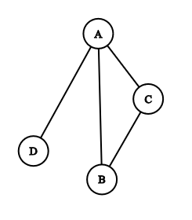
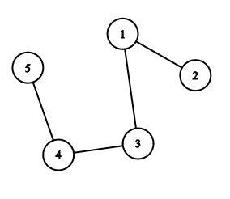
GRAPH : a list of pairs of “things” called nodes/vertices, and lines between those points, called edges
𝐴 = {(1, 2), (1, 3), (3, 4), (4, 5)}
𝐵 = {(A, B), (B, C), (A, C), (A, D)}
𝐶 = {(LHR,KRA), (LHR,ISB), (FSD,SWL), (STD,MUL)}
edges
vertex
GRAPH THEORY IN BOARD GAMES

Slide 3
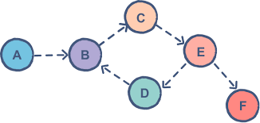
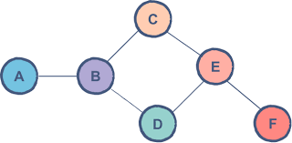
Directed and undirected graphs?
Directed Graphs:
directed graphs are typically used to model sequential games, information flow, or influence
Undirected Graphs:
Graphs where the direction in not required.
GRAPH THEORY IN BOARD GAMES

Slide 4
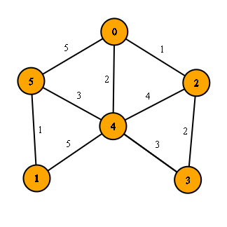
Weighted Graphs
Graphs where not all edges are equal, but they have different ‘weights’ allocated to them.
The weight represents the cost or benefit of a particular action in context of board games.
USE IN GAME:
Weights give value to moves:
Prioritize winning
Not letting opponent win
Maximize advantage and minimize losses
GRAPH THEORY IN BOARD GAMES

Slide 5
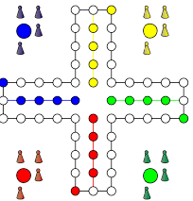
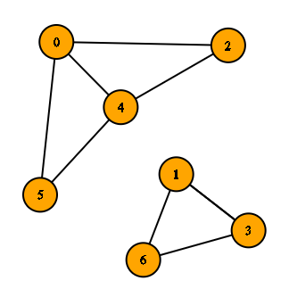
Connected vs Disconnected Graphs
A graph is called connected when a path exist between all of its vertices.
A graph is called disconnected when a path doesn’t exist between all of its vertices.
GRAPH THEORY IN BOARD GAMES

Slide 6

RECURSION:
Recursion is a process where a function calls itself to solve a problem.
It stops at a defined base case to avoid infinite loop
In board games, recursion helps explore possible future game states to evaluate optimal moves.
GRAPH THEORY IN BOARD GAMES

Slide 7

GRAPHS AND RECURSION:
Graph theory identifies the structure of the game (e.g., win paths).
Recursion explores these structures, simulating possible moves and counter-moves.
Together, they form the backbone of AI strategies in complex board games like Gomoku and chess
GRAPH THEORY IN BOARD GAMES

Slide 8
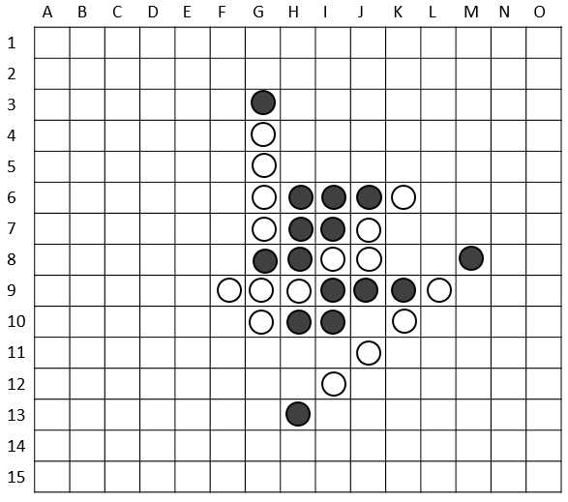
Graph in Board Games
Most board games are played two-dimensional grid.
• Nodes represent the cells where game pieces are placed.
• Winning conditions involve finding paths (edges) with consecutive stones.
GRAPH THEORY IN BOARD GAMES

Slide 9
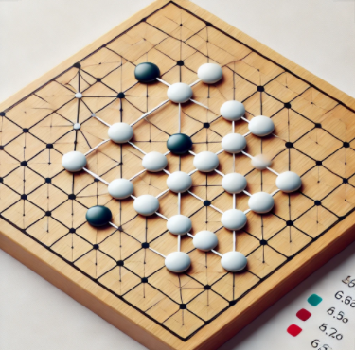
WHAT IS
GOMOKU?
GRAPH THEORY IN BOARD GAMES

Slide 10
Introduction to Gomoku
Gomoku (Five in a Row) is a board game played on a grid where players place stones to form a line of five consecutive stones.
Graph Model:
Vertices (Nodes) represent each cell.
Edges represent possible moves between adjacent positions.
Graph theory is used to model the entire board and analyze the connections between stones.
GRAPH THEORY IN BOARD GAMES

Slide 11
ROLE OF RECURSION
Exploring Moves:
AI can use recursion to evaluate multiple future moves, creating a game tree structure.
Each recursive call simulates a potential move, building layers of possible future game states.
AI Strategy:
Find Winning Moves
Block Opponent Moves
GRAPH THEORY IN BOARD GAMES

Slide 12
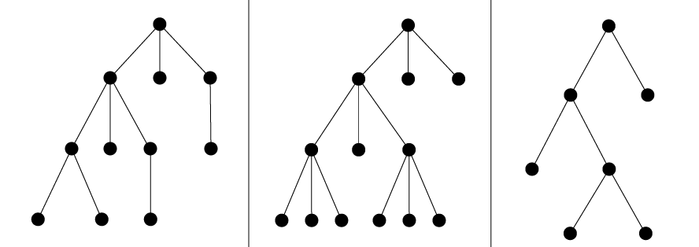
TREES
The root represents the current game state.
Each branch represents a move by either the AI or the opponent.
The leaf nodes (no branches) represent the terminal game states (win, loss, draw).
GRAPH THEORY IN BOARD GAMES

Slide 13
Path finding
“Pathfinding refers to the process of finding a path from one point (vertex) to another in a graph.”
Although not as crucial in Gomoku as other games, pathfinding can help determine the most optimal moves by analyzing unblocked paths or identifying potential threats (e.g., blocking an opponent’s path to five pieces).
For our Gomoku case study we used the BFS algorithm…
GRAPH THEORY IN BOARD GAMES

Slide 14
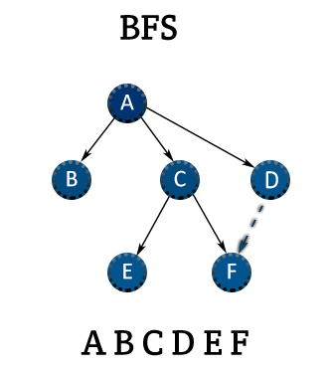
Breadth-First Search
BFS starts by exploring adjacent moves and extends outward
AI uses this to play ‘best moves’
Extends outwards until end of board, or winning move found
GRAPH THEORY IN BOARD GAMES

Slide 15
Minimax Algorithm
The game is represented as a tree.
The algorithm alternates:
Maximizer: Tries to maximize the score
Minimizer: Tries to minimize the score
It recursively evaluates all possible game states down to the terminal states
Backtracking from the terminal states, it assigns a score to each move by choosing the best option for the player whose turn it is.
GRAPH THEORY IN BOARD GAMES

Slide 16
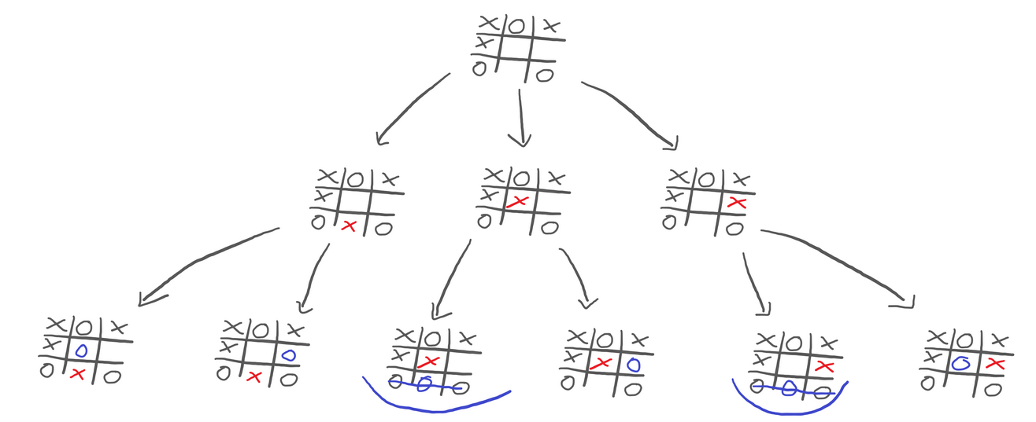
Minimax Algorithm:
Chooses the best possible move for a player by simulating all possible future moves and their outcomes.
GRAPH THEORY IN BOARD GAMES

Slide 17
Alpha-Beta Pruning
an optimization technique for minimax algorithm.
Reduces total number of notes to be evaluated by eliminating or pruning them if they don’t affect final evaluation.
Alpha (α): The best value the maximizer currently can guarantee.
Beta (β): The best value the minimizer currently can guarantee.
During the traversal:
If a branch's potential outcome is worse than an already evaluated branch for either player, that branch is eliminated.
GRAPH THEORY IN BOARD GAMES

Slide 18
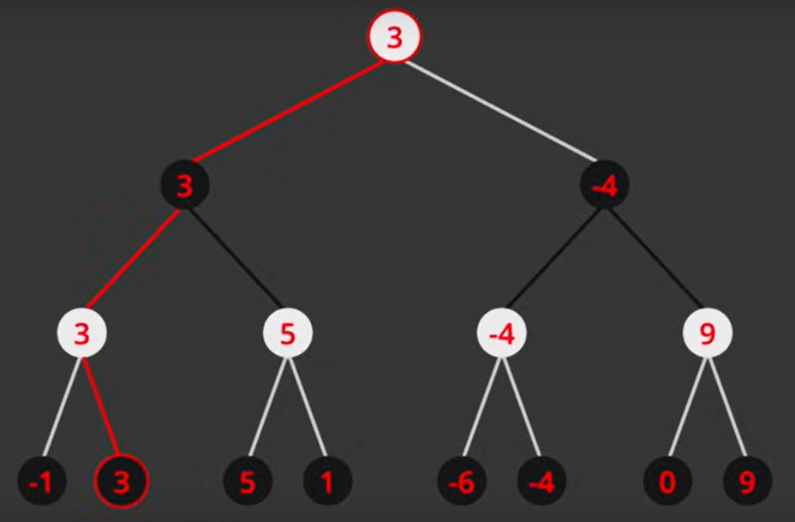
GRAPH THEORY IN BOARD GAMES

Slide 19
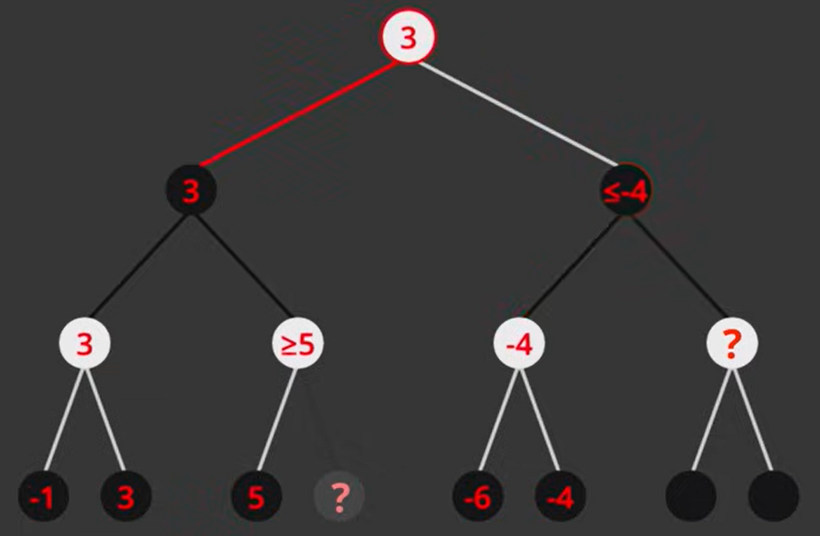
GRAPH THEORY IN BOARD GAMES

Slide 20
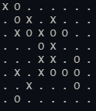
GRAPH THEORY IN BOARD GAMES

Slide 21
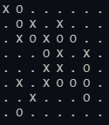
GRAPH THEORY IN BOARD GAMES

Slide 22
CONCLUSION
Graph Theory:
Models the game board and simulates moves, creating a network of possibilities.
Recursion:
Explores future game states, building a game tree for move evaluation.
AI in Board Games
Graph theory and recursion work hand-in-hand to make AI in board games like Gomoku capable of simulating, evaluating, and choosing the best moves.
GRAPH THEORY IN BOARD GAMES

Slide 23
Graph theory and recursion deepens our understanding of mathematical structures while transforming practical areas like game development. These concepts enable smarter AI, richer game mechanics, and effective problem-solving, bridging gap between theoretical knowledge and real-world applications.
- Group5
GRAPH THEORY IN BOARD GAMES

Slide 24

Thank you for your attention!
Feel free to ask any questions, share thoughts or discuss further.
Looking forward to insightful discussions!
GRAPH THEORY IN BOARD GAMES

