Slide 1
CAPSTONE FourSquare
Project

Slide 2
Description of the problem and a discussion of the background
Problem Statement: Finding a home suitable to personal tastes in relative to price expectation is getting harder and harder every other day. This research is done for real estate agencies to find houses for the people whom are eager to migrate or move into Toronto, CA from New York that are living in similar places.
Background: Toronto is a city in Canada growing fast and is provincial capital of Ontario and the most populous city in Canada.
A lot of people has the curiosity to discover what Toronto holds for them. Healtcare and wages are also well above expectations where for the most people in US which makes this city a target.
Immigration to Canada is more welcoming than most countries according to here; Toronto has the most immigration ratio compared to other cities in Canada.
Toronto is a culturally rich and diverse city as a result. Low crime rates and great cusine also a deciding factor for many and New Yorkers too.
This paper is helping agencies to boost on these kind of factors, diversities, likes when there is a potention customer. My solution is creating an algorithm to find the best possible house for the customer according to where he lives and like in his/her homeplace (New York in our case) and makes a suggestion using machine learning and geo locator services.

Slide 3
A description of the data
Toronto and New York location data will be used to compare the neighborhoods, and then we rank the neighborhoods from the selected boroughs for the cities.
I used the previous assignments to retrieve the neighborhood and geo co-ordinates for New York and Toronto. Unsupervised learning is used to cluster the neighborhoods of the two cities. Data sources are Toronto Wikipedia WebPage and New York. Geo locations for Toronto will use following source file.

Slide 4
How it will be used to solve the problem
Implementation logic is as follows:
Create a dataset that holds the Geo-cordinates for Toronto's neighborhood
Use Foursquare APIs to get venues for each of the Toronto's neighborhood
Sort through the data to identify top 10 common venue categories for each of the Toronto's neighborhood
Perform the above for New York's neighborhoods
This step wil be the input. Select a neighborhood in NY for which we are looking for similar places in Toronto
Use K-means on dataset that has all Toronto's neighborhoods plus this neighhborhood
Then find the cluster which has the NY neighborhood in it and list all Toronto neighborhoods there

Slide 5
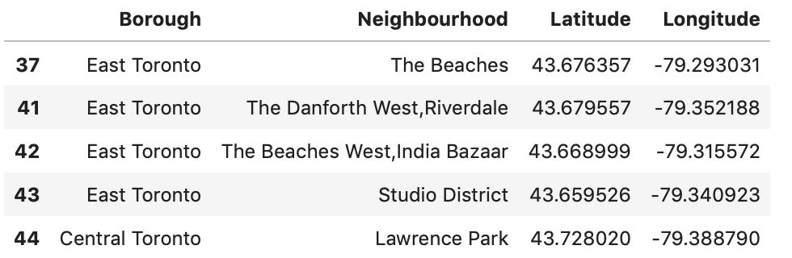
Methodology
Create a dataset that holds the Geo-coordinates for Toronto's neighborhood
Use BeautifulSoup package to perform web scraping on ​Toronto Wiki page​ to build the following dataset.

Slide 6
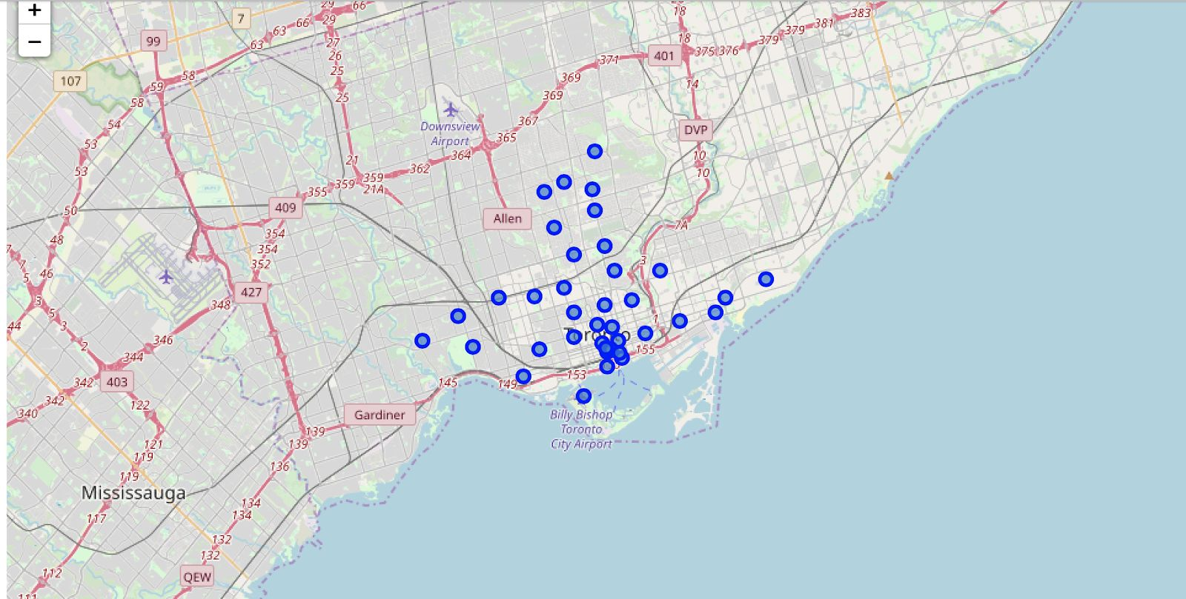
Methodology
I further explored the city of Toronto. The following unclustered map view is a representation of it.

Slide 7
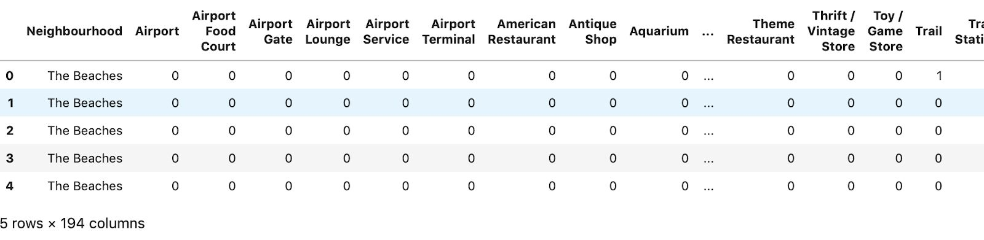
Methodology
Use Foursquare APIs to get venues for each of the Toronto's neighborhoods
Next, we use the Foursquare’s venues API to get nearby venues. We will capture the following data points: 'Neighbourhood', 'Neighbourhood Latitude', 'Neighbourhood Longitude', 'Venue', 'Venue Latitude', 'Venue Longitude', and 'Venue Category'. A snapshot of the dataset looks like the following. This dataset will form the basis for k-means clustering which I will illustrate in following sections.

Slide 8
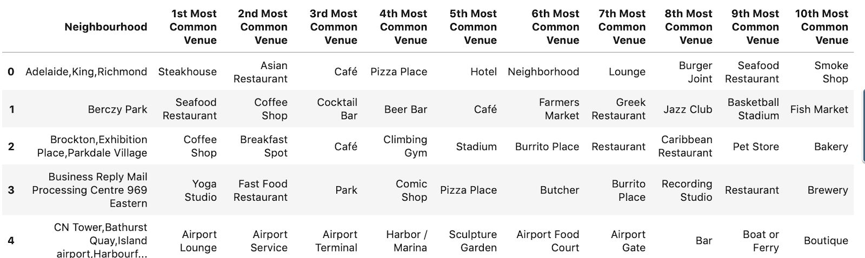
Methodology
Sort through the data to identify top 10 common venue categories for each of the Toronto's neighborhoods
Dataset snapshot is given below for your reference

Slide 9
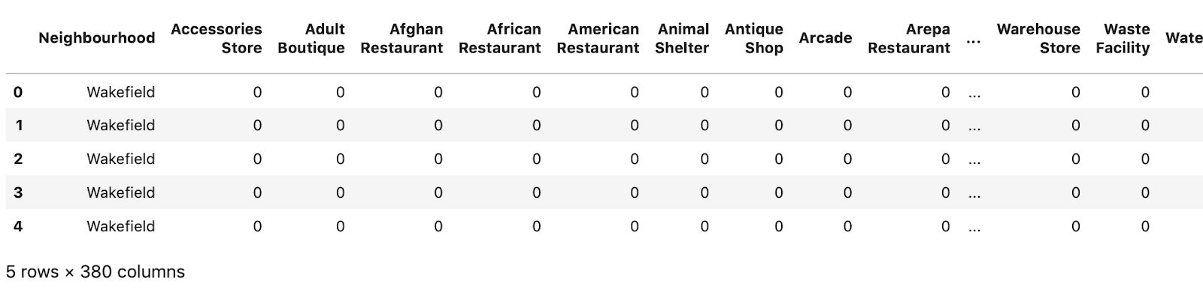
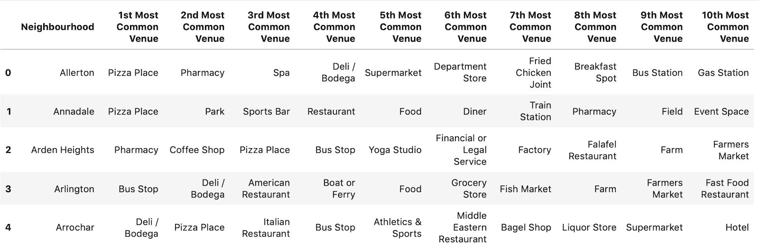
Methodology
Perform the above for New York's neighborhoods
Same steps are performed for the city of New York

Slide 10
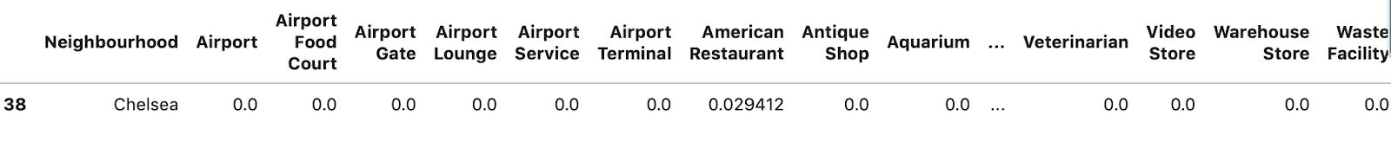
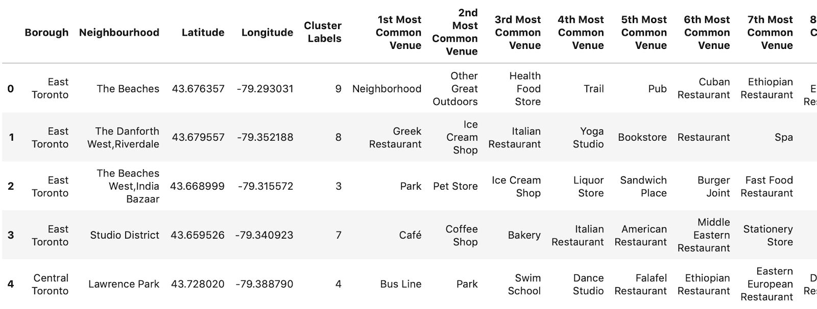
Methodology
This step will is the input. Select a neighborhood in NY for which we are looking for similarities in Toronto. Here, we chose Chelsea, NY.
Use K-means on dataset that has all Toronto's neighborhoods plus this neighborhood. Then find the cluster which has the NY neighborhood in it and list all Toronto neighborhoods there. Following dataset shows each neighborhood in Toronto with its assigned cluster label

Slide 11
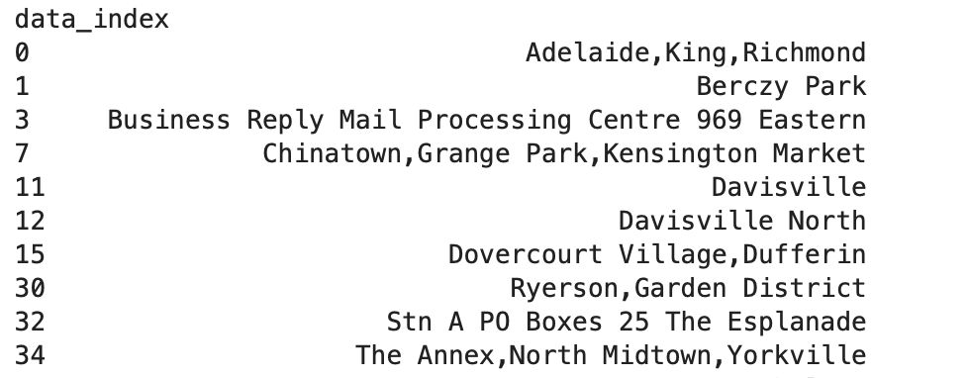
Results and Discussion
For Chelsea, NY, I found 10 similar neighborhoods in Toronto. They are listed below:

Slide 12
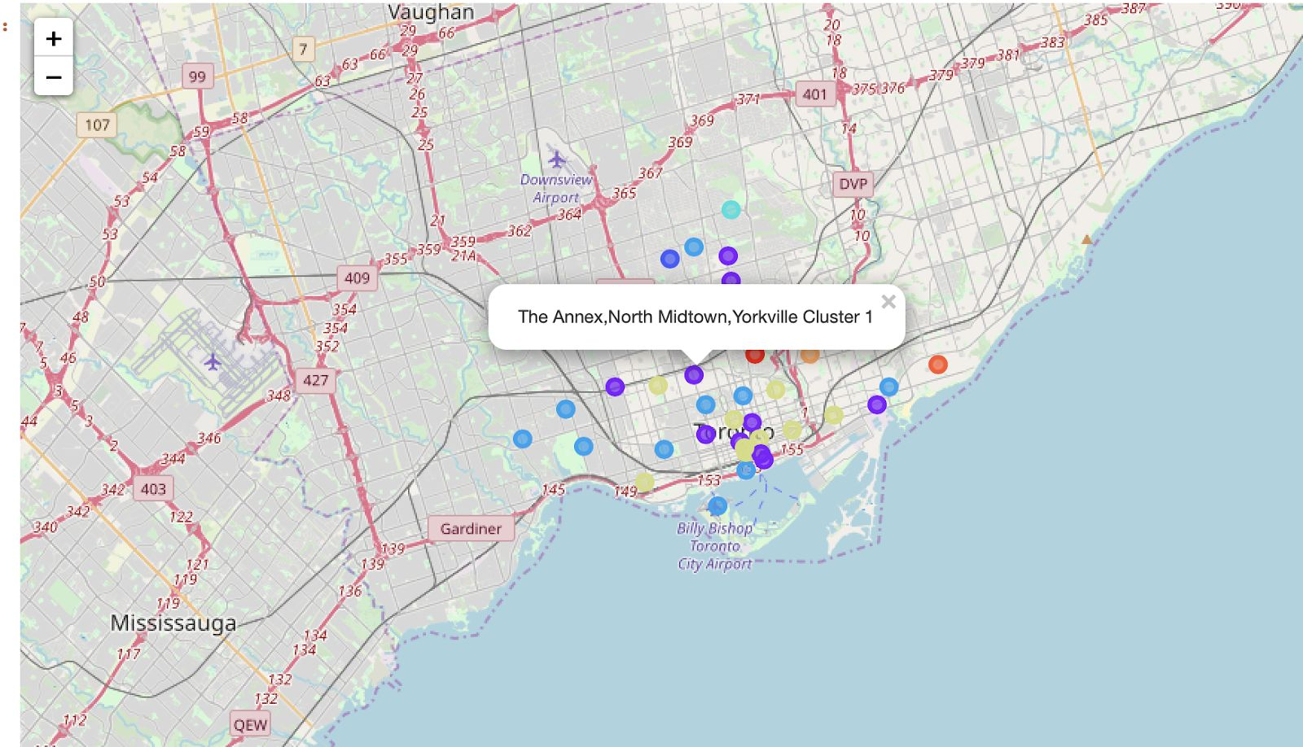
Results and Discussion
Visualize them in maps, we can see them as below (marked in ​purple​)

Slide 13
Results and Discussion
K-means is a very powerful yet simple unsupervised learning technique to compare neighborhoods.
For this algorithm to be successful, we need as much data as possible available for both the cities that speaks about the lifestyle of those areas. Then, we can run ML unsupervised K-means algorithm to find similars.
This algorithm can be generalized to compare any two cities, given the data is available as mentioned above and will be used for Real estate agencies for all over the World.

Slide 14
Conclusion
For Chelsea,NY we were able to find similar neighborhoods in Toronto, ON.
I based it off several lifestyle parameters for the neighborhoods and leveraged Foursquare APIs for the same.
This is a powerful algorithm that will help relocation agencies zero in on localities that will fit the bill for their clients.
If correctly incorporated in their client onboarding process, this algorithm can have potential positive impacts on the bottom line.

