Slide 1
IBM Java Snippet
ECOD

Slide 2
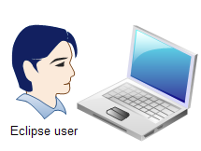

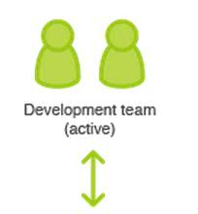

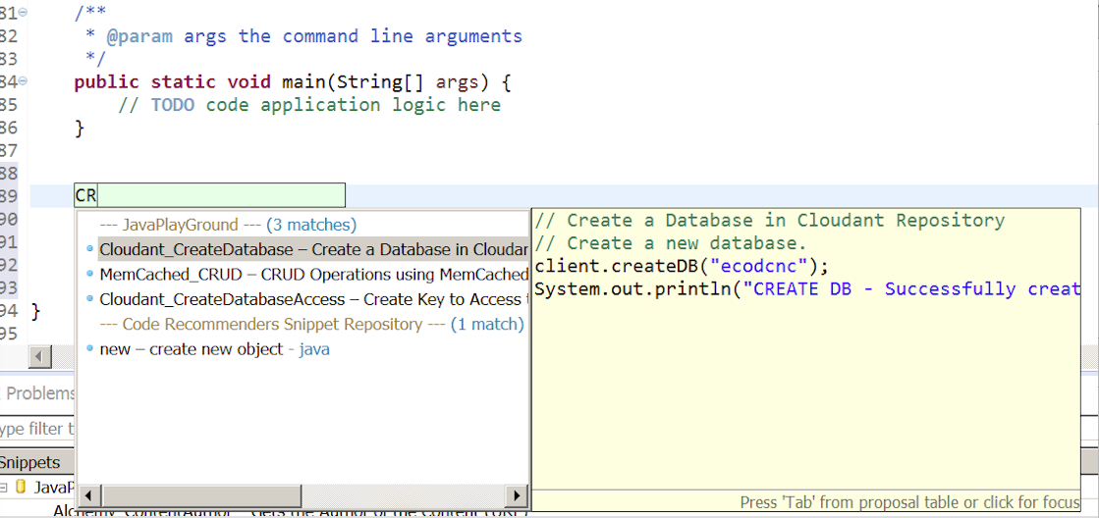

Java Snippets Playground
developers experience Bluemix services by editing and deploying provided snippets
Bluemix PLM Teams
❶Search named Bluemix Service
❷Retrieve Snippet Results
❸Display Snippet Results in Eclipse Editor
❹Inserts Code in Editor

Slide 3





























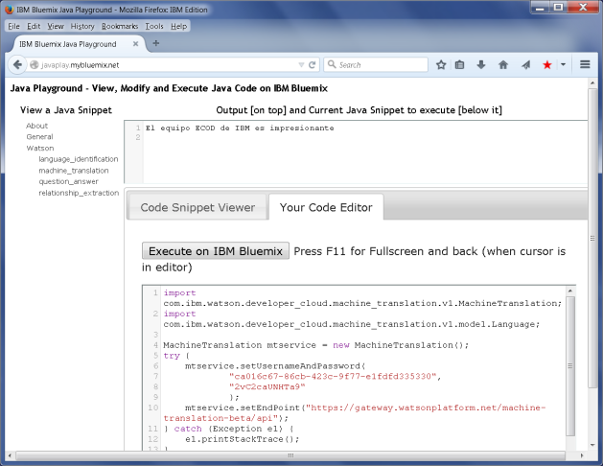
TOP 30 Categories (~25) with 60 Snippets -
Developers play with snippets to understand value & ease of running apps in Bluemix.
IBM - Hello World
Watson Services
MQLight
MQTT
AlchemyAPI
Cloudant
SQLDB
Softlayer
Memcached
Mongo
MySQL (see SQLDB)
REDIS
Twilio
Box
Twitter
DynamoDB
SendGrid
Facebook
Paypal
Linked-in
Flickr
Dropbox
Fitbit
Google youtube
Google calendar
Google contacts
Google email
Google maps
Google translate
Yahoofinance (stock data)
IBM
Services
IBM
PARTNER
Services
Popular 3rd Party
Services

Slide 4
Plugin Sources
The source code can be found in the following repositories:
GitHub: https://github.com/stefanprisca/SnipEditor
Eclipse incubator repository: http://git.eclipse.org/c/recommenders.incubator/org.eclipse.recommenders.snipmatch.git/
The update site can be found here :
http://download.eclipse.org/recommenders.incubator/updates/head/
Other resources include:
Xtext documentation: http://www.eclipse.org/Xtext/documentation.html
Google Guice: https://code.google.com/p/google-guice/
Apache maven: http://maven.apache.org/
Eclipse tycho : http://eclipse.org/tycho/

Slide 5
Lab Activity - Use Eclipse to test atleast one service
Hello World
Watson Services
AlchemyAPI
Cloudant
SQLDB
Plus any one more…

Slide 6
Backup

Slide 7
The Templates Project - org.eclipse.recommenders.templates
The ecore model for the jface template language was developed using Eclipse Xtext framework.
This is a framework used to create Domain Specific Languages. It offers a lot of out-of-the-box utilities for your DSL.
Based on this ecore model, Xtext offers an out-of-the-box text editor that includes all the features mentioned above. This editor is injected into the Multi-page editor using Google Guice. We’ll describe this in more detail in the project development section.
http://help.eclipse.org/kepler/index.jsp?topic=%2Forg.eclipse.jdt.doc.user%2Fconcepts%2Fconcept-template-variables.htm

Slide 8
Examples
Import a button:
${imp:import (org.eclipse.swt.widgets.Button)}
Declare a new array:
${array_type} arr = new ${array_type}();
Get a element from the array:
arr.get(0);
Declare a new iterable
${iterable_type} iter = new ${iterable_type}();
Assign the iterable
iter = ${iterable}

Slide 9
Both Java and Javadoc context define the following variables:
Some Variables that you can use
Variable | Description
${cursor} | Specifies the cursor position when the template edit mode is left. This is useful when the cursor should jump to another place than to the end of the template on leaving template edit mode.
${date} | Evaluates to the current date.
${dollar} | Evaluates to the dollar symbol $. Alternatively, two dollars can be used: $$.
${enclosing_method} | Evaluates to the name of the enclosing method.
${enclosing_method_arguments} | Evaluates to a comma separated list of argument names of the enclosing method. This variable can be useful when generating log statements for many methods.
${enclosing_package} | Evaluates to the name of the enclosing package.
${enclosing_project} | Evaluates to the name of the enclosing project.
${enclosing_type} | Evaluates to the name of the enclosing type.
${file} | Evaluates to the name of the file.
${line_selection} | Evaluates to content of all currently selected lines.
${primary_type_name} | Evaluates to the name primary type of the current compilation unit.
${return_type} | Evaluates to the return type of the enclosing method.
${time} | Evaluates to the current time.
${user} | Evaluates to the user name.
${word_selection} | Evaluates to the content of the current text selection.
${year} | Evaluates to the current year.
https://docs.google.com/document/d/1aIJ89KHYXwguM8m-CJ7LuLtG_0HbhHQr4lqqCwr01QU/edit#

