Slide 1
IBM Bluemix PaaS
Java Developers Dream come true

Slide 2

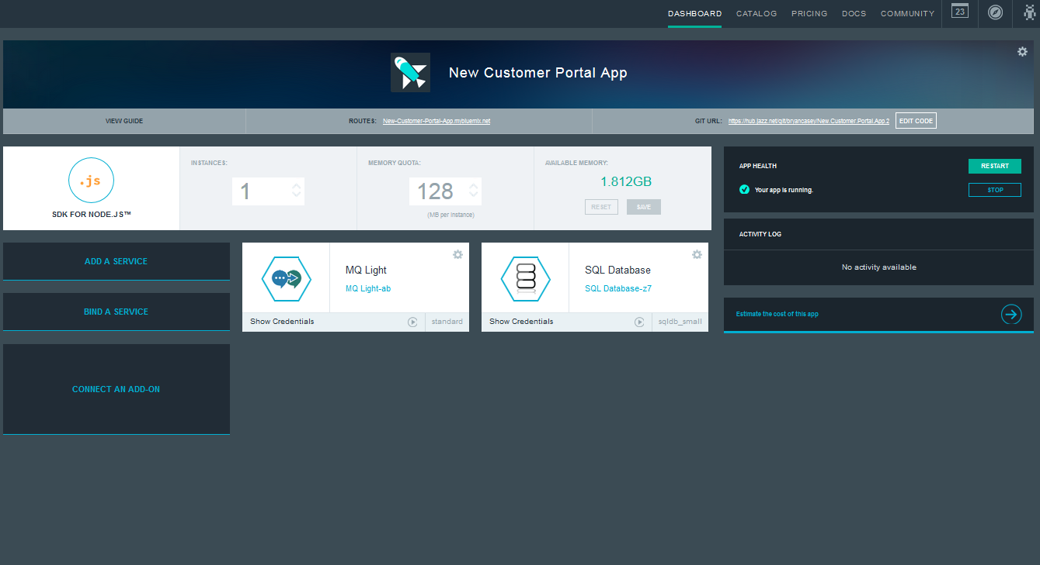




Bluemix: IBM’s Cloud Platform
Build, run, scale, manage, integrate & secure applications in the cloud
Developer experience
Rapidly deploy and scale applications in any language.
Compose applications quickly with useful APIs and services and avoid tedious backend config.
Realize fast time-to-value with simplicity, flexibility and clear documentation.
Enterprise capability
Securely integrate with existing on-prem data and systems.
Choose from flexible deployment models.
Manage the full application lifecycle with DevOps.
Develop and deploy on a platform built on a foundation of open technology.
Built on a foundation of open technology.
Bluemix service categories
DevOps
Big Data
Mobile
Watson
Business Analytics
Database
Web and application
Security
Internet of Things
Cloud Integration
Alchemy (Containers, NOSS)
Capstone (API management & Integration)

Slide 3
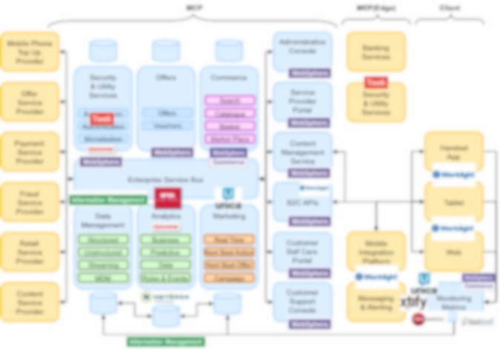
Bluemix is becoming part of many complex solutions
Bluemix
Notes:
Key themes
Speed
Instant environments
Quick deployments
Sign up in minutes
Ease of Use
Instant Environments
Services prebuilt for your use - IBM, Third Party, Community
DevOps tools to monitor, plan, deploy, and manage your apps
Flexibility
On-Prem integration
Flexible pricing
Security
IBM secures the platform and infrastructure - leveraging experience with softlayer and proven on-prem security implementations
Provides you with the tools to secure your apps

Slide 4
Bluemix Platform Architecture
DevOps/BOSH
IPS
Reverse Proxy, SSL termination
Services
Application User Flow
Authorization
Application
Runtimes
(DEA)
Services
S
E
R
V
I
C
E
G
A
T
E
W
A
Y
Cloud Foundry Control Elements
Developer Provisioning & DevOps Flow
D
A
T
A
P
O
W
E
R
Blob
Store
Application container isolation
F
I
R
E
W
A
L
L
R
O
U
T
E
R
Cloud
Controller
Health
Manager
NATS
(Messaging)
CCDB
Metering
ACE Dashboard
Services
BSS
UAA/
Login Server
Node
Node
Node
Login
Flow
Authentication
Single Sign On Service
Operating System security hardening
Network security
VLAN 1
VLAN 2
IBM Web ID
Operational Security Services (IBM Endpoint Manager, QRadar, Nessus, User Access Management)

Slide 5
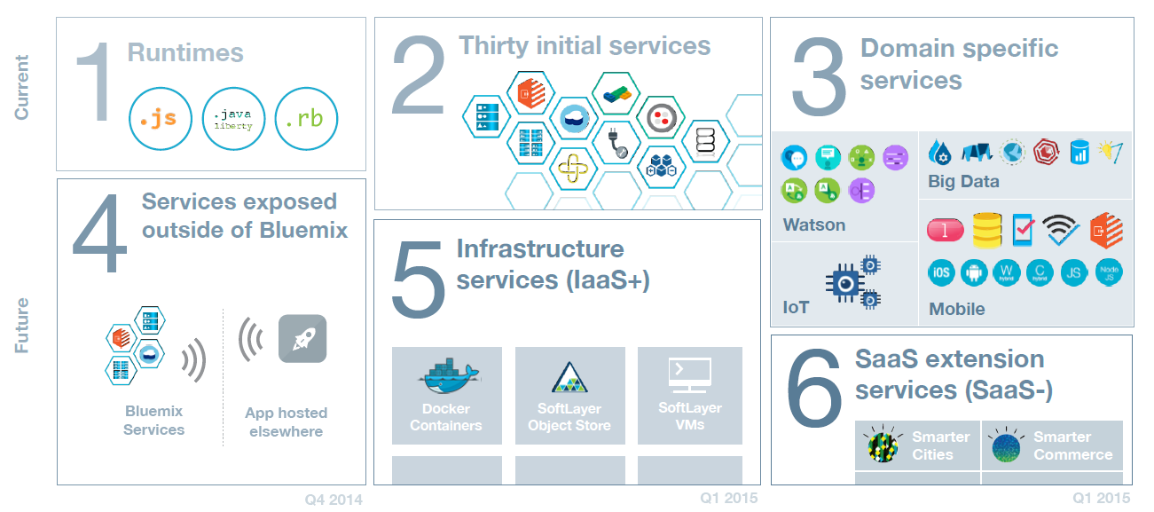
Evolving the Bluemix Platform Our next steps are to bring a full range of developer services into Bluemix
Services | Integration | Portability
Flexible Deployment Models
5

Slide 6
Java Buildpacks
Intro to Liberty Buildpack

Slide 7
Responsibility of the Liberty Buildpack
The buildpack will convert VCAP_SERVICES and VCAP_APPLICATION environment variables provided by CF into configuration variables for the Liberty server.
The variables end up in runtime-vars.xml, and are therefore referenceable from a pushed server.xml
For example ${vcap_app_port}: The port where the app server is listening (usually the same as ${port})
The buildpack will auto generate configuration for the bound services
The buildpack will auto wire multiple resources references to the appropriate cloud service resource
The buildpack will be responsible for starting and stopping the Liberty server and controlling the process environment
Generate the Liberty server configuration when war/ear files are pushed
Pull in additional Liberty runtime packages when the pushed applications need them

Slide 8
Liberty Buildpack vs Java Buildpack
 | Liberty buildpack | Java buidlpack
Application server | WebSphere Liberty profile – Java EE 6/7 Web Profile & Beyond | Apache Tomcat 8 – Servlet 3.1, JSP 2.3, EL 3.0, WebSocket 1.1
Java runtime | IBM JRE or OpenJDK | OpenJDK
Supported Java Web applications | WAR, EAR, server directory or package | WAR
Configuration | Configuration can be provided with application or via environment variables | Must fork to customize configurations for many scenarios
Service integration | Auto-configuration for 14 services | Auto-configuration for 5 services
Support statement | IBM supported | Community supported
Performance | Better performance (push time, memory footprint, throughput, scaling time)
Developer aids | Remote debugging & incremental update support, health center access, shell access

Slide 9
Easier configuration
What it takes to make the following configuration change:
Configuration | with Liberty buildpack | with Java buildpack
JRE choice | Repush: IBM JRE or OpenJDK | Fork the buildpack
JRE overlay | Repush: include the overlay files in your app package | Fork the buildpack
Server customization | Repush: use the server package | Fork the buildpack
JVM options | Repush or Restart | Repush

Slide 10
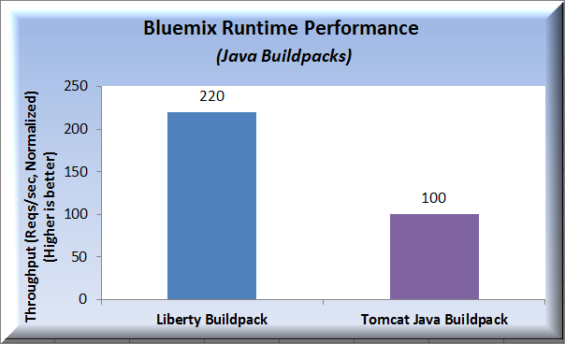
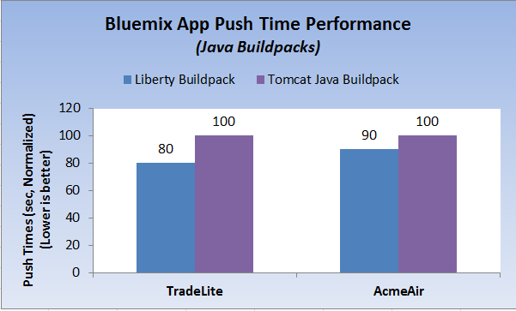
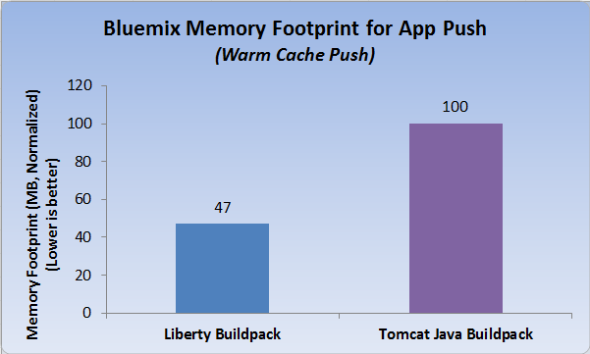
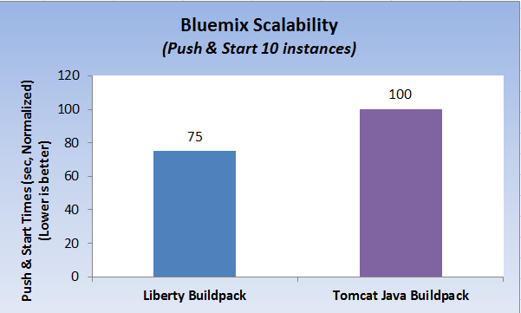
Performance comparison

Slide 11
A Java Developer Perspective
To the Cloud

Slide 12
Bluemix Tools at a glance
Pivotal CF Tools
IBM Eclipse Tools for Bluemix
Vendor-specific extensions
Cloud Foundry (CF) Eclipse Tools
Open source CF framework
Vendor neutral support for all CF environments
Eclipse + Web Tools Platform (WTP)
Eclipse open source projects
We develop and contribute to all 3 layers (WTP, CF Eclipse Tools and IBM Eclipse Tools for Bluemix)
Notes:
Let’s take a look at Bluemix tools. We have IBM Eclipse Tools for Bluemix and Pivotal Cloud Foundry Tools which are Vendor specific extensions, built on top of Cloud Foundry Eclipse Tools. The CF tools provide vendor neutral support for all Cloud Foundry environments. The Cloud Foundry Eclipse Tools are built on Eclipse and Web Tools Platform.

Slide 13
IBM Eclipse Tools for Bluemix
Eclipse is the IDE of choice for developing applications for Bluemix
Powerful tools enable developers to develop, test, and push applications to the Cloud, quickly and easily
Tools currently targets IBM supported (Tier 1) runtimes
Notes:
Eclipse is standard IDE environment for developing applications. The IBM Eclipse Tools are based on Cloud Foundry Eclipse Tools. They allow developers to develop, test and push applications to the Cloud directly within Eclipse. These tools support the Tier 1 runtimes namely Liberty for Java and Node.js.

Slide 14
IBM Eclipse Tools for Bluemix Powerful & Versatile DevOps tools
Ops Tools for Sever lifecycle:
Creation, Removal, Start, Stop, Restart
Ops Tools for lifecycle of Applications of various types:
Deploy, Remove, Update, Restart
Dev Tools supporting Architect & Developer
Compose applications by creating and binding services
Run, Debug, Profile
Tune
Everything supported locally or remotely
Notes:
IBM Eclipse Tools for Bluemix enable us to create Bluemix server and connect to it. We can deploy applications directly to Bluemix Server, within Eclipse, namely WAR, EAR files. The tools provide capability to tune Bluemix Server, edit Application Information as well as deployed Application Instance information. We can create services and bind them to application instance, edit Environment variables and debug remotely.

Slide 15
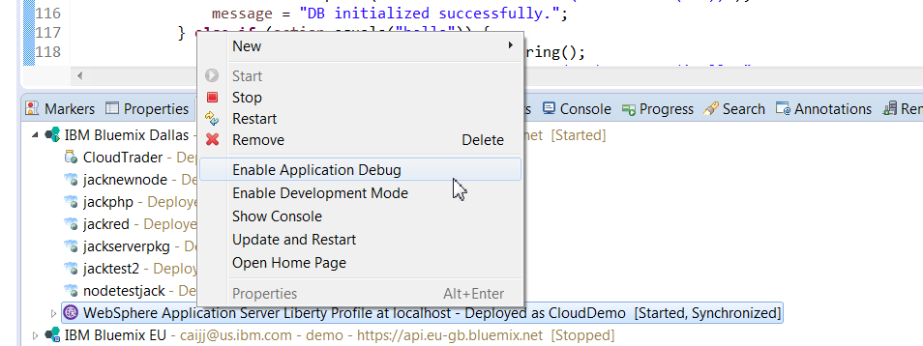
Development Mode - Demo
A special mode of an application instance that allows the app developer to conduct various development operations.
Remote debugging
Incremental update

Slide 16
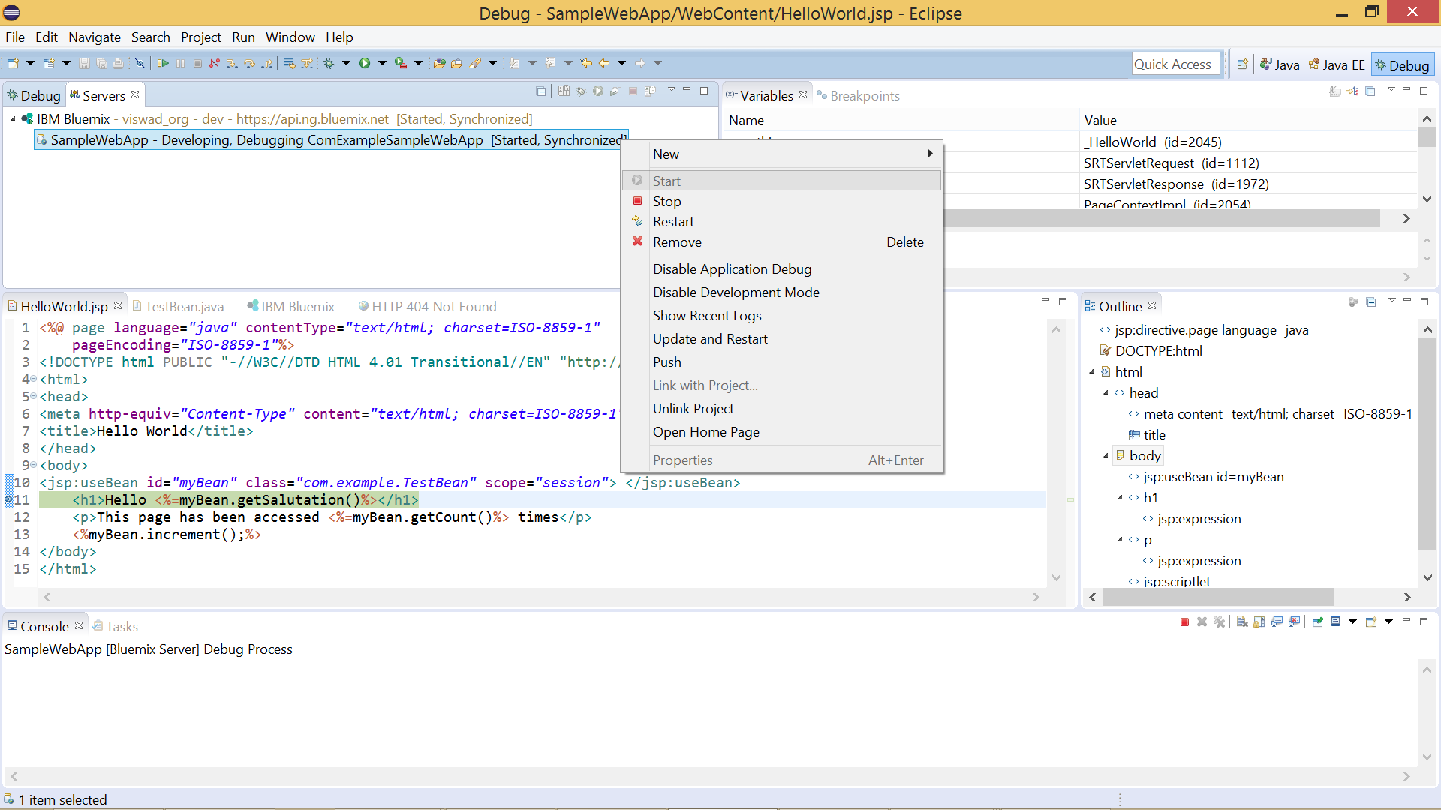
Remotely Debug Applications in Bluemix
App in Dev & Debug mode
Inspect variables
Set break points

Slide 17
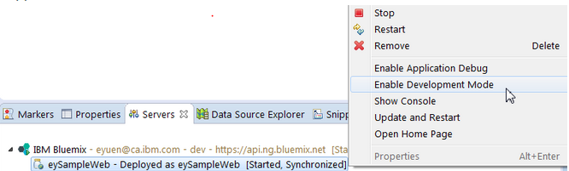
Incremental Publish of Applications in Bluemix
Enable Development Mode
Enabling Development Mode provides access to
Push incremental file updates
Run additional tools inside app container like SSH web console
Notes:
Earlier, one had to deploy the entire application for a simple change in the App. With incremental publish support, you can publish only the changed files to Bluemix and the changes will take place immediately without a redeploy of the entire application.
After an application has been deployed to Bluemix, you can right click on the application from the Servers view and select Enable Development Mode. When the application is running in Development Mode, you can incrementally publish your application to Bluemix by clicking the Publish button.

Slide 18
3 Basic Labs

Slide 19
Consuming the Services
From Java Applications

Slide 20
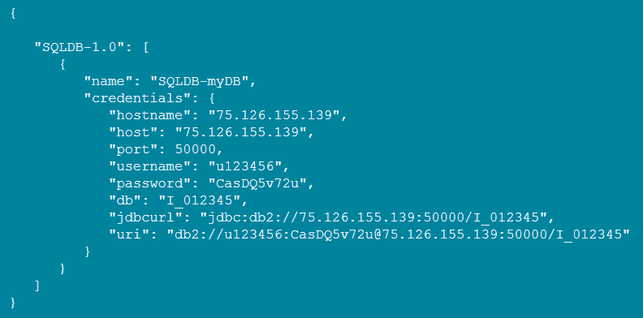
The plain way to use a service in Bluemix
Create & Bind the service
Command line
cf marketplace to see available services
cf create-service to create a service instance
cf bind-service to bind the service instance to your application
cf restart, or cf push again
Web portal (see demo)
Read service connection and credentials
Sample VCAP_SERVICES environment variable:

Slide 21
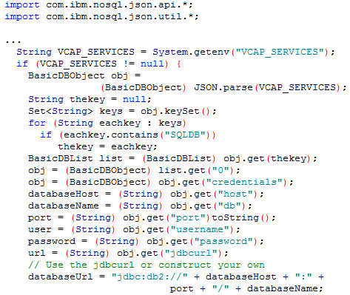
Sample code to connect to a SQL service
Read the credentials
Notes:
import com.ibm.nosql.json.api.*;
import com.ibm.nosql.json.util.*;
...
String VCAP_SERVICES = System.getenv("VCAP_SERVICES");
if (VCAP_SERVICES != null) {
BasicDBObject obj =
(BasicDBObject) JSON.parse(VCAP_SERVICES);
String thekey = null;
Set<String> keys = obj.keySet();
for (String eachkey : keys)
if (eachkey.contains("SQLDB"))
thekey = eachkey;
BasicDBList list = (BasicDBList) obj.get(thekey);
obj = (BasicDBObject) list.get("0");
obj = (BasicDBObject) obj.get("credentials");
databaseHost = (String) obj.get("host");
databaseName = (String) obj.get("db");
port = (String) obj.get("port")toString();
user = (String) obj.get("username");
password = (String) obj.get("password");
url = (String) obj.get("jdbcurl");
// Use the jdbcurl or construct your own
databaseUrl = "jdbc:db2://" + databaseHost + ":" +
port + "/" + databaseName;
}

Slide 22
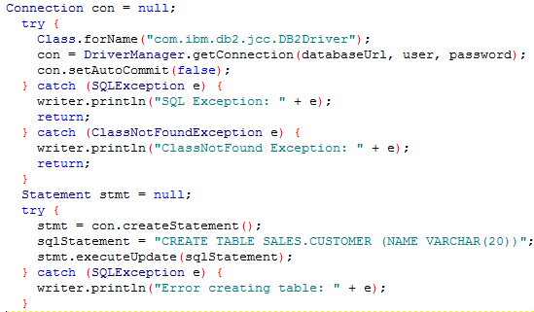
Sample code to connect to a SQL service
Establish the connection
22
Notes:
Connection con = null;
try {
Class.forName("com.ibm.db2.jcc.DB2Driver");
con = DriverManager.getConnection(databaseUrl, user, password);
con.setAutoCommit(false);
} catch (SQLException e) {
writer.println("SQL Exception: " + e);
return;
} catch (ClassNotFoundException e) {
writer.println("ClassNotFound Exception: " + e);
return;
}
Statement stmt = null;
try {
stmt = con.createStatement();
sqlStatement = "CREATE TABLE SALES.CUSTOMER (NAME VARCHAR(20))";
stmt.executeUpdate(sqlStatement);
} catch (SQLException e) {
writer.println("Error creating table: " + e);
}

Slide 23
Java EE Resource Auto-wiring for IBM created BlueMix services
23
Notes:
For Spring applications, similar things are also available: http://docs.cloudfoundry.org/devguide/services/spring-service-bindings.html

Slide 24
Service Integration with the Liberty buildpack
Bluemix IBM Created services
Configuration service
SQLDB (DB2)
Monitoring service
Auto Scaling service
Security Service
Data Cache
Session Cache
Log Analytics
Elastic MQ
Cloudant
Bluemix IBM Community Services
MySQL
PostgreSQL
MongDB
Twillio
Information about bound services is available in the VCAP_SERVICES env var.
Some services are container managed only (SessionCache) Require xml.
Some services can be either container managed or application managed. (RDB)
Some services contain multiple features which can be separately enabled. (LogAnalysis)
Some services have local analogs (RDB, mongo) and some do not (LogAnalysis)
Services may require client driver jars, extension features (wxs esa), Liberty features, bootstrapping.properties.

Slide 25
Auto configuration of Liberty server
When an application is staged, the buildpack service plugin examines the bound service information (VCAP_SERVICES) & generates the corresponding server.xml snippets for the bound services
Before
After
<server>
<featureManager>
<feature>webProfile-6.0</feature>
</featureManager>
…
</server>
<server>
<featureManager>
<feature>webProfile-6.0</feature>
<feature>eXtremeScale.webapp-1.1</feature>
</featureManager>
…
<xsWebApp
objectGridName=“${cloud…}“
catalogHostPort=“${cloud…}"
securityEnabled=“${cloud…}" />
</server>

Slide 26
Auto Configuration & Auto-Wiring of services
Option to opt-out of auto-configuration when the generated configuration is not correct or if the service plugin cannot discern intent correctly
Additional Liberty features are provisioned from the Liberty runtime-extended package if needed by the service
In depth treatment of services and how to write a service provider covered in session
In addition to auto-configuration Liberty exposes auto-wiring of data sources at runtime
Application does a lookup for a resource using the JNDI name java:comp/env/jdbc/myDB
Service bound with name ‘dbService’ which is mapped to JNDI name jdbc/dbService
Allows the single service that is bound to be returned as the result of the lookup

Slide 27














These services are made easier to consume
Java EE standard “resource”
SQL Database
BLU Data Warehouse
Elastic MQ
Modern “resource”
Cloudant
Data Cache
Mongo DB
Operational services
Session Cache
Auto Scaling
Monitoring and Analytics
Log Analysis
Notes:
27

Slide 28
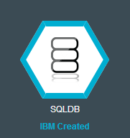
Using SQLDB service
SQLDB is an on-demand relational database to your application. Powered by DB2, it provides a managed database service to handle the demanding web and transactional workloads.
How you can use it?
The plain “VCAP_SERVICES” way
The Java EE way
DataSource
JPA

Slide 29
The Java EE way – Sample code for using SQLDB
“mydb” is the name of the service instance you create in Bluemix
“mydb” is the name of the service instance you create in Bluemix
public class TestServlet extends HttpServlet {
@Resource (name = "jdbc/mydb") private DataSource db;
...
protected void doGet(HttpServletRequest request, HttpServletResponse response) throws ServletException, IOException {
// Alternatively use InitialContext lookup DataSource lookup = (DataSource) new InitialContext().lookup("jdbc/mydb");
...
}
That’s it! All familiar code, no changes required in order to make it work in cloud!
No need for a server.xml
Don’t need to read VCAP_SERVICES
Notes:
Followed with a demo here

Slide 30

Using the ElasticMQ service – your familiar way again!
Develop responsive, scalable applications with a fully managed messaging provider in the cloud. Quickly integrate with application frameworks through easy to use APIs.
public class TestServlet extends HttpServlet {
@Resource (name = "jms/emq") private ConnectionFactory cf;
...
protected void doGet(HttpServletRequest request, HttpServletResponse response) throws ServletException, IOException {
// Alternatively use InitialContext lookup ConnectionFactory lookup =
(ConnectionFactory) new InitialContext().lookup(“jms/myemq");
...
}

Slide 31
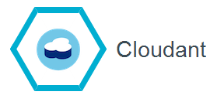
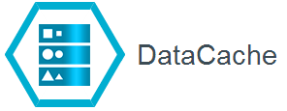
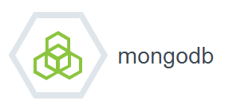
More “resource” services accessible in the same way
Cloudant’s distributed database as a service (DBaaS) allows developers of fast-growing web and mobile apps to focus on building and improving their products, instead of worrying about scaling and managing databases on their own.
Improve the performance & user experience of web applications by retrieving information from fast, managed, in-memory caches, instead of relying entirely on slower disk-based databases.
MongoDB is an open source document database and the leading NoSQL database that is owned by MongoDB Inc
31
Notes:
Cloudant <demo>
MongoDB
Data Cache
List the brief introduction and ICON for all 3 here.
List sample code for each of them in the following 3 slides.
Do a demo for Cloudant.

Slide 32
Cloudant
“mycloudantdb” is the name of the service instance you create in Bluemix
public class TestServlet extends HttpServlet {
@Resource (name = “cloudant/mycloudantdb") private CouchDbInstasnce db;
...
protected void doGet(HttpServletRequest request, HttpServletResponse response) throws ServletException, IOException {
// Alternatively use InitialContext lookup CouchDbInstance db = (CouchDbInstance) new InitialContext().lookup("java:comp/env/cloudant/mycloudantdb");
CouchDbConnector dbc = _db.createConnector(DATABASE, true);
CouchDocument dbentry = new CouchDocument();
dbentry.setContent("testEntry");
dbc.create(dbentry);
}

Slide 33
DataCache
“myGrid” is the name of the service instance you create in Bluemix
public class TestServlet extends HttpServlet {
@Resource (name = “wxs/myGrid") private ObjectGrid og;
...
protected void doGet(HttpServletRequest request, HttpServletResponse response) throws ServletException, IOException {
// Alternatively use InitialContext lookup ObjectGrid og = (ObjectGrid) new InitialContext().lookup(“wxs/myGrid");
...
}

Slide 34
Mongo
“mymongo” is the name of the service instance you create in Bluemix
import com.mongodb.DB;
public class TestServlet extends HttpServlet {
@Resource (name = “cloudant/mymongo") private DB db;
...
protected void doGet(HttpServletRequest request, HttpServletResponse response) throws ServletException, IOException {
// Alternatively use InitialContext lookup db = (DB) new InitialContext().lookup("java:comp/env/cloudant/mymongo");
...
}

Slide 35
Using Operational Services

Slide 36
Using operational services
Session Cache (demo)
Application Auto-Scaling (demo)
Log Analysis
Monitoring
36
Notes:
No code necessary.
Configure? and bind them.

Slide 37
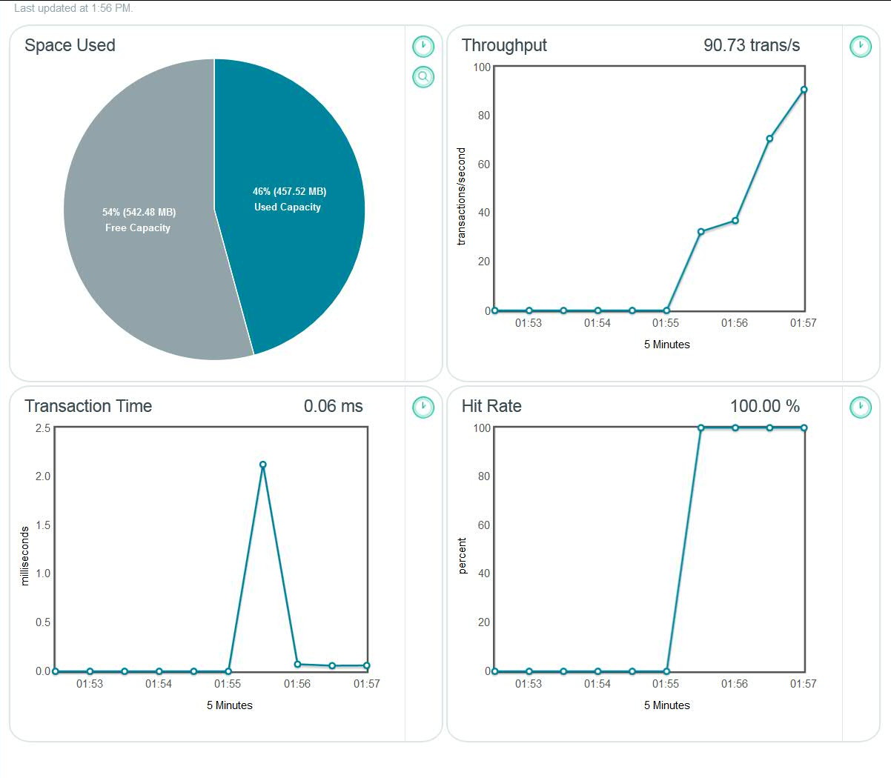

Session Cache
Improve application resiliency by storing session state information across many HTTP requests.
Enable persistence HTTP sessions for your application & seamless session recovery in event of an application failure.
37
Notes:
No code necessary.
Configure? and bind them.

Slide 38
Behind the scene – Auto-Configuration
When an application is staged, the buildpack examines the bound service information (VCAP_SERVICES) & generates the corresponding server.xml snippets for the bound services
Before
After
<server>
<featureManager>
<feature>webProfile-6.0</feature>
</featureManager>
…
</server>
<server>
<featureManager>
<feature>webProfile-6.0</feature>
<feature>eXtremeScale.webapp-1.1</feature>
</featureManager>
…
<xsWebApp
objectGridName=“${cloud…}“
catalogHostPort=“${cloud…}"
securityEnabled=“${cloud…}" />
</server>
38
38

Slide 39
DataCache and SessionCache
Sometimes the same resource can be configured in different ways depending on how the resource will be used. The service provider can offer different services in order to allow the user to convey their intent by binding to the appropriate service.
Session Caching
Data Caching
<server>
<featureManager>
<feature>webProfile-6.0</feature>
<feature>eXtremeScale.webapp-1.1
</feature>
</featureManager>
…
<xsWebApp
objectGridName=“${cloud…}“
catalogHostPort=“${cloud…}"
securityEnabled=“${cloud…}" />
</server>
<server>
<featureManager>
<feature>webProfile-6.0</feature>
<feature>eXtremeScale.client-1.1
</feature>
</featureManager>
…
<xsGrid
gridName=“${cloud…}“
clientDomain=“${cloud…}"
… />
</server>
39

Slide 40
Backup

Slide 41
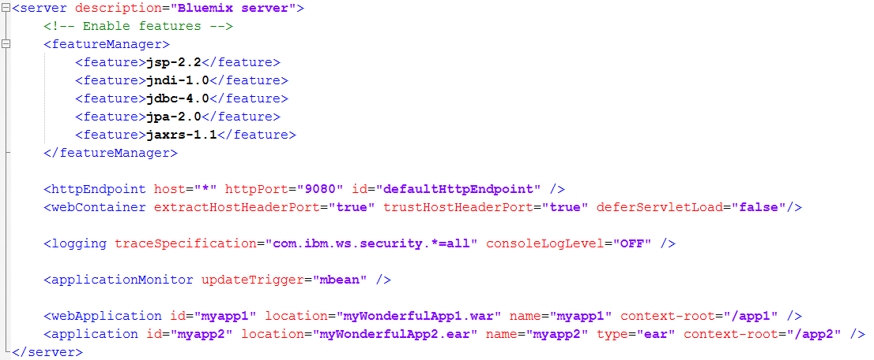
Liberty server dir/package
A server package
Use “./bin/server package myServer --include=usr” to create it
Or, simply a server directory
myServer
server.xml
apps
myWondefulApp1.war
myWondefulApp2.ear
Now you take full control!

Slide 42
You can also turn off Auto-Configuration and get the control
Connection info in runtime-vars.xml as variables
Provide a server.xml that reads these variables
Push server package
myServerPackage.zip
wlp
usr
servers
defaultServer
server.xml
apps
myapp.war
42

Slide 43
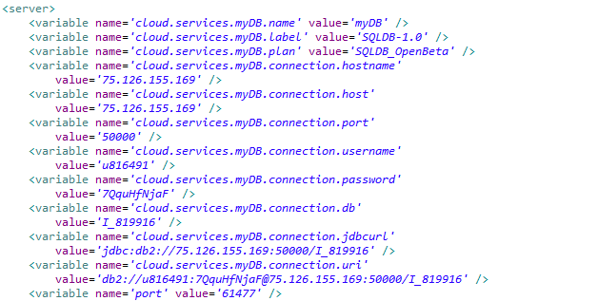
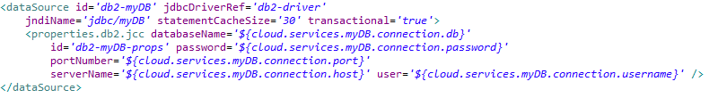
You can also turn off Auto-Configuration and get the control
variables available via runtime-vars.xml (provided)
server.xml (you provide)
43

Slide 44
Deploying Liberty applications to Bluemix
Server centric paradigm
Focus on runtime infrastructure available in the cloud
server.xml provided along with the application
User understands how to configure Liberty for their application
User wants that configuration reflected in the cloud deployment
Cloud centric paradigm
Focus on the application, not on the runtime infrastructure
server.xml is generated by the buildpack
User does not have to configure the Liberty server instance
User expects the environment to just do the right thing in order for their application to run

Slide 45
Supported Application Types
cf push - Push a single app (with or without a manifest):
cf push APP [-b BUILDPACK_NAME] [-c COMMAND] [-d DOMAIN] [-f MANIFEST_PATH] [-i NUM_INSTANCES] [-m MEMORY] [-n HOST] [-p PATH] [-s STACK] [-t TIMEOUT] [--no-hostname] [--no-manifest] [--no-route] [--no-start]
Standalone jar files (*.jar)
Web Applications (*.war)
Enterprise Applications (*.ear)
Liberty profile server package (*.zip)
Liberty profile server directory (dir.)
https://www.ng.bluemix.net/docs/Liberty/LibertyApp.html

Slide 46
Support Statement for Java apps deployed to Bluemix
We will keep two Liberty buildpacks in bluemix
Latest and one back
Buildpacks can be explicitly targeted with the –b option
Default Liberty Buildpack will always be the latest valid service level
Cumulative service will only be provided on the latest Buildpack level
We will retire any level of the buildpack as we see fit
Provide scripts & documentation to perform the “blue-green” application update at eGA
IBM reserves the right to restart and in very rare situations restage applications due to operational processes or maintenance requirements

Slide 47
Debugging and Troubleshooting apps pushed with Liberty buildpack
cf push with the latest production client explicitly specifying location with the –p
If you see timeouts during push increase environment variable values
CF_STAGING_TIMEOUT=15 Max wait time for buildpack staging, in minutes
CF_STARTUP_TIMEOUT=5 Max wait time for app instance startup, in inutes
Check to see if you are inadvertently pushing with a manifest file
Liberty logs can be viewed and downloaded using cf commands
cf files, cf logs, cf logs --recent, cf events
Logs and Files can also be looked at from ACE
Liberty logs: messages.log, stderr.log, stdout.log, FFDCs
env.log: environment variables of the application process
staging_task.log: staging logs from the app staging process
Set CF_TRACE=true and then use application guid to drive cf curl commands
Bind to the Configuration service to dynamically enable trace
Set trace specification in server.xml and push the server package again
Buildpack logging enabled if you push after setting the JBP_LOG_LEVEL environment variable in manifest.yml or using the cf set-env command – logs available in the diagnostics directory
Explicitly set the liberty buildpack start command with –command
Inspect the VCAP_SERVICES environment variable and connect directly to the service from the service console

