Slide 1

Wimbledon 2013
Darren Shaw, IBM Emerging Technology Services

Slide 2
Wimbledon 2013 Data
Web
Over 19.7 million unique users to wimbledon.com (+16% on 2012)
Over 433 million page views (+10%)
Over 54.6 million visits (+11%)
SlamTracker
Analysis of over 8 years of grand slam data > 41 million data points
Tweets
24 million Tweets processed
6 million Championship related Tweets analysed (+88% on 2012)
Low thousands per second peak

Slide 3
What IBM Wants To Demonstrate
Smarter Analytics
Social Business
Cloud
Mobile
3D Printing

Slide 4
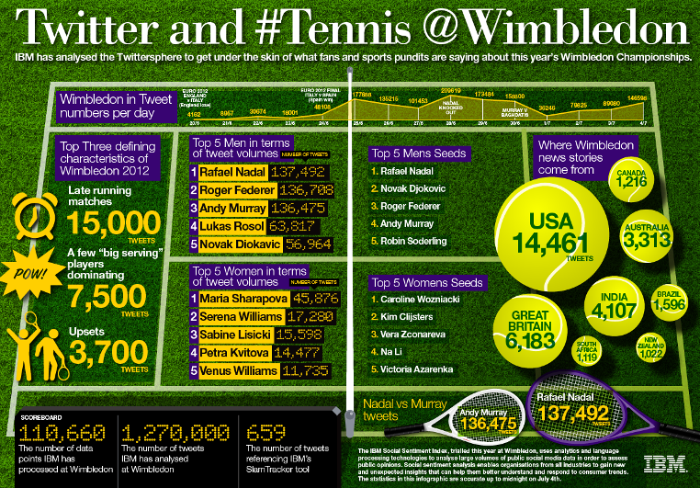
2012 Version

Slide 5
2013 Challenge
Volume and Reach
Demonstrate volume and rate of change of Twitter traffic
How broad a potential audience is being engaged
Geographic
Show the global reach of the Wimbledon Championships
Visualise differences in global interest by topic
Trending Topics
Demonstrate how relevant trending topics can be identified
Linkage to Other Data
Show how Twitter data can be linked to other, local and non-social information
Live and in Real Time

Slide 6
Process
Raw Feeds
Initial Analysis
ICA Text Analysis
Static File Generation
Push to Wimbledon
Visualisation

Slide 8
What Did We Find

Slide 9
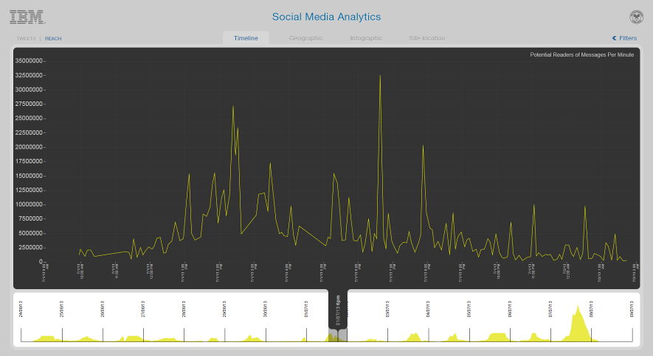
Perez Hilton
Peak reach corresponds
to Perez Hilton re-Tweeting
just 6 Tweets relating to
Serena Williams’ defeat

Slide 10
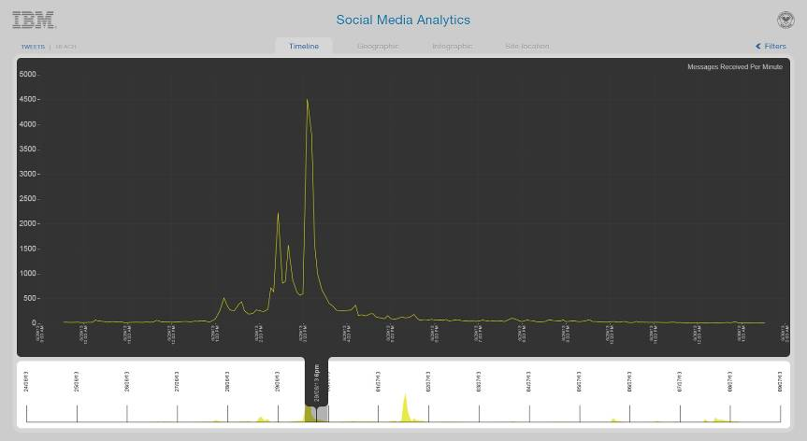
Laura Robson

Slide 11
Andy Murray Sentiment
 | 1 Jul | 2 Jul | 3 Jul | 4 Jul | 5 Jul | 6 Jul | 7 Jul
Overall Positive (%) | 89.3 | 84.8 | 83.6 | 89.8 | 88.3 | 92.9 | 96.0
Positive (%) | 37.7 | 43.3 | 32.3 | 53.4 | 35.2 | 46.5 | 45.4
Neutral (%) | 51.6 | 41.6 | 51.3 | 36.4 | 53.2 | 46.4 | 50.5
Negative (%) | 10.7 | 15.2 | 16.4 | 10.2 | 11.7 | 7.1 | 4.1
 |  |  | Men's Quarter Finals |  | Men's Semi Finals |  | Men's Final

Slide 12
Murray v Djokovic

Slide 13
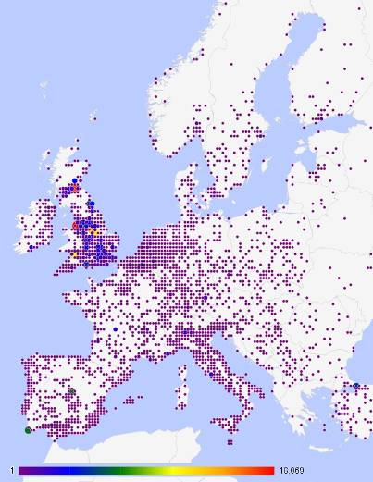
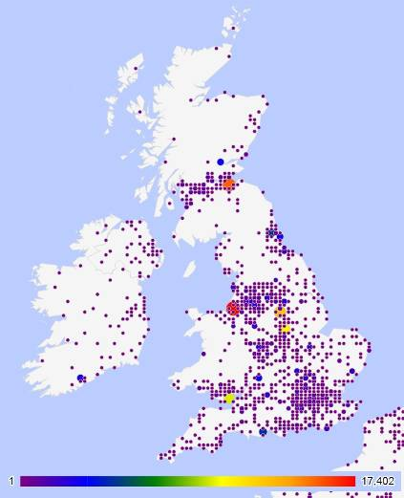
Geography Europe

Slide 14
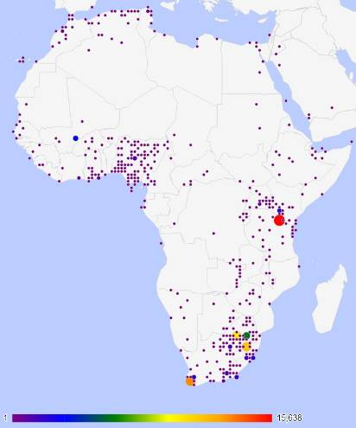
Geography Africa

Slide 15
Who Are Your Influencers
Instagram | 22,560,852
CNN Breaking News | 12,261,802
Facebook | 9,699,686
CNN | 9,282,212
Jimmy Fallon | 9,085,984
Ricky Martin | 8,978,322
NY Times | 8,739,541
Emma Watson | 8,462,505
ESPN | 6,749,634
BBC Breaking News | 6,374,650
Victoria Beckham | 6,367,918
Perez Hilton | 6,186,241
Stephen Fry | 5,941,903

Slide 16
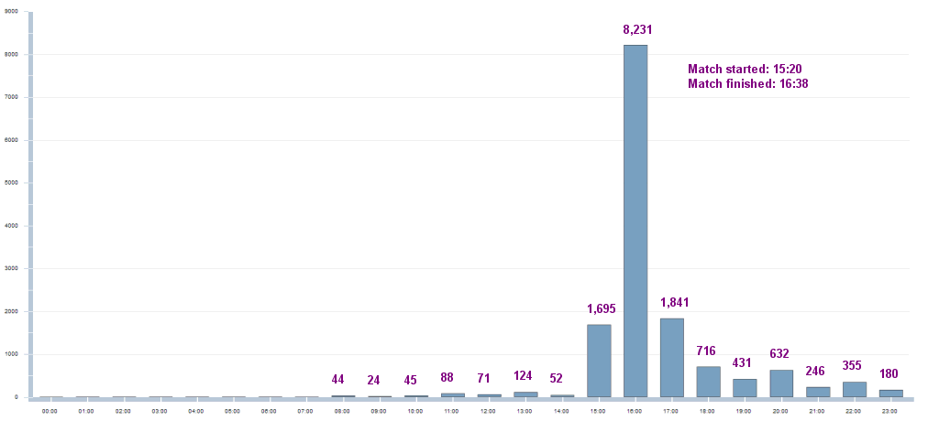
Traditional Media Impact
Laura Robson vs. Maria Kirilenko
No.1 Court – Ladies’ Singles – First Round
25th June 2013
BBC 2 Coverage of
Wimbledon from 20:00
BBC News at 22:00

Slide 18
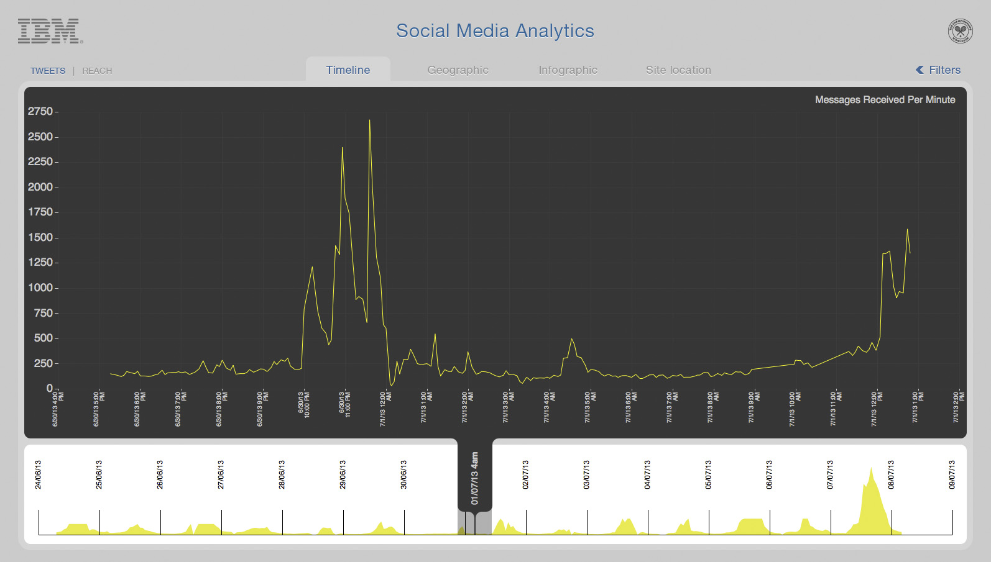

Slide 19
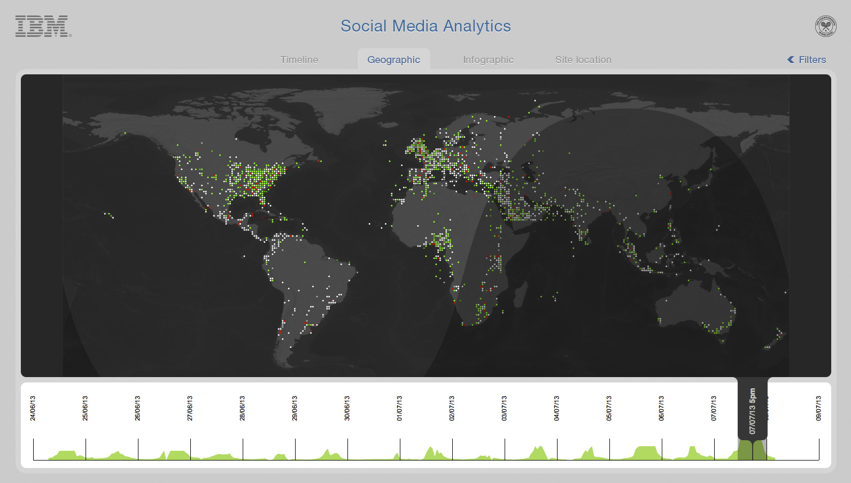

Slide 20
