Slide 1
Help me with my mood (SHADE)
Application
IBM HACKATHON 2018
By:
TEAM X4

Slide 2
Table of Content
Problem Statement
Team Members
Tools/Platform/APIs used
Process Flow
Screenshots
Functional Requirements
IBM Services Used
Uniqueness of our proposed solution
References

Slide 3
Problem Statement
Help me with my Mood- With Social-media Health Analysis and Display Engine (SHADE).
Our Proposed Solution:
This application gathers the username as an input for a particular twitter handle, and then it analysis the all tweets made by the user in last 24 hour.
Based on which it finds the current mood/emotion of the user and used it to suggest some YouTube content that will calm down his mood or help to eliminate the negative state of mind that could affect his daily life.

Slide 4
Team Members
In our team, there are 4 members.
Mukul Varshney : UI Designer, handles HTML, CSS, JavaScripts.
Manish Kumar : Handles Backend, Integration of codes, IBM Watson API.
Syed Shamikh Iqbal : YouTube API.
Sumit Agrawal : Twitter API.

Slide 5
Tools/Platform/APIs Used
Technologies Used : Python, HTML, CSS, Javascript
Tools Used : Django-Python, Sublime, Pycharm
Platform : Windows OS
APIs : Twitter, IBM Watson Tone Analyser, Youtube

Slide 6
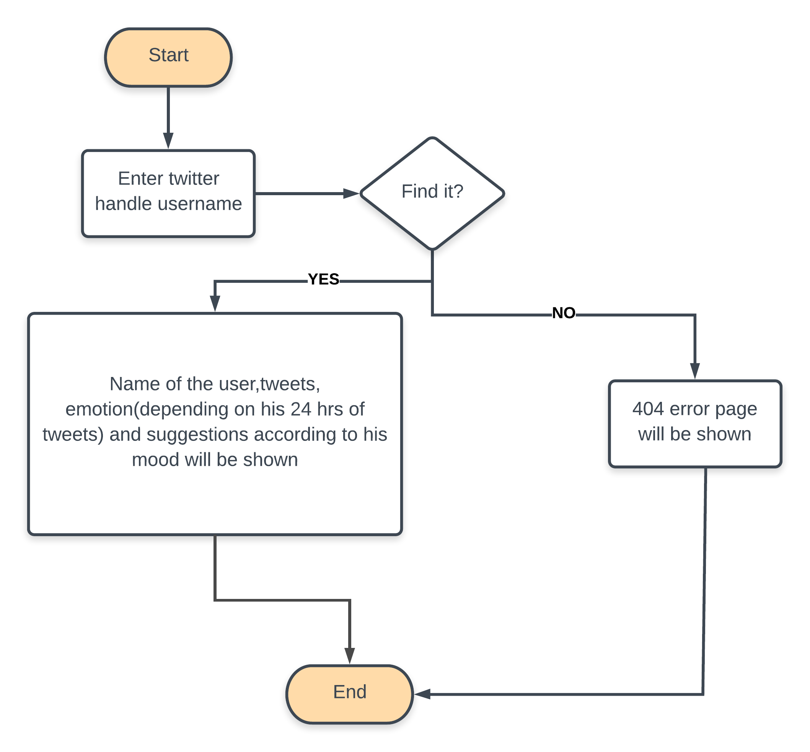
Process Flow

Slide 7
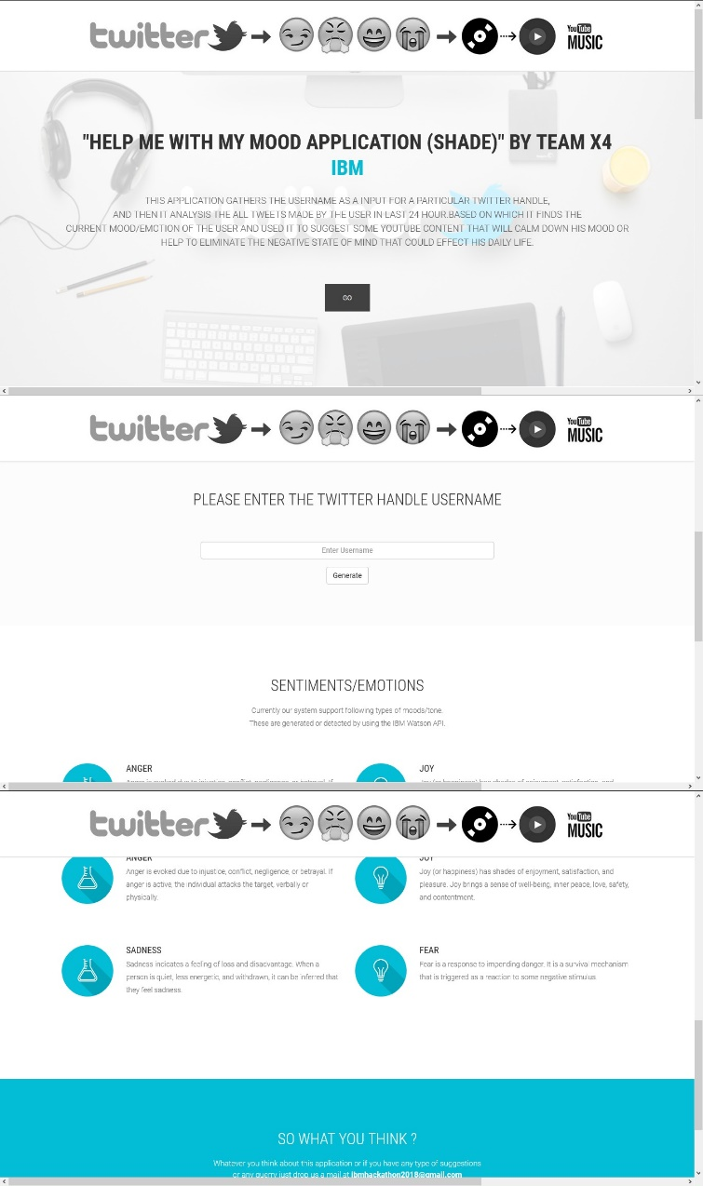
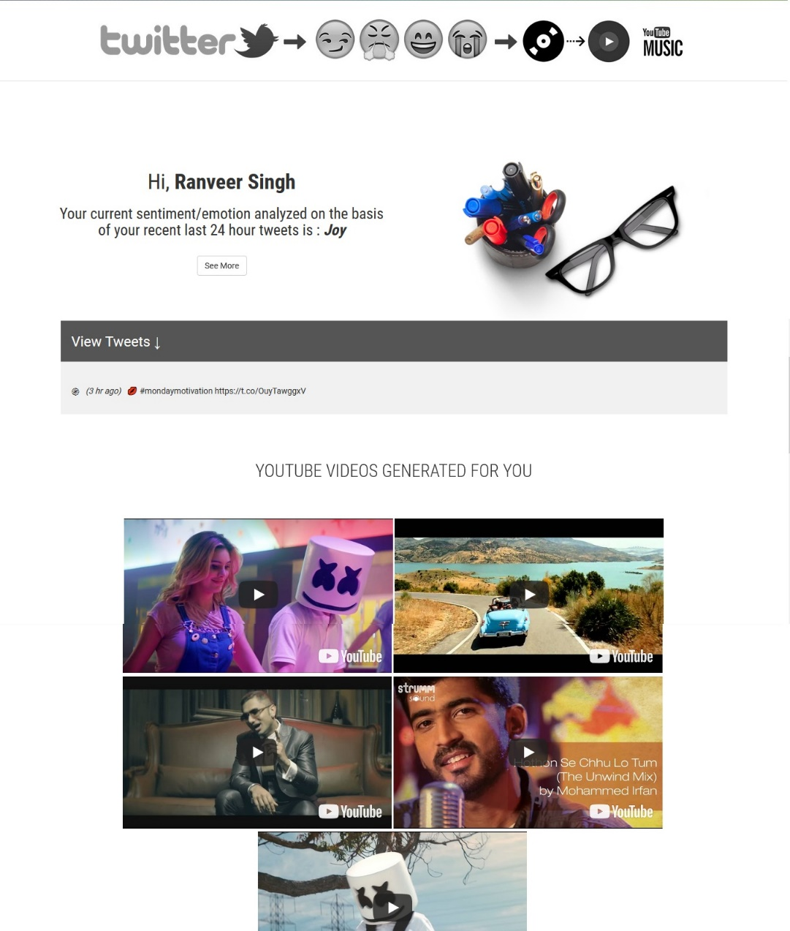
Screen Shots
Input

Slide 8
Functional Requirements
Browser: User must have some browser like Google Chrome, etc.
Internet Connection: This application requires good internet connection.
Twitter Account: User must have a Twitter handle username.
Tweets: User must have tweets in last 24 hours and tweets should be in English language.

Slide 9
IBM Services Used
IBM Watson Tone Analyser:
In this application, we are using IBM Watson Tone Analyser to analyse tweets of last 24 hours.
As result, we get output in the form of different emotions as per the content of tweets.

Slide 10
Uniqueness of our proposed Solution
Error Handling: We are handling most of the major errors such as for valid twitter account, invalid tweets, etc.
YouTube : In this application, user is able to enjoy some amazing YouTube videos according to his mood.
Tweets: In this application, user is also able to view tweets which was posted in last 24 hours and also view duration of every tweet.

Slide 11
References
https://www.ibm.com/watson/developercloud/tone-analyzer/api/v3/python.html?python#introduction
https://developer.twitter.com/content/developer-twitter/en.html
https://stackoverflow.com/questions/
https://www.djangoproject.com/
https://www.w3schools.com/python/

