Slide 1
1. MySQL
MySQL ,is an open-source relational database management system (RDBMS). ... A relational database organizes data into one or more data tables in which data types may be related to each other, these relations help structure the data.
In other words , MySQL Relational Database is an assemblage of relational data that is structured or organized in the form of tables, columns, and rows, where tables represent the objects, columns represent the fields and rows represent the records.
1

Slide 2
2. PostgreSQL
PostgreSQL ,also known as Postgres, is a free and open-source object relational database management system (RDBMS) emphasizing extensibility and SQL compliance. ... It is the default database for macOS Server and is also available for Windows, Linux, FreeBSD, and OpenBSD.
In other words, PostgreSQL is a powerful, open source object-relational database system that uses and extends the SQL language combined with many features that safely store and scale the most complicated data workloads.
2

Slide 3
3. SQL server
SQL Server is a database server by Microsoft. The Microsoft relational database management system is a software product which primarily stores and retrieves data requested by other applications. ... Therefore, a SQL Server is a database server that implements the Structured Query Language (SQL).
SQL Server is a process, viewed from an operating system perspective. Memory allocated from the operating system is owned by the process and so are files that are opened, and the process has a number of threads that the operating system can schedule for execution. SQL Server was started as a service.
3

Slide 4
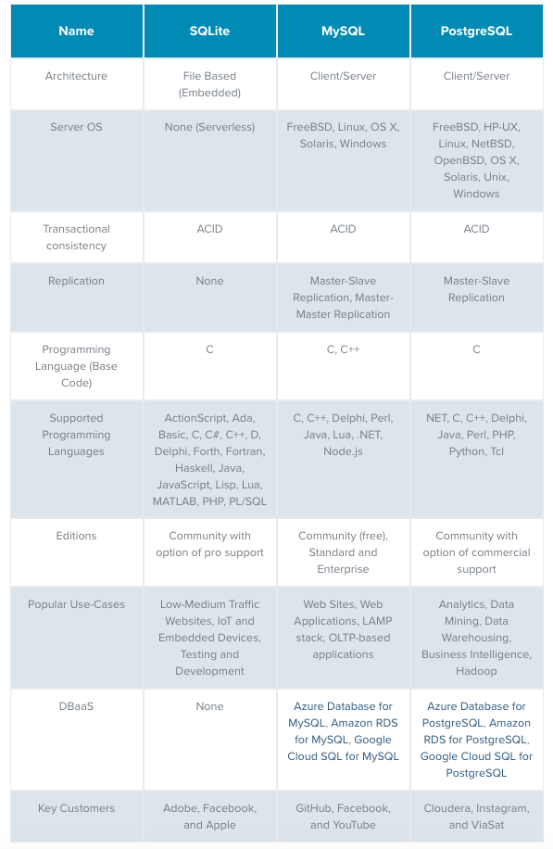
4. Comparison between MySQL,PostgreSQL &SQL server
4

