Slide 1
Developer Challenge:
Machine Learning using Watson Studio
“Feature Prediction – Loan credit default risk”
Problem statement:
Can you predict how capable each applicant is of repaying a loan?
Bank “ABC” is challenged with loan defaulters. It is struggling with taking a decision on whether the client is capable to repay the loan or not.
Bank is using basic statistical models to understand the pattern in the data collected in the last few years.
Bank needs help in exploring the data to the fullest potential. Doing so will ensure that clients capable of repayment are not rejected and that loans will empower their clients to be successful.
In this challenge, you will help this bank by predicting the probability that a member will default.
Data Information:
Two files will be provided: ( through git repository or Kaggle )
1) Credit_history_train.csv
2) Credit_history_test.csv
Github link - https://github.com/ibmrcruicks/RBSL2L2019

Slide 2

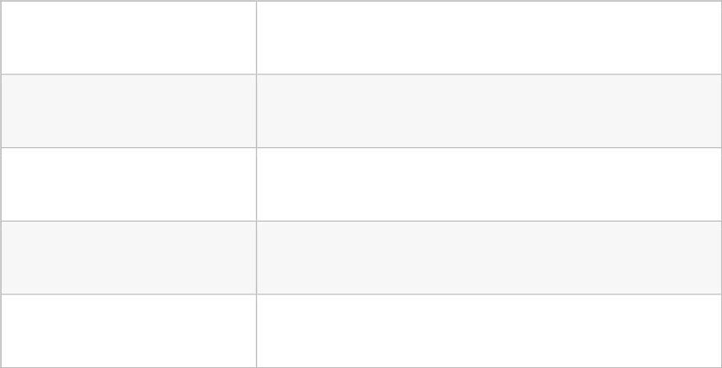
Sample data parameters
Variable
Description
unique ID assigned to each member
loan amount ($) applied by the member
loan amount ($) sanctioned by the bank
member_id
loan_amnt
funded_amnt
tot_coll_amt
total collection amount ever owed
tot_cur_bal
total current balance of all accounts
total revolving credit limit
total_rev_hi_lim
loan_status
status of loan amount, 1 = Defaulter, 0 = Non Defaulters

Slide 3
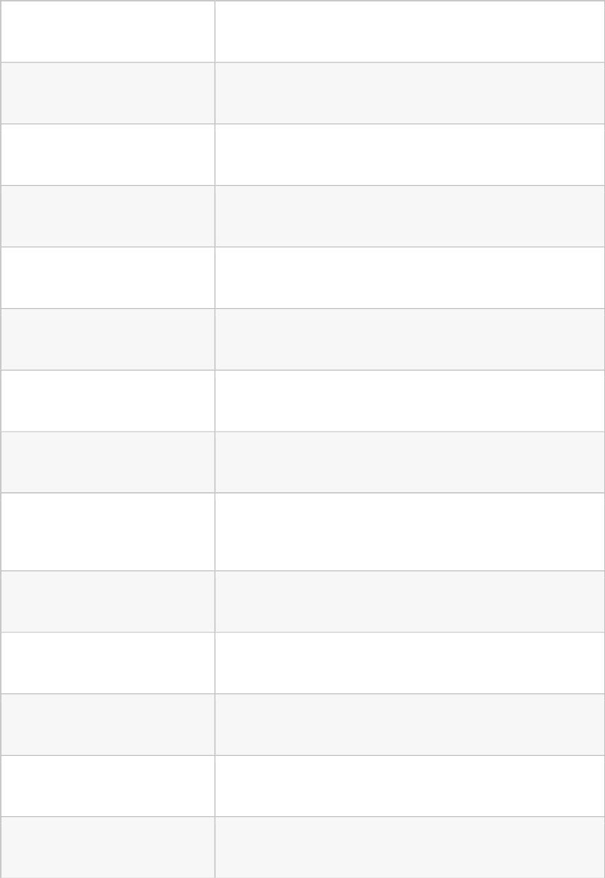
Variable
funded_amnt_inv
term
Description
loan amount ($) sanctioned by the investors
term of loan (in months)
batch_enrolled
int_rate
batch numbers allotted to members
interest rate (%) on loan
grade
grade assigned by the bank
sub_grade
emp_title
grade assigned by the bank
job / Employer title of member
emp_length
employment length, where 0 means less than one year
and 10 means ten or more years
home_ownership
annual_inc
status of home ownership
annual income ($) reported by the member
status of income verified by the bank
indicates if any payment plan has started against loan
loan description provided by member
verification_status
pymnt_plan
desc

Slide 4
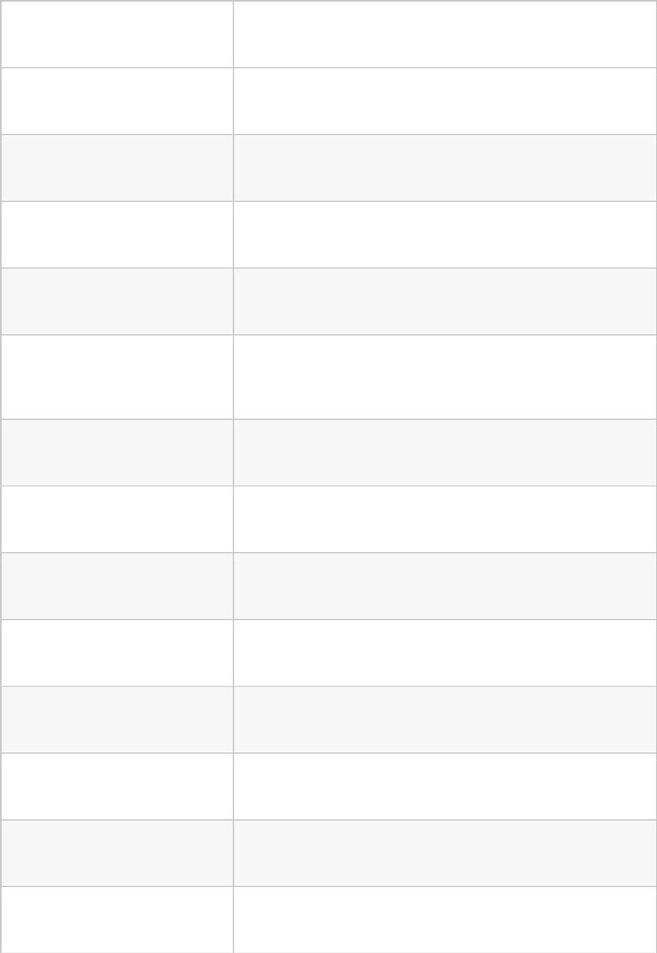
Variable
Description
purpose
title
purpose of loan
loan title provided by member
first three digits of area zipcode of member
living state of member
zip_code
addr_state
dti
ratio of member's total monthly debt repayment excluding
mortgage divided by self reported monthly income
delinq_2yrs
number of 30+ days delinquency in past 2 years
number of inquiries in last 6 months
inq_last_6mths
mths_since_last_delinq
mths_since_last_record
open_acc
number of months since last delinq
number of months since last public record
number of open credit line in member's credit line
number of derogatory public records
pub_rec
revol_bal
total credit revolving balance
revol_util
amount of credit a member is using relative to revol_bal

Slide 5

Variable
Description
total_acc
total number of credit lines available in members credit
line
initial_list_status
unique listing status of the loan - W(Waiting),
F(Forwarded)
total_rec_int
interest received till date
total_rec_late_fee
recoveries
Late fee received till date
post charge off gross recovery
post charge off collection fee
collection_recovery_fee
collections_12_mths_ex_med
number of collections in last 12 months excluding medical
collections
mths_since_last_major_derog
application_type
months since most recent 90 day or worse rating
indicates when the member is an individual or joint
verification_status_joint
indicates if the joint members income was verified by the
bank
last_week_pay
acc_now_delinq
indicates how long (in weeks) a member has paid EMI
after batch enrolled
number of accounts on which the member is delinquent

Slide 6
Evaluation:
Based on AUC-ROC score
Based on approach -> Feature engineering , Tools used
Files to upload:
Predicted value – csv file
Source file – file(s) describing the approach , feature engineering, tools and source code. Files to be compressed and uploaded to the git repository
Pre-requisite:
Registration to IBM cloud (https://cloud.ibm.com)
Individual github repository from the participants to upload their source files
Skills:
Statistical programming and basic ML concepts
Awareness of various ML libraries , frameworks and tools
Language awareness – python
Timeline: ( 3 weeks )
• ML hands on workshop and challenge announcement
o One day
• Challenge
o 3 weeks
• Evaluation
o 1 day
Collaboration channel:
• Slack channel will be provided
Resources:
https://developer.ibm.com/code/patterns/
https://dataplatform.ibm.com/exchange/public/entry/view/fe3f5db21152f9e668009cb2f40cb096
https://dataplatform.ibm.com/community?context=analytics&format=notebook

