Slide 1
Creating, Evaluating and Improving Machine Learning Models
Gaurav Goswami AI/ML Expert with modifications by Ross Cruickshank
Slides prepared and compiled using various online sources.

Slide 2


The full story
https://cognitiveclass.ai/learn/data-science/

Slide 3
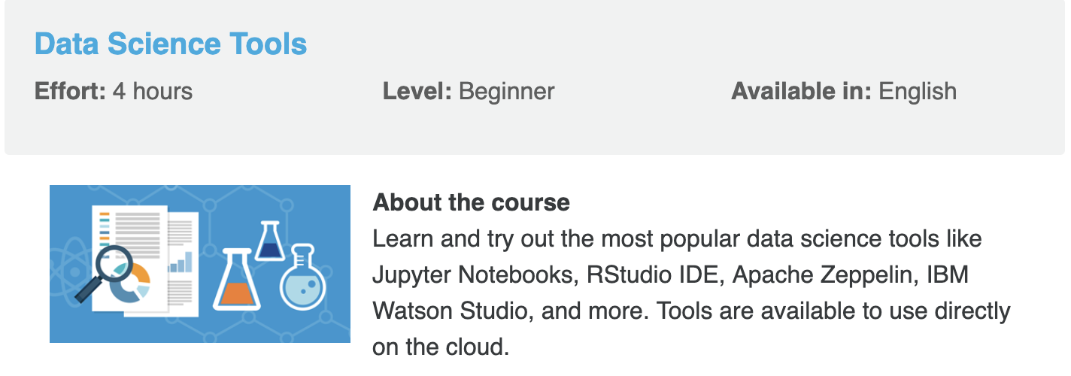
The full story
https://cognitiveclass.ai/learn/data-science/

Slide 4
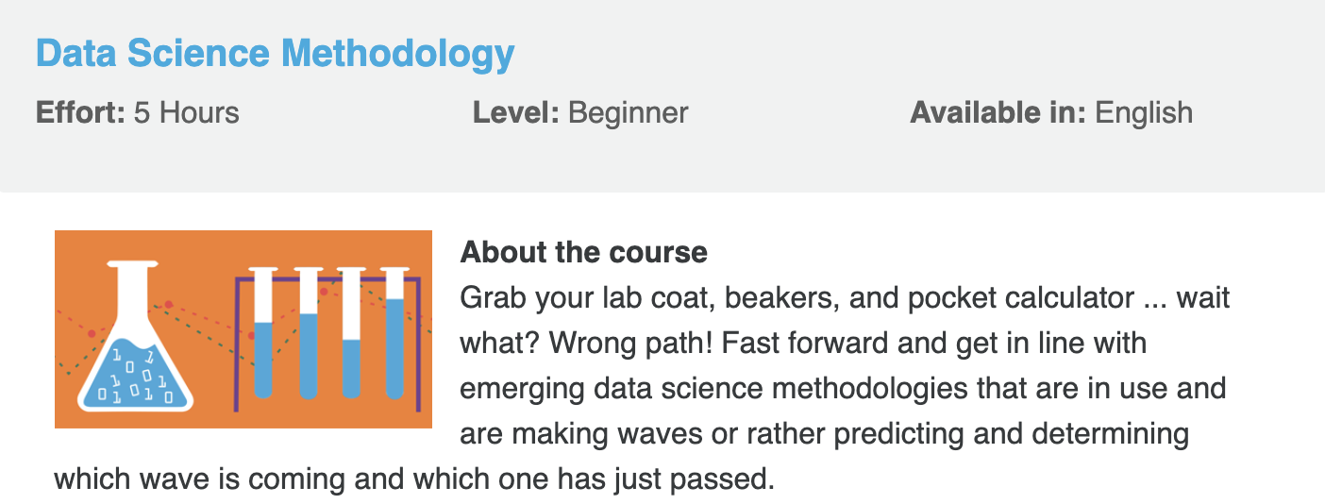
The full story
https://cognitiveclass.ai/learn/data-science/

Slide 5









The machine learning pipeline
Raw data
Features
Models
Deploy in production
Predictions
I fell in love the instant I laid my eyes on that puppy. His
big eyes and playful tail, his soft furry paws, …
2

Slide 6
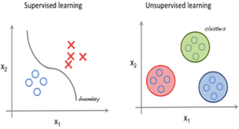
Different Modes of Machine Learning
Supervised:
Ground truth is available for each data point
Map input (features) to output (labels)
Examples: find the sentiment of a new tweet given a
database of labeled tweets
Unsupervised:
No ground truth is available
Map data points to groups (or clusters) in the data
Examples: categorize people into different spending capability groups based on financial data
Reinforcement:
Behavior inspired: Action and consequence (reward)
No “correct” input-output pairs
Focus is on the overall ‘reward’
Examples: robot control

Slide 7
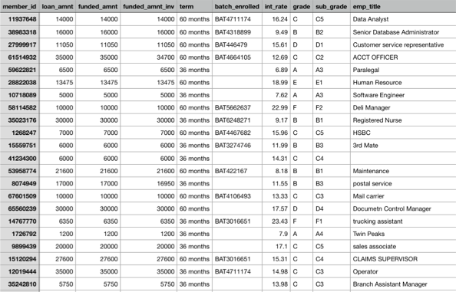
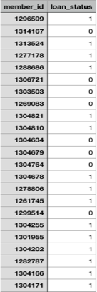
Features
Label

Slide 8
Golden Rule of ML: Data is King
Everything in ML revolves around the data
First step of creating a model: Explore the data (EDA)
Various plots and visualizations
Determine preprocessing steps required for the data
Custom build the initial pipeline based on the data

Slide 9
Goals of Preprocessing
Adapt and coalesce the data to a compatible format
Cleaning the data
Handle missing values
Handle outliers
Encode categorical variables
Drop irrelevant features
Transformation of the data
Splitting the data into training/validation/testing sets

Slide 10
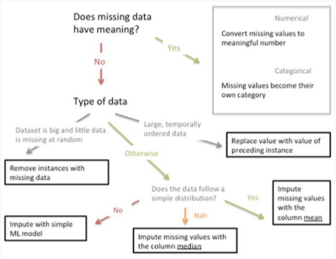
Preprocessing: Handling Missing Data

Slide 11
Preprocessing: Data Transformation
Some data mining tools tends to give variables with a large range a higher significance than variables with a smaller range. For example,
•
Age versus income.
The typical approach is to standardize the scales:
Min-Max Normalization:
1
0.8
X − min(X)
max(X) − min(X)
normalized values
0.6
X ∗ =
.
0.4
0.2
A1 A2
0
-20
0
20
40 60
original values
80
100
120
3
A1 A2
Z-score standardization:
2
_{X ∗ =} X − mean(X) .
SD ( X )
standardized values
1
0
-1
-2
-3
-4
-20 0 20 40 60 80 100
original values
120
ITEV, F-2008 6/12

Slide 12
Preprocessing: Outliers
Data: 1, 2, 3, 3, 4, 4, 5, 5, 6, 6, 6, 6, 7, 7, 8, 8, 8, 20.
4
3.5
Summary statistics:
3
•
•
•
First quartile (1Q): 25% of the data = 4 . Second quartile (2Q): 50% of the data = 6.
Third quartile (3Q): 75% of the data = 7.
2.5
2
1.5
1
Interquartile range IQ R = 3Q − 1Q = 3.
0.5
0
0
5
10
15
20
A data point may be an outlier if:
•
•
It is lower than 1Q − 1.5 ·IQ R = 4 − 1.5 ·3 = −0.5. It is higher than 3Q + 1.5 ·IQ R = 7 + 1.5 ·3 = 11.5.
This approach is extreme value analysis
ITEV, F-2008 7/12

Slide 13
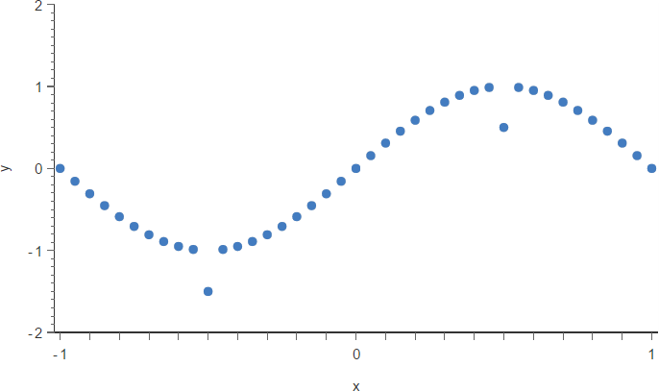
Preprocessing:Outliers
What if ?
Multi Variate Outlier (MVO) detection approach

Slide 14
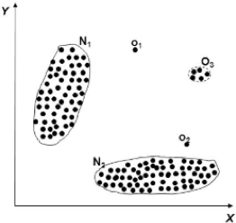
Preprocessing:Outliers
Univariate Example: Age and height , but either only age or height is
Analysed. (bar chart , histogram)
Bivariate Example : Analyzing caloric intake vs weight , temp vs ice cream sale (Scatterplot)
Multi variate Example ( cluster /Discrimant Analysis
/ PCA/..)
Proximity method
Identify the natural cluster in the data (k-means)
Identify cluster centroids
Identify data instances that are fixed distance
from centroid
Filter out outliers candidate from dataset

Slide 15
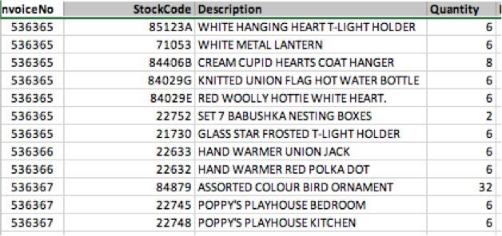
Outlier - Example

Slide 16
Preprocessing: Categorical Data
Label encoding:
Assign an ID to each unique value
Days = [Mon, Tues, Wed, Thurs, Fri, Sat, Sun]
Days_transformed = [0,1,2,3,4,5,6]
Consideration: Possible implications for some ML models
One-hot encoding:
Create as many new columns as there are distinct values in the feature
From one Days column to: IsMon, IsTues, IsWed, IsThurs, IsFri, IsSat, IsSun
1 for the feature value, 0 for other columns
Consideration: dimensionality of the feature matrix

Slide 17
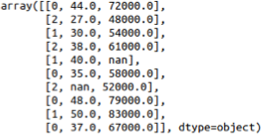
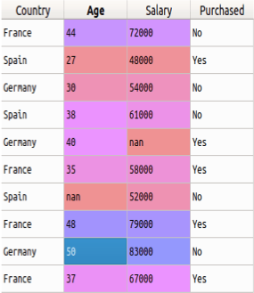
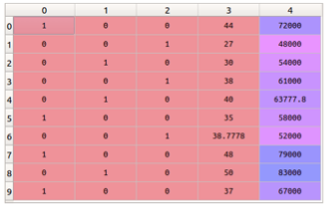
Label Vs One-Hot Encoding

Slide 18
Features
Extract representations that capture the “essence” of data
For classification: Maximize the intra-class similarity and inter-class distance
For regression: Maximize the explanation power
Multiple methods
No clear “right” or “wrong” answers
Question: What are the potential “features” for:
Assessing the credit risk of an individual
Predicting the type of loan a customer is most likely to accept

Slide 19













Features: Representing natural text
Raw Text |  | Bag of Words
Classify: puppy or not?
It is a puppy and it is extremely cute.
{“it”:2,
“is”:2,
“a”:1,
“puppy”:1,
“and”:1, “extremely”:1, “cute”:1 }
What’s important? Phrases? Specific words? Ordering?
Subject, object, verb?
16

Slide 20



Features: Representing natural text
Raw Text |  | Bag of Words
Classify: puppy or not?
It is a puppy and it is extremely cute.
it | 2
they | 0
I | 1
am | 0
how | 0
puppy | 1
and | 1
cat | 0
aardvark | 0
cute | 1
extremely | 1
… | …
Sparse vector representation
17

Slide 21









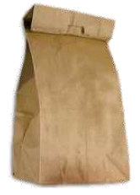

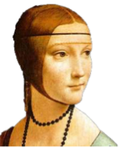










Features: Representing images
Classify:
person or animal?
Raw Image |  | Bag of Visual Words
Raw image:
millions of RGB triplets,
one for each pixel
Image source: “Recognizing and learning object categories,” Li Fei-Fei, Rob Fergus, Anthony Torralba, ICCV 2005—2009.
18

Slide 22






Features: Representing images
Raw Image Deep learning features
Classify:
person or animal?
3.29
-15
-5.24
48.3
1.36
47.1
- 1.92
36.5
2.83
95.4
-19
-89
5.09
37.8
Dense vector representation
19

Slide 23
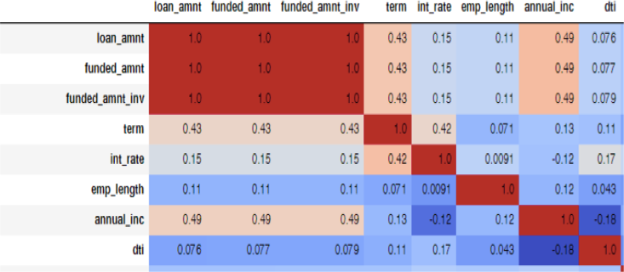

Slide 24
Features: Dimensionality Reduction
Preserve the most relevant features
Converge to a good model in lesser number of iterations
Reduce computational complexity of training and testing
Various techniques are available: PCA, Mutual Information, Correlation analysis, Feature Importance, Quality, Visual Saliency, etc.

Slide 25
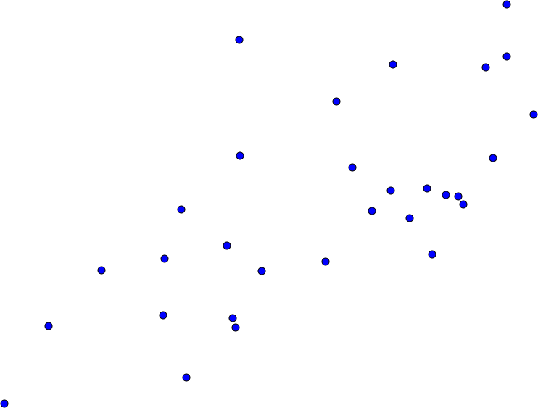





PCA : Principal Component Analysis
Find a line, such that the average distance of every data point to the line is minimized.
This is the 1st Principal Component
23

Slide 26





PCA : Principal Component Analysis
Find a 2nd line,
-at right angles to the 1st
-such that the average distance of every data point to the line is minimized.
This is the 2nd Principal Component
24

Slide 27
PCA : Principal Component Analysis
Find a 3rd line
-at right angles to the previous lines
-such that the average distance of every data point to the line is
minimized.
…
There can only be as many principle components as the dimensionality of the data.
25

Slide 28
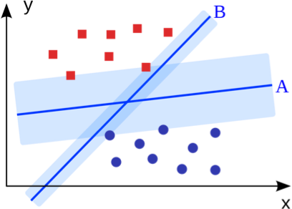
Model Training
Learn the mapping from features to output
Ideal: 100% accuracy in differentiating features of different classes
Practical: Maximize accuracy while maintaining “generalizability”
Quality dependent on training data quality/quantity
Choosing an ML algorithm for the task
Choosing the labels

Slide 29
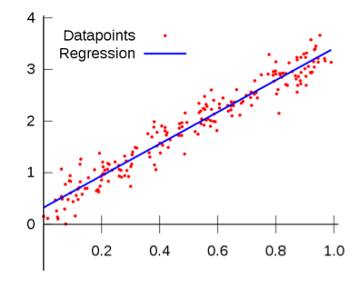
Linear Regression
Fit a model to compute the value of a dependent scalar variable based on one or more predictors
Single predictor: Simple linear regression
y = B0 + B1 * x1
B0 – bias / error
B1- coefficient/weights
Weight = B0 +B1*Height
For example, lets use B0 = 0.1 and B1 = 0.5
Weight=91 = 0.1 +0.5*182
Multiple predictors: Multiple linear regression
Vector dependent variable: Multivariate linear regression

Slide 30
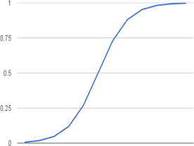
Logistic Regression
sigmoid function to describe properties of population growth in ecology
It’s an S-shaped curve that can take any real-valued number and map it into a value between 0 and 1,
y = e^(b0 + b1*x) / (1 + e^(b0 + b1*x))
Y -> predicted output
b – bias (error) / co-efficient (weights)
P(X) = P(Y=1|X)
Given Y=1 (diabetic)/given age)
Model – Learn the co-efficients (b0/b1)
Remove highly co-related features

Slide 31
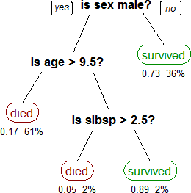
Decision Tree
Performs intrinsic feature ranking
Branches out at each level based on the feature that can provide the best separation
Decides based on intervals of the features
Different types of algorithms

Slide 32
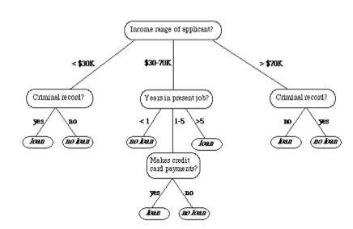
Decision Tree
Not a black box Algo – can visualize the logic
Performs intrinsic feature ranking
Each node represents a feature(attribute), each link(branch) represents a decision(rule) and each leaf represents an outcome(categorical or continues value)
No loan
Loan
Different types of algorithms
CART

Slide 33
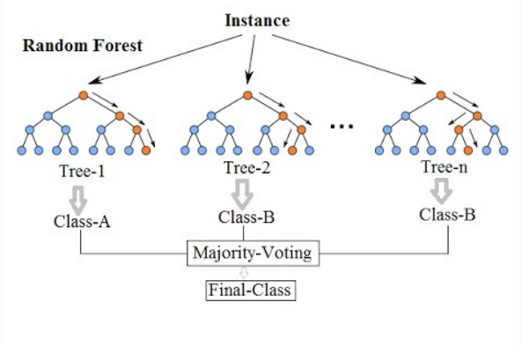
Random Decision Forest
“Ensemble” of decision trees
Train many classifiers on part of the data
“Vote” for the right answer

Slide 34
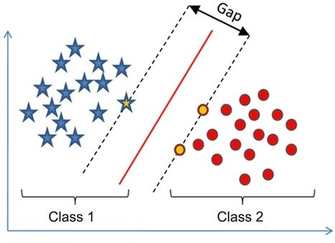
Support Vector Machine
Perform classification based on the features closest to the decision boundary
Maximize the distance between the boundary and the “support vectors”
Many variants

Slide 35
HyperParameters – Knobs to tune..
Define higher level concepts about the model such as complexity, or capacity to learn.
Cannot be learned directly from the data in the standard model training process and need to be predefined.
Can be decided by setting different values, training different models, and choosing the values that test better
Some examples of hyperparameters:
Number of leaves or depth of a tree
Number of latent factors in a matrix factorization
Learning rate (in many models)
Number of hidden layers in a deep neural network
Number of clusters in a k-means clustering

Slide 36
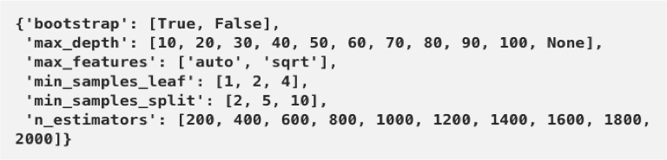
Random Forest – Hyper parameter
n_estimators = number of trees in the foreset
max_features = max number of features considered for splitting a node
max_depth = max number of levels in each decision tree
min_samples_split = min number of data points placed in a node before the node is split
min_samples_leaf = min number of data points allowed in a leaf node
bootstrap = method for sampling data points (with or without replacement)

Slide 37
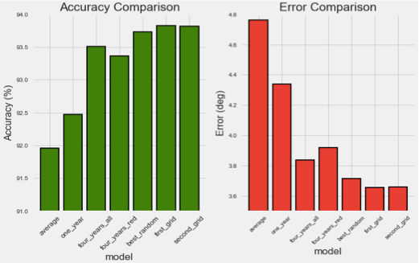
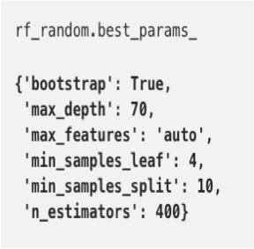
How to achieve optimized hyper parameter ?

Slide 38
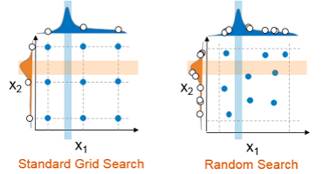
HyperParameter Optimization
Objective: Find the ideal value(s) of the parameters of your algorithm to maximize the evaluation criterion

Slide 39
Grid Search
Model – X
Hyperparameters – a1,a2,a3
a1={0,1,2,3,4,5}
a2=[10,20,30,40,50,60]
a3 =[105,105,110,115,120,125]
start with the combination of [0,10,105], and it will end with [5,60,125].
It will also go through all the intermediate combinations -
computationally very expensive.

Slide 40
Feedback and Model Deployment
Machine Learning is an iterative process
The model is re-trained many times until validation performance is satisfactory
What changes in future iterations?
Preprocessing
Features
Choice of algorithm
Choice of parameters
Training data
Testing performance indicates estimated real-world performance of the model
The testing performance is the final reported value

Slide 41


ML EVALUATION BASICS: THE GOLDEN RULE
Creating ML models is easy.
Press here:
TRAIN
Creating good ML models is not that easy.
o Especially if we are not crystal clear about the criteria to tell how good our models are!
So, good for what?
TIP
ML models should perform well during deployment.

Slide 42
ML EVALUATION BASICS: THE GOLDEN RULE
We need performance metrics and evaluation procedures that best match the deployment conditions.
Classification, regression, clustering, association rules, … use different metrics and procedures.
Estimating how good a model is crucial:
Golden rule: never overstate the performance that a ML model is expected to have during deployment because of good performance in optimal “laboratory conditions”
TIP

Slide 43





ML EVALUATION BASICS: THE GOLDEN RULE
Caveat: Overfitting and underfitting
o In predictive tasks, the golden rule is simplified to:
Golden rule for predictive tasks: Never use the same examples for training the model and evaluating it
TIP
Models
Best model
data
training Algorithms
test
1

error (h) 
( f (x)  h(x))
2
E valuation
S
n _{x}_{S}

Slide 44
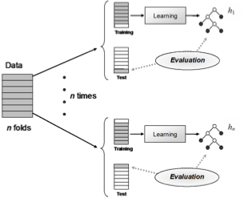
ML EVALUATION BASICS: THE GOLDEN RULE
Caveat: What if there is not much data available?
Bootstrap or cross-validation
We take all possible
combinations with n‒1 for training and the remaining fold for test.
The error (or any other metric) is calculated n times and then averaged.
A final model is trained with all the data.
No need to use cross-validation for large datasets
TIP

Slide 45
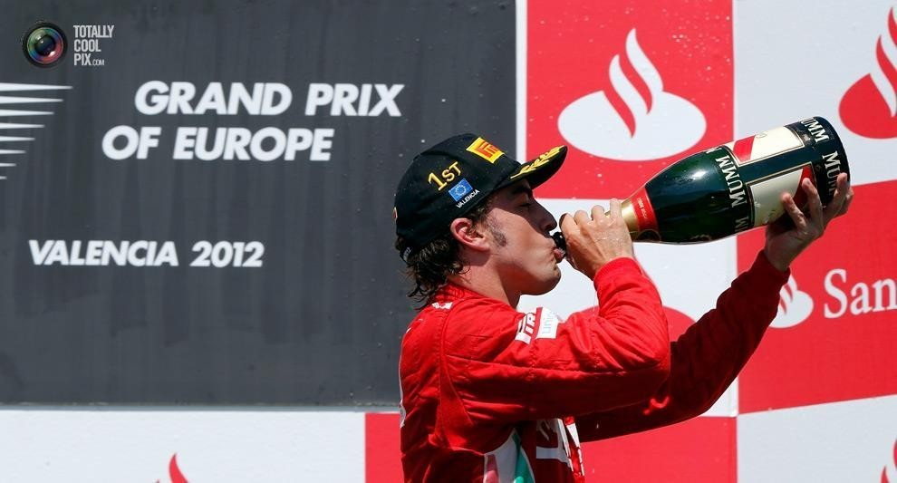

TEST VS. DEPLOYMENT: CONTEXT CHANGE
Is this enough?
Testing conditions (lab)
Deployment conditions (production)
Context is everything
Caveat: the simplified golden rule assumes that the context is the same for testing conditions as for deployment conditions.

Slide 46
ROC ANALYSIS
The context or skew (the class distribution and the costs of each error) determines classifier goodness.
Caveat:
In many circumstances, until deployment time, we do not know
the class distribution and/or it is difficult to estimate the cost matrix.
E.g. a spam filter.
But models are usually learned before.
SOLUTION:
ROC (Receiver Operating Characteristic) Analysis.

Slide 47
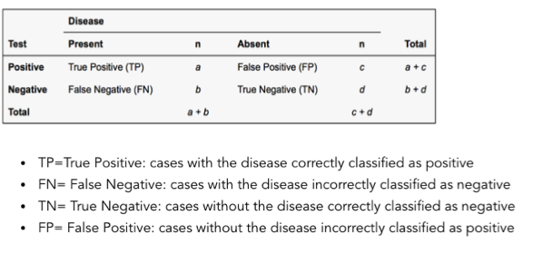

ROC ANALYSIS
To understand ROC curves, it is helpful to get a grasp of sensitivity, specificity, positive preditive value and negative predictive value:

Slide 48
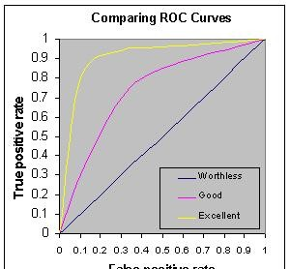
ROC ANALYSIS
The closer the curve follows the left side border and the top border, the more accurate the test.
The closer the curve is to the 45-degree diagonal, the less accurate the test.

Slide 49

ROC ANALYSIS
The ROC Space
Using the normalised terms of the confusion matrix:
TPR, FNR, TNR, FPR:
Actual
Actual
 | open | close
OPEN | 400 | 12000
CLOSE | 100 | 87500
 | open | close
OPEN | 0.8 | 0.121
CLOSE | 0.2 | 0.879
Pred
Pred
ROC Space
TPR= 400 / 500 = 80%
FNR= 100 / 500 = 20%
TNR= 87500 / 99500 = 87.9%
FPR= 12000 / 99500 = 12.1%
1,000
0,800
0,600
0,400
0,200
0,000
True Positives
14
0,000
0,200
0,400 0,600
False Positives
0,800
1,000

Slide 50
ROC ANALYSIS
Good and bad classifiers
TPR
TPR
1
1
1
TPR
0
0
1
0
0
FPR
1
0
0
FPR
FPR 1
Bad classifier (more realistic).
•
Bad classifier.
Good classifier.
High TPR.
Low FPR.
Low TPR
.
High FPR.

Slide 51
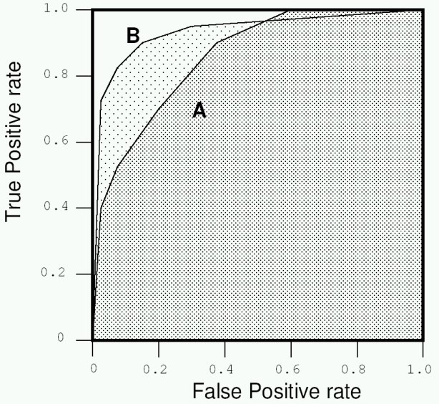
METRICS FOR A RANGE OF CONTEXTS
What if we want to select just one soft classifier?
o The classifier with greatest Area Under the ROC Curve (AUC) is chosen.
AUC is useful but it is always better to draw the curves and choose depending on the operating condition.
TIP
AUC does not consider calibration. If calibration is important, use other metrics, such as the Brier score.
TIP

Slide 52
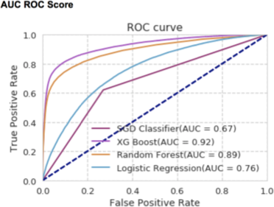

Slide 53
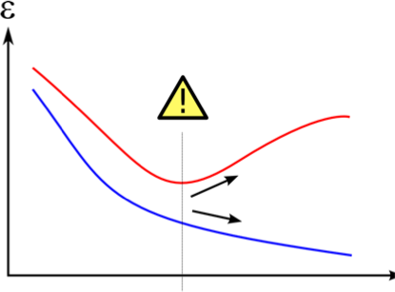
Underfitting and Overfitting

Slide 54
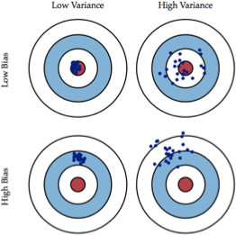
Underfitting and Overfitting
Underfitting:
High bias
High training/validation/test error
Low model complexity
Increase features
Choose a more expressive model
Overfitting:
High variance
Low training error, high validation/test error
High model complexity, low generalizability
Increase training data, lower feature dimension
Regularization (making the model simpler)

Slide 55
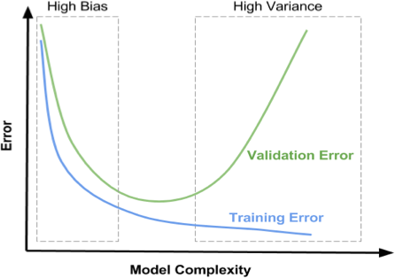
Error – Bias / Variance tradeoff

Slide 56
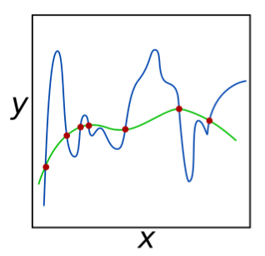
Regularization
Reduce the decision boundary complexity
Reduce overfitting on training data
Increase real world performance
Existing regularization methods: L-1, L-2, Elastic Net, dropout, dropconnect (deep learning)

Slide 57
Regularization: Example
Overfit decision rule:
If X <= 3.7, class = 1
Regularized decision rule:
If X <=3 class = 1
Sacrifice training performance to obtain a more generalizable decision rule that can potentially scale better to unseen data
Trade-off
Class Label | Feature (X)
1 | 2.7
2 | 3.8
1 | 2.8
2 | 5.5
1 | 3.7
1 | 3.0
1 | 2.9
2 | 3.9

Slide 58
Feature Engineering
“A model is only as good as the data”
How to improve the data?
Higher dimension of features (polynomial, interactive terms, kernel trick)
Specialized features (domain knowledge)
More feature sources (external data)
Some tools are available to help in feature engineering (https://docs.featuretools.com/getting_started/install.html)
The “art” aspect of machine learning

Slide 59
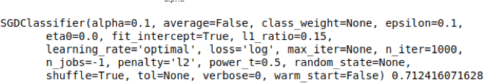
Logistic regression - Hyperparameter
C = 1/λ, where λ is the regularisation parameter
Smaller values of C specify stronger regularisation

Slide 60

Random Forest – Hyper parameter
n_estimators : - number of trees you want to build
min_sample_leaf - No. of end nodes in a tree
Max_depth - how deep you want to make your trees.
Max_feature - maximum number of features Random Forest is allowed to try in individual tree
Bootstrap - bootstrap method can be used to estimate a quantity of a population – statistical sampling
Criteria – Gini – minimize misclassification , Entropy – exploratory analysis

Slide 61
Backup

Slide 62
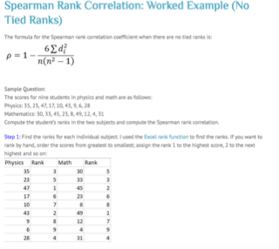
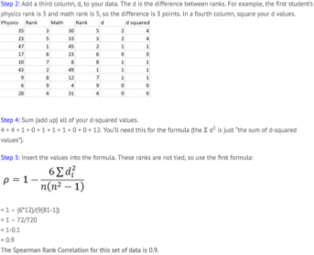

Slide 63
ROC ANALYSIS - Backup
The ROC “Curve”: “Continuity”.
Given two classifiers:
We can construct any “intermediate” classifier just randomly weighting both classifiers (giving more or less weight to one or the other).
This creates a “continuum” of classifiers between any two classifiers.
1
TPR
RO C diagram
0
0
FPR
1

Slide 64
ROC ANALYSIS - Backup
The ROC “Curve”: Construction
o Given several classifiers:
RO C diagram
We construct the convex hull of their points (FPR,TPR) as well as
the two trivial classifiers (0,0) and (1,1).
The classifiers below the ROC curve are discarded.
The best classifier (from those remaining) will be selected in
application time…
1
TPR
The diagonal shows the worst
situation possible.
0
0 FPR 1
We can discard those which are below because
there is no context (combination of class distribution
/ cost matrix) for which they could be optimal.
TIP

Slide 65
ROC ANALYSIS - Backup
Crisp and Soft Classifiers:
A “hard” or “crisp” classifier predicts a class between a set of possible classes.
Caveat: crisp classifiers are not versatile to changing contexts.
Soft or scoring classifiers can be
reframed to each context.
TIP
A “soft” or “scoring” (probabilistic) classifier predicts a
class, but accompanies each prediction with an estimation of the reliability (confidence) of each prediction.
Most learning methods can be adapted to generate soft classifiers.
A soft classifier can be converted into a crisp classifier using a threshold.
Example: “if score > 0.7 then class A, otherwise class B”.
With different thresholds, we have different classifiers, giving more or less relevance to each of the classes

Slide 66

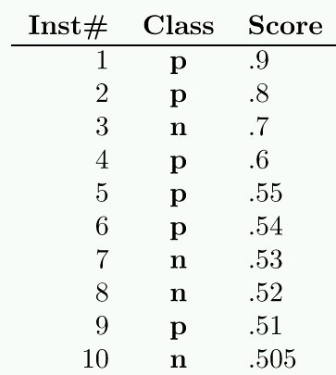
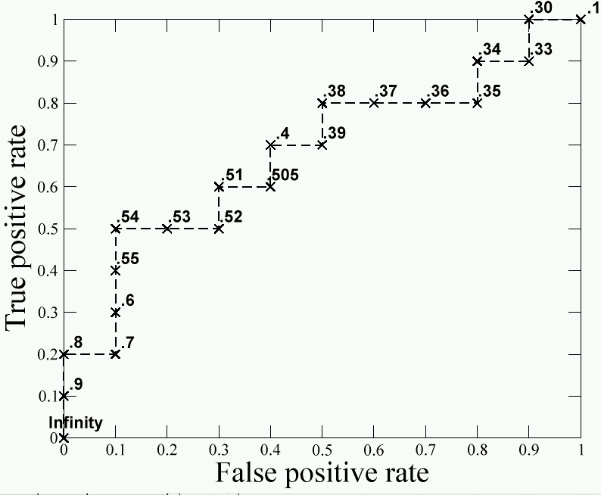
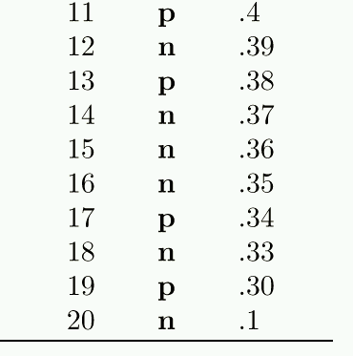
ROC ANALYSIS - Backup
ROC Curve of a Soft Classifier:
o We can consider each threshold as a different classifier and draw them in the ROC space. This generates a curve…
Actual Class
Predicted Class
n p p p
n n p p
n n n p
n n n p
n n n p
n n n p
n n n p
n n n p
n n n p
n n n ... p
n n n p
n n n p
n n n p
n n n p
n n n p
n n n p
n n n p
n n n p
n n n p
n n n p
© T om Faw cett
21
We have a “curve” for just one soft classifier

Slide 67
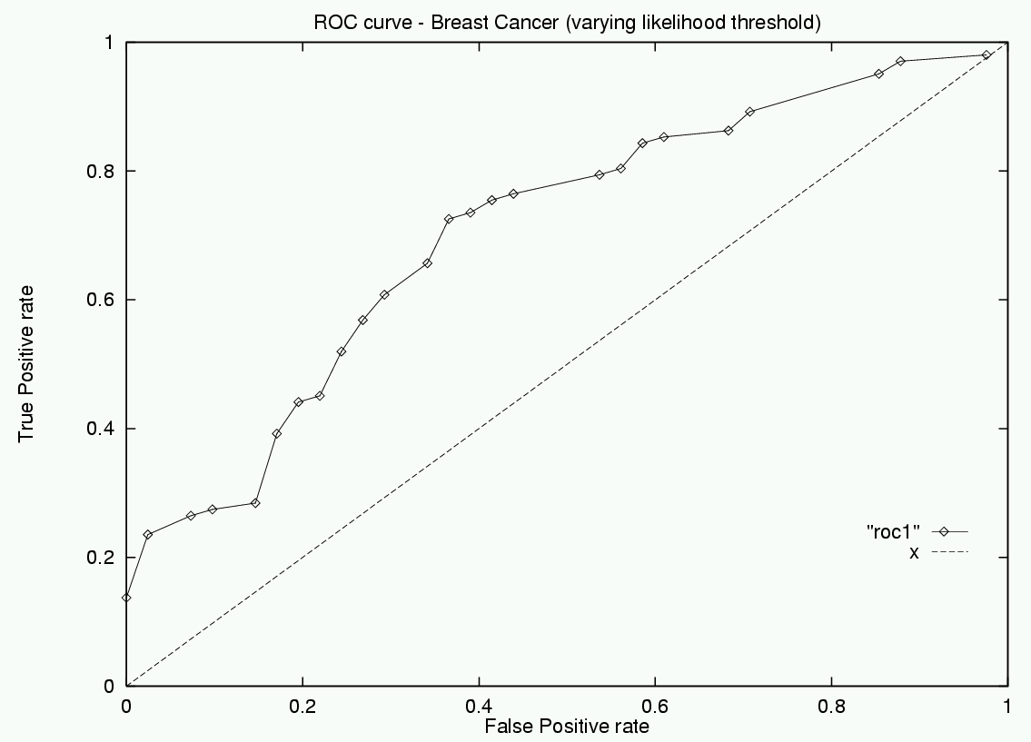
ROC ANALYSIS – Backup
ROC Curve of a soft classifier.

Slide 68
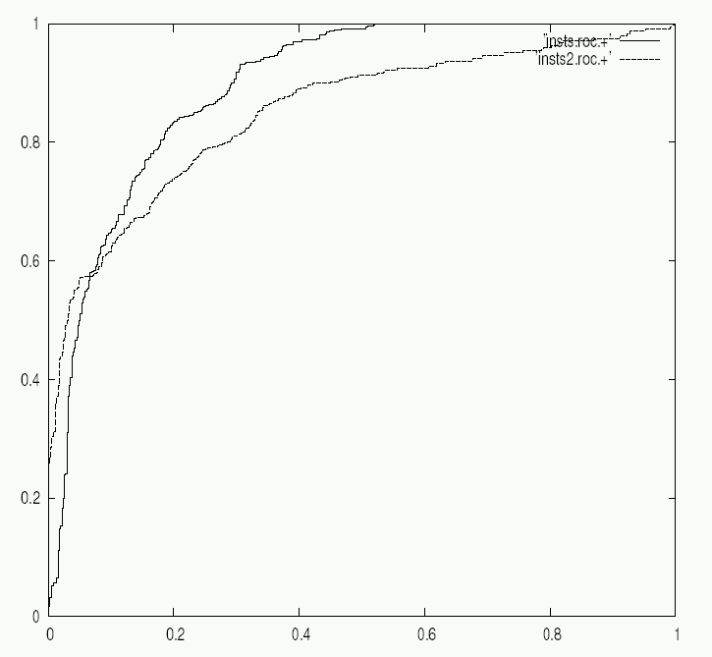
ROC ANALYSIS - Backup
ROC Curve of a soft classifier.
In this zone the best classifier is “insts”
In this zone the best classifier is“insts2”
© Robert Holte
We must preserve the classifiers that have at least one “best zone” (dominance) and then behave in the same way as we did for crisp classifiers.
TIP

