Slide 1

An enterprise artificial intelligence (AI) assistant that helps businesses enhance brand loyalty and transform their customer experiences by delivering proactive and personalized services while ensuring data privacy.
IBM
An AI assistant for:
Watson
Assistant
Your brand:
Increased engagement and loyalty
Your customers:
Guided learning for customized experiences
Your data:
Secure and personalized insights

Slide 2
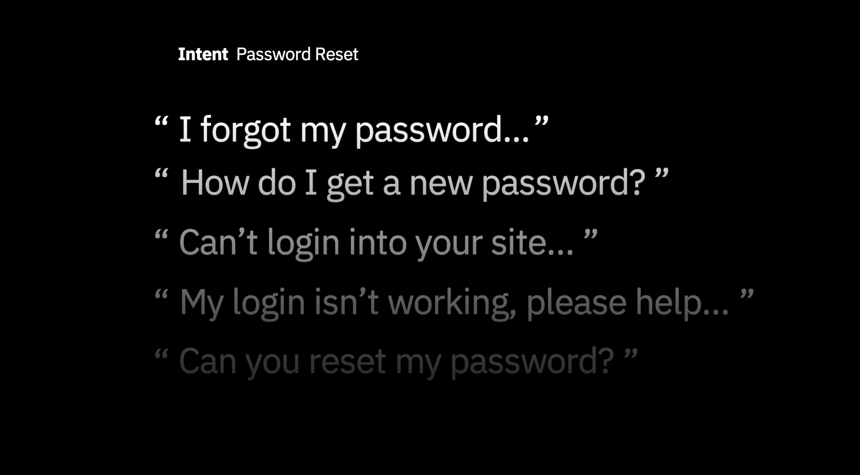

Slide 3

Extract other key information from a question
Intent Password Reset
“
I’m frustrated,
I haven’t been
able to login
into your online
billing system
”

Slide 4

Extract other key information from a question
“
I’m frustrated,
I haven’t been
able to login
Intent
Password Reset
Entities
Online Billing System
into your online
billing system
”

Slide 5

Extract other key information from a question
“
I’m frustrated,
I haven’t been
able to login
Intent
Password Reset
Entities
Online Billing System
into your online
Emotional Tone
Anger
Leverages Watson Tone
Analyzer
billing system
”

Slide 6

Extract other key information from a question
“
I’m frustrated,
I haven’t been
able to login
Intent
Password Reset
Entities
Online Billing System
into your online
Emotional Tone
Context
Anger
Leverages Watson Tone
Analyzer
billing system
”
Bill Smith, 47 / Gold Member
Mobile
Context

Slide 7

Watson
+
Watson
Assistant
Discovery
Watson uses reasoning strategies
that focus on the language and
context of the question to answer
simple questions.
Watson uses reasoning
strategies that focus on identifying
the most appropriate answer for complex questions using the context of the entire corpus.

Slide 8
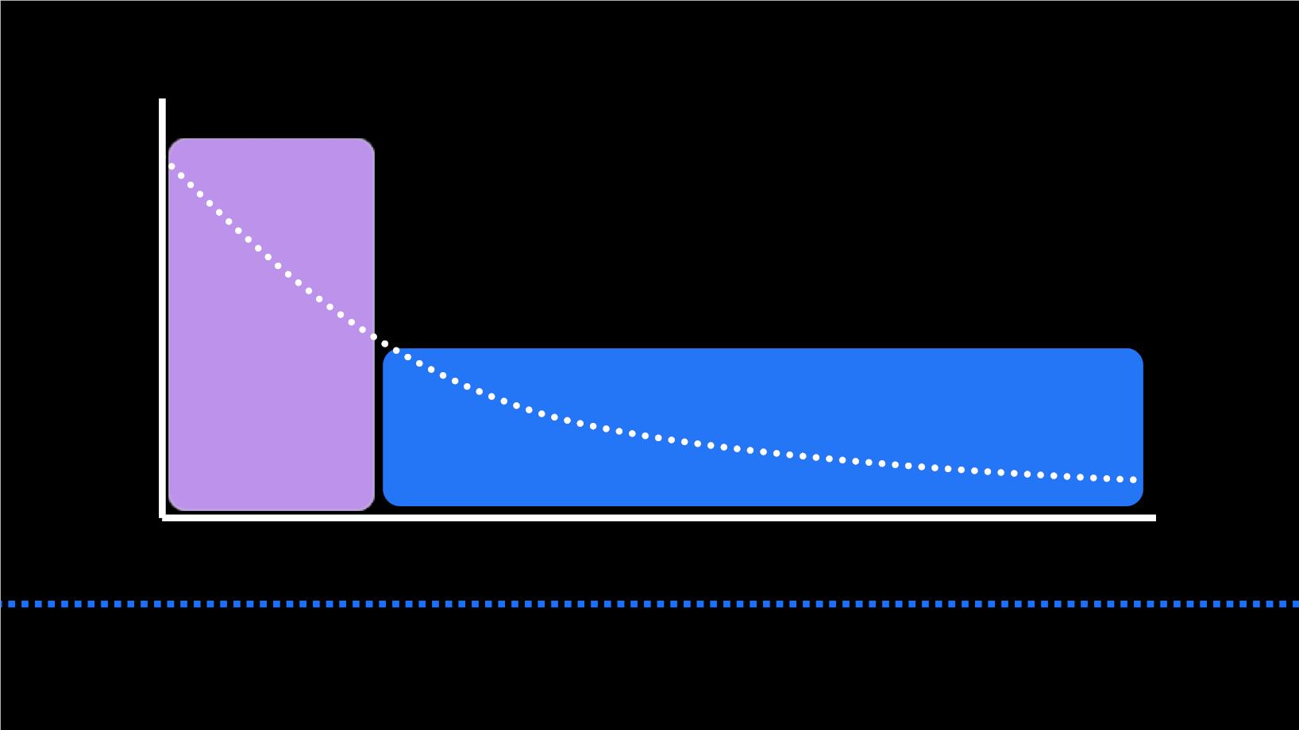
Watson Assistant + Discovery for all types of Qs
Simple Questions
100s
Complex Questions
100,000+
Unique Intents
“ My exhaust is making a rattling sound, how do I troubleshoot the problem? ”
“ How do I turn on the headlights?”
“ How do I turn on my device ”
“ My device won’t power on. I am concerned if I do a reset that I will lose my data. What should I do? ”

Slide 9
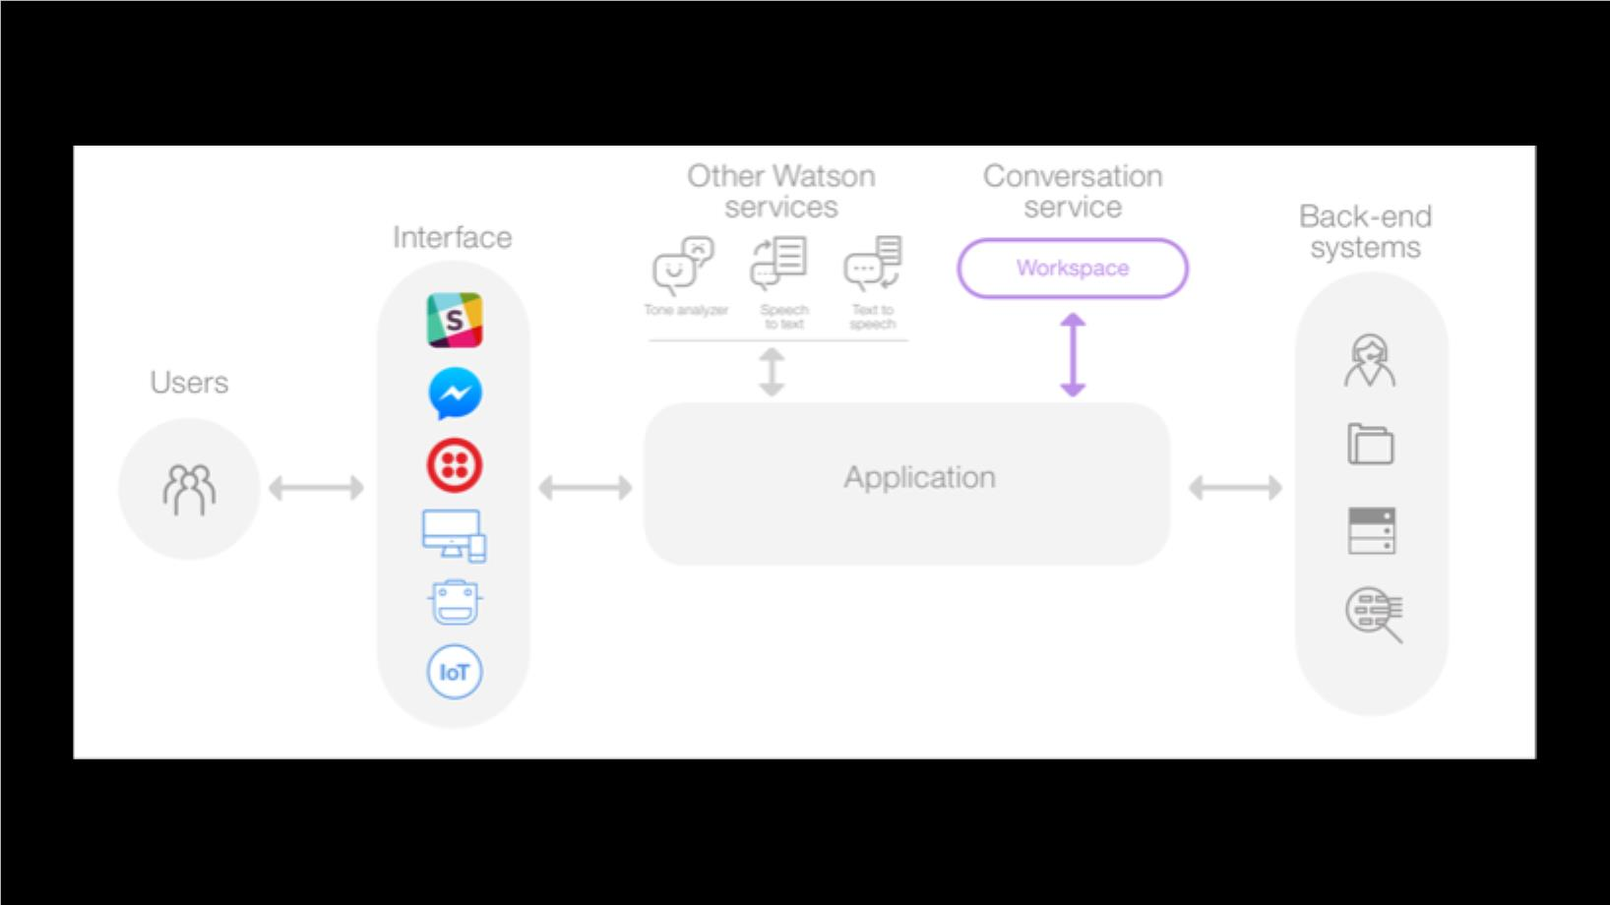

Slide 10

CREATE A SKILL
First step in the Conversation tool is to create a skill.
The natural-language processing for the Conversation service happens inside a skill, which is a container for all of the artifacts that define the conversation flow for an application.
A single instance can contain multiple skills.
A skill contains the following types of artifacts: Intents, Entities, Dialog
As you add information, the skill trains itself, so you don't have to do anything to initiate the training.

Slide 11
INTENT
■
■
An intent represents the purpose of a user's input.
By recognizing the intent expressed in a customer's input, the Watson Assistant service can choose the correct dialog flow for responding to it.
■
■
In the user interface, the name of an intent is always prefixed with the # character.
To plan the intents for your application, you need to consider what your customers might want to do, and what you want your application to be able to handle.
■
To train the skill to recognize your intents, you supply lots of examples of user input and indicate which intents they map to.

Slide 12
ENTITIES
An entity represents a class of object or a data type that is relevant to a user's purpose.
For example, an entity might represent a city where the user wants to find a business
location, or the amount of a bill payment.
By recognizing the entities that are mentioned in the user's input, the Watson Assistant
service can choose the specific actions to take to fulfill an intent.

Slide 13
If intents represent verbs (something a user wants to do), entities represent nouns (such as the object of, or the context for, an action).
In the user interface, the name of an entity is always prefixed with the @ character.
To train the skills to recognize your entities, you list the possible values for each entity and synonyms/patterns(regex) that users might enter.

Slide 14
DIALOG
A dialog is a branching conversation flow that defines how your application responds when it recognizes the defined intents and entities.
You use the dialog builder to create conversations with users, providing responses based on the intents and entities that you recognize in their input.
The application can pass information to the dialog, and the dialog can update the context information and pass it back to the application.
Valid expressions in conditions are written in the Spring Expression (SpEL) language.
Your dialog is represented graphically as a tree; create a branch to process each intent that you define.

Slide 15
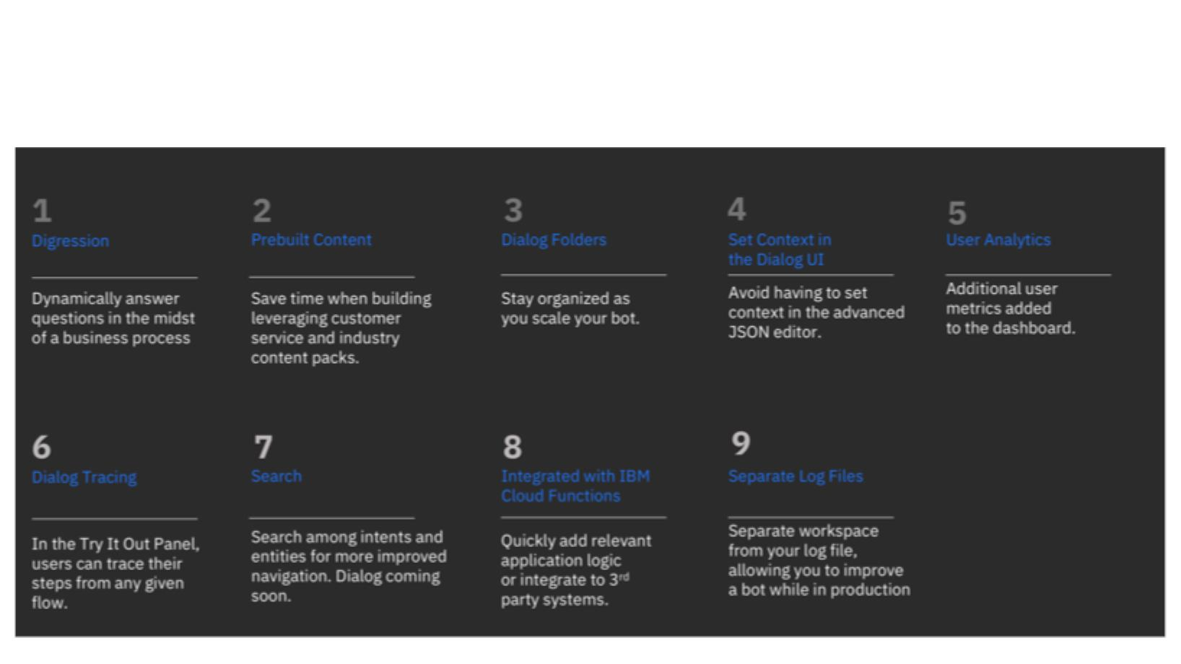
Watson Assistant Features
15

Slide 16
Watson Assistant
Premium Features
Recommendations based on analysis of conversations
⎯ How users interacted based on analysis on conversations
⎯ The certainty that the system had about its response
⎯ Training data currently used by your system
Improve your
workspace with
Recommendations
Recommendations
are presented to
easily and efficiently
improve your system.
Improve Existing Intents
This recommendation involves taking individual phrases entered by users, that the system does not recognize, and then presenting them to you to select an intent for each phrase. This will help your workspace better understand what your users are saying.
One Premium deployment can have up to 30 instances, each with 20 workspaces.
The Premium Plan uses network containers and VMs (virtual machines) to provide isolation for cognitive service instances, and runtime storage isolation.

Slide 17

Make programmatic calls from Dialog Node to third party API’s
https://github.com/watson-developer-cloud/assistant-with-
discovery-openwhisk
17

Slide 18

Workshop:
https://developer.ibm.com/patterns/create-cognitive-banking-chatbot/
https://ibm.co/2NRqDoK
18

Slide 19
Adding a Promocode:
https://cognitiveclass.ai/applying-ibm-cloud-promo-code/
https://bit.ly/2TOeEv6
18

Slide 20
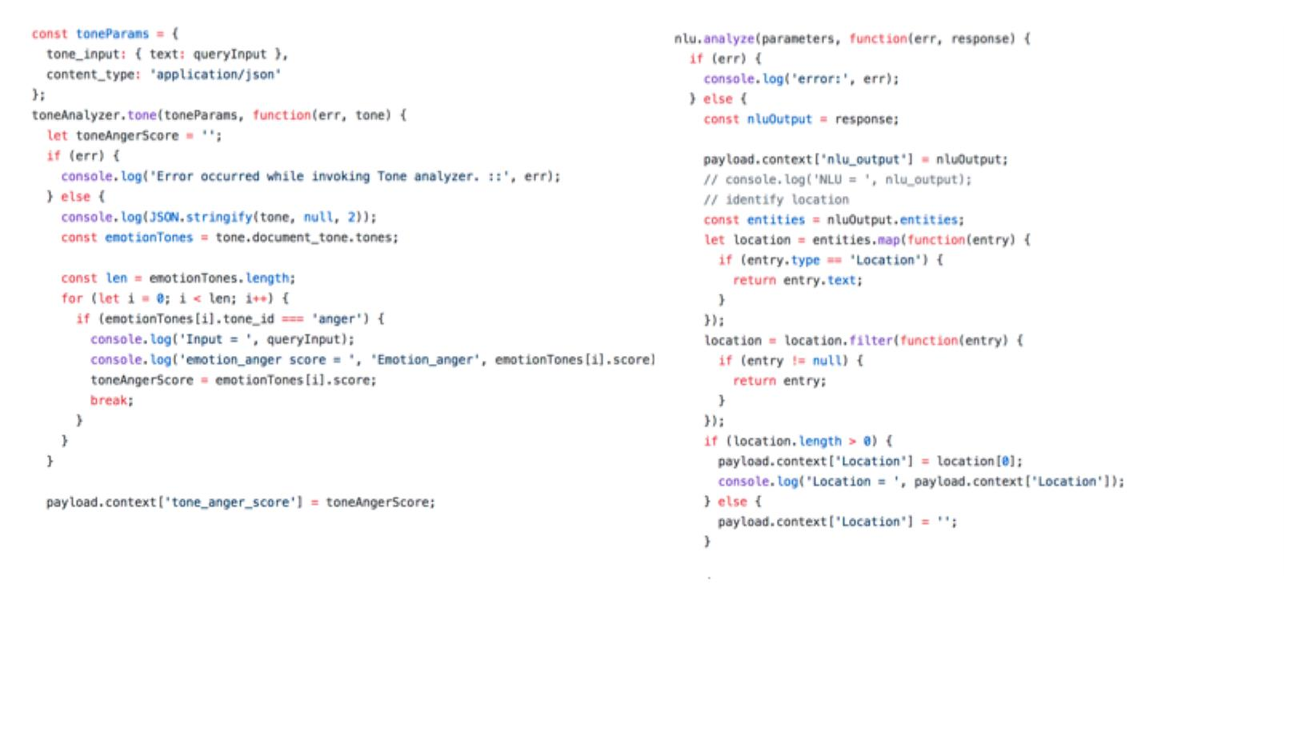
Tone Analyzer implementation
Invoking NLU service to extract entities
from utterance

Slide 21
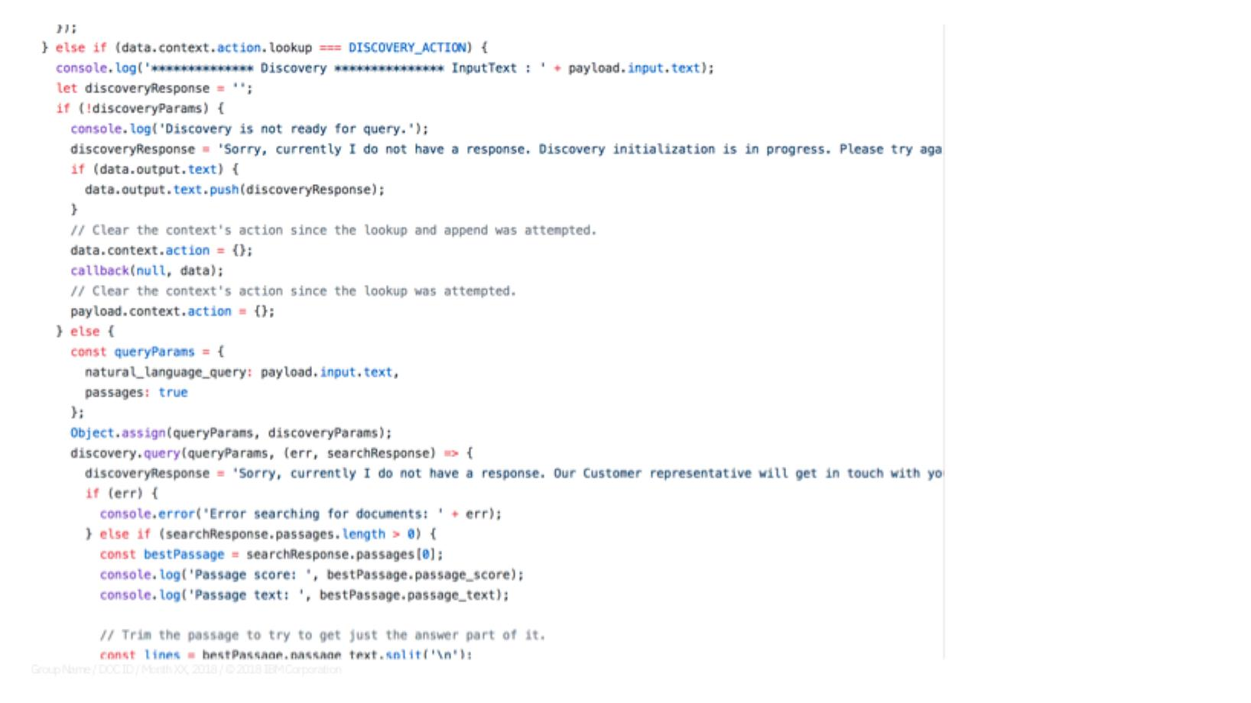
Invoking Discovery Service
20

Slide 22
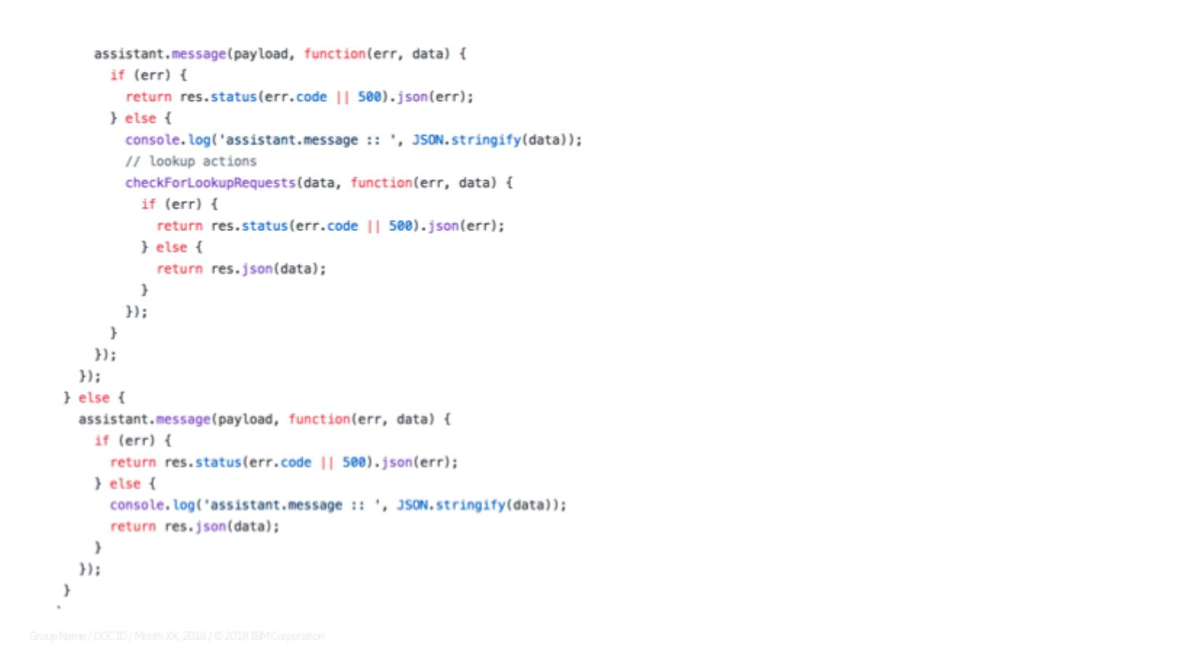
Calling Watson Assistant service
21

Slide 23
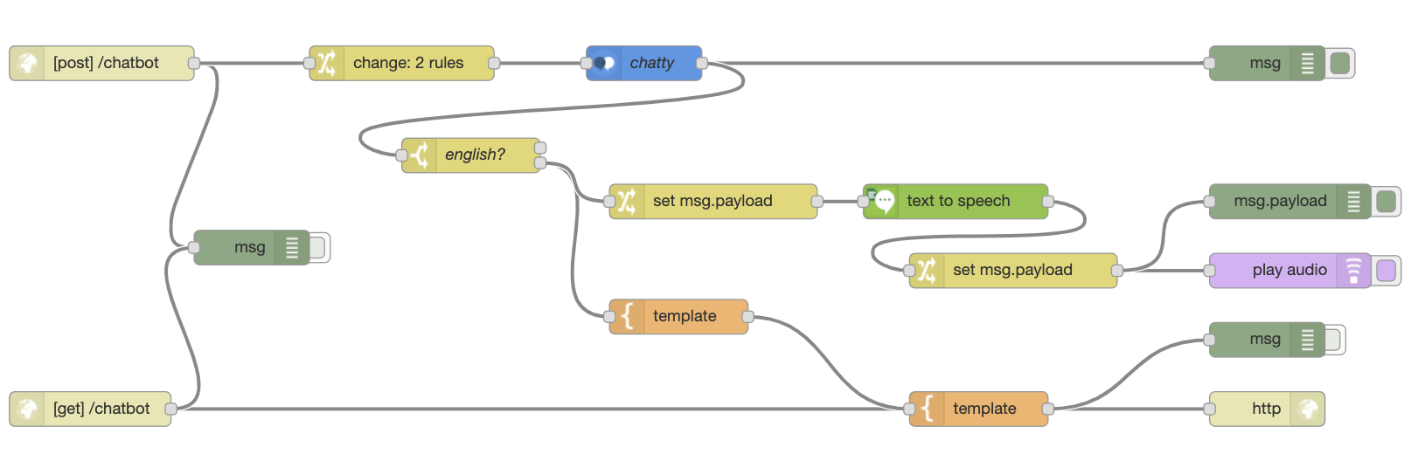
Calling Watson Assistant service
21

Slide 24
THANK YOU!
22

