Slide 1
Runtimes Meetup
Java futurity
A new era in technology, a new era in business.

Slide 2
Everyone can engage in the future of Java development.
Why, and How ?
Every development team has both common and unique problems to solve.
The source code and development process for OpenJDK is mostly open.
Specifications for Java are defined at the JCP.

Slide 3
Java will evolve faster
predictable consistent cadence
easier migration
increased perception of innovation

Slide 4
Java innovation is a journey
lambda
streams
modules
reactive streams
panama
valhalla
penrose
sumatra

Slide 5
Where code goes, where data flows, cognition will follow.

Slide 6




Consider:
Cognitive systems can understand the world through sensing and interaction, reason using hypotheses and arguments and learn from experts and through data. Watson is the most advanced such system.
Among C-Suite executives familiar with cognitive computing:
96%
in insurance intend to invest in cognitive capabilities.
Today, businesses in
78%
of business and IT executives believe that successful business will manage employees alongside intelligent machines.
36
countries across.
in healthcare believe it will play a disruptive role in the industry, and 60% believe they lack the skilled professionals and technical experience to achieve it.
17
84%
industries are applying cognitive technologies.
There are
On average there are
94%
350+
1.3B
in retail intend to invest in cognitive capabilities.
Watson ecosystem partner companies, with
Watson API calls a month and growing.
100
in telecommunications believe it will have a critical impact on the future of their business.
89%
of those have taken their product to market.

Slide 7
We can now confer on every digitized object, product, process and service a kind of thinking ability.
How, and why now?
Data is transforming industries and professions.
The world is being reinvented in code.
Computing is entering a new Cognitive Era.

Slide 8

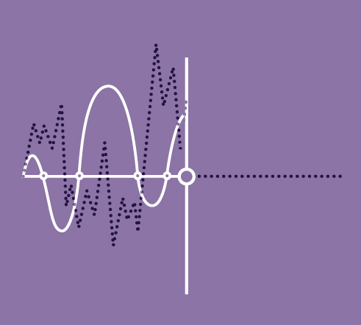
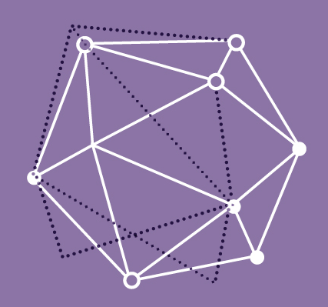


Imagine the possibilities…
Tailoring responses to the personalities of your customers without meeting a single one of them.
Knowing the latest, most significant developments in your profession or industry the moment they take place
Products and services that improve themselves over time, learning from and adapting to the world around them.
Processes that identify their own inefficiencies-and address them automatically-in real time.
Uncovering patterns, resources, trends and other competitive advantages invisible to competitors and their information systems.

Slide 9
Problem:
solving a word search puzzle
a | e | k | j | c | b | a | o | a | j
l | g | m | e | e | t | u | p | a | p
l | n | a | v | a | a | j | v | i | o
p | c | me | i | e | t | u | p | a | a
r | d | a | t | a | j | a | j | k | l
u | t | w | i | q | a | y | a | m | h
d | u | e | n | x | v | d | v | g | a
j | o | d | g | t | f | f | a | u | i
a | a | s | o | g | a | g | t | v | c
z | i | a | c | h | j | a | i | b | m
meetup
java
ibm
cognitive

Slide 10
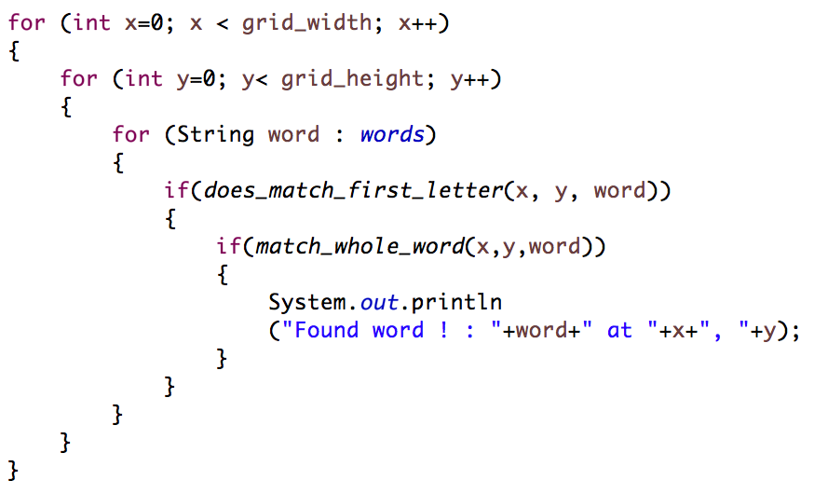
Classically:
a | e | k | j | c | b | a | o | a | j
l | g | m | e | e | t | u | p | a | p
l | n | a | v | a | a | j | v | i | o
p | c | me | i | e | t | u | p | a | a
r | d | a | t | a | j | a | j | k | l
u | t | w | i | q | a | y | a | m | h
d | u | e | n | x | v | d | f | g | a
j | o | d | g | t | f | f | a | u | i
a | a | s | o | g | a | g | t | v | c
z | i | a | c | h | j | a | i | b | m
meetup
java
ibm
cognitive

Slide 11



Partitioning:
Executor node
a | e | k | j | c | b | a | o | a | j
l | g | m | e | e | t | u | p | a | p
l | n | a | v | a | a | j | v | i | o
p | c | me | i | e | t | u | p | a | a
r | d | a | t | a | j | a | j | k | l
u | t | w | i | q | a | y | a | m | h
d | u | e | n | x | v | d | f | g | a
j | o | d | g | t | f | f | a | u | i
a | a | s | o | g | a | g | t | v | c
z | i | a | c | h | j | a | i | b | m
Executor node
Executor
node
meetup
java
ibm
cognitive
Executor
node

Slide 12
Partitioning:
Executor node
CPU
a | e | k | j | c | b | a | o | a | j
l | g | m | e | e | t | u | p | a | p
l | n | a | v | a | a | j | v | i | o
p | c | me | i | e | t | u | p | a | a
r | d | a | t | a | j | a | j | k | l
u | t | w | i | q | a | y | a | m | h
d | u | e | n | x | v | d | f | g | a
j | o | d | g | t | f | f | a | u | i
a | a | s | o | g | a | g | t | v | c
z | i | a | c | h | j | a | i | b | m
Executor node
GPU
Executor
node
FPGA
meetup
java
ibm
cognitive
Executor
node
ASIC

Slide 13
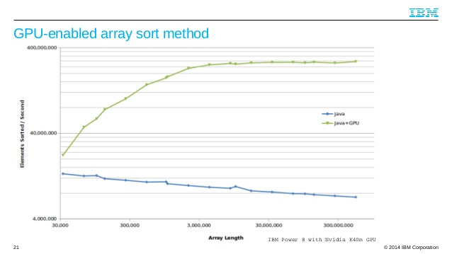
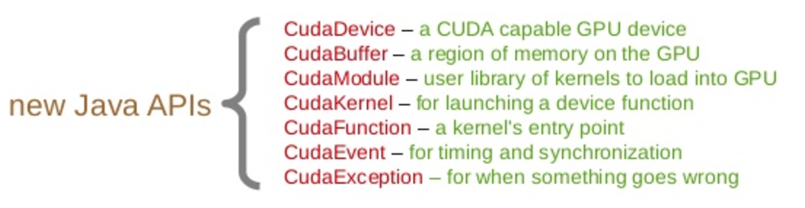


IBM + NVIDIA
Improving Java application performance with GPU exploitation is available in IBM Java 8 today.
standard SE API optimisation as well as CUDA4J for explicit low level control
+

Slide 14
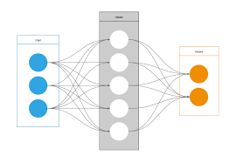




NeURAL:
a | e | k | j | c | b | a | o | a | j
l | g | m | e | e | t | u | p | a | p
l | n | a | v | a | a | j | v | i | o
p | c | me | i | e | t | u | p | a | a
r | d | a | t | a | j | a | j | k | l
u | t | w | i | q | a | y | a | m | h
d | u | e | n | x | v | d | f | g | a
j | o | d | g | t | f | f | a | u | i
a | a | s | o | g | a | g | t | v | c
z | i | a | c | h | j | a | i | b | m
meetup
java
ibm
cognitive

Slide 15
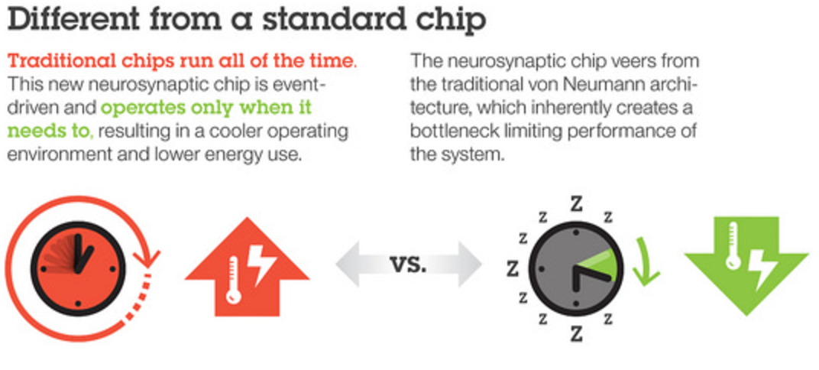
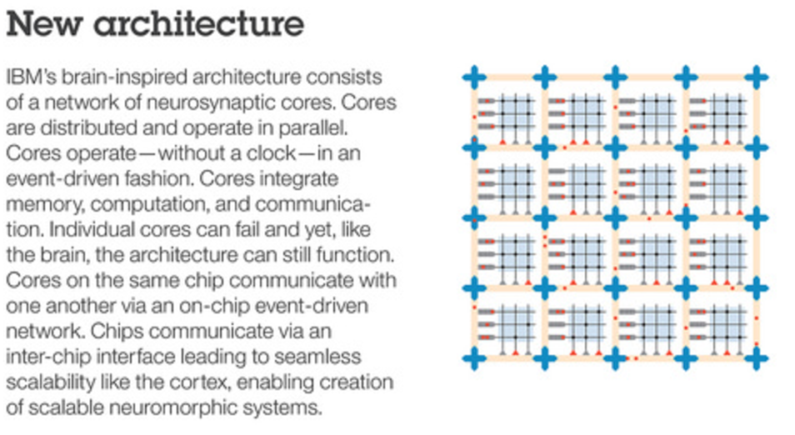
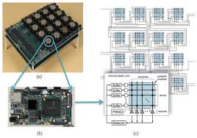
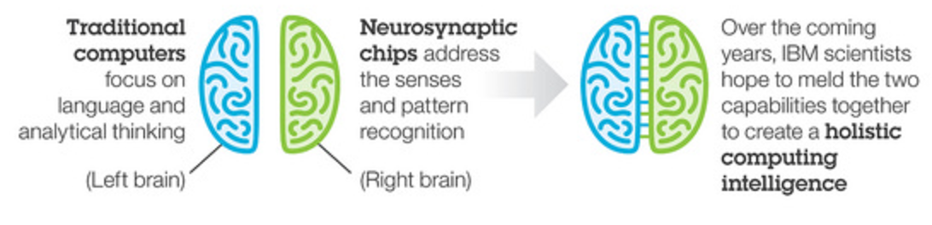
Synapse:
A program to develop a neuromorphic processor that is a new kind of cognitive computer.
Designed to simulate the neurones and dendrites of the brain for low power efficient operation

Slide 16
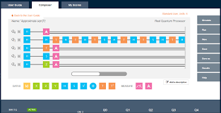
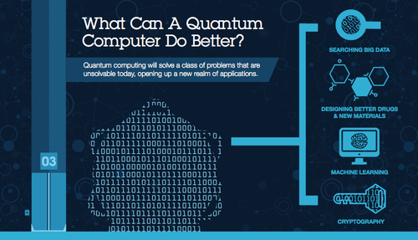
Quantum:
Grovers Search algorithm could be used if the source data were to structured to allow the highest probable locations of the words by fastest possible search algorithm O(√N)
a | e | k | j | c | b | a | o | a | j
l | g | m | e | e | t | u | p | a | p
l | n | a | v | a | a | j | v | i | o
p | c | me | i | e | t | u | p | a | a
r | d | a | t | a | j | a | j | k | l
u | t | w | i | q | a | y | a | m | h
d | u | e | n | x | v | d | v | g | a
j | o | d | g | t | f | f | a | u | i
a | a | s | o | g | a | g | t | v | c
z | i | a | c | h | j | a | i | b | m
meetup
java
ibm
cognitive

Slide 17
How do you think?
Executor node
a | e | k | j | c | b | a | o | a | j
l | g | m | e | e | t | u | p | a | p
l | n | a | v | a | a | j | v | i | o
p | c | me | i | e | t | u | p | a | a
r | d | a | t | a | j | a | j | k | l
u | t | w | i | q | a | y | a | m | h
d | u | e | n | x | v | d | f | g | a
j | o | d | g | t | f | f | a | u | i
a | a | s | o | g | a | g | t | v | c
z | i | a | c | h | j | a | i | b | m
Executor node
Executor
node
Executor
node
Classic
Big Data
Neural
Quantum

Slide 18
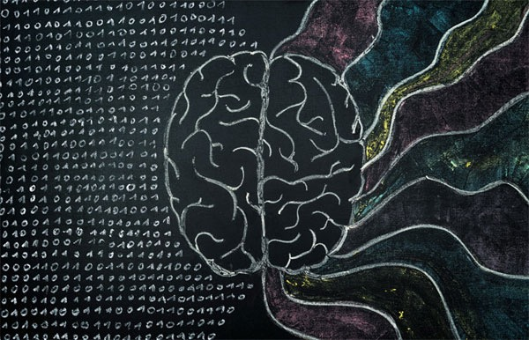
Co-processors:

Slide 19
How, and why now?
The world is being reinvented in code. Java code.

Slide 20

Opportunity:
healthcare data
government & education data
Data flows from every device, replacing guessing and approximations with precise information. Yet 80% of this data is unstructured; therefore, invisible to computers and of limited use to business.
99%
88%
94%
84%
growth by 2017
unstructured
growth by 2017
unstructured
Healthcare data comes from sources such as:
Government & education data comes from sources such as:
Patient Sensors
Electronic Medical Records
Test Results
Vehicle Fleet Sensors
Traffic Sensors
Student Evaluations
By 2020,
utilities data
Media data
1.7 MB
93%
84%
97%
82%
of new information will be created every second for every human being on the planet.
growth by 2017
unstructured
growth by 2017
unstructured
Utilities data comes from sources such as:
Media data comes from sources such as:
Utility Sensors
Employee Sensors
Location Data
Video and Film
Images
Audio

Slide 21
How, and why now?
Computing is entering a new cognitive era.
What do you Think when you solve a problem?

Slide 22


