Slide 1
Java Memory Leaks: Catch Me If You Can
Satish Chandra Gupta

Slide 2
C/C++ Memory Management (Ancient!)
Allocate
OS gives a heap block
Use
Read, Write (and pointer arithmetic!)
Free
Return the block back to OS for reuse
If all pointers to a heap block are lost
No way to free it ➔ memory leak
Pointer to an already freed block
Dangling pointer

Slide 3
Example
int *pi;
void foo() { pi = (int*) malloc(8*sizeof(int));
// oops, memory leak of 4 ints // use pi free(pi); // foo() is done with pi }
void main() { pi = (int*) malloc(4*sizeof(int)); foo(); pi[0] = 10;
// oops, pi is now a dangling pointer }

Slide 4
Java Memory Management
No need to to free, only allocate and use
Garbage Collection
When no reference to a heap block exists, free it
Dangling References: Not possible by design
But Memory Leaks are still possible
If a reference to a memory is retained, but memory never used
GC can’t collect it for reuse
But program doesn’t use it during rest of its life
Keeping references to unused objects unintentionally prevents GC from freeing memory, causes leak

Slide 5
Simple Example
public class MyClass {
static HashSet myContainer = new HashSet();
public void leak(int numObjects) {
for (int i = 0; i < numObjects; ++i) {
String leakingUnit
= new String("leaking object: " + i);
myContainer.add(leakingUnit);
}
}
public static void main(String[] args) {
MyClass myObj = new MyClass();
myObj.leak(10000000);
// Do something with myContainer
// If you don’t clear myContainer, it will hold
// 10000000 Strings for the life of program !!!
}
}

Slide 6
Is it something new to Java?
Nope, same error/leak existed in C/C++
It got lesser attention
Programmers were busy slaying more prevalent monsters: the “typical” memory leaks and dangling pointers
It happened less
Memory was scare resource, not freeing it was a taboo
Programmers were taught to decide corresponding free() calls as soon as they do a malloc()

Slide 7
Java Magnifies it
GC slays old monsters
Gives programmers false sense of freedom
No need to worry about memory / leak
Huge set of Collection classes and 3rd party libraries
May hide away memory allocation somewhere “deep”

Slide 8
Java Memory Leaks
These are Logical Errors
Directly or indirectly allocate heap memory
Retain reference beyond its need
Typical case
Add objects to a container
Never remove them, and it keeps growing
Tools
YourKit
Leakbot: IBM Memory Dump Diagnostics

Slide 9
Java Memory Profiling
Heap Dump Analysis
Take two dumps, and in between perform the operation suspected to cause leak
Heap Dump : memory graph
Objects ➔ references
Path
Heap Root
Owner
Container

Slide 10
Understanding s
Where is the leak?
Identify the data structure which is increasing in size.
Identify the objects/classes holding unintentional references to the leaking data structure.
Why is it leaking?
Identify the method responsible for not releasing the references
Needs program inspection
Concepts
Leak Region
Owner Chain, Leak Root, Container

Slide 11
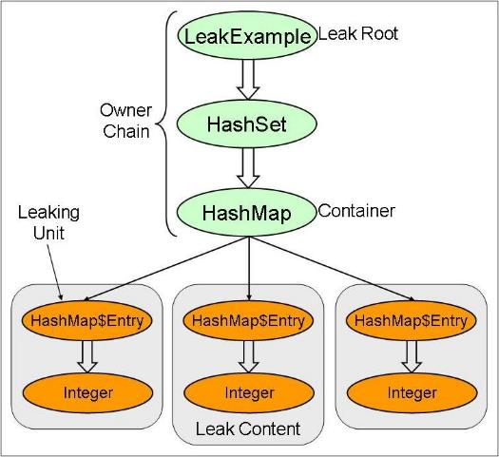
Concepts

Slide 12
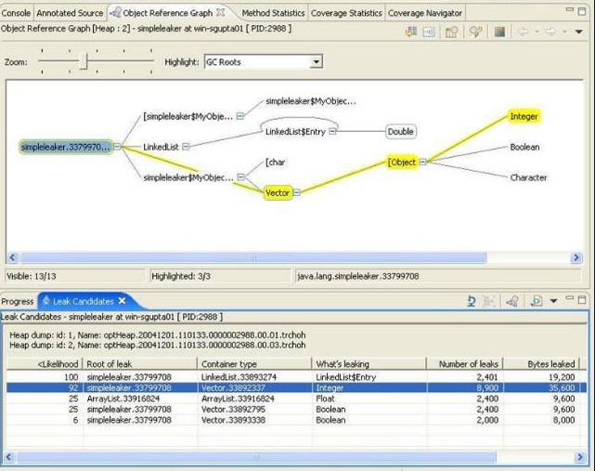
Example

Slide 13
Examining the Path
Object Ownership Path
Memory Size
Object Count
Analyze various classes in path
Logic to add elements to the container
Logic to remove elements to the container

Slide 14
Discussion
Thank You

