Slide 1



EXITE 2016
Code your constellation!
Notes:
Chrissie

Slide 2
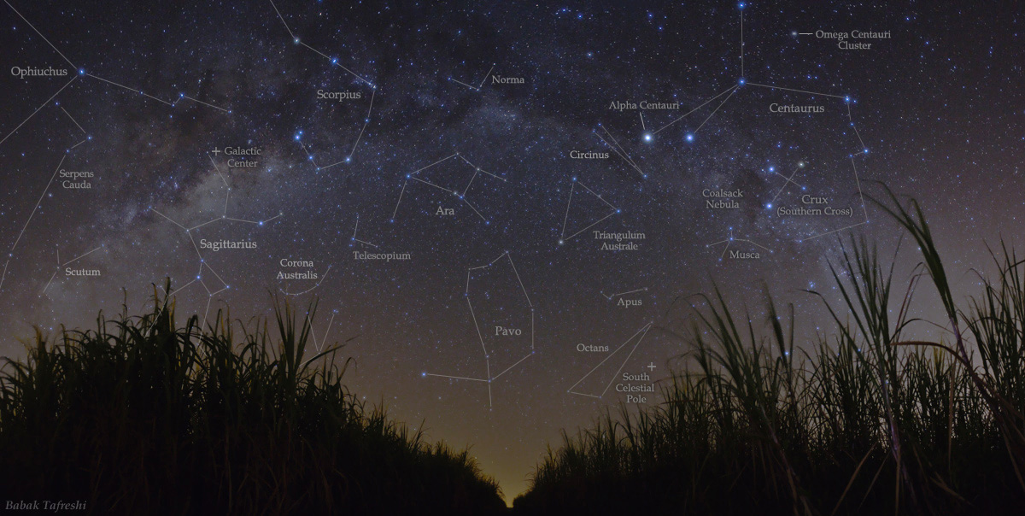

Welcome EXITE campers!
Notes:
Chrissie
Welcome space astronauts!! Your mission today is to document some of the constellations that you’ve travelled by in your rocket ship during your trip to outer space.You’re each going to create your own personal web diary page for this!

Slide 3
Introductions
Your star-guides:
Hailey
Sherry
Bernadette
Ariel
Felise
Chrissie
Notes:
Chrissie

Slide 4
Activity Outline
You’ve each been given a constellation to document. You’ll need to:
Determine the coordinates for each star in the constellation
Get the computer to draw them in the correct position
Add some additional information about the stars or the constellation
Add some information about you, the author
Make your web page look super awesome!
Notes:
Chrissie
Has anyone heard of HTML before? CSS? JavaScript?
Has anyone made a blog or a webpage before?

Slide 5
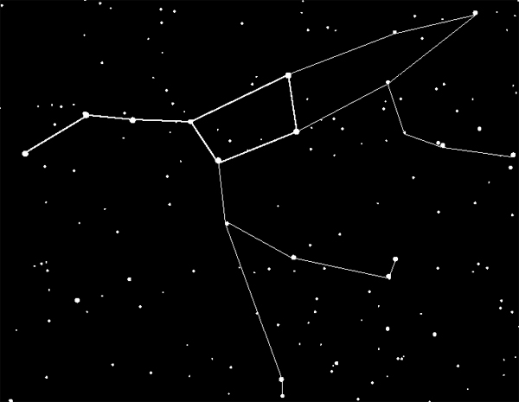
Constellations
A group of visible stars that form a pattern when viewed from Earth
Notes:
Felise

Slide 6
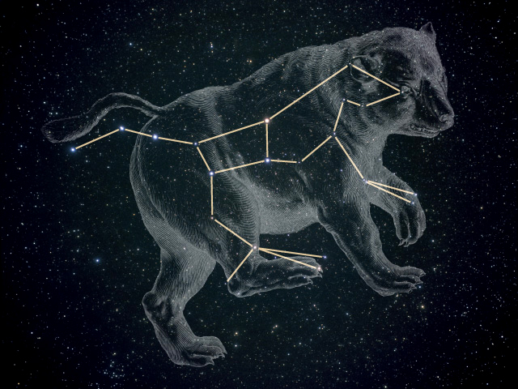
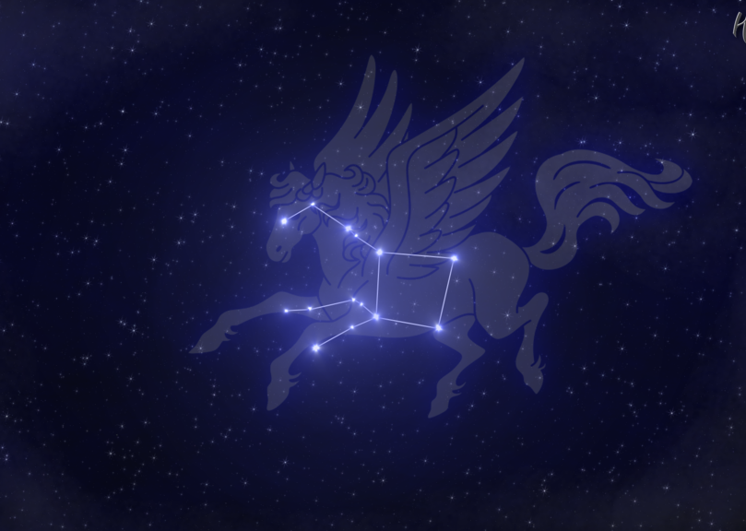
Constellations
Ursa Major - bear
Typically given a name based on what it looks like or mythological figures such as Orion or Pegasus
Pegasus - winged horse
Notes:
Felise

Slide 7
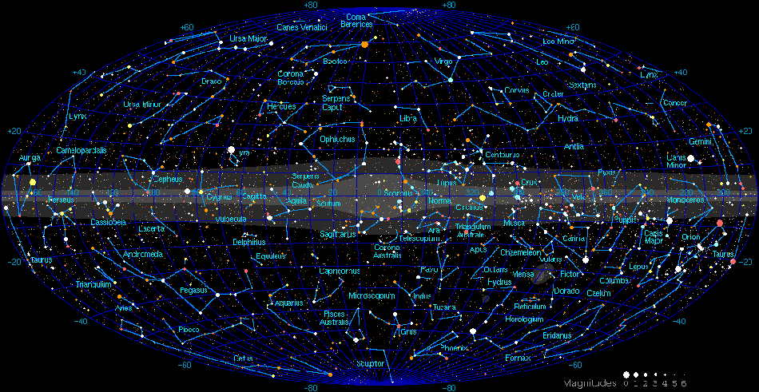
Constellations
Astronomers divide the sky into eighty-eight constellations
Notes:
Felise

Slide 8
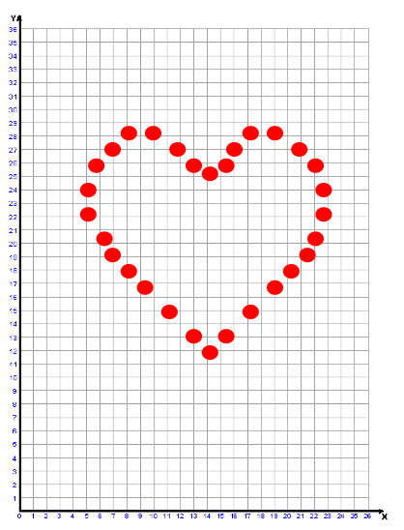
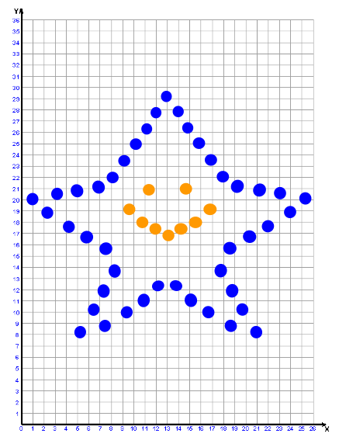
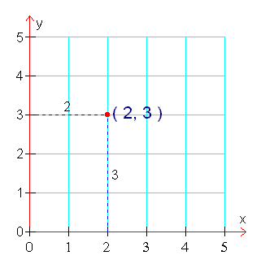
Now, let’s find out the coordinates of the stars in your constellation!
Notes:
Lucy

Slide 9
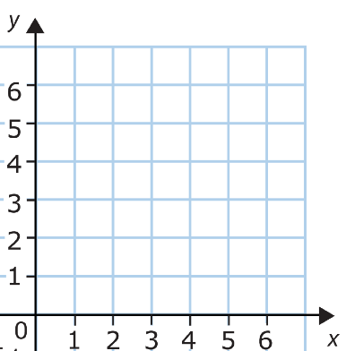
Now, let’s find out the coordinates of the stars in your constellation!
x-y coordinate plane
Imagine the sky as an x-y coordinate plane, with the origin (0,0) positioned at the bottom left corner.
Origin
Notes:
Lucy

Slide 10
Now, let’s find out the coordinates of the stars in your constellation!
y-axis
x-axis
Notes:
Lucy

Slide 11
Now, let’s find out the coordinates of the stars in your constellation!
1 Unit
(3, 4)
coordinate plane
Notes:
Lucy

Slide 12
Now, it’s your turn. Find the coordinates of all the stars in your constellation!
(x, y)
(x, y)
(x, y)
coordinate plane
Notes:
Lucy

Slide 13
BREAK =)

Slide 14
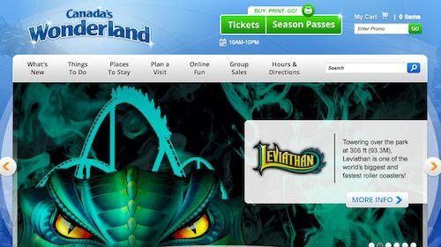
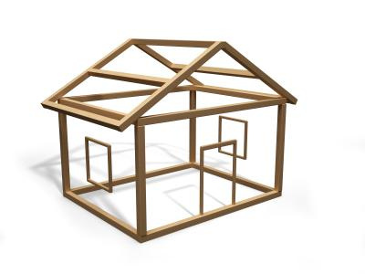
Three Elements of a Web Page
2. JavaScript
“The moving parts”
Interactivity and Functionality
We’ll be adding your coordinates here!
A web page is
like a house
1. HTML “The house frame”
Webpage structure
3. CSS “The look”
Look and feel
A web page!
Notes:
Felise
Go to Canada’s Wonderland site and show source code. It looks intimidating and complicated, but it’s not really!
HTML is the bone structure of the webpage.

Slide 15
What is HTML?
“The house frame”
HyperText Markup Language
This language is based on English keywords called tags that tell a web browser how to display content on a web page.
Notes:
Chrissie

Slide 16
Examples of HTML Tags
<p>
<body>
<title>
<a>
<h1>
<head>
<br>
<span>
<link>
<h3>
<img>
<li>
Notes:
Chrissie

Slide 17
HTML tags
Tags always have angle brackets < > on both ends, with a keyword in the middle:
<p>
<title>
Tags typically come in pairs -- an opening tag and a closing tag with a forward slash:
<p> </p>
<title> </title>
Tags can also be nested inside of another pair of tags, like this:
<p><span></span></p>
“p” stands for paragraph
Notes:
Chrissie

Slide 18

HTML Tags
How do they work?
Like a juicy hamburger, HTML needs and opening and closing tag to hold it together
<p>
Juicy content in between
</p>
Notes:
Chrissie
For example, we tell the browser we want a paragraph using a tag called a paragraph tag, which looks like this: <p>
Because the browser isn’t very smart, it doesn’t know where your paragraph starts and stops. So we need to put the content of the paragraph in between two paragraph tags. The paragraph tag at the end of the paragraph has a forward slash after the first angle bracket to let the browser know that it’s an ending tag.

Slide 19
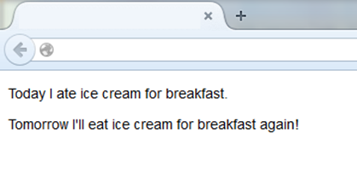
HTML tags
Start tag #1
End tag #1
<p>Today I ate ice cream for breakfast.</p>
<p>Tomorrow I’ll eat ice cream for breakfast again!</p>
End tag #2
Start tag #2
<p>Today I ate ice cream for breakfast. </p>
<p>Tomorrow I’ll eat ice cream for breakfast again! </p>
Today I ate ice cream for breakfast.
Tomorrow I’ll eat ice cream for breakfast again!
Notes:
Chrissie

Slide 20
Some useful HTML tags
<link rel="stylesheet" href="main.css">: Creates a link to additional files, such as your CSS file
<script src="myScript.js"></script>: Adds JavaScript to your web page as a separate JavaScript file.
<h1> … <h6>: Creates headings in the web page, with heading 1 appearing larger than heading 2, which is larger than heading 3.
<a href=”www.example.com”>An awesome link</a>: Anchor tag, creates a link to another web page.
<img src=”http://placekitten.com/g/200/200”>: Displays a picture in the web page
Notes:
Chrissie

Slide 21
What is CSS?
“The look”
Cascading Style Sheets
gives you control of the styling on a webpage using specific properties
inline in the HTML or separate file
this is what we’ll be doing!
Notes:
Felise

Slide 22
Examples of CSS properties
color
background-color
font-size
font-weight
text-align
border
padding
margin

Slide 23

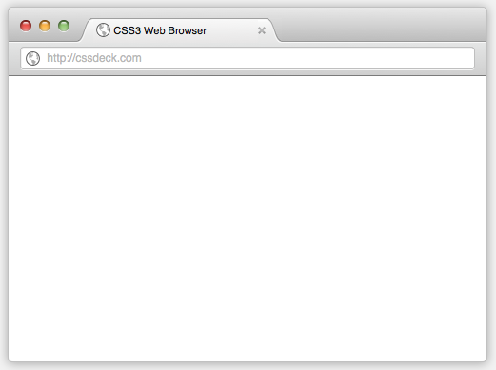

What CSS looks like
In the CSS file:
h1 {
background-color: yellow;
color: purple;
font-weight: bold;
}
www.feliseuy.com
Felise’s Awesome Webpage!
In the HTML file:
<h1>Felise’s Awesome Webpage!</h1>
Notes:
Felise
There’s the element you want to style, followed by curly braces holding the properties you’d like to edit

Slide 24
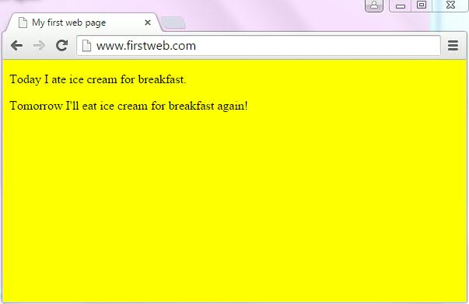
Some Sample CSS Properties
In the CSS file:
body {
background-color: yellow;
}
Notes:
Felise

Slide 25
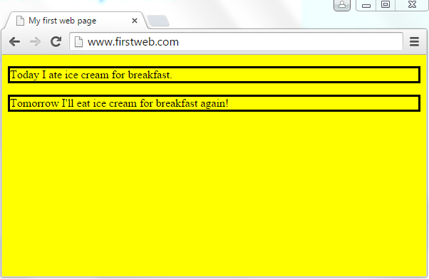
Some Sample CSS Properties
In the CSS file:
p {
border-style: solid;
}
Notes:
Felise

Slide 26
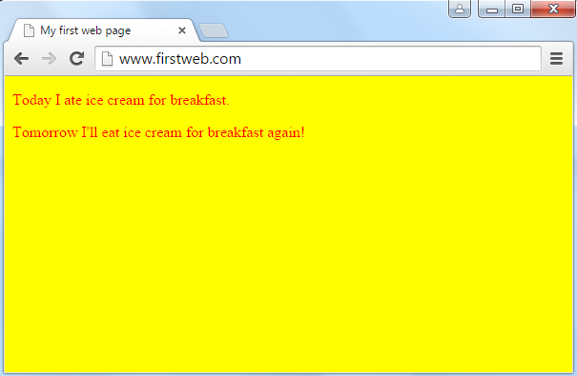
Some Sample CSS Properties
In the CSS file:
p {
color:red;
}
Notes:
Felise

Slide 27
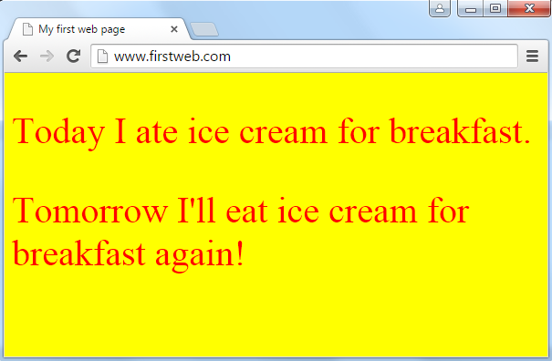
Some Sample CSS Properties
In the CSS file:
p {
color:red;
font-size: 40px;
}
Notes:
Felise

Slide 28

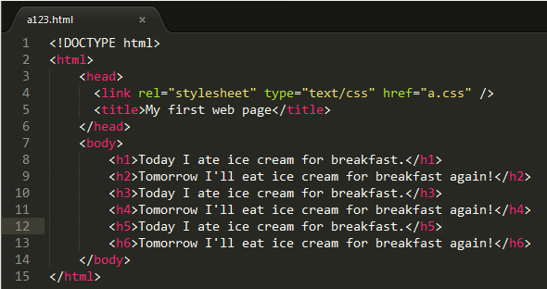

Slide 29
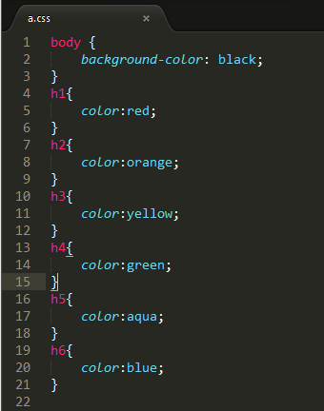

Slide 30
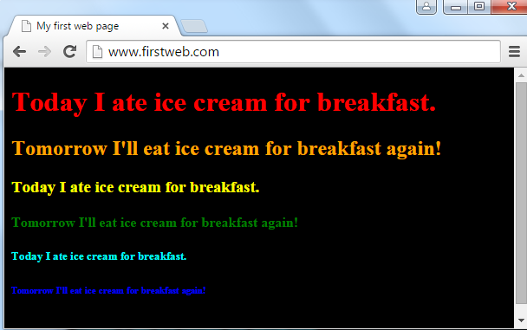

Slide 31

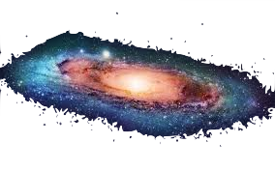
Let’s edit our webpage!
FOLLOW ALONG CAREFULLY
Open index.html in Sublime text editor. Look through the code.
Right click anywhere in the file, and click Open in Browser.
Return to the index.html file in Sublime.
Find the <h1> tag in the <body> section.
Delete the text “Your constellation name goes here!”.
Add the name of your constellation between the <h1> and </h1> tags.
Save the file.
Right click anywhere in the file and click “Open in browser” to open it in a browser. Ensure your changes are there.
Notes:
Felise
http://www.w3schools.com/cssref/css_colornames.asp

Slide 32
Editing CSS
FOLLOW ALONG CAREFULLY
Open the main.css file in Sublime text editor.
Change the colour of the text in the <h1> tag.
Save the main.css file and refresh your browser to view your changes.
Notes:
Felise

Slide 33
JavaScript - the “moving parts”
the most widely used programming language
a way to add programs to web pages
adds functionality and interaction to web pages
any webpage you see today is most likely using JavaScript
Your star coordinates will be put into the JavaScript of your web page!
Notes:
Felise
like how you programmed your LEGO robots, the robots language
we’re going to be using it to map your star coordintates onto your web page.
You store the star coordinates in JSON, which is way that Javascript stores data

Slide 34
How do you store information about a star?
Saved in key/value pairs in the JavaScript (Brain!)
"x_coordinate" : 2
Key
Value
Notes:
Lucy
like how you programmed your LEGO robots, the robots language
we’re going to be using it to map your star coordintates onto your web page.

Slide 35
How do you store information about a star?
Use commas to separate different pairs of data
"x_coordinate" : 2,
"y_coordinate" : 4,
"color":"yellow",
"number_of_spikes":5
Notes:
Lucy

Slide 36
How do you store information about a star?
Use curly brackets {} to hold info for one star
{"x_coordinate" : 2,
"y_coordinate" : 4,
"color":"yellow",
"number_of_spikes":5}
Notes:
Lucy

Slide 37
How do you store information about two stars?
Use square brackets [] to hold information for all of the stars in the constellation
[{"x_coordinate" : 2,
"y_coordinate" : 4,
"color":"yellow",
"number_of_spikes":5},
{"x_coordinate" : 6,
"y_coordinate" : 10,
"color":"yellow",
"number_of_spikes":6}]
Notes:
Lucy

Slide 38
How do you store information about a star?
Stars :
[{"x_coordinate" : 2,
"y_coordinate" : 4,
"color":"yellow",
"number_of_spikes":5},
{"x_coordinate" : 6,
"y_coordinate" : 10,
"color":"yellow",
"number_of_spikes":6}]
Value
Key
Notes:
Lucy

Slide 39
Let’s add our stars!
FOLLOW ALONG CAREFULLY
Navigate into folder called “json-generator”.
Double click on json-generator.html to open in Browser.
Choose the constellation Name and enter the (x,y) coordinates for your first star, the colour, and the number of spikes.
Click on “Add Star”.
Repeat step 3-4 until all stars are added.
Notes:
Lucy
http://www.w3schools.com/cssref/css_colornames.asp

Slide 40
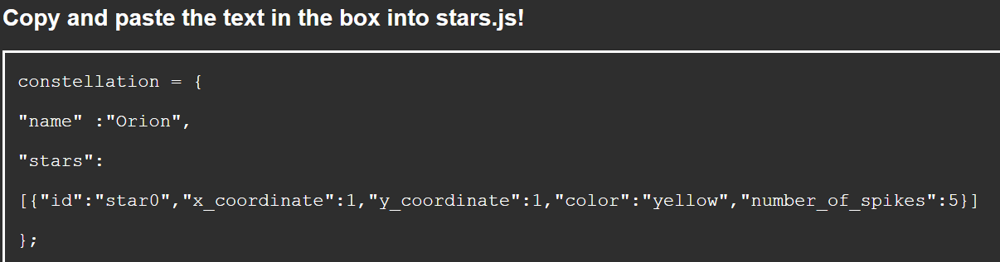
Let’s add our stars!
FOLLOW ALONG CAREFULLY
You should see something like this below:

Slide 41
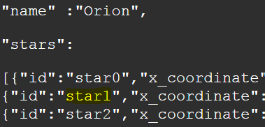
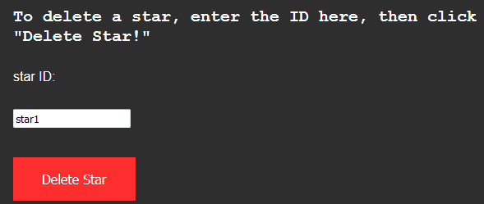
Oops! I made a mistake
FOLLOW ALONG CAREFULLY
If you make a mistake, you can delete the star.
Find the Star ID.
Copy the ID name into top right
box and press “Delete Star.”
Notes:
Lucy
http://www.w3schools.com/cssref/css_colornames.asp

Slide 42
Let’s add the coordinates!
FOLLOW ALONG CAREFULLY
Navigate into the “scripts” folder
Right click on “stars.js” and open in sublime
Remove the old code in stars.js
Copy and paste the text from json-generator into stars.js
Save the file
Open index.html to see your constellation!
Notes:
Lucy
http://www.w3schools.com/cssref/css_colornames.asp

Slide 43
Adding JavaScript code
1. Uncomment the following line in index.html.
- <script src="scripts/your_code.js"></script>
2. Uncomment line 8 in your_code.js and save.
Refresh the browser and open the dev tools using the F12 button.
- sibling <p> should show up after my-description element.
3. Uncomment line 11 and see what happened to the index.html page.
- new text on the page.
4. Uncomment line 14 and see how the text has been changed.
- the text is now pink!
Notes:
ok, now let’s play with javascript code!
what you guys are going to do with me is to add a paragraph under your constellation description paragraph. and do some math with values and make it pretty. :)
first, go to index.html and at the bottom there is a grey text. this grey because it’s commented out which means, it will be ignored when the code is running.
to make it work, uncomment that by removing these square brackets which are wrapping this script tag.
now your website will know about the file. let’s go to the file now.
in line 2,
it looks like an equation, right? we will read this equation from the right side, in our document which refers to the web page, we are creating a paragraph element.
this will be a p tag. and we will assign it to a variable and call this constellationDescription. this is like calling a room a kitchen instead of a place where you cook and eat.
in line 5, we want to find a description box in the html file so that we can add the constellationDescription paragraph element to this box.
from the document (web page), get an element with an id of description-box. every element can have it’s own unique id like your student number. we are using more descriptive id here so that it’s easier to find it and use it. the, we will call this descriptionBox.
NOW, we will check our web page before we make a visible changes!
ok, we only have the constellation description paragrph now.
in your javascript file, uncomment the line #8 by removing the 2 slashed in the beginning of the line.
what it is doing is, to the descriptionBox, we are appending a child, constellationDescription. this will add the constellationDescription paragraph to the descriptionBox. Let’s see what’s changed.
it’s empty!. let’s fill this paragraph out.
here, this equation says, we are doing something with constellationDescription paragraph. so what’s innerHTML?
innerHTML is used to set or refer to the HTML content of an element. by using this we can set text of an element.
What I did here is get a name of my constellation from the json data, and add “has” and add the length of the starts array of our json data to get the number of the stars. and text “starts”. it’s so simple. to just add texts with plus sign, right?
ok, let’s check out web page.
now let’s give this a bit of style.
uncomment line #14, this is to set style of our constellationDescription paragraph. and we want to change the color of it. here I set it to pink. cause I like pink. :)
let’s check out the web page.!
cool~?
constellation = {--"name" :"Pegasus",--"stars":--[{"id":"star0","x_coordinate":5,"y_coordinate":7,"color":"yellow","number_of_spikes":5},{"id":"star1","x_coordinate":5,"y_coordinate":14,"color":"yellow","number_of_spikes":5},{"id":"star2","x_coordinate":10,"y_coordinate":14,"color":"yellow","number_of_spikes":5},{"id":"star3","x_coordinate":10,"y_coordinate":20,"color":"yellow","number_of_spikes":5}]--};
Lock conversation

Slide 44
Additional steps
Add your name, grade and school to the <footer>. Keep the <br> tags! (They add a new line)
Add text to the paragraph <p> tags in your index.html file.
Change the font-size of “.myparagraph” in the main.css file. Save and refresh your web page.
Add a background colour to your footer section in the main.css file:
e.g. background-color: green;
5. Change the border colour of your footer section:
e.g. border-color: orange;
6. Play around with your code and HAVE FUN! :)
Go to http://www.webmonkey.com/2010/02/css-properties/ if you want to see other CSS properties you can add!
http://www.webmonkey.com/2010/02/html_cheatsheet/ - Go here to learn more HTML tags!
Notes:
Here are additional steps that you can try.

Slide 45
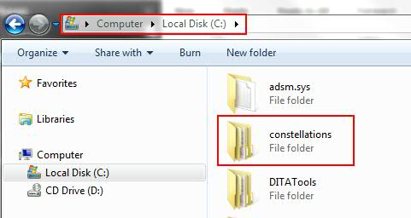
Saving your work
Open Windows Explorer on your laptop by clicking the Start button, and then My Computer.
Double-click the icon for the C: drive, and look for the constellations folder.
Ask your team counsellor or a star-guide to log into the EX.I.T.E camp online drive:
https://ibm.app.box.com/files/0/f/4308351603/constellations
Double-click on the folder with your name on it.
Drag the constellations folder over into the folder with your name on it!
Notes:
Chrissie

Slide 46
Bluemix web hosting
In order for people to access your Constellation web page on the internet, you have to actually upload it to the internet first.
Doing that requires finding something called a hosting provider that lets you upload your website files and gives you a web address so that people can connect to it.
There are many different hosting providers out there, some are free and some are expensive and the one you choose depends on what you need.
One example of a web hosting provider is IBM Bluemix.
Here's a sample Constellations web application on Bluemix.

Slide 47

BE SAFE!!
Before you publish anything on the web, check with a parent or guardian and ensure that you do not post any personal information on the internet.
Notes:
Chrissie

Slide 48
Congratulations campers!
You’ve completed your mission of creating a web diary page for your constellation! Way to go!!
Notes:
Chrissie

