Slide 1
ENGI 301 Automatic Watch Winder Project Proposal
2/19/2024
Ibrahim Muzammil

Slide 2
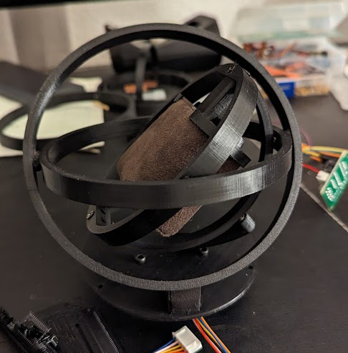
Background Information
I recently got an automatic watch (one that harnesses energy through movement), but I have made the critical error of forgetting to purchase a watch winder, which prevents the watch from dying when not wearing it.
There have been some DIY designs, and I am especially partial to the gyroscopic design pictured on the right. I want to incorporate magnets to quickly place/remove the watch, in addition to coding a stepper motor such that the user has finer control over how the watch is wound in comparison to designs using a DC motor.

Slide 3
Post Meeting Changes
Use a lower power servo motor that comes with a motor driver and can run off 5V from pocket beagle
Add display and interaction from user to control how often the servo motor winds the watch
For example, can add a window during the night where the winder turns off (do not disturb function), or can speed up/slow down rate of winding.

Slide 4
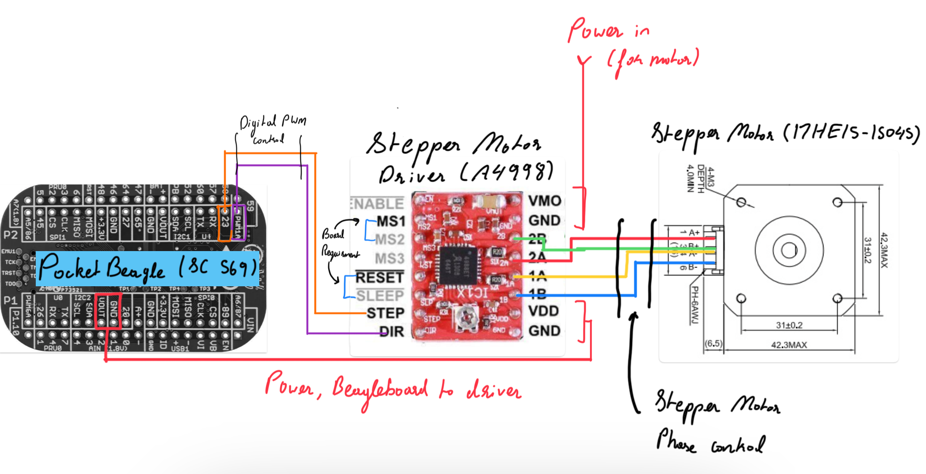
System Block Diagram (To be updated)
Notes:
How does it turn on/off
Emergency stop
How long has it been on
Smaller motor perhaps
Send Dr welsh email for small stepper motor
Run smaller motor straight from pocketbeagle 5v
A display for configuration
Real time clock module
Set time before each use?
Think about user interaction

Slide 5
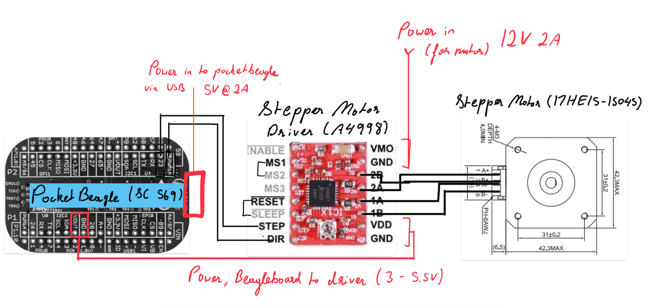
Power Block Diagram (To be updated)

Slide 6
Software Outline
Main User inputs:
Set Time (Optional for ease of use)
Set interval of rotation (Required)
Do Not Disturb Mode (Set Duration)
Main Components
Servo (Relies on Inputs from interval, do not disturb
Real Time Clock implementation (basis of time / interval / do not disturb accuracy)
16 Bit Display (User is given various options which they can select)
Joystick (User can select desired option)

Slide 7
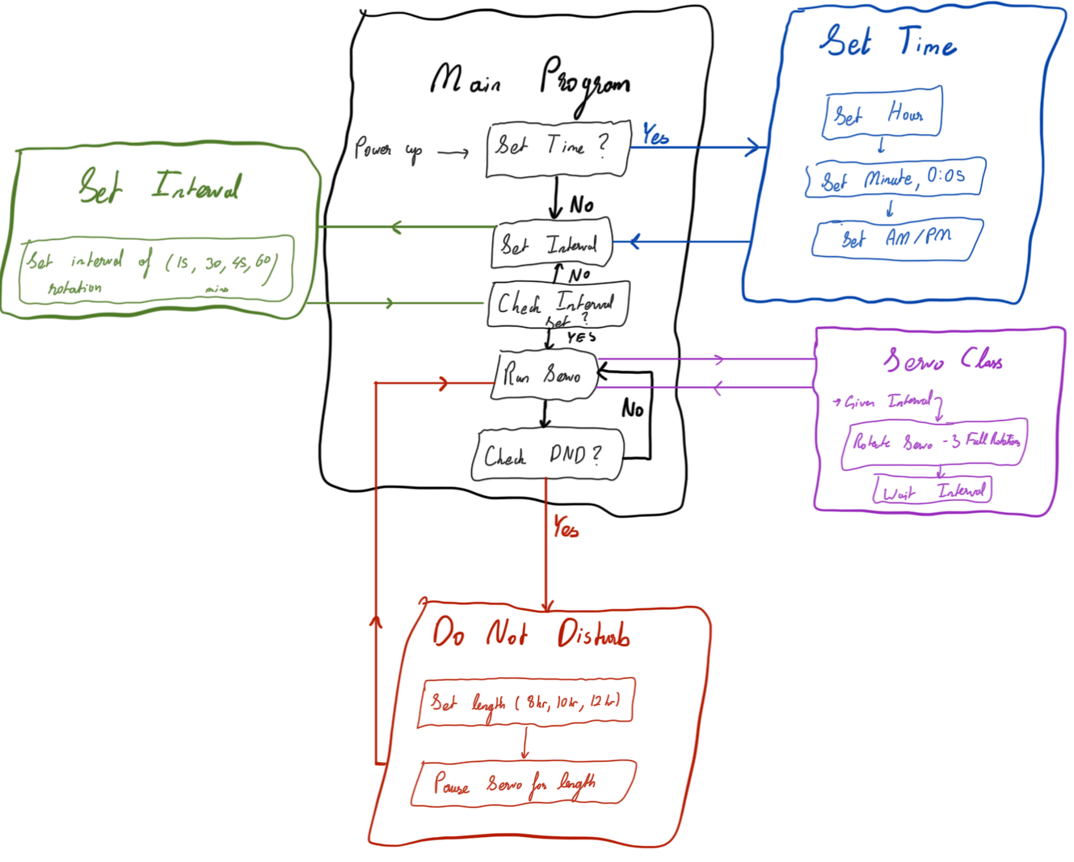
Software Block Diagram

Slide 8
Components / Budget – Updated 2/26/24
Component | ENGI301 to Buy? | Cost
5V Stepper Motor + Driver Board (https://a.co/d/exhWMXs) | Yes | $ 3.00
Standard LCD 16x2 (https://www.adafruit.com/product/181) | Yes | $ 9.95
Joystick (https://a.co/d/dYW8PqD) | Yes | $1.33
Bearings (https://a.co/d/02LscDA) | Yes | $ 7.49
Magnets (Present in OEDK) | No | $ 0.00
Total (Red Not Included) = |  | $ 21.77

