Slide 1
ENGI 301 Automatic Watch Winder Project Proposal
2/19/2024
Ibrahim Muzammil

Slide 2
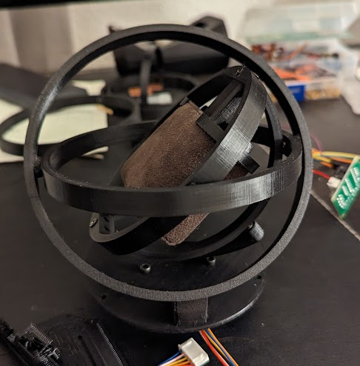
Background Information
I recently got an automatic watch (one that harnesses energy through movement), but I have made the critical error of forgetting to purchase a watch winder, which prevents the watch from dying when not wearing it.
There have been some DIY designs, and I am especially partial to the gyroscopic design pictured on the right. I want to incorporate magnets to quickly place/remove the watch, in addition to coding a stepper motor such that the user has finer control over how the watch is wound in comparison to designs using a DC motor.

Slide 3
Post Meeting Changes
Use a lower power servo motor that comes with a motor driver and can run off 5V from pocket beagle
Add display and interaction from user to control how often the servo motor winds the watch
For example, can add a window during the night where the winder turns off (do not disturb function), or can speed up/slow down rate of winding.

Slide 4
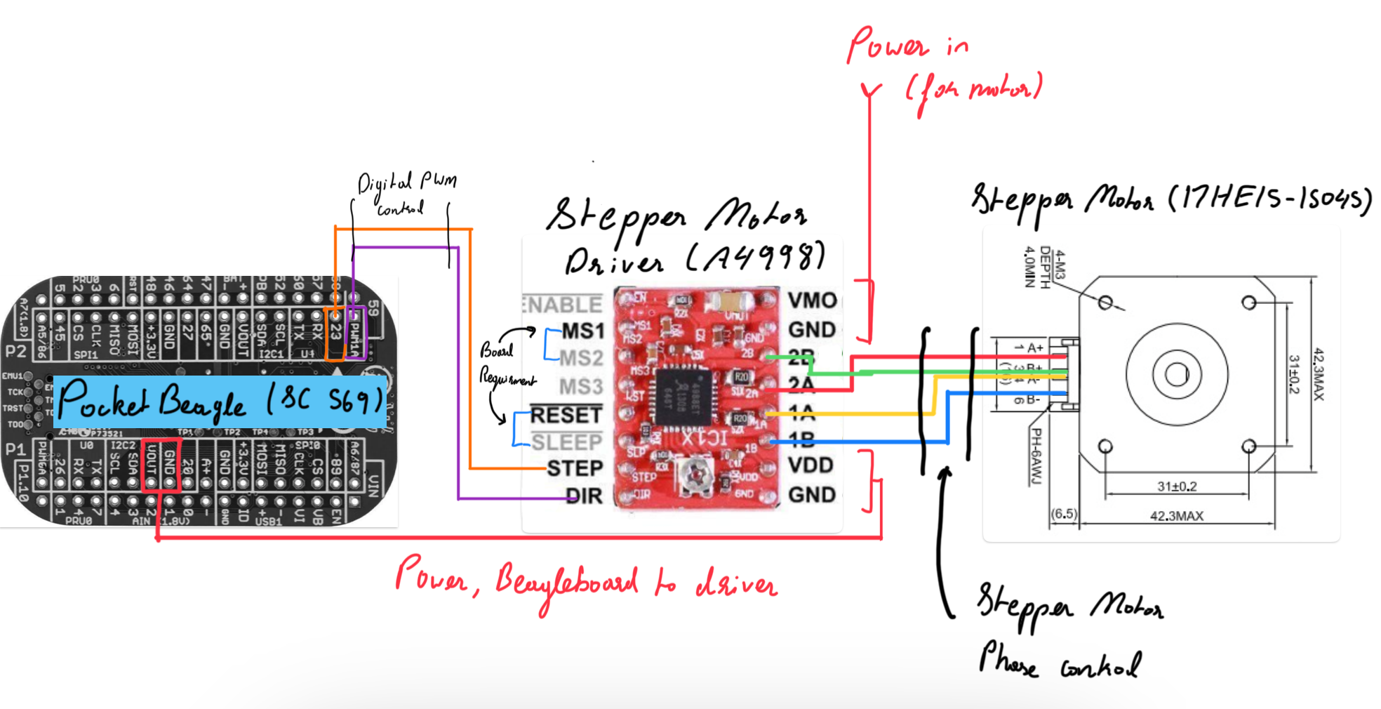
System Block Diagram (To be updated)
Notes:
How does it turn on/off
Emergency stop
How long has it been on
Smaller motor perhaps
Send Dr welsh email for small stepper motor
Run smaller motor straight from pocketbeagle 5v
A display for configuration
Real time clock module
Set time before each use?
Think about user interaction

Slide 5
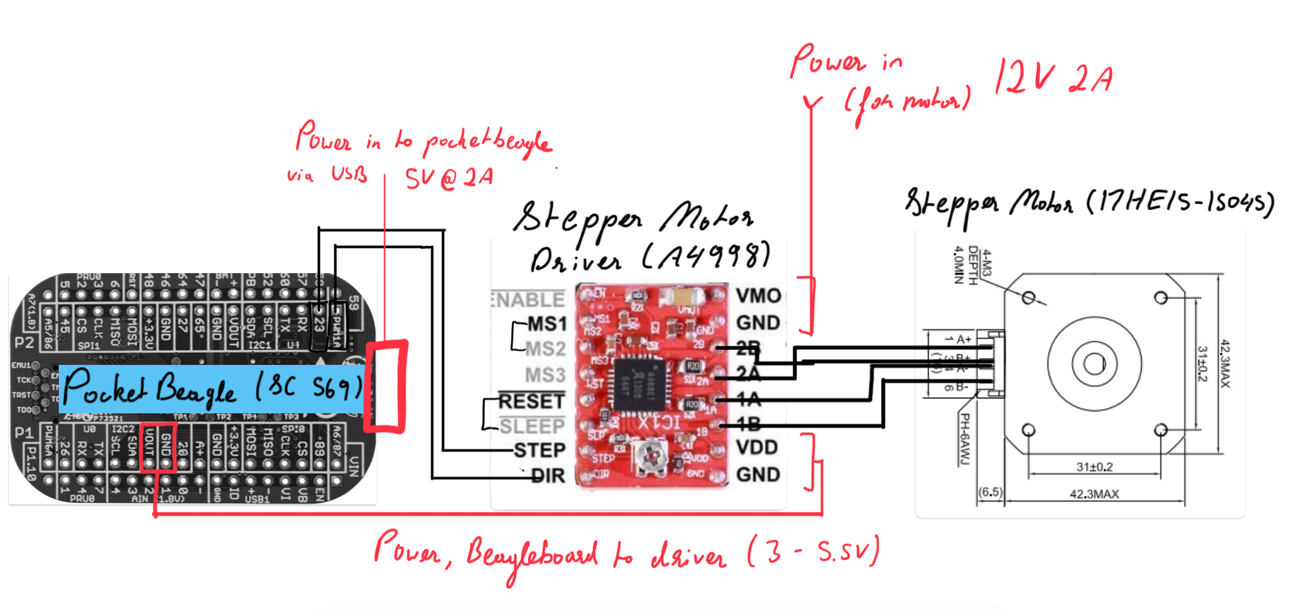
Power Block Diagram (To be updated)

Slide 6
Components / Budget – Updated 2/26/24
Component | ENGI301 to Buy? | Cost
5V Stepper Motor + Driver Board (https://a.co/d/exhWMXs) | Yes | $ 3.00
Standard LCD 16x2 (https://www.adafruit.com/product/181) | Yes | $ 9.95
Joystick (https://a.co/d/dYW8PqD) | Yes | $1.33
Bearings (https://a.co/d/02LscDA) | Yes | $ 7.49
Magnets (Present in OEDK) | No | $ 0.00
Total (Red Not Included) = |  | $ 21.77

