Slide 1
ENGI 301 Automatic Watch Winder Project Proposal
2/19/2024
Ibrahim Muzammil

Slide 2
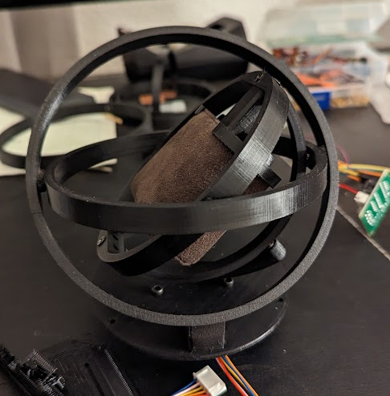
Background Information
I recently got an automatic watch (one that harnesses energy through movement), but I have made the critical error of forgetting to purchase a watch winder, which prevents the watch from dying when not wearing it.
There have been some DIY designs, and I am especially partial to the gyroscopic design pictured on the right. I want to incorporate magnets to quickly place/remove the watch, in addition to coding a stepper motor such that the user has finer control over how the watch is wound in comparison to designs using a DC motor.

Slide 3
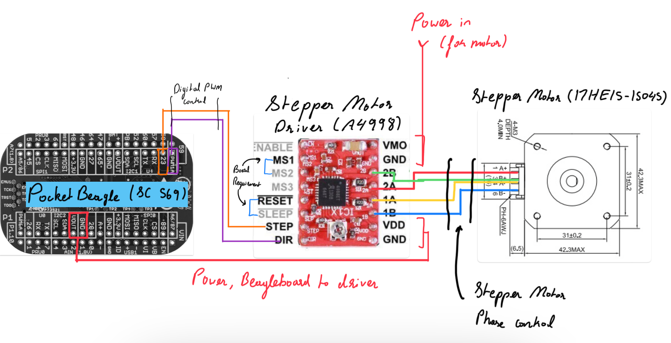
System Block Diagram

Slide 4
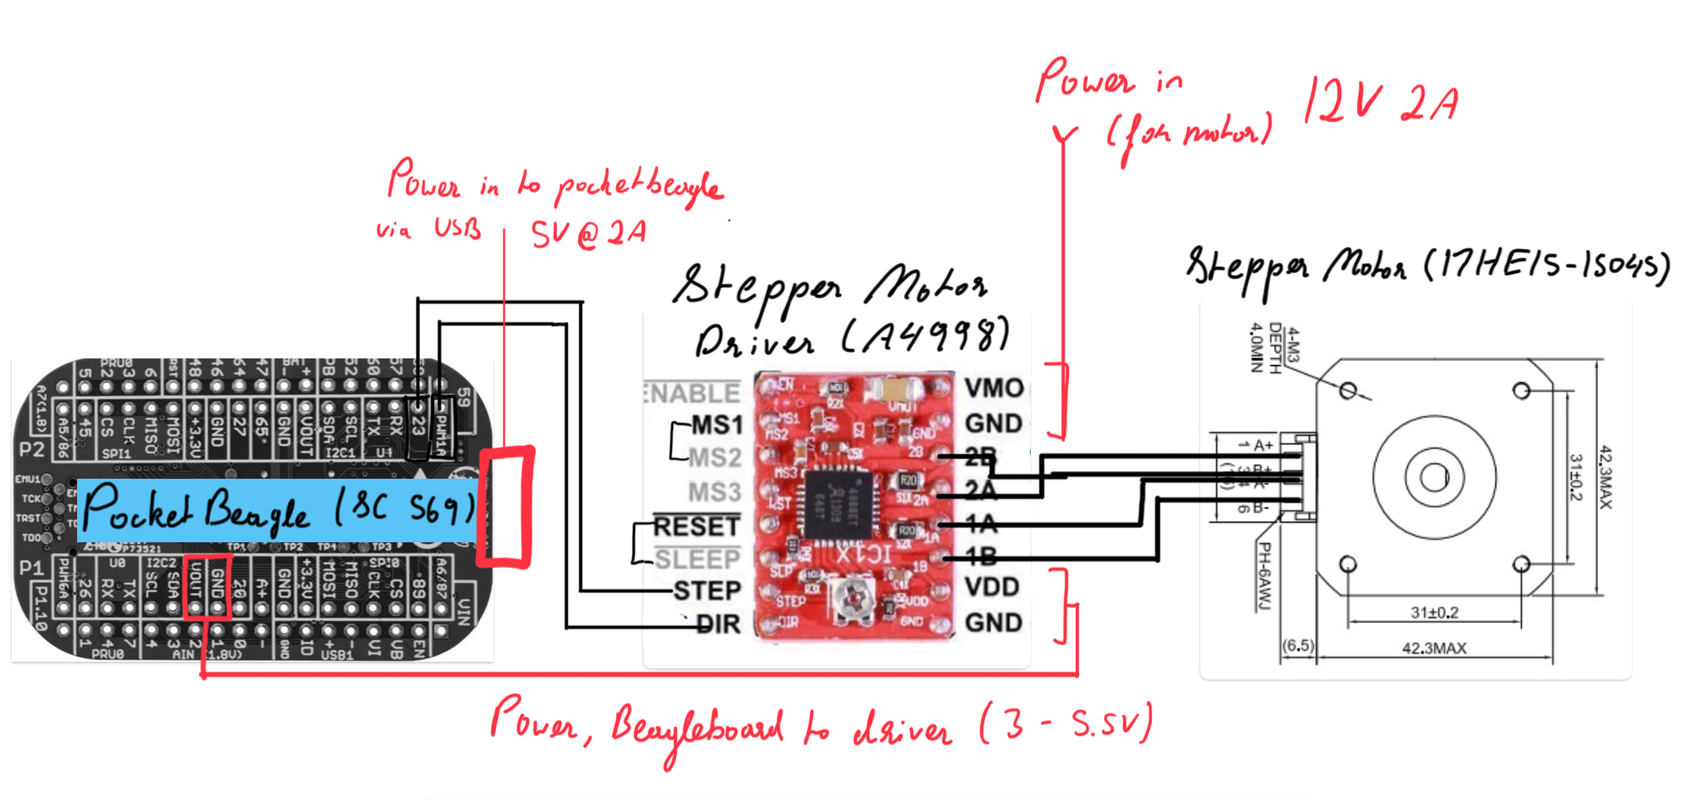
Power Block Diagram

Slide 5
Components / Budget
Component | ENGI301 to Buy? | Cost
Stepper Motor (https://a.co/d/fHOB0uw) | Yes | $ 7.99
Motor Driver (https://a.co/d/4HlsoSn) | Yes | $ 2.04
Adjustable Voltage Adapter 2A (https://a.co/d/8MbHaqz) | Yes | $15.98
Bearings (https://a.co/d/02LscDA) | Yes | $ 7.49
Steel Rods (https://a.co/d/drxrzN4) | No | $ 6.49
Magnets (Present in OEDK) | No | $ 0.00
Total (Red Not Included) = |  | $ 33.50

