Slide 1
Hyperparameter Tuning of Random Forest Algorithm for Maize Leaf Disease Detection and Classification
PGD Proposal
by: TAOFIQ Omotowo Alabi (24/11006)
Joseph Sarwuan Tarka University, Makurdi
Federal Polytechnic Study Center Bauchi
Department of Computer Science Supervisor: mr. Suberu yusuf 09/08/2025

Slide 2
Proposal Outline
INTRODUCTION
STATEMENT OF PROBLEM
AIM AND OBJECTIVES
Research question
Method of data collection
Significance of the study
SUMMARY OF RELATED WORKS
Research Methodology
References

Slide 3
Introduction
Plant disease detection is crucial in agriculture because farmers must constantly assess if the produce they're harvesting is of acceptable quality (Varshney et al., 2022).
Plant leaves are the most sensitive and display disease symptoms earliest; from the beginning of their life cycle until they're ready to be picked, the crops must be monitored for illnesses (Rossman, 2009).
Maize (Zea mays L.) is one of the most vital cereal crops globally, serving as a staple food for over 1.2 billion people and a critical feedstock for livestock and industrial applications (Erenstein et al., 2022).
Maize production faces significant threats from foliar diseases such as Common Rust (Puccinia sorghi), Gray Leaf Spot (Cercospora zeae-maydis), and Northern Leaf Blight (Exserohilum turcicum), which collectively account for yield losses of 15–70% in sub-Saharan Africa alone (Nsibo et al., 2024).

Slide 4
Introduction(cont.)
Machine learning (ML) and computer vision have demonstrated remarkable potential for automating plant disease detection.
Random Forest (RF) algorithms offer a compelling alternative due to their computational efficiency, robustness to overfitting, and inherent feature importance analysis.
Existing studies often use default hyperparameters, despite evidence that tuning parameters like tree depth (max_depth) and feature subsets (max_features) can improve accuracy by 10–20% (Salman et al., 2024).
This study addresses this gap by systematically optimizing RF hyperparameters for maize disease classification, using the PlantVillage dataset as a benchmark.

Slide 5
Statement of the Problem
Maize leaf disease detection remains a critical challenge in sustainable agriculture, where timely and accurate diagnosis can mean the difference between a bumper harvest and catastrophic yield loss. Despite significant advances in machine learning-based plant disease classification, fundamental gaps persist in both research and practical implementation. The gap found in literature include performance limitations of conventional approaches and neglect of hyperparameter optimization in hybrid models.

Slide 6
Aim and Objectives
Aim of the Research
The aim of the research is to developed an optimized model for maize leaf disease detection and classification using Random Forest Algorithm.
Objectives of the Research
The following objectives is to achieve the aim:
To collect maize leaf disease datasets from the plant village dataset
To use CNN for feature extraction in the model pipeline building
To perform hyperparameter tuning on Random Forest algorithm
To compare the results obtained against Panigrahi et al. (2020) using evaluation metrics like accuracy, recall, precision and f1 score.

Slide 7
Research Question
The following research questions are what this study seek to answer:
What is the effect of using CNN for feature extraction against using conventional method?
Does tuning the hyperparameters of Random Forest algorithm increase its accuracy and other evaluation metrics?
How does this improvement compare to existing literature (Panigrahi et al., 2020)?

Slide 8
Method of Data Collection
This research would get its dataset from the repository of Plant Village dataset hosted with Kaggle and Github. The Plant Village dataset is a collection of images for plant disease detection and classification organized into training, testing and validation. It contains images for numerous crops diseases.

Slide 9
Significance of the Study
Creating an enhanced Random Forest model to classify maize leaf diseases marks a significant breakthrough in the fusion of agricultural technology and machine learning. Through optimization of hyperparameters in a hybrid CNN-RF architecture, this study fills a crucial void in maize leaf disease diagnosis.

Slide 10
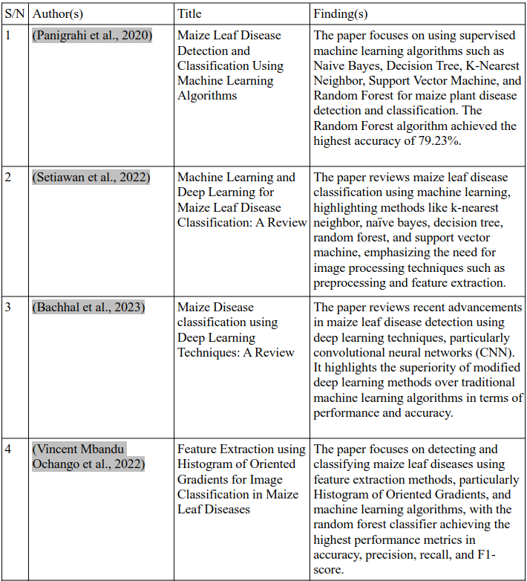
Summary of Related Works

Slide 11
Research Methodology
The Research methodology consists of the following stages:
Implementation Setup and System Specification
Image Collection
Image Preprocessing
Image Segmentation
Feature Extraction
Hyperparameter Tuning Using GridSearchCV
Classification
Performance Metrics

Slide 12
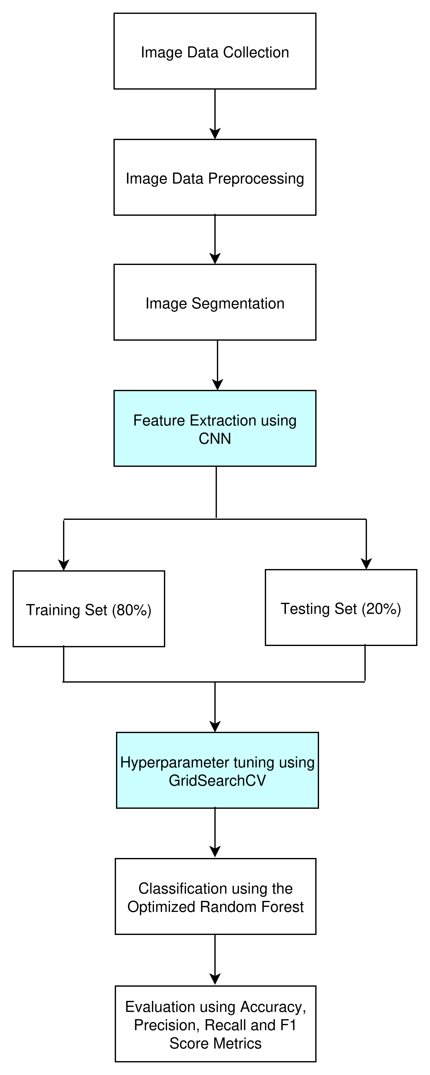
Research Methodology (cont.)
Overview of Proposed Framework

Slide 13
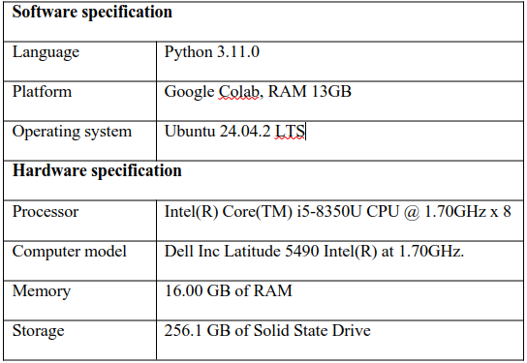
Research Methodology (cont.)
Summary of hardware and software specification

Slide 14
Reference
Ajit, A., Acharya, K., & Samanta, A. (2020). A Review of Convolutional Neural Networks. 2020 International Conference on Emerging Trends in Information Technology and Engineering (Ic-ETITE), 1–5. https://doi.org/10.1109/ic-ETITE47903.2020.049
Albelwi, S., & Mahmood, A. (2017). A Framework for Designing the Architectures of Deep Convolutional Neural Networks. Entropy, 19(6), 242. https://doi.org/10.3390/e19060242
Ali, A. H., Youssef, A., Abdelal, M., & Raja, M. A. (2024). An ensemble of deep learning architectures for accurate plant disease classification. Ecological Informatics, 81, 102618. https://doi.org/10.1016/j.ecoinf.2024.102618
Bachhal, P., Kukreja, V., & Ahuja, S. (2023). Maize Disease classification using Deep Learning Techniques: A Review. 2023 International Conference on Advancement in Computation & Computer Technologies (InCACCT), 259–264. https://doi.org/10.1109/InCACCT57535.2023.10141847
Bachhal, P., Kukreja, V., Ahuja, S., Lilhore, U. K., Simaiya, S., Bijalwan, A., Alroobaea, R., & Algarni, S. (2024). Maize leaf disease recognition using PRF-SVM integration: A breakthrough technique. Scientific Reports, 14(1), 10219. https://doi.org/10.1038/s41598-024-60506-8
Janiesch, C., Zschech, P., & Heinrich, K. (2021). Machine learning and deep learning. Electronic Markets, 31(3), 685–695. https://doi.org/10.1007/s12525-021-00475-2

Slide 15
Thank you for listening...

