Slide 1
Modeling Complex Energy Systems at City Scale using the CityGML UtilityNetworkADE
Case Study of a Hydroelectric Energy Reclamation Facility in Nanaimo, British Columbia, Canada

Slide 2
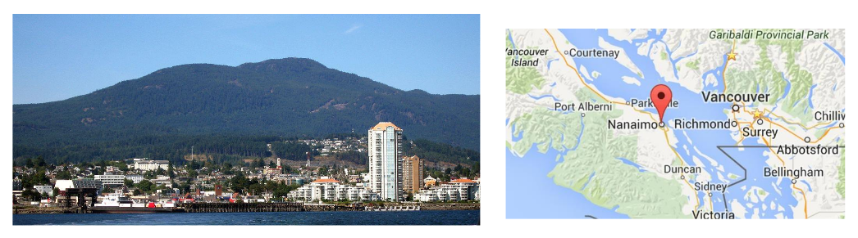
Context
Nanaimo
Small coastal city in British Columbia, Canada
Recently published open utility network data on their website

Slide 3
Context
Acquired open data for Nanaimo water pipes.
Developed the first public data sample for the UtilityNetwork ADE using the aforementioned pipes & FME.
Thoroughly researched the “Nanaimo Reservoir #1” project and made contact with Bill Simms, the water resources manager in Nanaimo.
Received a month’s worth of usage data from the “Reservoir #1” facility, including various water pressures & electric generation.

Slide 4
Available Data
Nanaimo Water Pipes (City of Nanaimo Open Data Catalogue)
Nanaimo Buildings & Parcels (City of Nanaimo Open Data Catalogue)
One month of usage data from the Nanaimo Reservoir #1 Facility (Bill Simms)
Various engineering diagrams & site plans for Nanaimo Reservoir #1 Facility (Various, but all public)

Slide 5
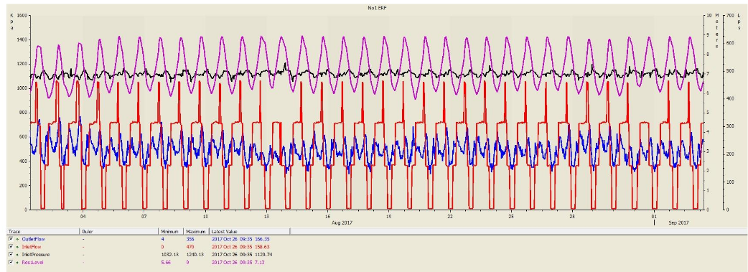
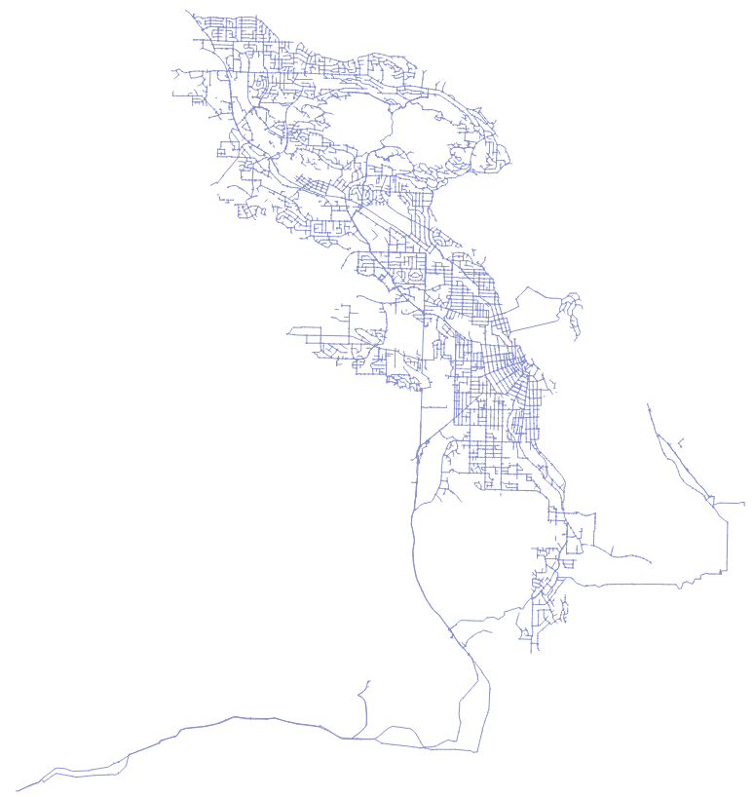
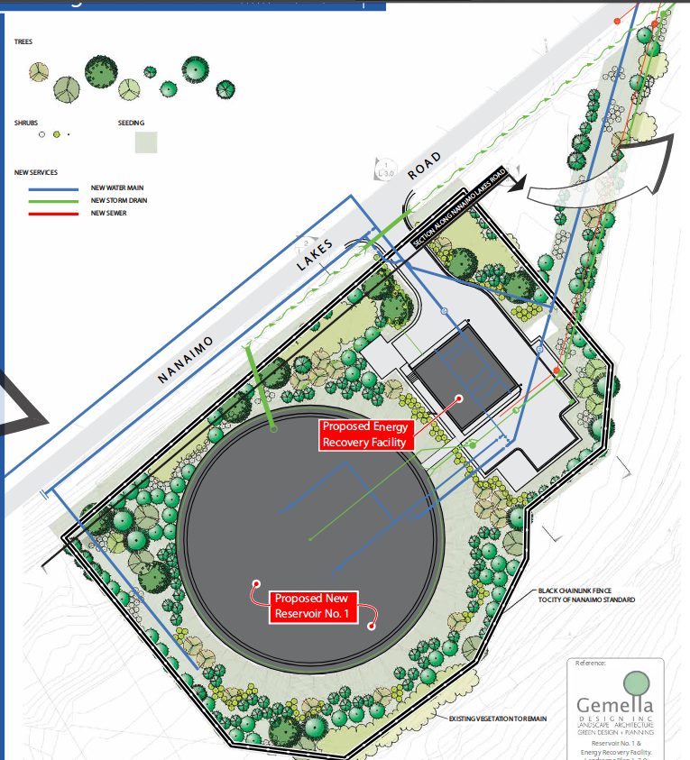
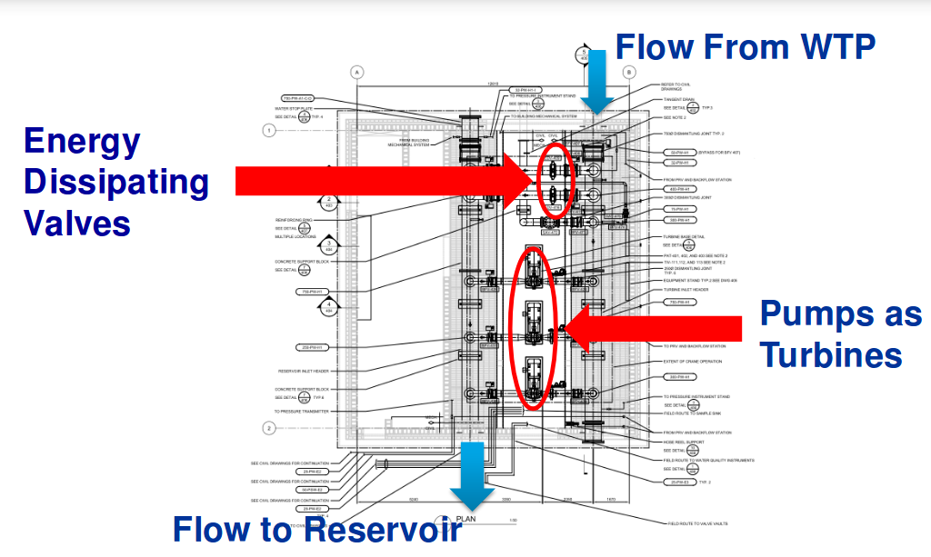
Available Data

Slide 6
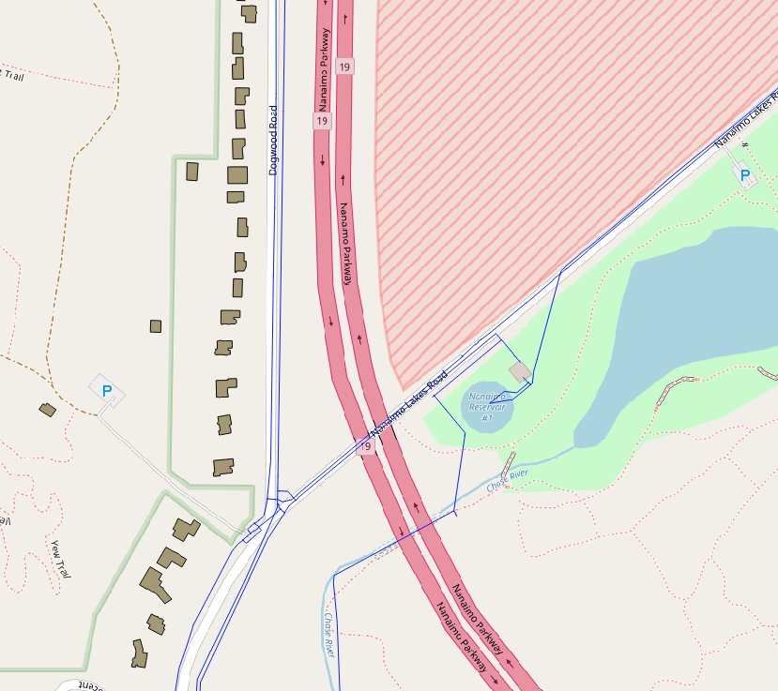
Goals – Build data in CityGML (+ UtilityNetwork ADE)
Improve the water network sample to include specific details around the Reservoir #1 facility.

Slide 7
Goals – Build data in CityGML (+ UtilityNetwork ADE)
Improve the water network sample to include specific details around the Reservoir #1 facility.
[1]
[2]

Slide 8
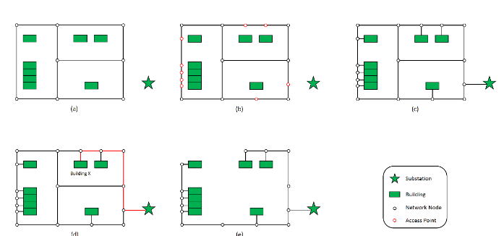
Goals – Build data in CityGML (+ UtilityNetwork ADE)
Create an electrical network to compliment the water network
      Contact Bill Simms to get the layout of the local electric plan.
      If not available, use a heuristic model to infer the electrical network from the roads, developed by Ji Q et al. At Newcastle University (and also concurrently at
      EIFER!).
[3]

Slide 9
Goals – Port CityGML model to 3DCityDB
Once the model is complete in CityGML, it can be imported to 3DCityDB.
There exists an extension for 3DCityDB to support UtilityNetwork ADE features, developed by Giorgio Agugiaro at the Austrian Institute of Technology (AIT).
He has also developed methods for importing data into the database, which he is eager to see applied in a real-world context.

Slide 10
Goals – Port CityGML model to 3DCityDB
Xander den Dujin, recently did his master’s thesis at TU Delft using the 3DCityDB UtilityNetwork ADE extension with the Rotterdam sewer & electrical network.
He was able to perform routing analysis on the data in the 3DCityDB schema using the pgRouting library.
His work will be valuable in working with the network features in the 3DCityDB.

Slide 11
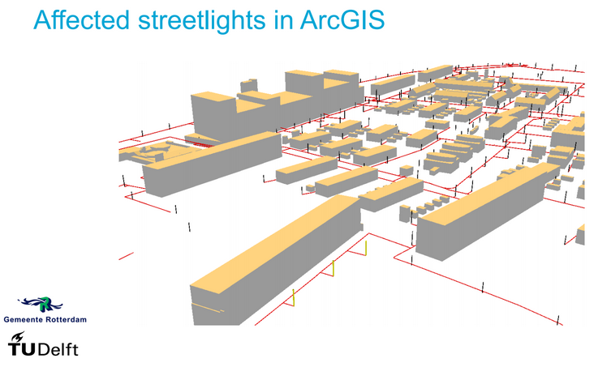
Goals – Port CityGML model to 3DCityDB
[4]

Slide 12
Goals – Develop Functional Model
The final step is to develop a model that can be used to simulate various scenarios, such as:
      Adding / removing building endpoints
      Adding new energy sources (solar panels, wind turbines, upgrades to existing equipment...)
      Varying input water flow (droughts, floods)
      Simulating network breaks & cascading failures
AnyLogic was used by Dr. Enrique Kremers at EIFER to model a multi-scale electrical network on Île de la Réunion.

Slide 13
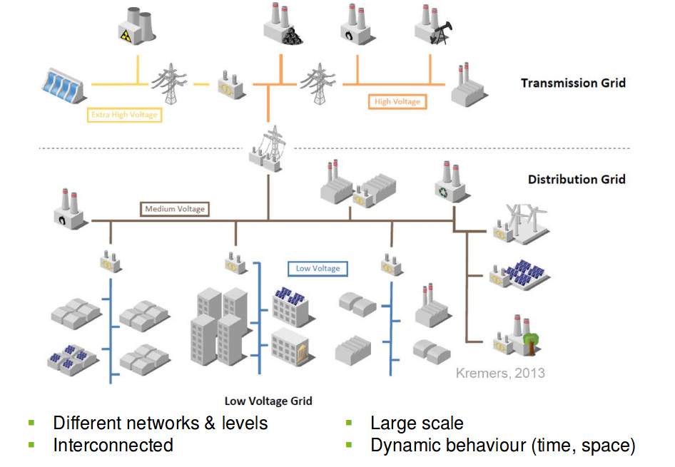
Goals – Develop Functional Model
[5]

Slide 14
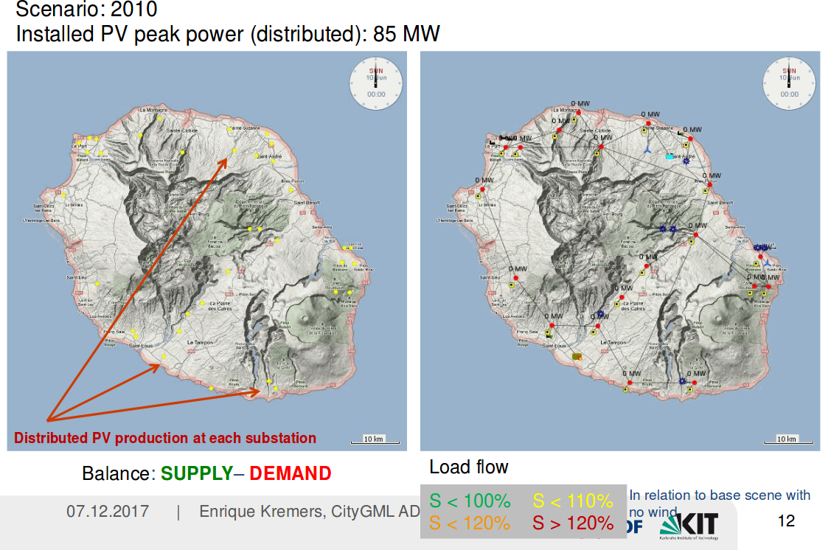
Goals – Develop Functional Model
[5]

Slide 15
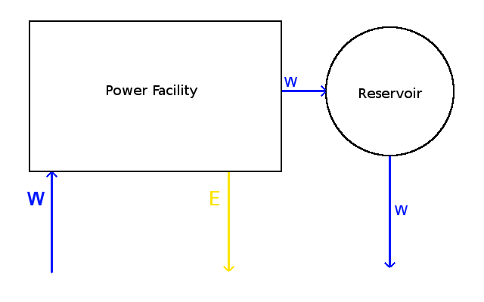
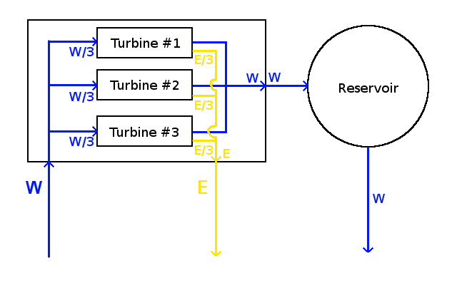
Goals – Develop Functional Model
AnyLogic will allow us to interface with the 3DCityDB containing our network data and perform the aforementioned scenario simulations.
It will also allow us to model the system on different levels of detail, which will be useful given the different possible levels of representation.

Slide 16
Conclusions
This thesis will:
        Provide a working example of a multi-network interdependency modeling scenario using a holistic data format.
        Serve as an experimental real-world application of the UtilityNetwork ADE, which is still in development.
        Demonstrate the research & development value of publishing open utility network data.

Slide 17
Sources
[1] Site Plan for Reservoir #1 Energy Recovery Facility. City of Nanaimo.
    <https://www.nanaimo.ca/docs/your-government/Projects/2012-reservoir-no-1/754ea6391b316d6b9fc9ff00001037d2.pdf>
[2] Engineering Plans for Reservoir #1 Energy Recovery Facility. Associated Engineering.
    <https://www.bcwwa.org/resourcelibrary/Stream3_MacraeL_05282015.pdf>
[3] Ji Q. et al.: “A heuristic algorithm for generative fine-scale infrastructure distribution networks”. Newcastle University.
    <http://huckg.is/gisruk2017/GISRUK_2017_paper_37.pdf>
[4] den Duijn: “A 3D data modelling approach for integrated management of below and above ground utility network features”. TU Delft.
    <https://en.wiki.utilitynetworks.sig3d.org/images/upload/UtilityNetworkADE_Karlsruhe_XanderdenDuijn.pdf>
[5] Kremers: Multi-Scale Simulation of Energy System: Focus on Power Grids”. EIFER.
    <https://en.wiki.utilitynetworks.sig3d.org/images/upload/Kremers_Simulating_multi_scale_energy_systems_sh.pdf>

