Slide 1
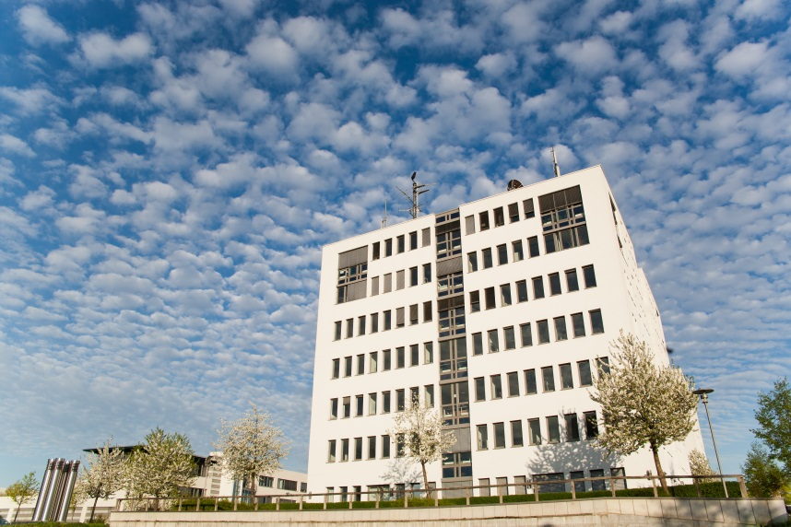
Isaac Boates Master Thesis
Status Report 2018-04-16
Demonstrating network interdependency modeling using the UtilityNetwork ADE
2018-04-16

Slide 2
Table of Contents
Network Construction
Adding appurtenances
Filling in the gaps at Reservoir #1
Creating surrogate electric network from streets
Adding surrogate network to CityGML file
Topological Dual Representation
Explanation of process
Pushed to much later
Initial Foray into 3DCityDB
Conclusion
Demonstrating network interdependency modeling using the UtilityNetwork ADE
2018-04-16

Slide 3
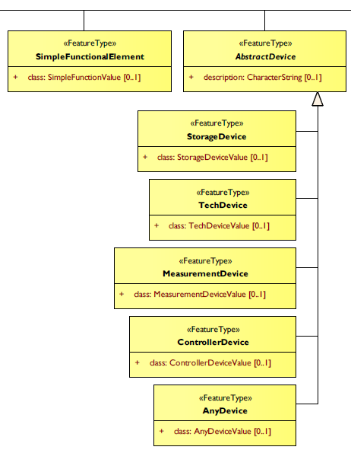
Network Construction
Adding appurtenances to water network
Appurtenaces come from the Nanaimo Open Data Catalogue (same as water pipes)
Only a few appurtenance types are in the study area:
„Butterfly Valve“
„Junction“
„Meter“
„Reservoir“
We look to the „Network Components“ branch of the UtilityNetwork ADE schema to decide how they will be represented.
Demonstrating network interdependency modeling using the UtilityNetwork ADE
2018-04-16

Slide 4
Network Construction
Adding appurtenances to water network
The source data does not always „break“ the pipe line features at appurtenance locations
We use the geometry of the source appurtenances are used to break the pipe line features already present in the source water network.
The pipes are then written to the CityGML file the same as they always have, including creation of topology and semantic properties.
The appurtenaces are written as point features, topographically and topologically.
Appurtenance‘s
FeatureGraph
RoundPipe 1‘s FeatureGraph
RoundPipe 2‘s FeatureGraph
Node
InteriorFeatureLink
Node
InterFeatureLink
InterFeatureLink
Node
InteriorFeatureLink
Node
Node
RoundPipe 1
Appurtenance
RoundPipe 2
Demonstrating network interdependency modeling using the UtilityNetwork ADE
2018-04-16

Slide 5
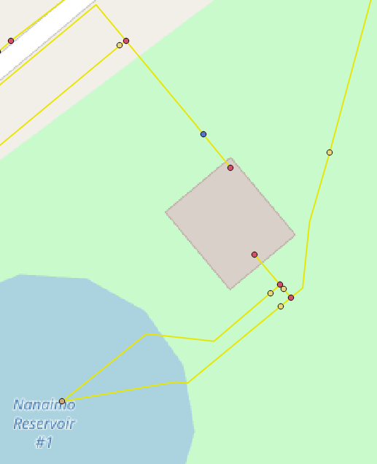
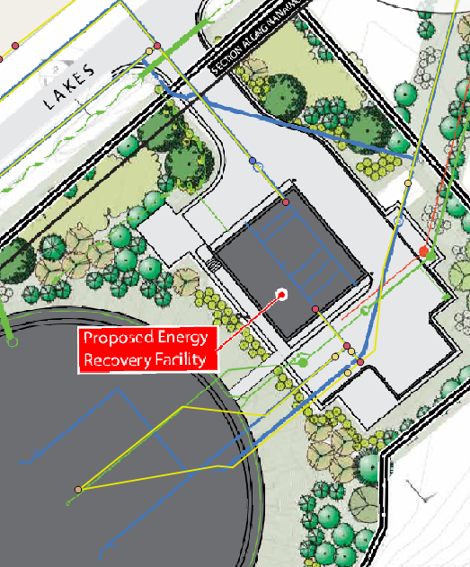
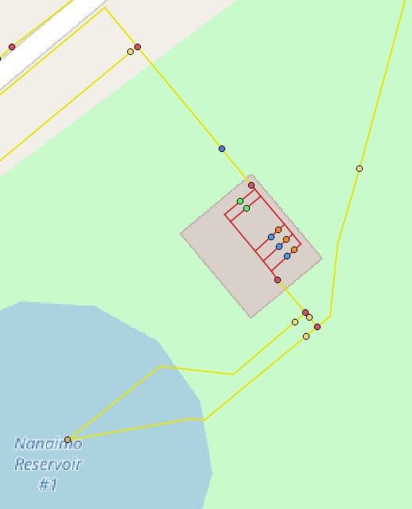
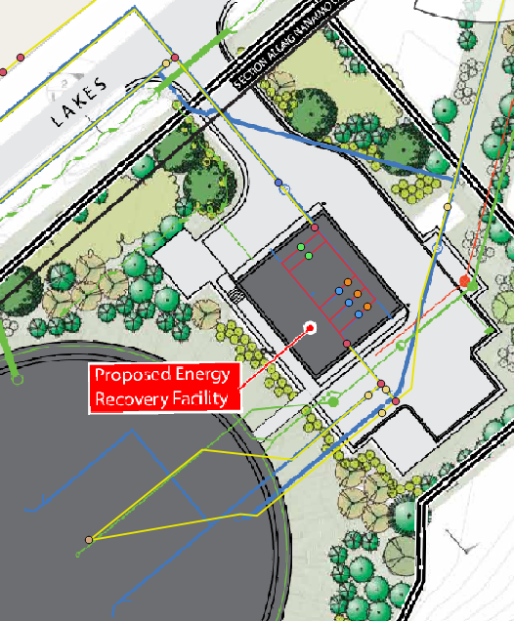
Network Construction
Filling in the gaps at Reservoir #1
The source data just has a big gap inside the Reservoir #1 Facility.
Use a georeferenced site plan to digitize the missing pipes.
Add new appurtenances to account for elements that will be important for the final model.
Demonstrating network interdependency modeling using the UtilityNetwork ADE
2018-04-16

Slide 6
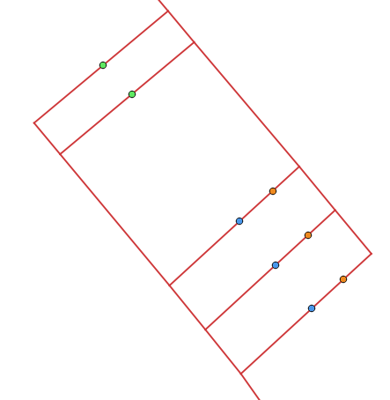
Network Construction
Filling in the gaps at Reservoir #1
What was added?
Turbines (SimpleFunctionalElement)
Will serve as the coupling point between water & electrical networks.
Turbine Valves (ControllerDevice)
Will be used to break the connection between the turbines and the incoming water source.
Pressure Reduction Valves (ControllerDevice)
Will be used to ensure that the reservoir still maintains connection to the incoming water source, even if all turbine valves are closed.
Demonstrating network interdependency modeling using the UtilityNetwork ADE
2018-04-16

Slide 7
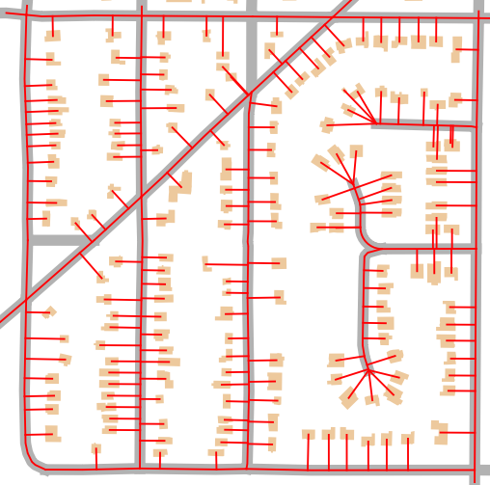
Network Construction
Creating surrogate electric network from streets
Have not received any electrical line info from Bill Sims.
Can just make a surrogate network using the streets in the study area.
There is street data offered by the Nanaimo Open Data Catalogue.
Decided to include the house connections as physical wires (opposed to the „conceptual connections“) used for the pipes, because it‘s all hypothetical anyway.
Demonstrating network interdependency modeling using the UtilityNetwork ADE
2018-04-16

Slide 8
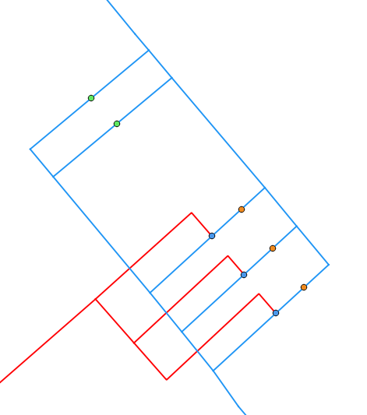
Network Construction
Creating surrogate electric network from streets
As mentioned earlier, the turbines at Reservoir #1 are the coupling point between the water and electrical networks.
This is achieved by both networks having their own SimpleFunctionalElement (SFE) representing them (+ associated topological elements).
...But both the water and electrical SFEs reference a CityFurniture feature via the „connectedCityObject“ property.
connectedCityObject
Turbine A (CityFurniture)
Cable
Turbine A‘s
Electric SFE
connectedCityObject
RoundPipe
RoundPipe
Turbine A‘s
Water SFE
Demonstrating network interdependency modeling using the UtilityNetwork ADE
2018-04-16

Slide 9
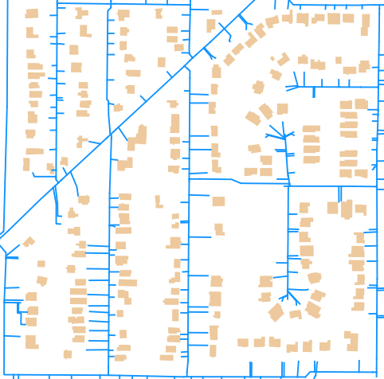
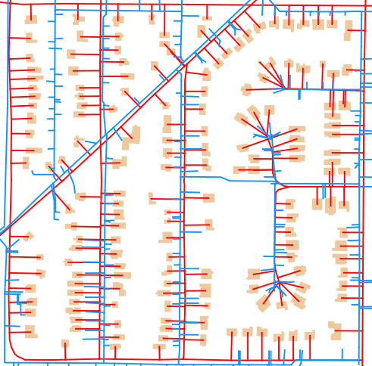
Network Construction
Adding surrogate network to CityGML file
A second FME workbench was created to add the electrical network.
Much simpler than the water workbench, because there are much fewer appurtenances and generally simpler network structure.
The second workbench reads the CityGML file created from the first and adds new features.
Demonstrating network interdependency modeling using the UtilityNetwork ADE
2018-04-16

Slide 10
Topological Dual Representation
Explanation of Process
During the creation of the topological representation in FME, the features are split to be topologically correct.
After the splitting occurs, we can assign each resultant feature a unique sequential identifier (dualrep_id)
Cannot use a UUID, because they will change between runs!
p5
p2
p1-3
n5
n6
Conversion to Topology
n3
p4-1
p4
n1
p1-2
p3-1
p5-1
p1
p3
p2-1
n4
p1-1
p4-2
n8
n2
p6-1
p4-3
p6
n7
Demonstrating network interdependency modeling using the UtilityNetwork ADE
2018-04-16

Slide 11
Topological Dual Representation
Explanation of Process
As long as nothing changes in between runs, the split features will be processed in exactly the same order.
Therefore, during the first run, we can write out the split features to a shapefile, edit their geometry manually.
p1-3
n5
n6
n3
p4-1
n1
p1-2
p5-1
Edit feature geometry as SHP
p3-1
p2-1
n4
p4-2
n6
p1-1
n8
n1
n2
p2-1
n3
n8
p6-1
p4-3
p1-2
p1-3
p5-1
p4-2
n7
p1-1
n2
p3-1
n5
p4-1
p6-1
p4-3
n4
n7
Demonstrating network interdependency modeling using the UtilityNetwork ADE
2018-04-16

Slide 12
Topological Dual Representation
Explanation of Process
The FME workbench can then be modified so that just before writing the topological features, the attributes are swapped to the edited shapefile, joined via dualrep_id.
The result is two different representations of topography and topology which remain conceptually linked!
Topography of Network Features
Topology of Network Graph
Demonstrating network interdependency modeling using the UtilityNetwork ADE
2018-04-16

Slide 13
Topological Dual Representation
Pushed to much later
Despite this methodology being tested and working properly, it needs to be put off until the network is guaranteed to be finished.
The method of writing the topological features once to shapefile, then modifying their geometry, then re-running the workbench to swap the attributes poses a serious caveat:
!
Any change to, or addition of a network feature will irreperably change the order of dualrep_id values that are generated, which will completely destroy the topological representation!
!
n3
p2-1
p1-1
n2
p1-2
p1-1
n1
n2
n1
n3
Demonstrating network interdependency modeling using the UtilityNetwork ADE
2018-04-16

Slide 14
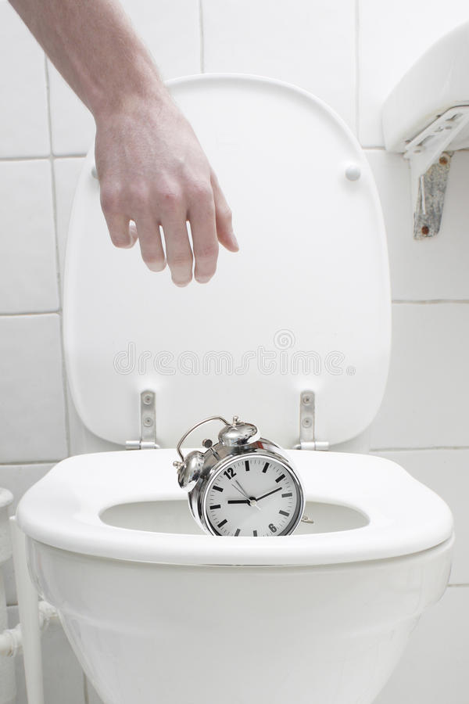
Topological Dual Representation
Pushed to much later
The topological adjustments must be done manually.
This will likely take a full day or more.
If anything needs to change, due to something that wasn‘t apparent until late into the thesis...
Therefore, it would be best to just put it off until it is certain that everything else is functioning properly.
Demonstrating network interdependency modeling using the UtilityNetwork ADE
2018-04-16

Slide 15
Initial Foray into 3DCityDB
Initial foray into 3DCityDB
Already spent some time pre-thesis in udnerstanding how to import features from CityGML into 3DCityDB using Python.
Have a script that imports both water and electrical networks.
Very messy, should be cleaned.
Have also begun to experiment with the atomic functions of interacting with the database (like an API).
getProperyById()
setPropertyById()
Still in very early development, mostly just exploratory at this point.
Demonstrating network interdependency modeling using the UtilityNetwork ADE
2018-04-16

Slide 16
Conclusion
Accomplishments
Water and electrical networks finished and in CityGML format.
Both networks also in 3DCityDB.
Laid groundwork for database interaction API.
Setbacks
Dual representation has to be put off in the interest of avoiding time wastes.
Things are proceeding slightly ahead of schedule. No major issues or problems to report.
Demonstrating network interdependency modeling using the UtilityNetwork ADE
2018-04-16

Slide 17
Thank you for your attention
Isaac Boates
Isaac.Boates@eifer.uni-karlsruhe.de
Demonstrating network interdependency modeling using the UtilityNetwork ADE
2018-04-16

