Slide 1
Barriers to Business: Albania, North Macedonia, Serbia
Presented by
Ian Bogley
Notes:
Today I will be presenting the Barriers to Business in Albania, North Macedonia, and Serbia.

Slide 2
Topic Importance
In 2017, IDG conducted a performance evaluation report of a previous USAID project: The Regional Economic Growth Project (REG)
The three countries discussed today: Albania, Serbia, and North Macedonia were specifically called out as having cut their budgets with respect to economic growth
Recommended a continuing presence in these countries
Significant and widespread issues in the face of incremental reforms
Corruption, centralized bureaucracy
Poor macroeconomic fundamentals
Poorly equipped energy sectors
Diplomatic tensions
Notes:
This topic is the successor to a performance evaluation report IDG conducted on a previous USAID project. Specifically, IDG noticed that fiscal policy was insufficient to sponsor long-term economic growth and development, with each country discussed today receiving a mention. This is in the face of serious, chronic issues that these countries still face with respect to economic development into the future.

Slide 3
Personal Profile
I am a graduate student at the University of Oregon, finishing my Master’s degree in Applied Economics in December
Specialties in international trade, regional growth and development, and data science
Proficient in the R programming language, previous experience using data software and empirical research. You can find out more on my website: https://ibogley.github.io/website/
As an intern here at IDG:
Supervisor: John Zeleznak
Worked on the IPOP CV Matrix
Helped with the Niger Baseline report: creating visuals and tables, also proofreading drafts
Assisted with BD work
Notes:
A little about me before we begin: I will finish my final term at the University of Oregon in December, taking a Master’s of Applied Economics specializing in international trade, economic growth and development, and data science. As an intern here, I worked on tasks relating to IPOP, the MCC Niger Roads Project, and Business Development.

Slide 4
Roadmap
Background
Issues in Albania
IDG Interventions
Doing Business Indicators
Previous USAID Missions
Notes:
To begin our discussion, we will mention some of the macroeconomic fundamentals prevalent in the region, then moving into a study of various doing business indicators that show marked issues for the countries involved, taking a moment to look through issues central to Albania, studyng previous USAID efforts, and concluding with potential interventions IDG can implement.

Slide 5
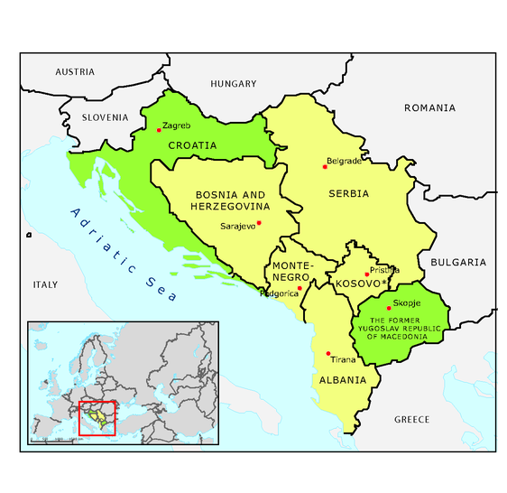
Background
Poor macroeconomic fundamentals
High Unemployment Rates (10-25%)
Poor education system – under-educated and under-skilled workforce
Low GDP Growth Rates
Uncompetitive markets, key sectors dominated by state owned firms
Corruption, confusing regulatory environments
Debt as percent of GDP: 50-60%
Centralized governance
All 3 are official candidates for EU ascension
Previous incremental reforms
Image source: https://www.eea.europa.eu/data-and-maps/figures/political-map-of-the-western
Notes:
All three countries involved struggle from serious macroeconomic issues. Their high unemployment rates and a poor education systems leave individual professionals underprepared to compete in the workforce, as well as contributing to a large informal sector. Low growth rates, uncompetitive markets, and high debt to GDP ratios present serious roadblocks to future growth, while a centralized governance structure allows for significant levels of corruption and uneven application of regulations. This is not to dismiss the incremental reforms each nation has made in the pursuit of EU ascension, often with the assistance from USAID and other foreign aid organizations.

Slide 6

Doing Business Indicators
The world bank publishes rankings and scores for each country
“Provides objective measures of business regulations for local firms”
Breaks down private sector quality through indexes in different aspects
Overall rankings: (All figures will from 2020)
Albania – 82
North Macedonia – 17
Serbia – 44
This presentation uses DB Indicators as a guide for barriers to business
Notes:
This presentation will use Doing Business Indicators, as published by the World Bank, as a guide for determining areas of necessary reform. Notice that overall, Albania lags Serbia, which in turn ranks lower than North Macedonia. This is a consistent trend which we will see across multiple categories.

Slide 7
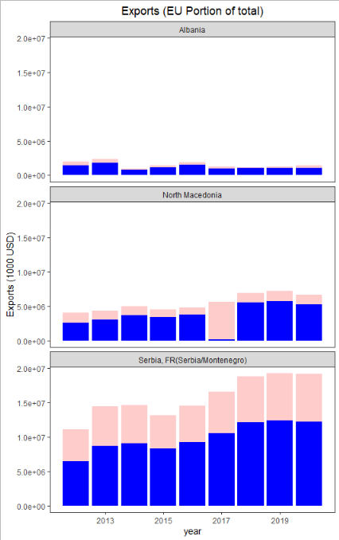
Cross-Border Trade
All three countries rank highly
Albania: 25
Serbia: 23
North Macedonia: 32
Focusing on export-driven industries has shown promise in helping these countries succeed
EU: Accounts for over 50% of imports and exports
Stabilization and Association Agreements: removed customs tariffs, but implemented heightened standards in different categories
NOTE: 2017 shows a drastic decrease in North Macedonian exports to the EU. I believe this to be a mistake in the data (Source: World Bank WITS)
Notes:
International trade is vital for any smaller nation pursuing economic growth and development. It provides access to low-cost and high-quality goods and services, while also allowing nations to focus on their specific comparative advantages. Previous efforts to allow effective cross-border trade, including one-stop customs implemented through EDGE, have shown merit in this indicator. The most important trading partner for the Western Balkans in general is the EU, shown through the visual on your right, indicating that over 50% of exports end up in the European Union.

Slide 8
Trade Barriers
Part of the Central European Free Trade Agreement (CEFTA)
Still allows for protectionism if trade thought to harm domestic firms
Stabilization and Association Agreement (SAA)
Bilateral trade agreements with individual WB nations
Erected trade barriers through higher standards and technical requirements, increased competition from EU firms
Examples of voluntary trade barriers
2012: Kosovo implemented 35% a tariff on Albanian cement
Albania and North Macedonia countered with their own
Each tariff was revoked voluntarily later that year
2018: Kosovo added 100% tariff to Serbian imports
In response to Serbia attempting to join Interpol
Tariffs revoked in 2020
Notes:
However, this is not to say that there aren’t significant trade barriers that are erected or exist to this day. The poor macroeconomic fundamentals of the region, as well as other geo-political factors harm the competitiveness of Western Balkan firms, meaning not only that domestic firms must compete with better equipped EU ones, but also that they must now abide by stricter regulations.
This isn’t to mention issues that arise from diplomatic tensions still present across all minorities and locales in the area. While all three nations are members of the Central European Free Trade Agreement, which serves to encourage the mobility of labor, goods, and services, the structuring of the agreements leaves open opportunities for protectionism, as shown in the examples mentioned.

Slide 9
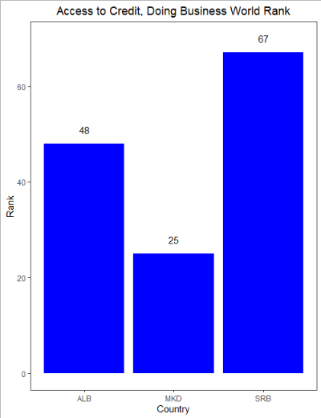
FDI Growth
Domestic sources are insufficient to sponsor long term growth
Requires large amounts of FDI, especially from the EU
Jirasavetakul et al.: Precondition's to FDI growth
Stability
Legal rights
Quality domestic suppliers
Quality institutions
Vocational training
Public investments
Notes:
Access to finance is another existential issue for Small and Medium Sized Enterprises. However, previous studies have noted that there isn’t enough money in the region to sponsor long term economic growth and development. FDI is an essential component of the near and long-term success of the region, but it still faces pervasive problems for attracting that attention.
Many of the precondition’s for FDI involve the very areas where the Western Balkans face chronic struggles. Tense diplomatic relations and lack of investor protections leave investors uncertain about the safety of their investments, while poor institutions and uncompetitive firms make such enterprises not worthwhile in the first place. Each country faces substantial public debts, hindering investments into public goods which would help sponsor growth.

Slide 10
Education
Unskilled, unprepared workforce without the skills to effectively support private sector growth
EDGE has launched a Workforce Assessment to better understand constraints
Program for International Student Assessment (PISA) – While education statistics are improving, they are inequitable
OECD - “Boys perform worse than girls at rates exceeding international averages”
Enrollment is academically selective, and regional systems might create systematic bias against certain Socio-economic backgrounds
Notes:
Education in the Western Balkans is also a huge issue. Inequitable and inefficient schooling leaves many in poor position to compete in the domestic labor force, let alone the international one. This also discourages FDI, as there is little reason to invest in a region with poor infrastructure and an under equipped workforce. Teaching is often focused on the lecturer rather than the student, leaving behind those who are not in position to adapt. Student assessments are often biased towards certain socio-economic backgrounds, further perpetuating systematic bias already existing from uneven application of rules and regulations.

Slide 11

Access to Electricity
Doing Business Rankings (Getting access)
Albania: 107
High costs, Longer process
Serbia: 94
North Macedonia: 68
State owned companies with unreliable service
Albania is almost entirely reliant on hydropower
Serbia and North Macedonia, however, rely primarily on coal and oil
Logo of Elektromreža Srbije, the state-owned electricity company of Serbia
Source: https://upload.wikimedia.org/wikipedia/en/thumb/3/32/Elektromreza_Srbije_Logo.jpg/200px-Elektromreza_Srbije_Logo.jpg
Notes:
Access to electricity is an issue in the Western Balkans, with power companies traditionally being state owned and providing unreliable service. Moreover, both Serbia and Macedonia still receive the majority of their energy production from dirty sources, providing further challenges in the pursuit of sustainable growth into the future.

Slide 12
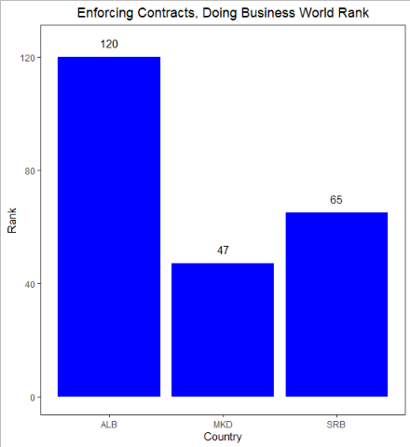
Governance
Well documented issues with corruption, bureaucracy (transparency.org)
Dominant executive branches, with mostly single-party rule
Poor coordination between state actors
3rd party organizations don’t have the resources for oversight
Good laws, but inefficient and uneven enforcement of them
Notes:
Governance and corruption is yet another category in which all three countries struggle. Dominant central authority figures, coupled with imperfect implementation and isolation lay the groundwork for unequal application of laws and regulations. Other local actors, including the media and third party organizations often fail to provide effective oversight, as they don’t have access to the necessary resources to do so. Regulations are often confusing, and there are even instances in which companies have gone private or public without official communications to investors, providing yet another source of uncertainty.

Slide 13
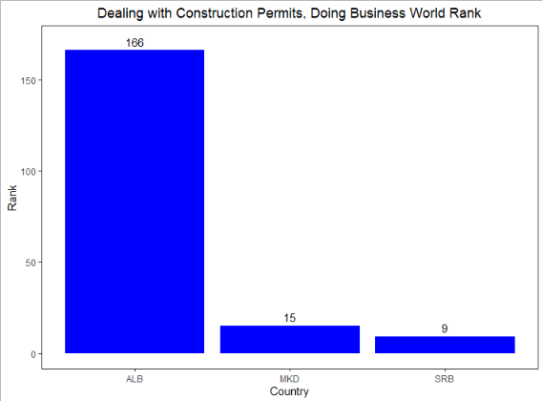
Issues in Albania
Albania lags in several categories
Protecting minority investors
Registering property
Paying taxes
Also suffered a devastating earthquake in 2019
844 million Euros worth of damage
Brain Drain is also a problem, while Serbia and North Macedonia each enjoy Brain Gain from a substantial international student presence
Notes:
Albania in particular lags in many categories, showing that special attention is needed in the nation. While Serbia and North Macedonia each receive net inflows of skilled labor, Albania suffers from Brain Drain, meaning that an already under-equipped workforce is failing to retain some of its most effective potential workers.
The nation also suffered from an earthquake in 2019, resulting in more damage at a time when fiscal policy resources were already stretched beyond reasonable capacity.

Slide 14
Previous USAID Missions: REG
Project for Regional Economic Growth (REG, 2013-2019)
Provided E&E countries opportunities for growth and integration
Sectors with particular emphasis in the Western Balkans
Info & Communication Tech (ICT): provided networking domestically and abroad, provided new opportunities for knowledge spillovers from abroad
Agriculture: Focus of 40% of REG activities, helped HR capacity in marketing and operations
Entrepreneurship: Helped build skills for small businesses
Recommendations
Prioritize objectives clearly, create regional iterations with implementers on the ground
Prioritize regional scopes, as issues differ greatly from country to country
Continue presence in areas where budgets for growth are limited (ALB, SRB, NMD)
Clarify implementer role in context of existing bilateral/regional programs
Improve performance management, reporting systems for monitoring success
Notes:
Now for a discussion and brief overview of notable previous USAID activity in the region. The project for Regional Economic Growth (REG) was the precursor to EDGE, working in the Eurasian region. The project focused on agriculture primarily, but also spent time and resources assisting the rapidly growing ICT sector in the region.
Some key takeaways from the project included clearly defined objectives and roles for teams involved, especially in the context of existing bilateral and multilateral activities. Another suggestion was to focus more on the geographic scope of activities, as each region often was accompanied by localized issues not prevalent elsewhere. Finally, targets for success are a necessary addition, with simplified metrics and effective monitoring systems to define whether these activities are successful.

Slide 15
Current USAID Missions: EDGE
Economic Development, Governance, and Enterprise Growth Project (EDGE): currently being conducted, began in August of 2019 (IDG)
Reducing barriers to trade (Single stop border customs, Multi-Annual Action Plan on Regional Economic Area in the WB [MAP REA])
Assisting with compliance to WTO Trade Facilitation Agreement
Improving Financial Sector Stability and Increased Access to Finance
Conducting Value Chain Assessment
Sectors: Fruits and Vegetable Production (Fresh and Processed), Rural and Adventure Tourism, Textiles/apparel and wood processing/furniture production
Workforce Assessment
Cross-Cutting IR: Counter Malign influences, corruption and violent extremism
Assisting SME’s: digital transformation, understanding the impact of COVID-19
Notes:
For any who are unfamiliar, EDGE is a project currently being undertaken by IDG to assist in economic growth and development, with activities specific to the countries we are discussing. The team here at IDG is assisting in reducing barriers to trade, compliance to international standards, improving access to finance, and conducting further analysis on value chain representation and workforce assessments.
The team is also working on assisting Small and Medium sized enterprises through technology, as well as studying the impact that COVID-19 is currently having on them.

Slide 16
Previous USAID Missions: PLGP
Planning and Local Governance Project (PLGP) (2012-2019)
Worked to improve local governance in Albania
Worked in multiple sectors regarding municipal governance and civic engagement
Improved tax collection by 20-30%
Assisted decentralization strategy (General Local Territorial Plans [GLTPs]), laws on government finance
Created One-Stop Shops for local public services
Notes:
The Planning and Local Governance project was specific to Albania, working to assist the domestic decentralization efforts already present from General Local Territorial Plans. These efforts included marked success’ like improved tax revenues and one-stop shops for local public services.

Slide 17
Near term COVID outlook
European Commission: Post COVID outlook
Serbia and Albania weathered COVID-19 better than expected, but North Macedonia saw a period of growth pivot sharply into contraction
Timely fiscal and policy measures were enacted
Future growth likely in the private sector
Future near-term growth may be large, followed by the pre-COVID growth rates around 4-6% annually.
EDGE is currently working on an assessment of the impact that COVID has had on SME’s
Notes:
In the near term, each country is primarily dealing with the impacts of COVID. Timely fiscal stimulus and effective policy measures have resulted in better than expected results, but North Macedonia especially suffered a decisive end to a long period of steady growth. Predictions by the European Commission expect growth in the near and mid term to be based on private sector growth, likely returning to and staying at the previous average growth rates between 4 and 6 percent.

Slide 18
Possible IDG interventions
EU Integration
WB firms often underprepared compared to EU
Assist in compliance with heightened standards/regulations from EU market and trade agreements
Assist in providing opportunities for FDI
Equitable Education system
Low spending on education, provide additional resources to this end
Provide flexible, individual based teaching environments
Teacher assessment often associated with student test results
Assist local governments in rethinking student assessments
Lack of skilled labor
Improve vocational training
Encourage Renewable Energy Adoption in Serbia and North Macedonia
Improve transparency in corporate law and governance
Notes:
To assist the region in achieving its long-term goals of EU ascension, as well as sustainable economic growth and development, IDG has several options. Most will primarily affect the region through attractiveness to foreign investors. Namely, continuing efforts to assist prosperous integration into the EU market have shown promise, but they need help in improving private sector competitiveness in the face of better equipped counterparts and stricter regulations.
Providing more opportunities through education can help make the Western Balkans in general a more attractive labor pool to invest in. Potential avenues include providing resources for marginalized areas, and assisting with reforming student assessments in the region. Providing more avenues to enter the workforce through vocational training are also an option.
Serbia and North Macedonia will require assistance in transferring energy production into renewable energies, while attempting to lay the groundwork for the creation of private sector energy companies can serve as a long term goal for domestic liberalization.
Finally, transparency in both governance and corporate decision-making will help ensure satisfactory protection of investor property rights, while continued incremental change in diplomatic tensions and other socio-economic issues can help heal the region and build a future focused on sustainable economic growth.

Slide 19
Further Reading/ Sources
Bartlett, W. (2013). In Europe's troubled region: Economic Development, institutional reform and social welfare in the Western Balkans. Routledge.
Mitrovic, Radmila & Bjelić, Predrag. (2015). „Trade regimes and bilateral trade in the EU enlargement process: Focus on the Western Balkans“. Acta Oeconomica. 65. 249-270. 10.1556/032.65.2015.2.4.
World Bank, 2020. "Doing Business 2020," World Bank Publications, The World Bank, number 32436, December.
The Observatory of Economic Complexity. OEC. (n.d.). https://oec.world/en/.
Goran Popović & Ognjen Erić (2018) Economic development of the Western
Balkans and European Union investments, Economic Research-Ekonomska Istraživanja, 31:1,
1539-1556, DOI: 10.1080/1331677X.2018.1498009
Dinkovski, V. & Markovska-Simoska, S. (2018) Brain Drain as a function of sustainable development in the Republic of Macedonia, Industrija, Vol 46 No. 1 (2018), DOI: https://doi.org/10.5937/industrija46-15201
Jirasavetakul, L. F., & Rahman, J. (2018). Foreign Direct Investment in New Member State of the EU and Western Balkans: Taking Stock and Assessing Prospects, IMF Working Papers, 2018(187), A001. Retrieved Aug 11, 2021, from https://www.elibrary.imf.org/view/journals/001/2018/187/article-A001-en.xml
Radonjic, O. & Bobic, M. (2020). Brain Drain Losses – A Case Study of Serbia, International Migration Vol. 59 (1), DOI: 10.1111/imig.12710
Jusufi, G., & Bellaqa, B. (2019). Trade Barriers and Exports between Western Balkan Countries. Naše gospodarstvo/Our Economy, 65(4), 72–80. DOI: 10.2478/ngoe-2019-0021
International Development Group LLC (2017), USAID Performance Evaluation of the Regional Economic Growth (REG) Project, https://pdf.usaid.gov/pdf_docs/PA00N298.pdf
International Development Group LLC (2017), USAID Economic Development, Governance, and Enterprise Growth Project, Annual Report: Year 1, Available on Sharepoint
McDevitt, A. (2016). Fighting corruption in the Western Balkans and Turkey: Priorities for Reform, Transparency.org. (n.d.). https://www.transparency.org/en/publications/fighting-corruption-in-the-western-balkans-and-turkey-priorities-for-reform. ISBN: 978-3-96076-032-0
European Commission. (2021, July 14). Economic governance: Economic Reform Programme of Western Balkan Nations (Albania, Serbia, North Macedonia) (2021-2023) Commission Assessment. European Neighbourhood Policy And Enlargement Negotiations - European Commission. https://ec.europa.eu/neighbourhood-enlargement/policy/policy-highlights/economic-governance_en.
FACT sheet: Planning and local governance project: Fact SHEET: ALBANIA. U.S. Agency for International Development. (2021, July 12). https://www.usaid.gov/albania/news-information/fact-sheets/fact-sheet-planning-and-local-governance-project.
Notes:
Thank you for your time, does anyone have any questions?

