Slide 1

SPICY ONES
CREATED BY
ILYA BOKOV, MARIKO BRIGGS,
MERCEDES CHEA, KOREY PECHA

Slide 2
INTRODUCTION
Objective
Currently, it’s difficult to find consolidated info about hot sauce beyond the field’s biggest players we are motivated by the idea of a comprehensive, detailed, and functional database for all hot sauce fans
Target Audience
Our database is geared towards Hot Ones viewers and hot sauce enthusiasts, as well as general foodies and fans of pop culture and media
Main features
Ability to search any hot sauce from the series,
Can view the Hot Ones’ Hall of Shame

Slide 3
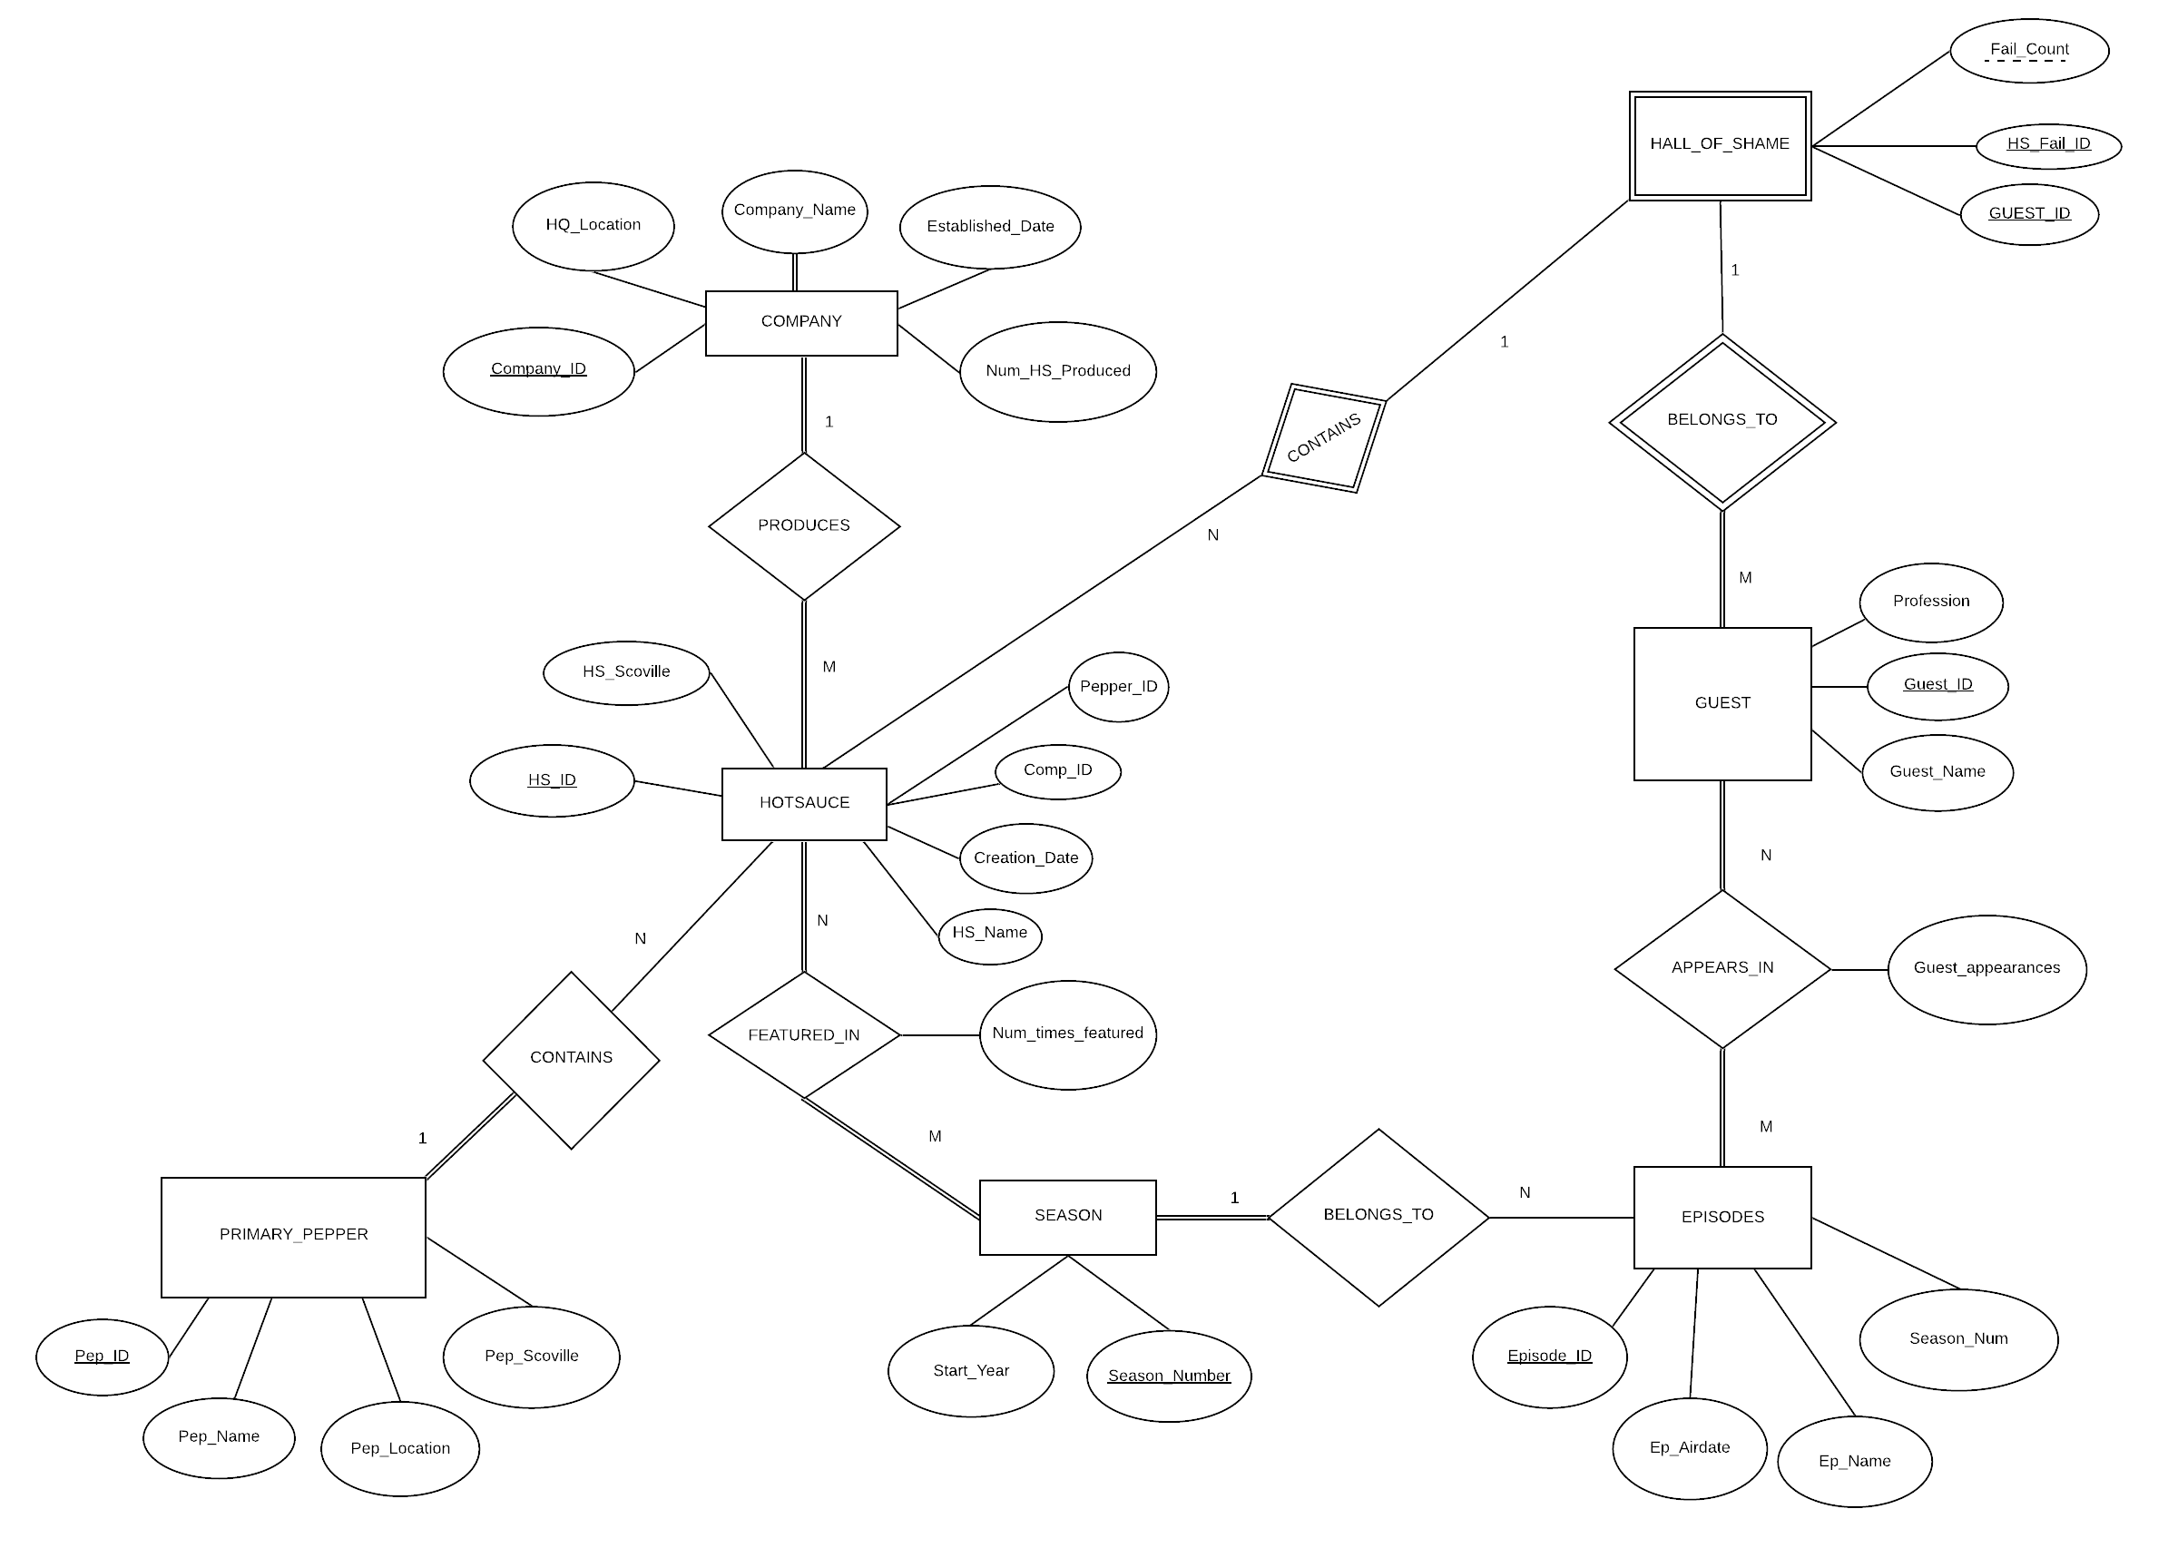
ER DIAGRAM
Main entities:
HOT SAUCE, PEPPER, GUEST, EPISODES, COMPANY, HALL_OF_SHAME
We created new tables to handle M to N relationships

Slide 4
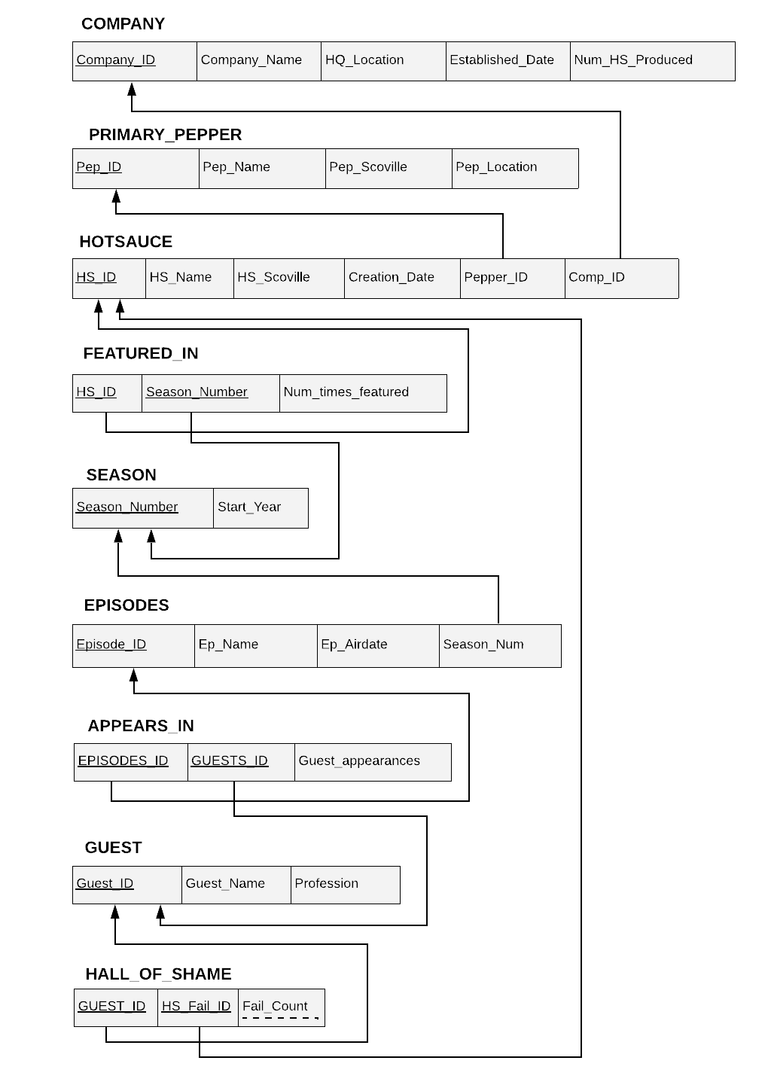
RELATIONAL SCHEMA PHASE III
More tables are added such that redundancy is reduced and the database is normalized
FEATURED_IN
APPEARS_IN
HALL_OF_SHAME

Slide 5
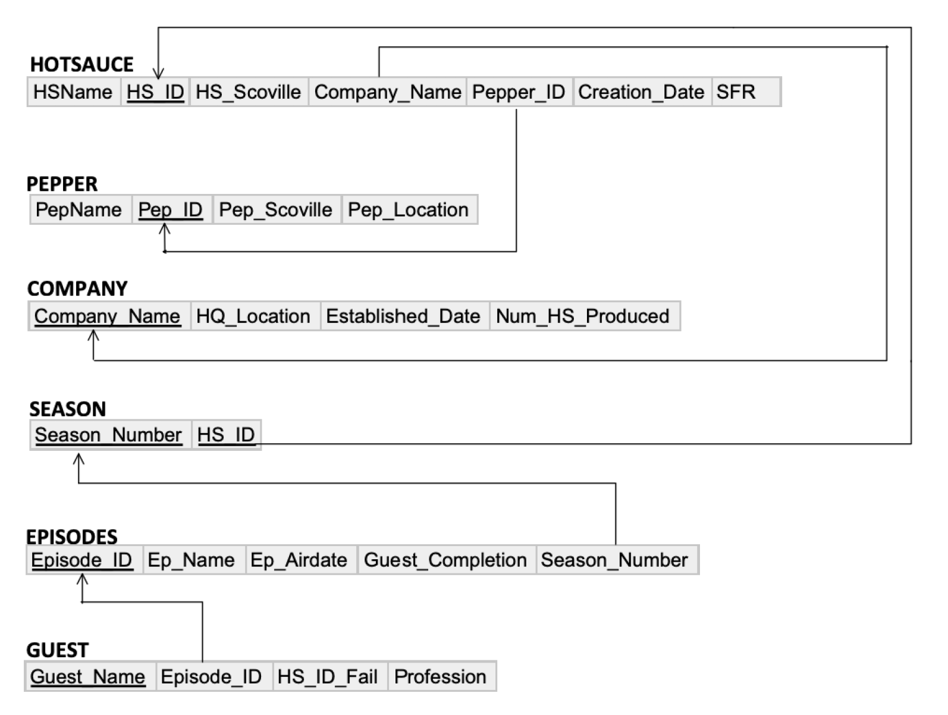
Removed:
SauceFailRate from HOTSAUCE
Guest_Completion, Episode_ID from GUEST
More redundancy within tables
RELATIONAL SCHEMA PHASE II

Slide 6
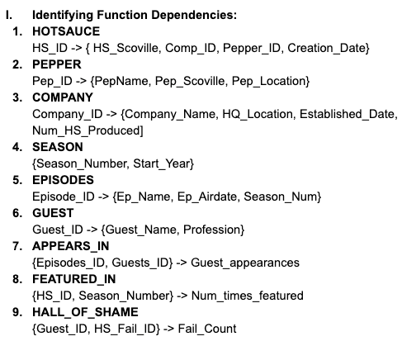
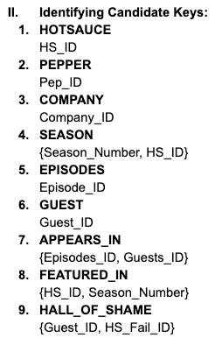
NORMALIZATION PROOF

Slide 7
LETS JUMP INTO THE DEMO!
https://spicyones.azurewebsites.net/

Slide 8
CHALLENGES
Encountered issues when trying to connect MySQL to Visual Studio, needed to revert to an older version of MySQL
Had difficulty connecting Azure Server on the cloud to MySQL
Needed to alter the ER diagram/schema for normalization

Slide 9
REFERENCES
“The Chilli Hunter.” The Chilli Hunter, thechillihunter.blogspot.com/.
“First We Feast | Where Food, Drink & Pop Culture Converge.” First We Feast, firstwefeast.com/.
“Hot Ones.” Wikipedia, 12 Mar. 2020, en.wikipedia.org/wiki/Hot_Ones.
“Hot Ones Collection.” Heat, Heat Hot Sauce Shop, heathotsauce.com/collections/hot-ones.
“Hot Ones Hot Sauces.” HEATONIST, heatonist.com/collections/hot-ones-hot-sauces.
‌“Stack Overflow Developer Survey 2019.” Stack Overflow, insights.stackoverflow.com/survey/2019.

Slide 10
THANKS!
Do you have any questions?
Contact
support @spicyones.com
https://github.com/ibokov/SpicyOnes

