Slide 1
Métodos de Sort

Slide 2
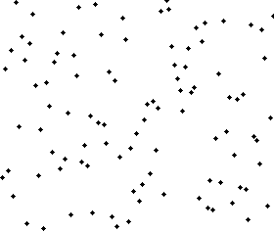
Método Burbujeo

Slide 3


Ordenamiento por inserción

Slide 4
Ordenamiento por inserción

Slide 5
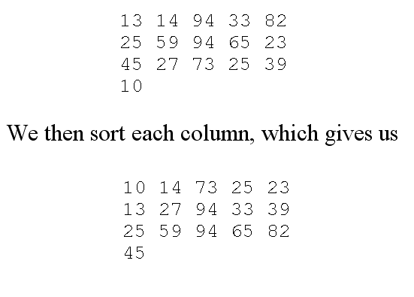
Ordenamiento Shell
insertion sort is efficient if the input is "almost sorted", and
insertion sort is typically inefficient because it moves values just one position at a time.
Best sequence: 1,4,10,23,57,132,301,701,(progresión geométrica)
For example, consider a list of numbers like:
  [ 13 14 94 33 82 25 59 94 65 23 45 27 73 25 39 10 ]
If we started with a step-size of 5, we could visualize this as breaking the list of numbers into a table with 5 columns. This would look like this:

Slide 6
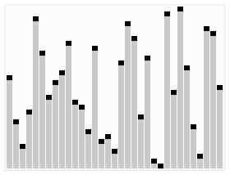
QuickSort

