Slide 1
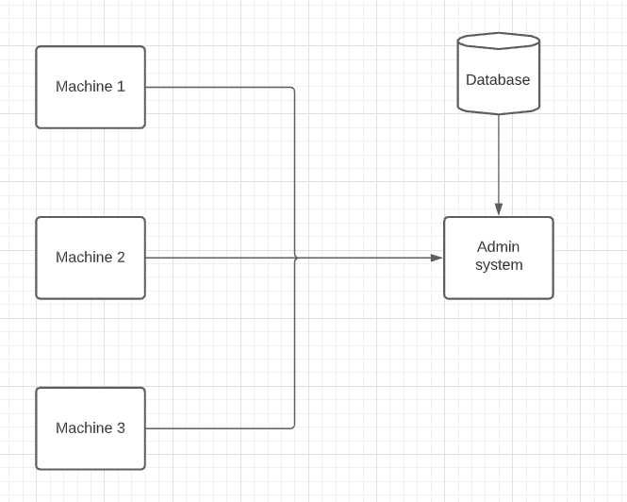
Current Diagram - All

Slide 2
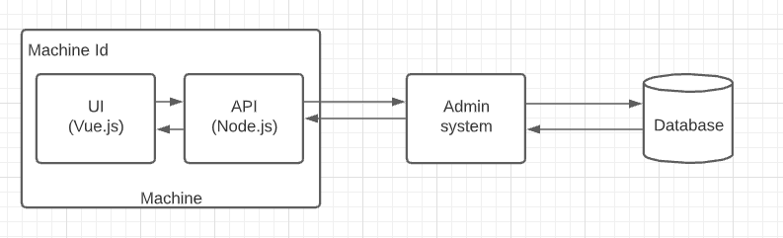
Current Diagram – Machine side

Slide 3
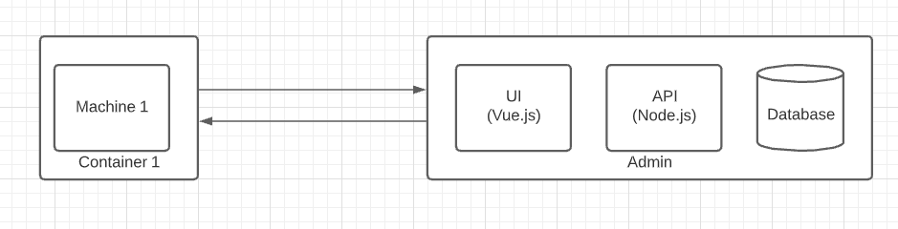
Current Diagram – Admin side

Slide 4
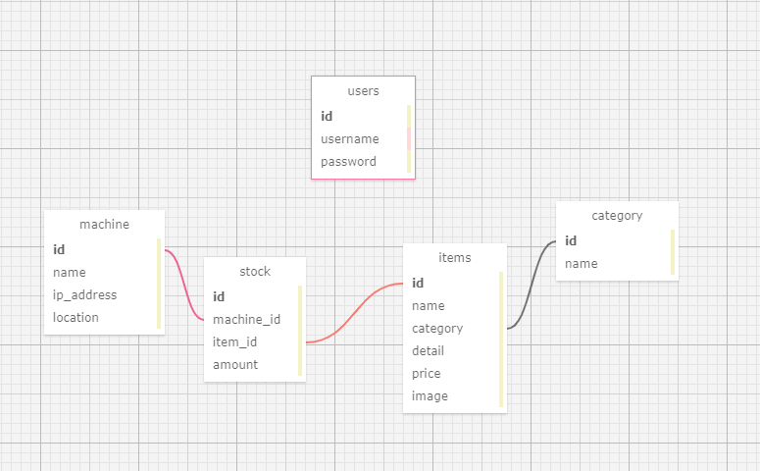
Current Diagram – Database

Slide 5
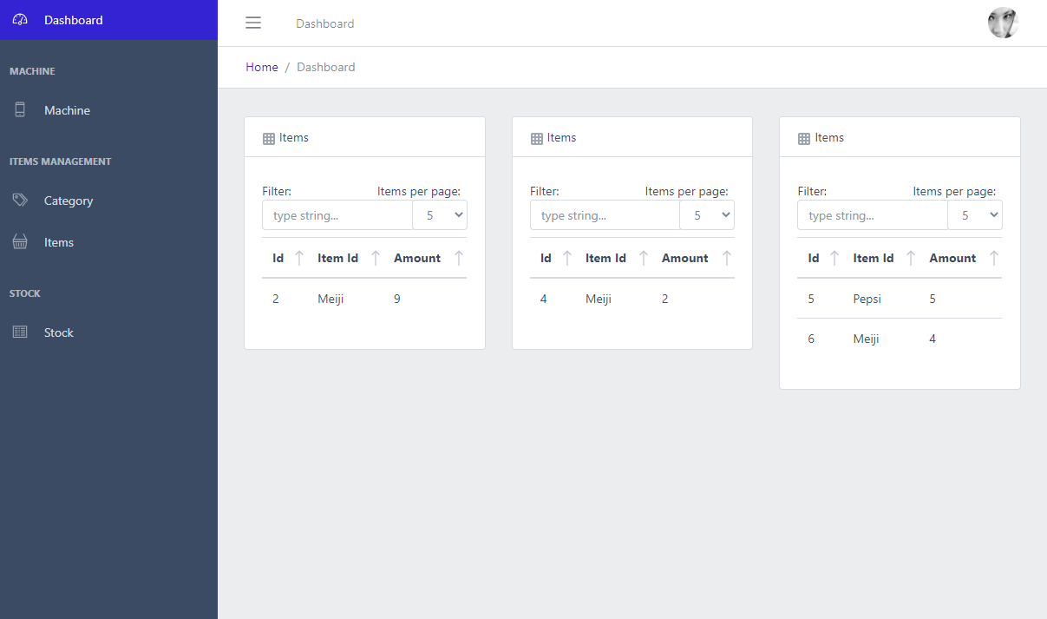
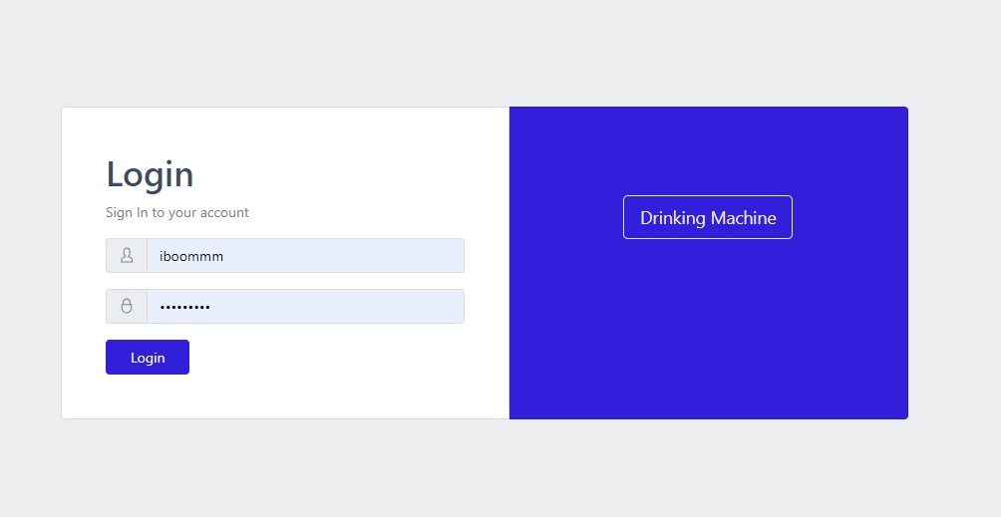
Current Diagram – UI
Login page
Admin Dashboard
- Showing item amount less than 10 in every machine

Slide 6
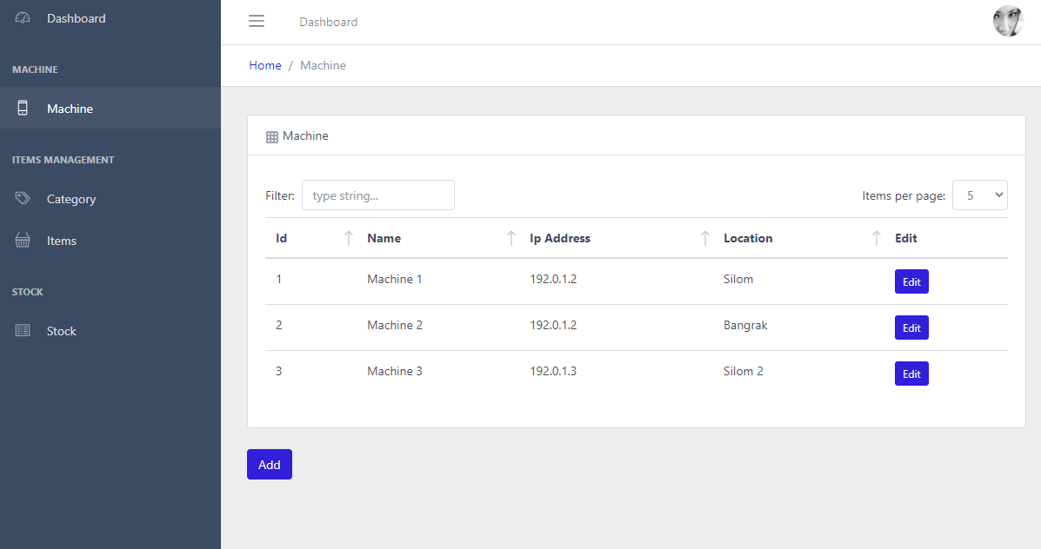
Current Diagram – UI
Machine management

Slide 7
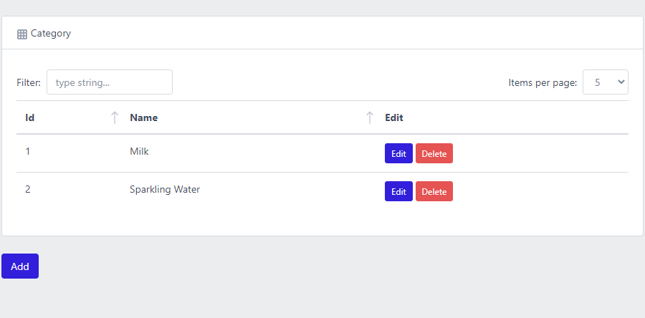
Current Diagram – UI
Category management

Slide 8
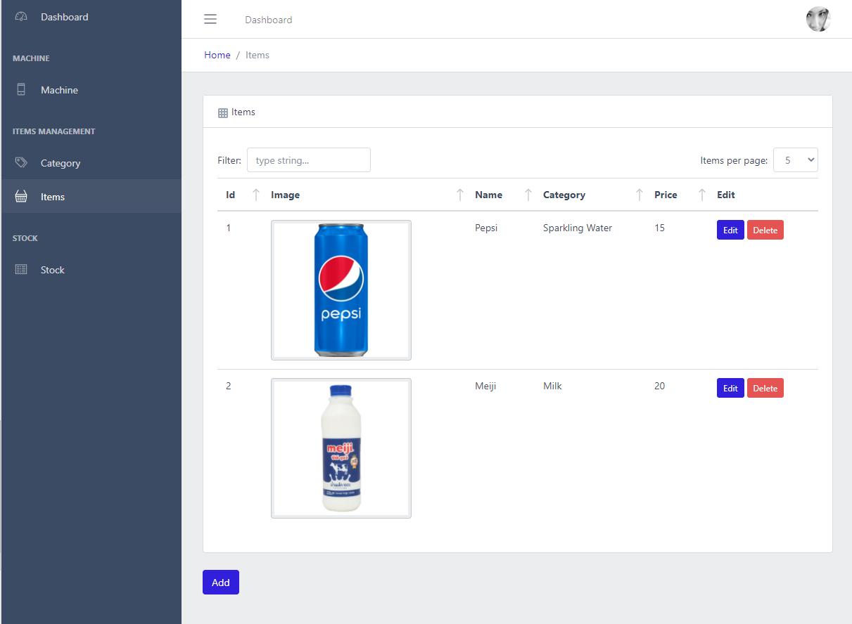
Current Diagram – UI
Items management

Slide 9
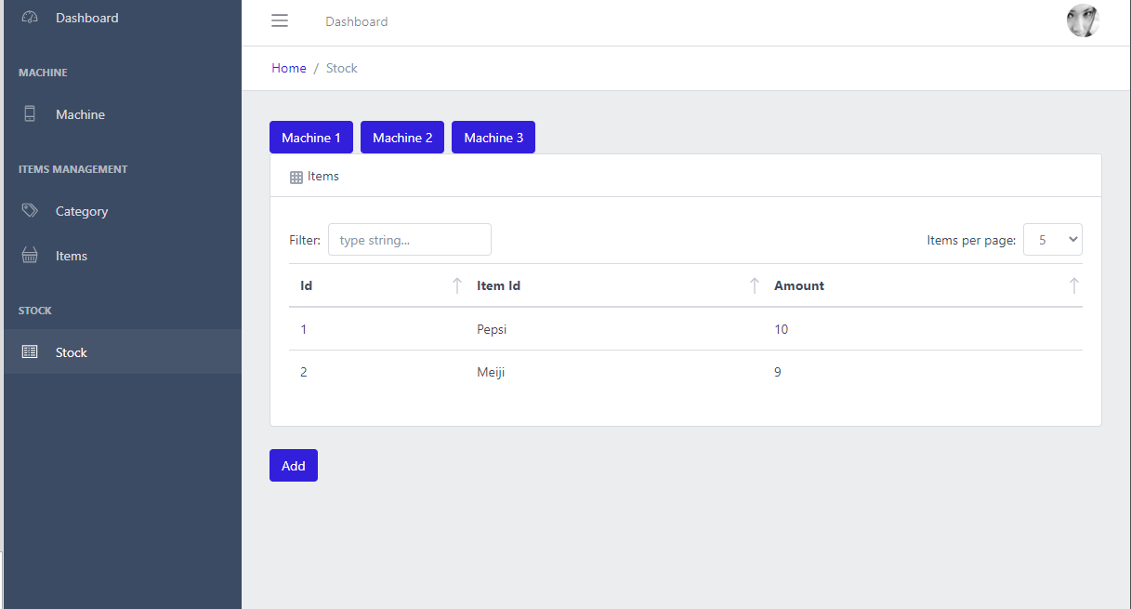
Current Diagram – UI
Stock management

Slide 10
Current Diagram – Goal
Machine
UI => Can interrace with UI and can order drink.
API => Can check last price and promotion.
Admin
UI => Can manage all require table
API => Can manage all require table and setup with JWT base.

Slide 11
Current Diagram – Current status after 1 week
Machine
UI => Can interrace with UI and can order drink.
API => Can check last price and promotion.
Admin
UI => Can manage all require table
API => Can manage all require table and setup with JWT base.
Done Not done yet

Slide 12
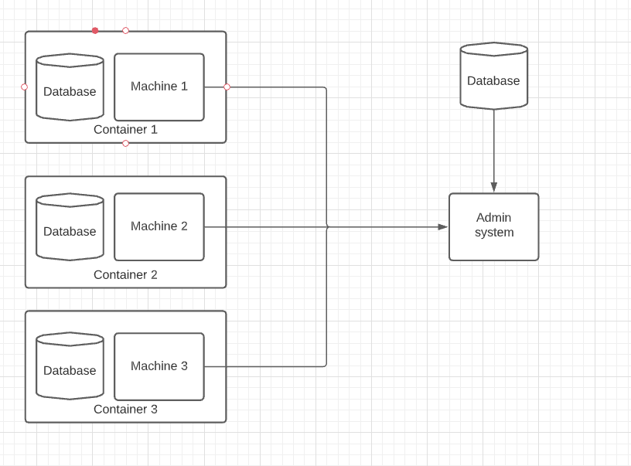
Current Diagram – Future upgrade
Create DB to every box for offine case
Machine Api will only fetch data from admin side and sent the last amount of items

Slide 13
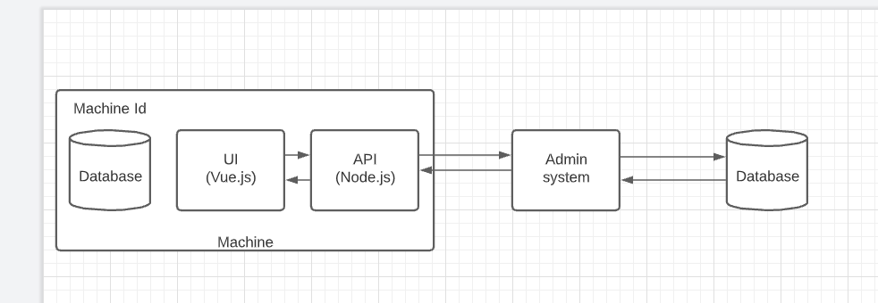
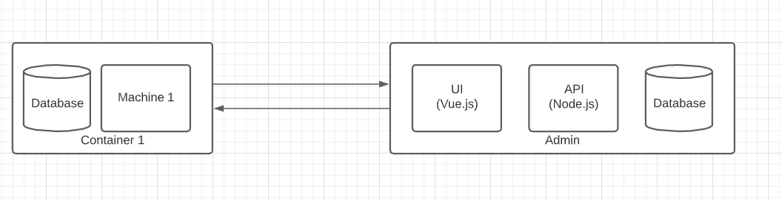
Current Diagram – Future upgrade
Machine side
Admin side

