Slide 1

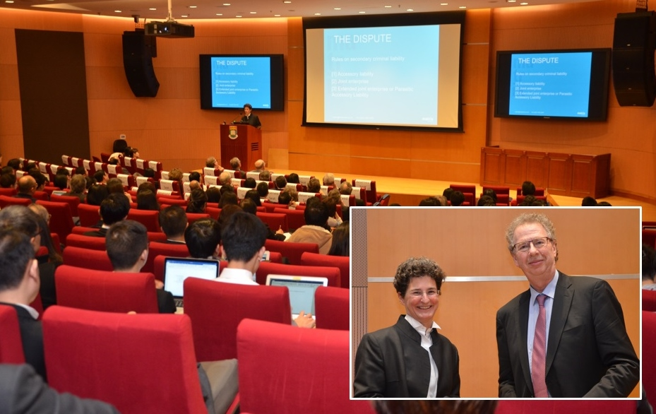
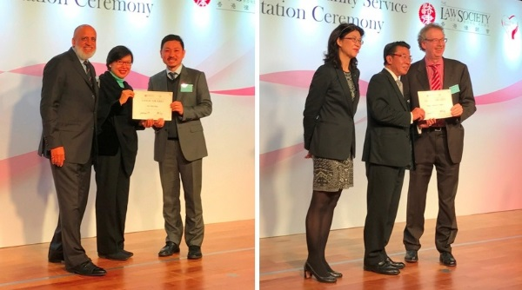
February 2017
Boase Cohen & Collins
News:
“Our Lecture
Series could
not have
got off to a
better start
and we have
set the bar
high with
regard to
next year’s
event”
Clare Montgomery delivers her lecture; (inset) pictured with Colin Cohen.
BC&C’s inaugural Criminal Law Lecture at University of Hong Kong is huge success
A large audience and an electrifying talk from award-winning international barrister Clare Montgomery QC helped make the inaugural Boase Cohen & Collins Criminal Law Lecture an overwhelming success. More than 250 people attended, including senior figures from the Department of Justice, members of the Judiciary and high-profile barristers and solicitors. They joined law students from Hong Kong’s three law schools – the University of Hong Kong, which hosted the event, Chinese University and City University. Read more...
Alex Liu and firm saluted for pro bono work
BC&C and Partner Alex Liu have once again been recognised by the Law Society of Hong Kong for their commitment to the community. Mr Liu received a Gold Award under the Law Society’s Pro Bono and Community Work Recognition Programme for the third year in a row while BC&C was collectively honoured with a Bronze Award. Read more...
Proud sponsors of Hong Kong’s Inter-School Sailing Festival

