Slide 1
Add a modular heat pump approach #1576
https://github.com/ibpsa/modelica-ibpsa/issues/1576

Slide 2
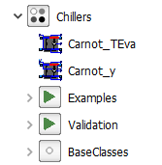
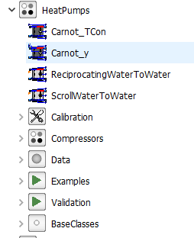
Motivation
IBPSA offers essentially two heat pump models
Carnot (y and TCon)
WaterToWater (Scroll and Reciprocating)
IBPSA offers essentially one chiller model
Carnot (y and TCon)
Central technology for energy transition → IBPSA should offer more options
Options
Different sinks and sources (air, water, brine, …)
Different sizes (small and large scale)
Different model approaches (White, Gray, Black-box)
Devices can be reversible, act as one another (currently not offered at all)
Modular reversible approach to have one model interface (parameters, assumptions, …) but flexible model options

Slide 3
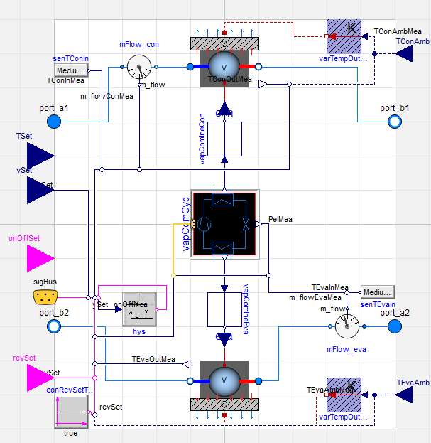
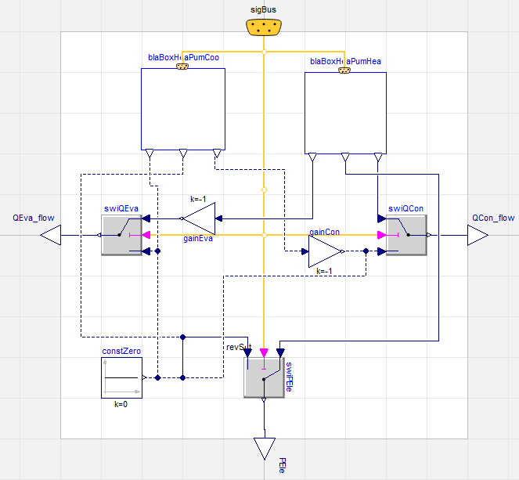
How the model looks IBPSA.Fluid.HeatPumps.BaseClasses.PartialReversibleVapourCompressionMachine
Different Options

Slide 4
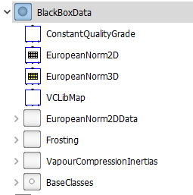
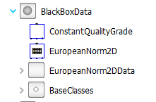
How the model looks IBPSA.Fluid.HeatPumps.BlackBoxData
Heat pump approaches
Carnot
European Data 2D and 3D (EN 14511)
ASHRAE tbd.
VCLib (validated stationary performance map) → SDF Problem
Chiller approaches
Carnot
European Norm 2D (EN 14511)
ASHRAE tbd.
Discussion: Is BlackBoxData fitting?
Carnot or VCLib are purely physical models, i.e. white-box
To the system level, the models are I/O, i.e. black-box
What could be a better name?
Discussion: Is “revSet” fitting?
Prior: ModeSet for mode of heat pump
Currently: ReverseSet → Not Backwards compatible
RefrigerantCycle
coo and hea

Slide 5
Current status
Mayor changes compared to AixLib
Different naming
Easy parameterization
No external bus connector (still available for libraries if wanted) → Merge scripts to be adjusted
Several fixes to be compatible to OpenModelica
Added carnot models instead of functions
…
Open points
Finalize Examples for heat pumps → On/Off enough?
Create Examples for chillers
Write Documentation
Discussion: What to delete
TSet option (would require even more examples → tbd. in a later issue
SDF option → Requires SDF option in MSL (https://github.com/modelica/ModelicaStandardLibrary/issues/1153)
In later issue
Provide speed comparison

