Slide 1
E-commerce Performance Analysis
Ibrahim Alhashim | Data Analyst Project | 2026
SQL • Power BI • DAX

Slide 2
The Business Context
Olist is one of Brazil's largest e-commerce marketplaces,
connecting thousands of small sellers with buyers nationwide.
This analysis explores ~193,000 orders processed between
2016 and 2018 to answer key business questions:
- How is revenue performing over time?
- Which products and sellers drive the most value?
- How reliable is the delivery experience for customers?
- Where are the biggest opportunities for improvement?

Slide 3
Data & Approach
Dataset: Olist Brazilian E-commerce Public Dataset
Source: Kaggle
Scope: ~193,00 0 orders | 9 relational tables | 2016–2018
Tools Used:
- PostgreSQL: data extraction, transformation, aggregation
- Power BI : data modeling, visualization, dashboard
- DAX : calculated measures (KPIs, % calculations)
Workflow:
1. Explored relational schema and identified key fact/dimension tables
2. Wrote SQL queries (CTEs, aggregations, CASE logic) to produce clean datasets
3. Imported into Power BI and built calculated measures with DAX
4. Designed an interactive dashboard around revenue, delivery, and seller performance

Slide 4


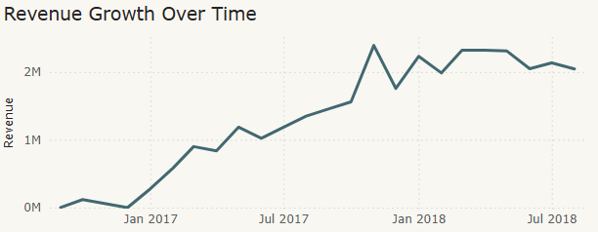
Revenue Performance
Revenue scaled rapidly through 2017, stabilizing at ~R$ 2M/month in 2018
Key Takeaway:
The platform scaled aggressively in 2017, growing revenue
from R$ 280K to R$ 2.4M/month. By 2018, growth stabilized,
suggesting market maturation and the need for new strategies
to drive the next phase of growth.

Slide 5
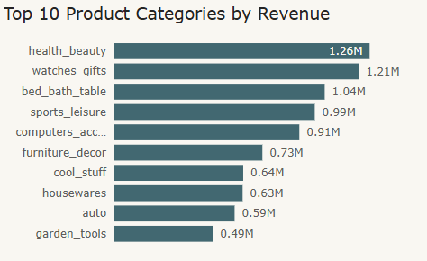
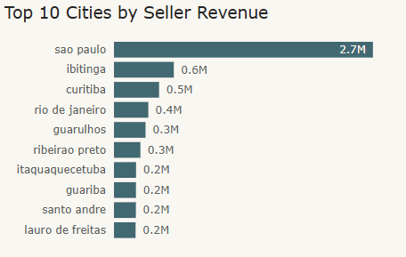
Product & Seller Analysis
Revenue is concentrated in a few categories and heavily driven by São Paulo-based sellers
Key Takeaway:
The top 3 product categories (Health & Beauty, Watches & Gifts,
and Bed & Bath) generate nearly 30% of total revenue. Geographically,
São Paulo dominates seller activity with R$ 2.7M, nearly 4x the next
city. This concentration is both a strength (focus) and a risk
(dependency on a narrow seller base).

Slide 6
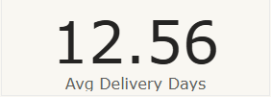

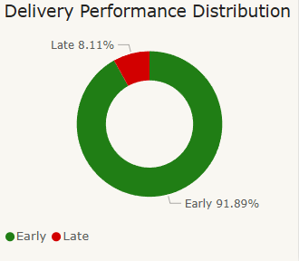
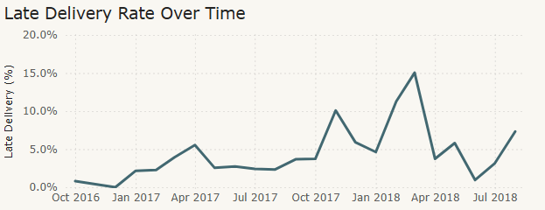
Delivery Performance
92% of orders arrive on time or early, but volatility in 2018 signals a growing risk
Key Takeaway:
Overall delivery performance is strong (91.89% early or on-time)
with an average delivery time of 12.56 days. However, late deliveries
spiked sharply in early 2018, peaking above 15%. This points to
operational strain during high-demand periods and a need for
better capacity planning during peak months.

Slide 7
Recommendations
Based on the analysis, three strategic priorities emerge:
1. Strengthen Peak-Season Delivery Capacity
Late delivery rates spiked above 15% in early 2018, suggesting logistics strain during high-volume periods.
Action: Invest in carrier partnerships and regional fulfillment centers ahead of Q4 and seasonal peaks.
Impact: Reduce late delivery rate toward the 5% benchmark and protect customer retention.
2. Diversify the Seller and Category Base
Revenue is heavily concentrated in a few categories and in São Paulo-based sellers, creating dependency risk.
Action: Launch targeted seller onboarding campaigns in underrepresented cities and mid-tier categories.
Impact: Stronger resilience against regional or category-level shocks.
3. Leverage Delivery Strength as Marketing Advantage
With 91.89% of orders arriving early or on-time, delivery is a genuine competitive strength that's currently undersold.
Action: Highlight delivery reliability in marketing, product pages, and seller scorecards.
Impact: Differentiation vs. competitors and stronger buyer trust.

Slide 8
Thanks
Do you have any questions?
Email
LinkedIn
GitHub

