Slide 1
Wheatech

Slide 2
Why we choose yellow rust
“the crop Corona”, growing intensely the past 5 years as global warming worsened, which can ultimately destroy up to 100% of the crop.

Slide 3
1. Phases of Model

Slide 4
PHASES OF MODEL
1) Data Collection
2) Data Preprocessing
3) Correlation
4) Data Analysis
5) Splitting Data
6) Learning Model
7) Testing Model

Slide 5
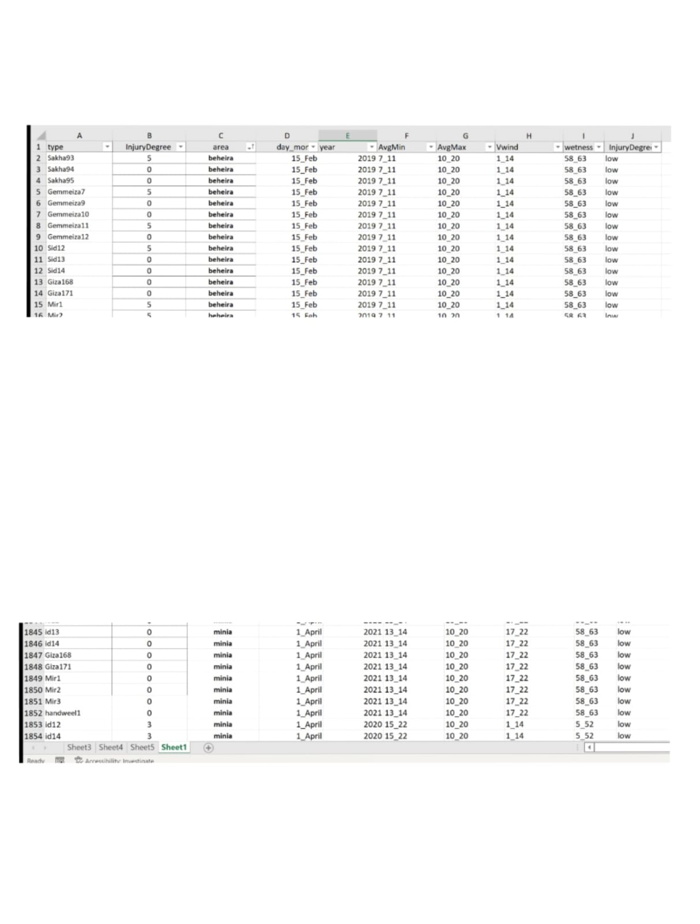
DATA COLLECTION
Taken from 2 entities
Agriculture Research Centre
- types of wheat - injury degree
-area - year - month
Egyptian Meteorological authority
- temperature – wind velocity - witness – sample size: 1854 row

Slide 6
DATA PREPROCESSING
Single Imputation
Generates 1 value
Multiple Imputation
Generates more than 1 value → more accurate
Techniques include: mean, mode, median.hot deck, regresion
Type example: multiple regression
Missing Data
- causes bias - 2 ways to solve this problem: A) delete (it can be used only if the missing is less than 10%)
B) impute (if missing is more than 10%)

Slide 7
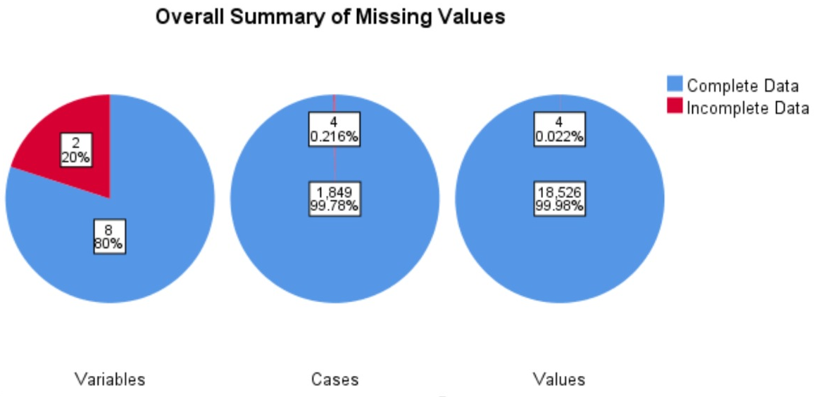

Slide 8
DATA PREPROCESSING
2) Data Transformation
2.1- discretization : convert data from numerical to categorical to decrease size of observations
2.2- encoding : convert data from categorical to numerical

Slide 9
How to find the “best” feature?

Slide 10
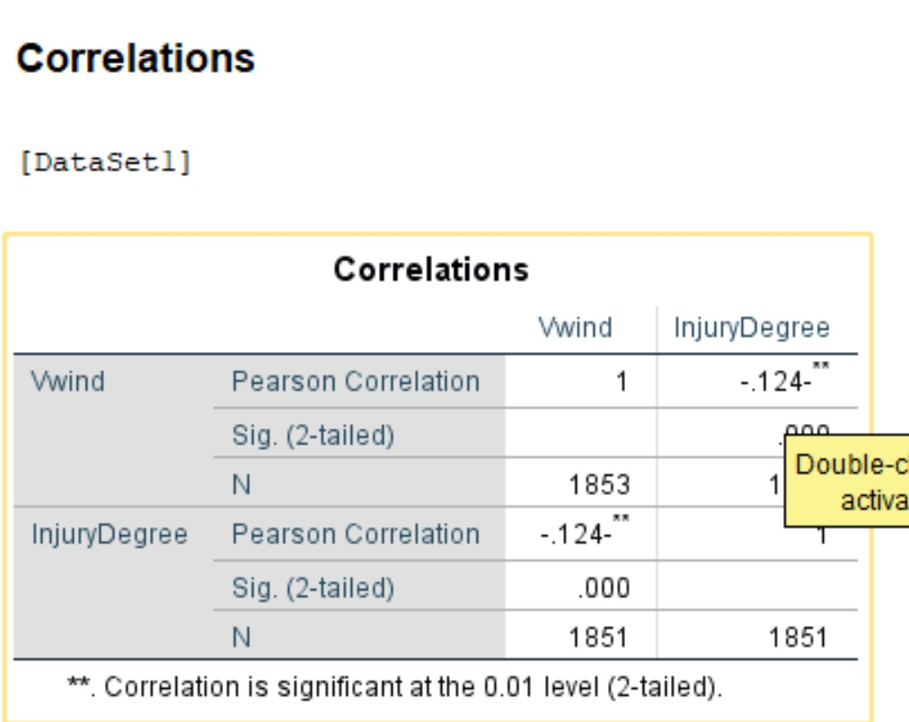
Feature Selection
The best features are the ones that have a degree of correlation between each other.

Slide 11
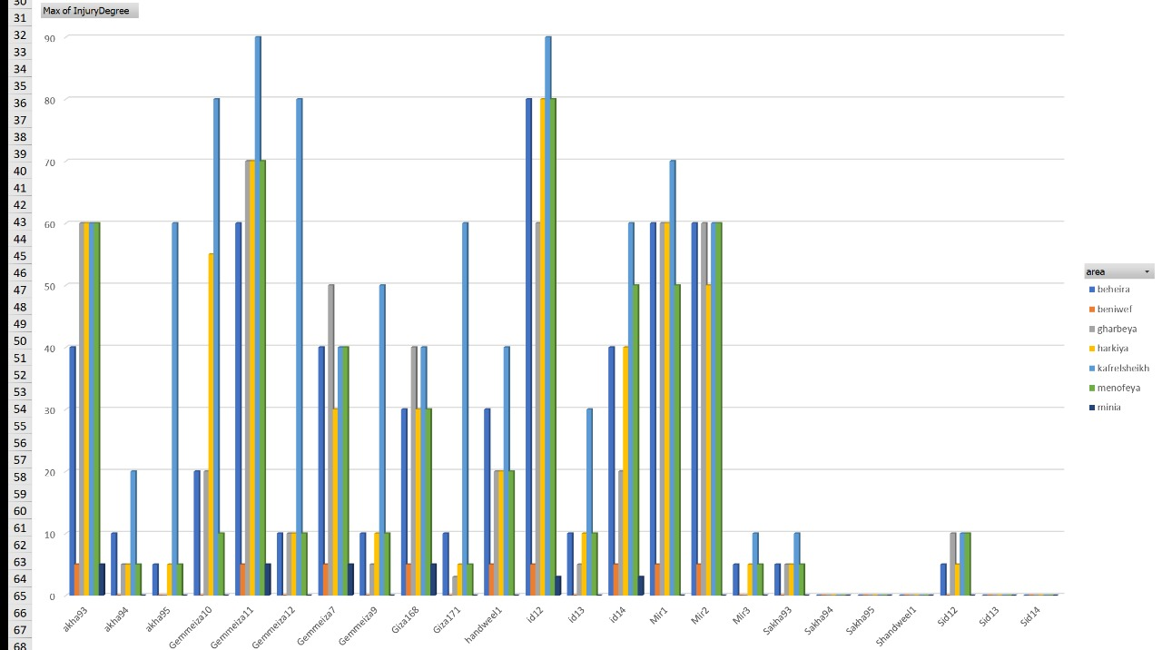
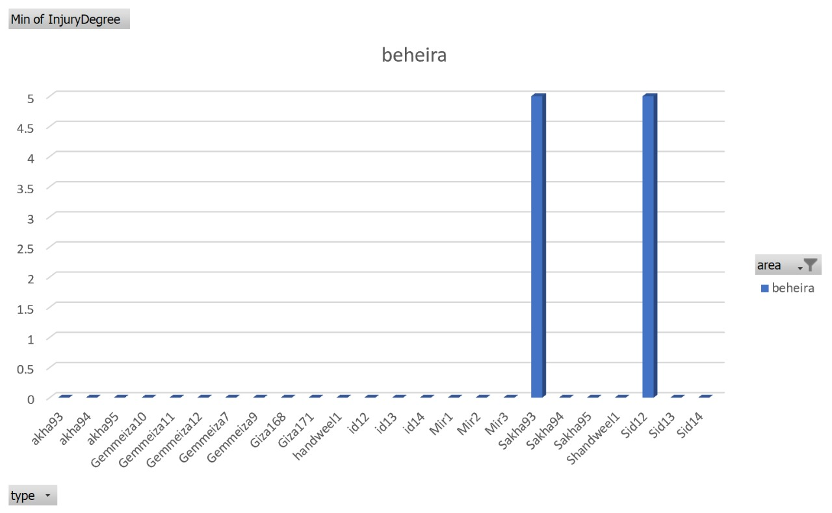
Data Analysis
1- what is the most affected area?
2- what is the least affected area?

Slide 12
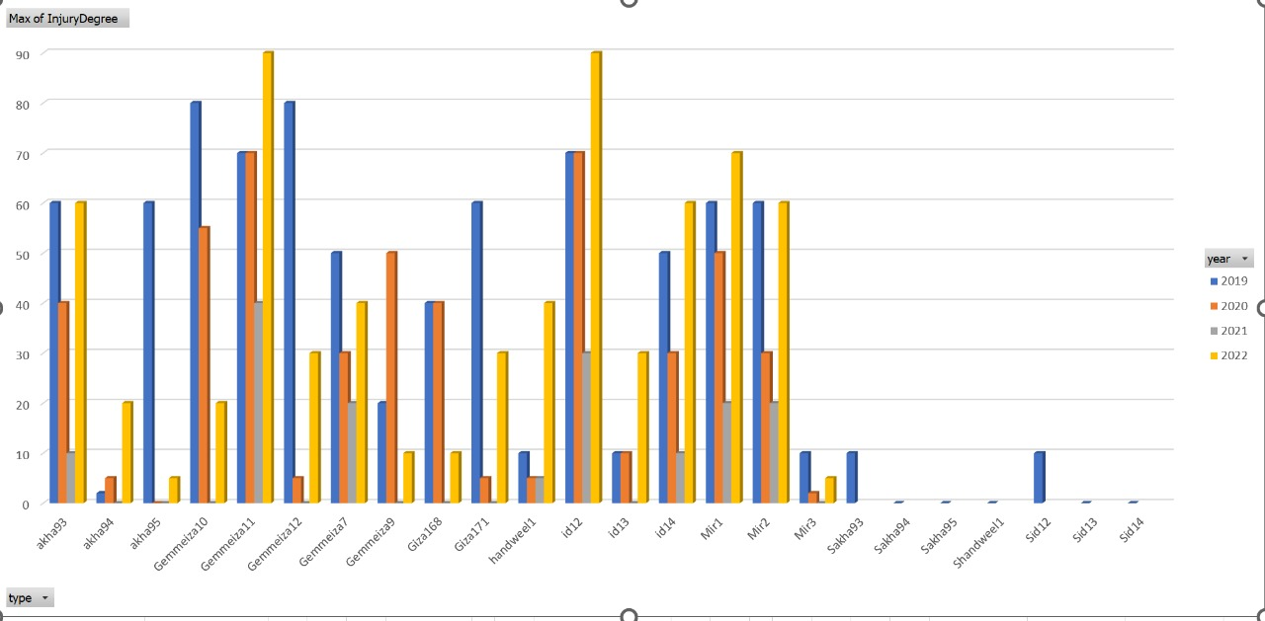
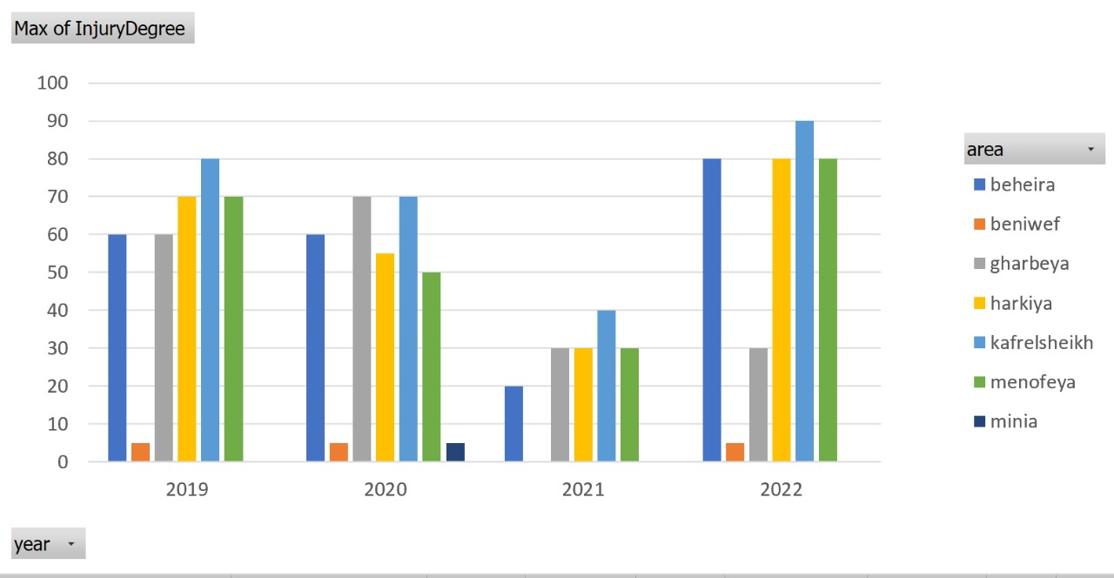
Data Analysis
3- what is the most affected plant type in each year?
4- what is the most affected type in each area?

Slide 13
SPLITTING DATA
Data is split into 2 parts:
Used in training process
Used in testing (testing model)
Methods:
Hold out (Training: 70/80%, Testing 20/30%)
K Fold (All data is used in training and testing)

Slide 14
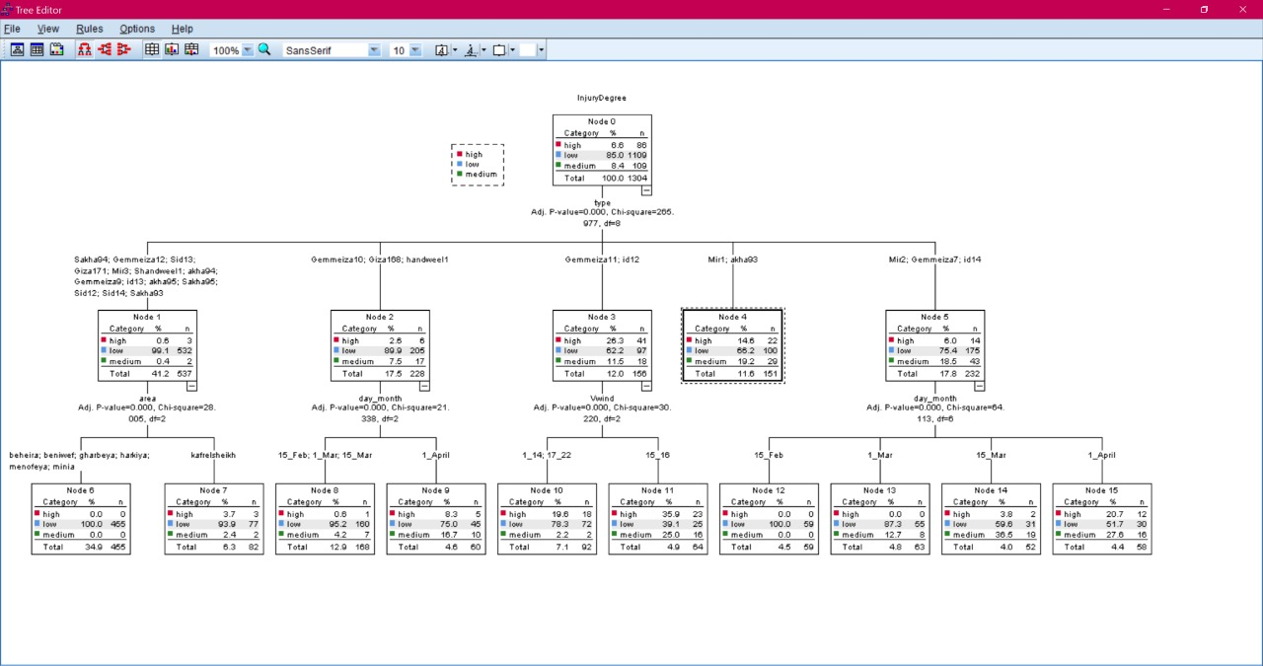
Learning Model
We input the training data in the algorithm to extract knowledge.

Slide 15
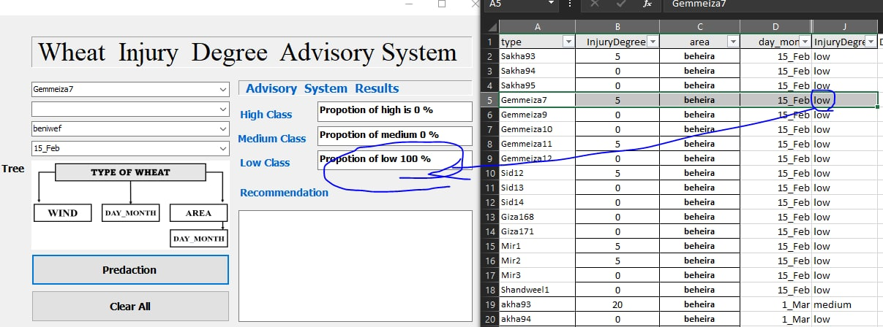
Testing Model
We convert knowledge into rules that applied to predict the test data and we evaluate model according to it's accuracy

Slide 16

Thank You!
Any questions?

