Slide 1
CloudVote
A multi-container voting app, built and deployed on AWS
Cloud Computing Capstone
Live: https://voting.ibraheembello.com Ibraheem Bello
Notes:
CloudVote: a real-time multi-container voting app. The app is deliberately simple; the architecture, containerisation, CI/CD and cloud deployment are the focus.

Slide 2
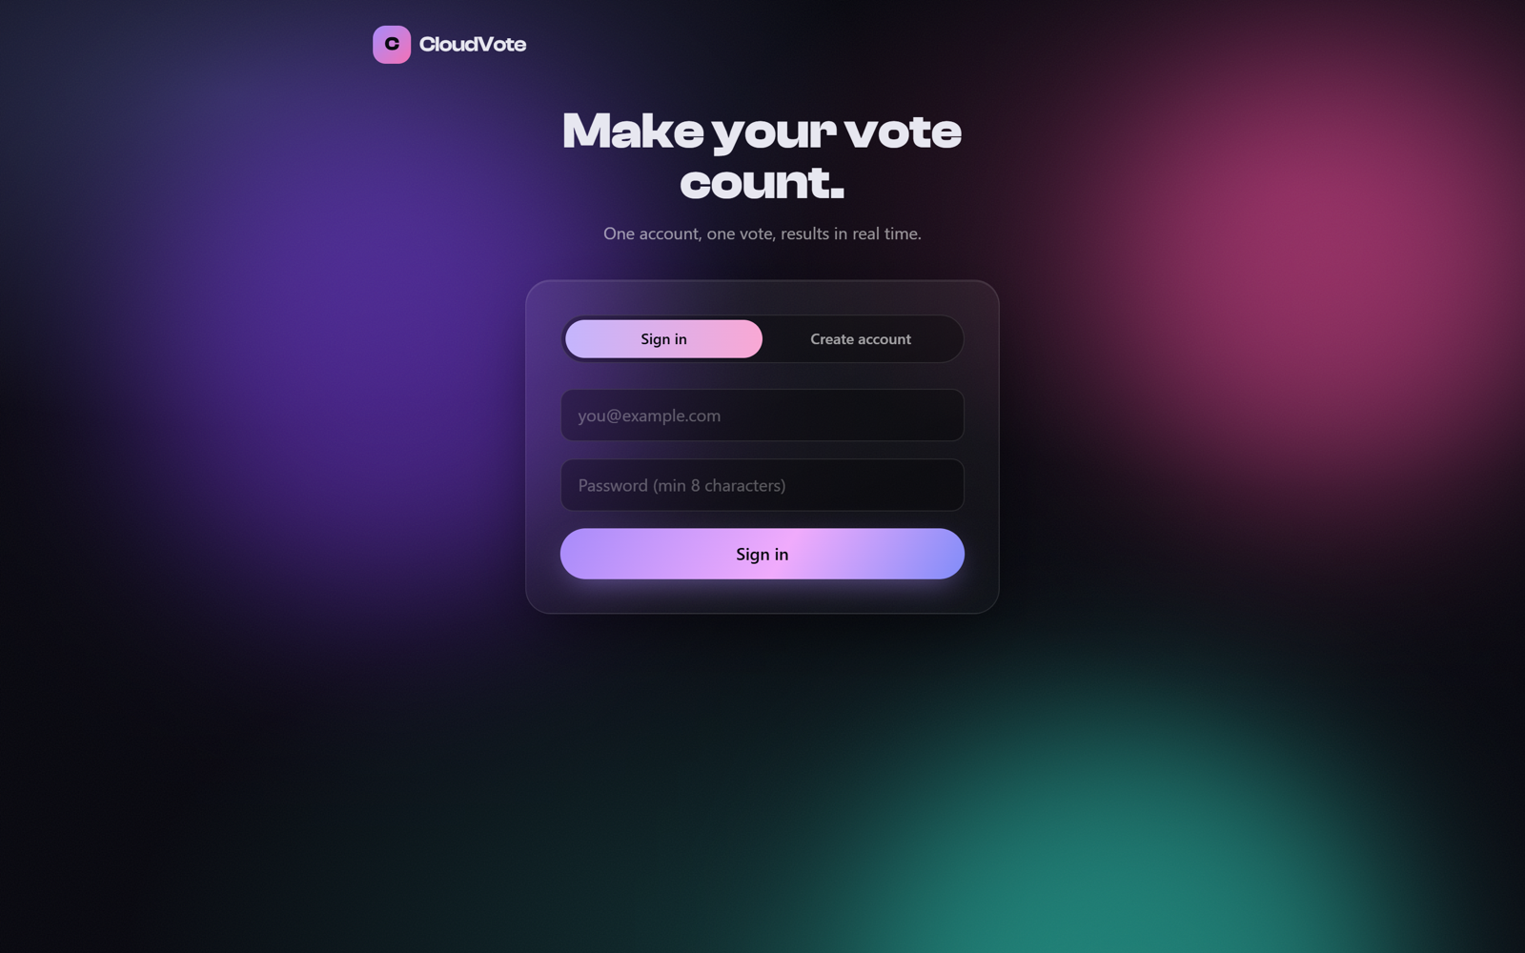
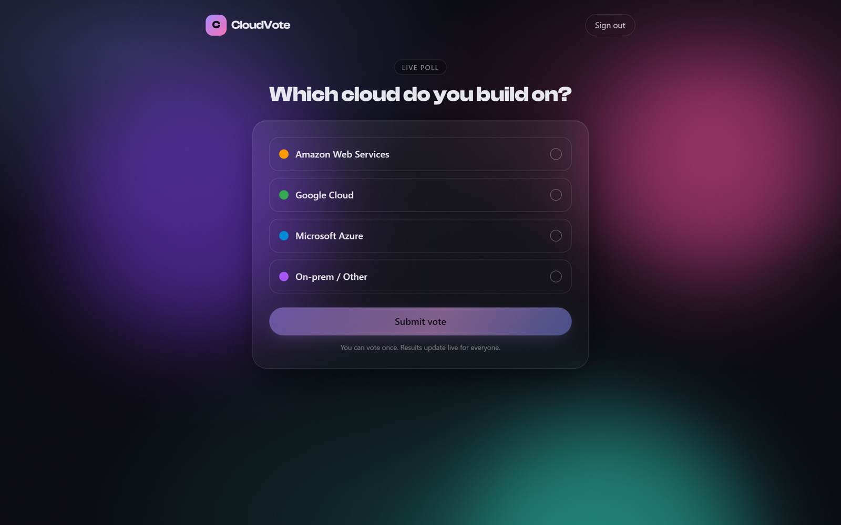
PROJECT INTRODUCTION
What CloudVote is
A real-time poll where people sign in, cast one vote, and watch results update live. It runs as a set of cooperating containers so the write path stays fast and the read path is cached.
Accounts and one vote per user
Votes queued, then persisted by a worker
Results cached in Redis, served live
Admin dashboard with live statistics
Health checks on every service

Slide 3
PROBLEM STATEMENT
The problem we set out to solve
Spiky write load
Honest results
Production concerns
A burst of votes should never slow the site or lose a vote.
Every account votes once, and the count must stay correct under retries.
It needs auth, HTTPS, health checks, logging and a repeatable deploy, not just a demo.
The application stays small on purpose. The learning is in the architecture and the cloud operations around it.

Slide 4
SYSTEM ARCHITECTURE
How a vote flows through the system
User
Host nginx
web
api
browser, HTTPS
TLS, reverse proxy
React SPA (nginx)
NestJS
worker
Redis
BRPOP, persist
queue + results cache
cached reads +
cold-cache fallback
The API accepts a vote, flips has_voted atomically, and queues it. The worker drains the queue and writes the database with ON CONFLICT DO NOTHING, so retries never double-count.
PostgreSQL
system of record

Slide 5
TECH STACK USED
Built in TypeScript, end to end
Frontend
Backend API
Worker
React, Vite, Tailwind, Framer Motion
NestJS, TypeORM, Passport JWT, bcrypt
Node.js, ioredis, node-postgres
Data
Containers
Cloud + CI/CD
PostgreSQL 16, Redis 7
Docker, Compose, multi-stage, non-root
AWS EC2, nginx, Certbot, GitHub Actions, GHCR

Slide 6
CI/CD WORKFLOW
Every push to main ships itself
Lint + unit tests (API, worker), build the frontend
1
Test
Build 3 images, push to GHCR tagged by commit SHA
2
Build + push
SSH to EC2, pull the SHA images, docker compose up
3
Deploy
Smoke-test /health, roll back to last-good on failure
4
Verify + rollback
Images are tagged with the commit SHA, not only latest, so a rollback is a one-line redeploy.

Slide 7
DEPLOYMENT PROCESS
Deployed on AWS behind nginx and HTTPS
1
Images built in CI and pushed to GHCR
Infrastructure
EC2 host pulls the SHA-tagged images
Host
AWS EC2 (shared with the portfolio site)
2
DNS
Route 53, voting.ibraheembello.com
3
docker compose brings up db, redis, api, worker, web
TLS
Let's Encrypt via Certbot, auto-renew
4
Host nginx terminates TLS and proxies to the web container
Secrets
GitHub Actions secrets + chmod 600 .env
5
Certbot issues and auto-renews the certificate
Isolation
db and redis never exposed publicly

Slide 8
CHALLENGES ENCOUNTERED
What got in the way
One vote, under retries
Small host, many services
A naive check-then-write race could let a user vote twice or double-count.
The host has under 1 GB of RAM and already runs the portfolio site.
Container health in Alpine
Reproducible builds
Health checks failed even though the app was up and listening.
Installs behaved differently between the dev machine and the CI image.

Slide 9
SOLUTIONS IMPLEMENTED
How each one was solved
Atomic guard + unique index
Loopback + swap + lean images
UPDATE ... WHERE has_voted = false, plus ON CONFLICT DO NOTHING on a unique user_id. Retries are safe.
Containers bind 127.0.0.1 only; the host fronts them. Alpine images and a 2 GB swapfile keep memory in budget.
127.0.0.1 health checks
Pinned pnpm + frozen lockfile
Alpine resolves localhost to IPv6 first; pointing checks at 127.0.0.1 fixed every health check.
packageManager pins pnpm, and installs are frozen, so CI and prod match the dev machine exactly.

Slide 10
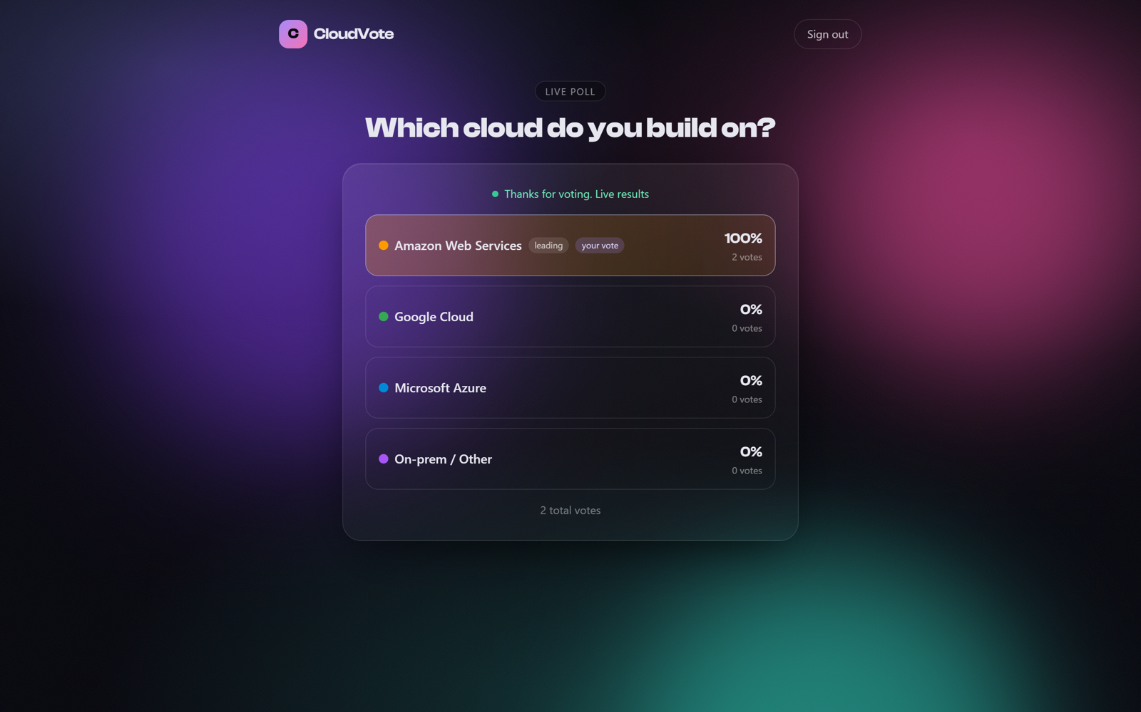
RESULTS AND OUTCOMES
Live, tested, and automated
5
containers, all health-checked
3
images built and shipped on every push
100%
automated deploy with rollback
End to end: register, vote, the worker persists it, results update, and a second vote is refused.
HTTPS
live on a custom subdomain

Slide 11
FUTURE IMPROVEMENTS
Where it goes next
Multiple polls
CloudWatch + alarms
Let admins create and schedule polls, not just the seeded one.
Ship container logs to CloudWatch and alert on CPU or queue depth.
Horizontal scale
Managed data
Run several API and worker replicas behind a load balancer.
Move Postgres to RDS and Redis to ElastiCache with backups.
WebSocket live updates
Rate limiting
Push results instead of polling every few seconds.
Protect auth and vote endpoints from abuse.

Slide 12
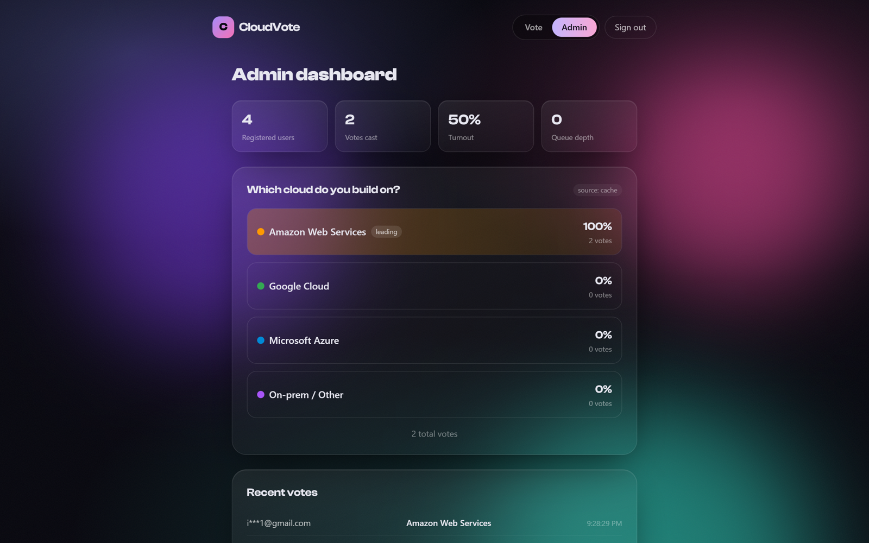
CONCLUSION AND DEMONSTRATION
CloudVote is production-ready
The build
A multi-container voting app, containerised, tested, shipped by CI/CD, and deployed on AWS with HTTPS.
Live
voting.ibraheembello.com
Code
github.com/ibraheembello/
multi-container-voting-app
Notes:
Demo: open the live URL, register, vote, show the live results and the admin dashboard.

