Slide 1
MIN-CONFLICTS
Nagy Nabil Mohamed
Ahmed Mahmoud Azzam
Ibrahim Yasser
Mohamed Adel
Mohamed Hadhoud

Slide 2
What is min-conflicts algo?
Min conflicts is local search algorithm used to solve CSPs
So let’s take two steps backward, and understand what is local search algorithms

Slide 3
LOCAL SEARCH ALGORITHMS

Slide 4
Local Search Algorithms
The search algorithms that we have seen so far are designed to explore search spaces systematically.
This systematicity is achieved by keeping one or more paths in memory and by recording which alternatives have been explored at each point along the path.
However in many problems we don’t care about the path, only the final configuration is what matters
For example 8 queens
Local search algorithms operate using CURRENT NODE a single current node (rather than multiple paths) and generally move only to neighbors
of that node.

Slide 5
Local Search Notes
Local search algorithms typically use a complete-state formulation
A complete local search algorithm always finds a goal if one exists;
an optimal algorithm always finds a global minimum/maximum.

Slide 6
CSPs

Slide 7
Constraint Satisfaction Problem(CSP)
A Constraint Satisfaction Problem (CSP) is a formalism used to model and solve problems where a set of variables must be assigned values based on specified constraints.

Slide 8
Constraint Satisfaction Problem(CSP)
In a CSP, the problem is defined by:
Variables: Representing the elements to be determined or decided.
Domains: Specifying the possible values that each variable can take.
Constraints: Defining restrictions or relationships among the variables, restricting the combinations of values that are valid.
The objective of solving a CSP is to find an assignment of values to variables that satisfies all constraints, effectively reaching a solution where no constraint is violated

Slide 9
Let’s get back to how min-conflicts help solving CSPs

Slide 10
min-conflicts
Local search algorithms turn out to be effective in solving many CSPs. They
use a complete-state formulation: the initial state assigns a value to every variable, and the search changes the value of one variable at a time.
Typically, the initial guess violates several constraints. The point of local search is to eliminate the violated constraints
In choosing a new value for a variable, the most obvious heuristic is to select the value that results in the minimum number of conflicts with other variables => min conflicts

Slide 11
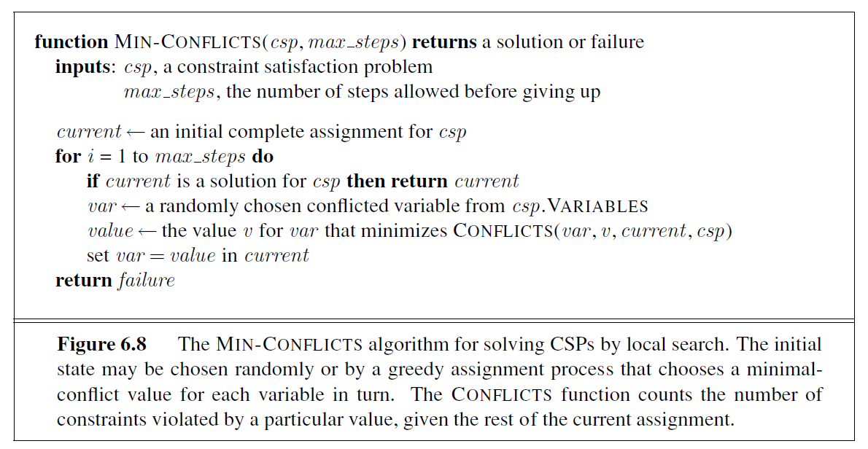
min-conflicts

Slide 12
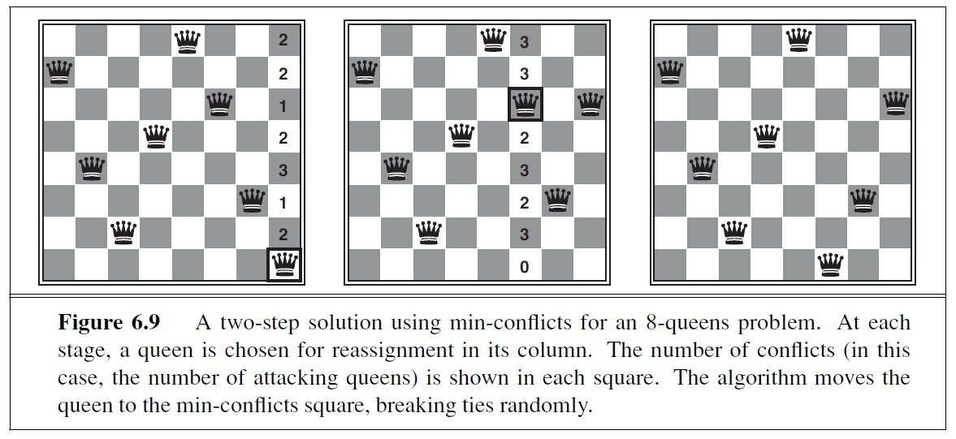
Min-conflicts example

Slide 13
Min-conflicts example
Min-conflicts is surprisingly effective for many CSPs. Amazingly, on the n-queens
problem, if you don’t count the initial placement of queens, the run time of min-conflicts is
roughly independent of problem size. It solves even the million-queens problem in an average
of 50 steps (after the initial assignment).

Slide 14
THANK YOU

