Slide 1
Schooling costs and literacy in rural Sindh
ECO346 Assignment 1 | FA24-BED-034 | Variant 2 (34 = 4 × 8 + 2): Sindh, rural
10,960
7,171
1,440
persons in variant
literacy sample, ages 10-64
students (ed_total > 0)
Data: PSLM 2019-20 person and household files. Every statistic is weighted by hhweight.
Notes:
Introduce variant: 034 = 4 x 8 + 2, so variant 2, Sindh rural. Person file joined to household file by hhid to get weight, province and area. Sample sizes are from my script output.

Slide 2
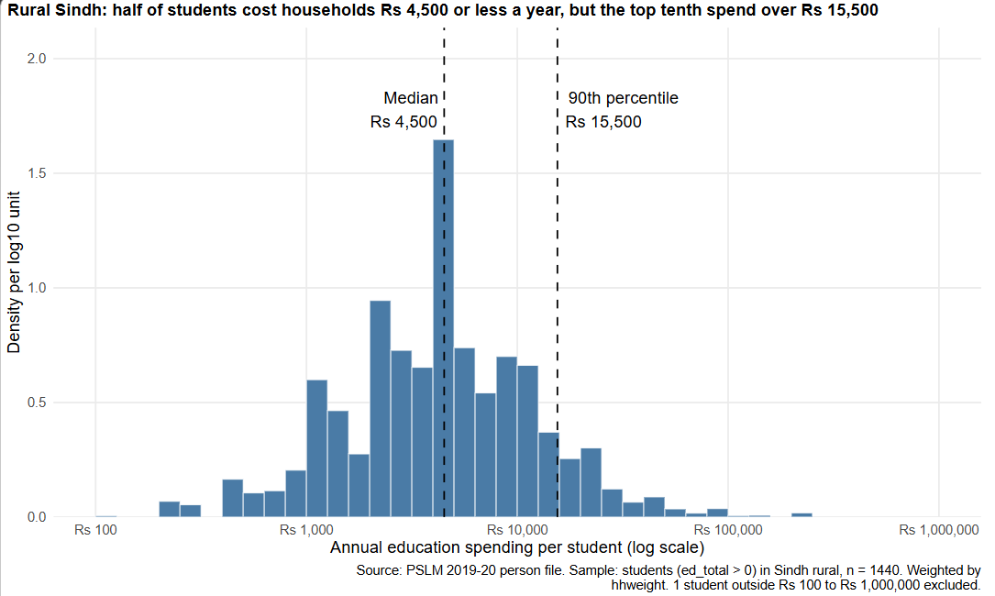
Half of students cost Rs 4,500 or less a year
Rs 4,500
weighted median
Unweighted: Rs 4,295
Rs 15,500
90th percentile
10th percentile: Rs 1,000
15.50×
p90 / p10 ratio
1 student outside plot range
Source: PSLM 2019-20, students in Sindh rural (n = 1,440), weighted by hhweight.
Notes:
Log scale because spending is right-skewed. Median and p90 use all 1,440 students; the histogram drops 1 student outside Rs 100 to Rs 1,000,000. Weighted median slightly above unweighted.

Slide 3
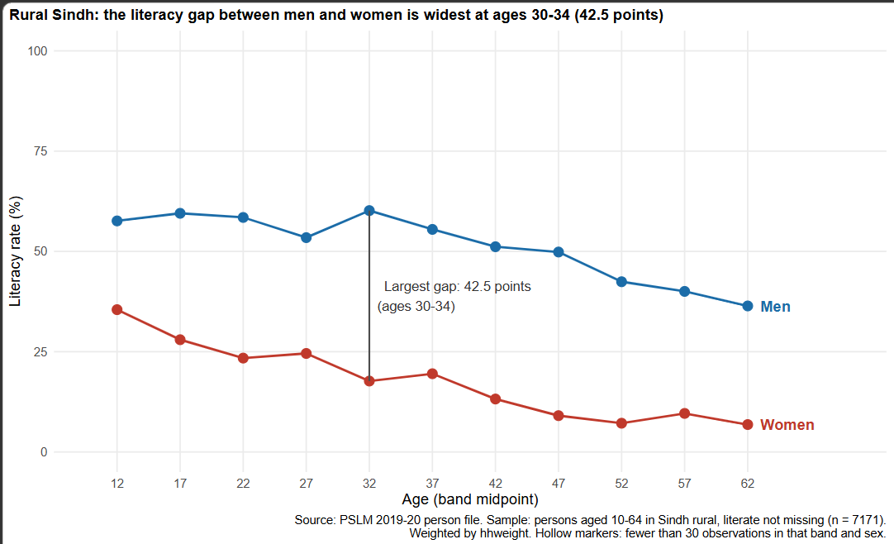
The makeover: points to conditional means
Default (R, untouched)
Redesign
INSERT figures/default.svg HERE
(Insert → Pictures)
Points → weighted means by band: a rate, not 7,171 stacked 0/1 dots.
Position on one 0-100 scale, with lines: the most accurate channel.
Direct labels, hollow-marker rule, one annotation: more data-ink.
Notes:
Left: ggplot(data, aes(age, literate)) + geom_point(), committed before the redesign. Right: Question 3 figure. The default shows individual ages; the redesign hides them by pooling into bands.

Slide 4
Women 28.0% vs men 59.5% literate at ages 15‑19
28.0%
women, ages 15-19
59.5%
men, ages 15-19
42.5 pts
largest gap, ages 30‑34
Cannot tell us: age vs cohort. A single cross-section cannot show whether literacy falls with age or older generations never gained it.
Source: PSLM 2019-20, persons aged 10-64 in Sindh rural (n = 7,171), weighted. No band has fewer than 30 observations.
Notes:
Most important finding. The 30-34 spike is a single band, not a trend. Smallest cell n = 77.

