Slide 1



AI 101 Mini-Project
PROJECT NAME : Airline Passenger Satisfaction Prediction.
TEAM NO. 79
MEMBERS AND ROLES :
Anubhab Chakraborty – 2026EEB1324 – Execution Lead
Naitik Jangid – 2026AIB1060 – Video Lead
Syed Ibrahim Affan – 2026EEB1417 – Documentation Lead
Gunjan Likhar – 2026MCB1527 – PPT Lead
REPO LINK :
https://github.com/ibrahim-affan/airline-passenger-satisfaction

Slide 2
WHAT AND WHY
WHAT IS THIS DATASET : The dataset contains passenger details, flight information, airline service ratings, and overall customer satisfaction.
WHY : To identify factors affecting passenger satisfaction and help airlines improve their services and customer experience.
DATASET SOURCE : https://www.kaggle.com/datasets/teejmahal20/airline-passenger-satisfaction
SIZE : Dataset Source: Kaggle – Airline Passenger Satisfaction
Total Rows: 129,880 ,Total Columns: 25 ,Training Data: 103,904 rows ,Testing Data: 25,976 rows ,Dataset Format: CSV
COLUMNS : Unnamed: 0, id, Gender, Customer Type, Age, Type of Travel, Class, Flight Distance, Inflight Wi-Fi service, Departure/Arrival time convenient, Ease of Online booking, Gate location, Food and drink, Online boarding, Seat comfort, Inflight entertainment, On-board service, Leg room service, Baggage handling, Checkin service, Inflight service, Cleanliness, Departure Delay in Minutes, Arrival Delay in Minutes, Satisfaction.

Slide 3
APPROACH
PIPELINE DIAGRAM:
Data Loading → Data Visualization → Data Preprocessing → Model Training → Model Testing → Performance Analysis
DATA -> MODEL -> OUTPUT
Data: Passenger details, flight distance, service ratings and delays.
Model: Logistic Regression.
Output: Passenger Satisfaction Prediction (Satisfied / Neutral or Dissatisfied).
LIBRARIES USED:
Pandas, NumPy, Matplotlib, Seaborn, Scikit-learn

Slide 4
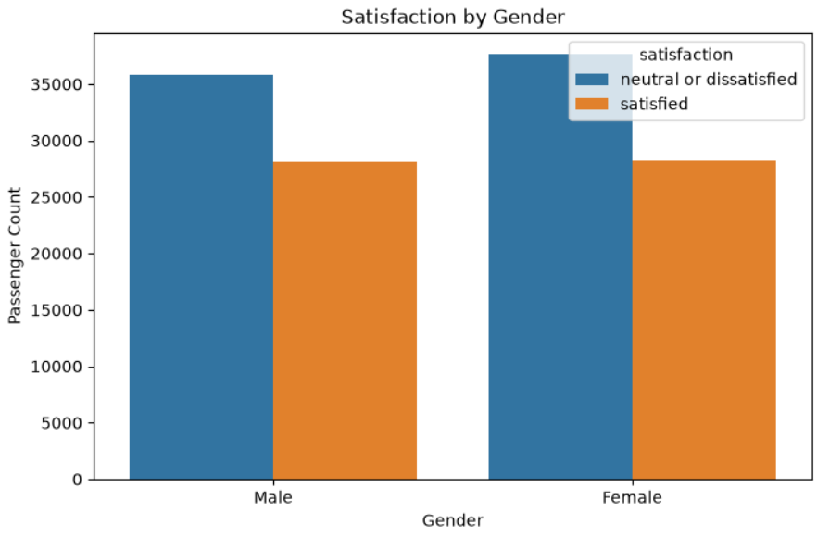
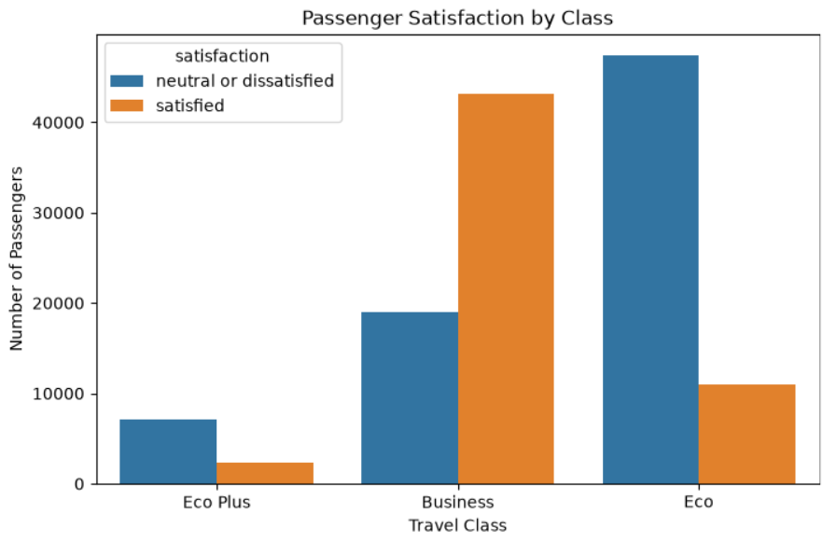
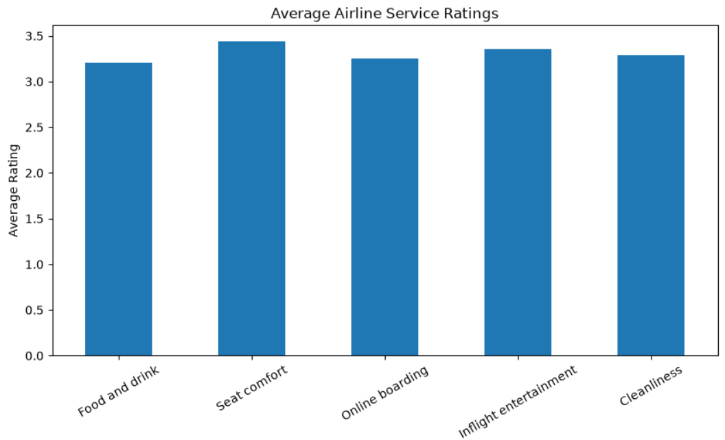
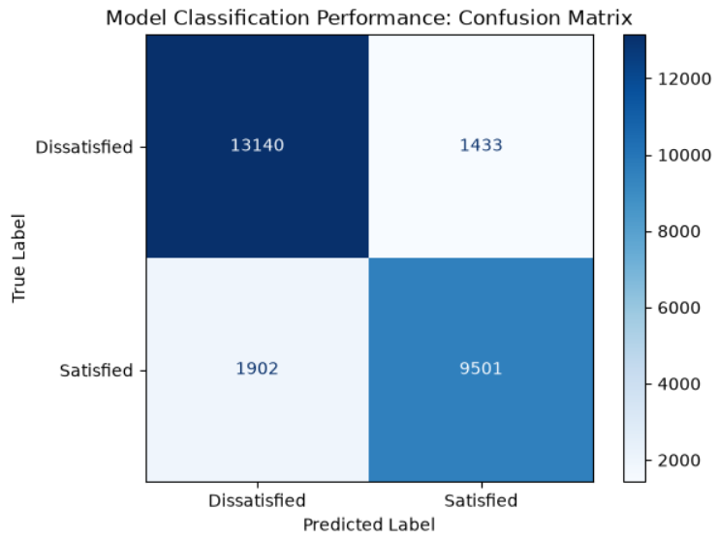
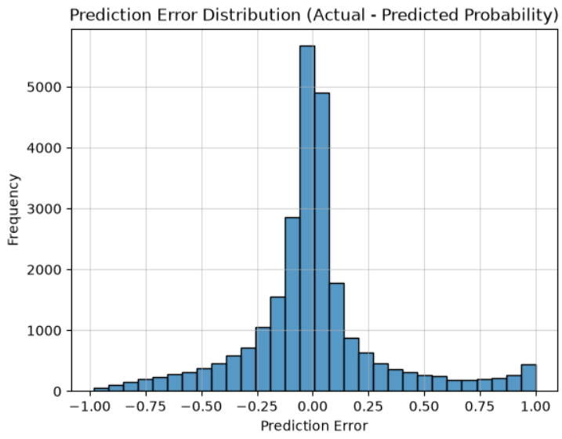
FINDINGS AND RESULTS
RESULTS
Accuracy Score: 0.872
Precision Score: 0.869
Recall Score: 0.833
F1 Score: 0.851

Slide 5
LEARNINGS
WHAT WORKED:
Data cleaning improved data quality , ML models predicted passenger satisfaction , Service ratings helped identify key factors.
WHAT DID’NT WORKED:
Missing values affected data quality , Irrelevant columns provided no useful information , Some models gave less accurate predictions.
WHO DID WHAT:
Anubhab Chakraborty – Execution lead :Model implement and execution
Naitik Jangid – Video lead :Project demonstration video.
Syed Ibrahim Affan - Documentation lead: README and GitHub documentation.
Gunjan Likhar – PPT Lead :Presentation preparation
AI-USE DISCLOSURE: ChatGPT was used to assist with project planning ,understanding documentation requirements ,and preparing initial project documentation and ppt preparation . AI generated suggestions were reviewed by the team.

