Slide 1
1. Problem Overview: Inventory Management and Demand Forecasting Issues in the OEM Industry
The OEM industry faces significant problems in inventory management and accurately forecasting demand, caused by:
Inconsistent Demand Patterns: Seasonal changes, varying client preferences, and product life cycle shifts make forecasting difficult.
The Bullwhip Effect: Minor fluctuations in consumer demand cause exaggerated demand signals across the supply chain, resulting in overproduction or stockouts.
Inaccurate Demand Forecasting: Traditional forecasting methods struggle with dynamic market behavior, which leads to either:
Overstocking: Tied up working capital and increased warehousing costs.
Understocking: Missed sales opportunity and decreased customer satisfaction.
Without exact forecasting, OEMs face inefficiencies in resource allocation, additional operational costs, and loss of competitive advantage in uncertain markets.

Slide 2



2. Recommended Solution/Project Objective:
3. Solution's value:
4. Conclusion:
Leverage AI/ML models to properly estimate demand and optimize inventory management.
AI/ML techniques include time series forecasting, demand sensing via neural networks, and anomaly detection.
Dataset Requirements:
Historical sales and inventory movement records
Real-time supplier and delivery information
External data (economic indicators, promotions, etc.)
Precision in Forecasting: Accurate demand sensing minimizes stockouts and excess inventories.
Optimized Inventory Management: Matches stock levels to real-time demand trends, reducing storage expenses.
Proactive Demand Planning: Identifies shifts in market patterns early on, allowing for more agile decision-making.
AI/ML integration improves inventory management from reactive to proactive, increasing operational efficiency and allowing OEMs to prosper in a rapidly changing environment.
This solution guarantees cost savings, increased client satisfaction, and resilience in supply chain operations

Slide 3
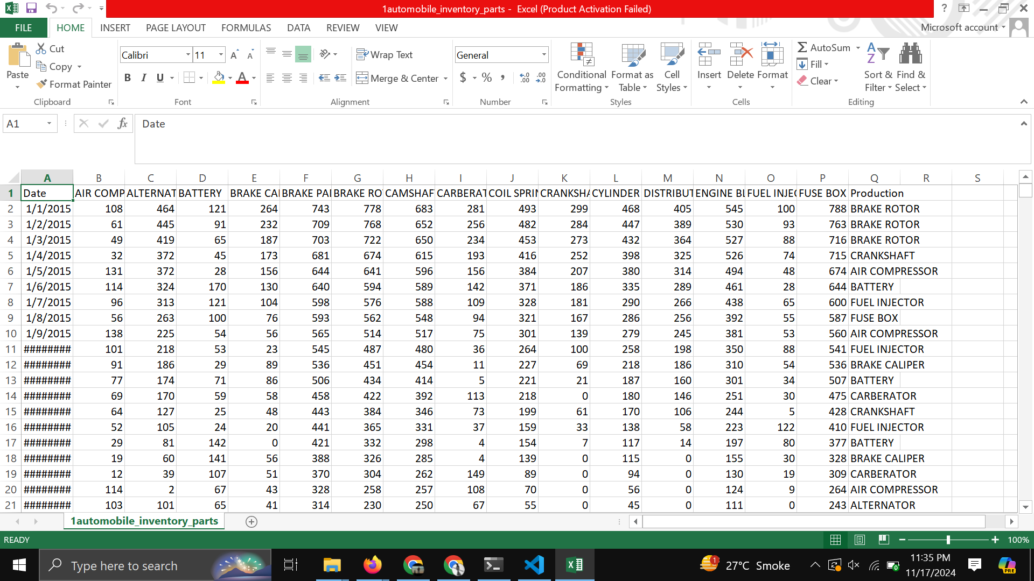
CSV FILE

Slide 4
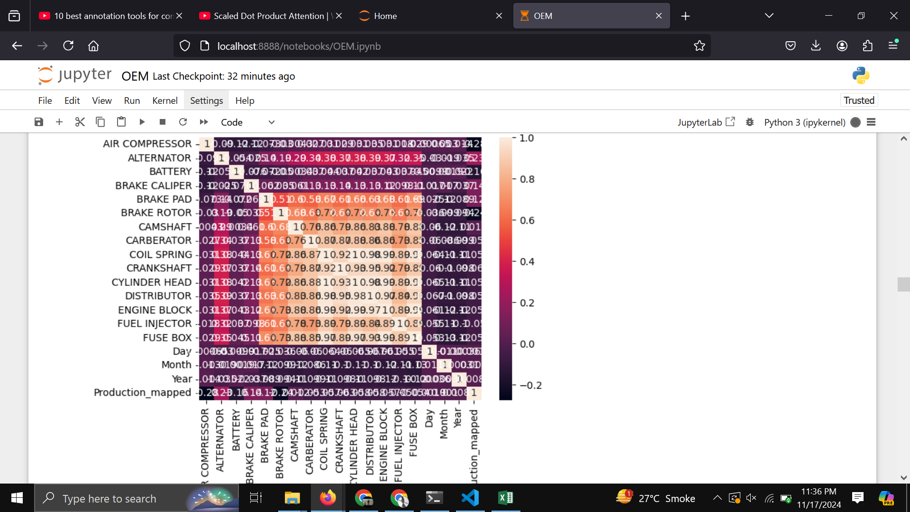
CORRELATION MATRIX

Slide 5
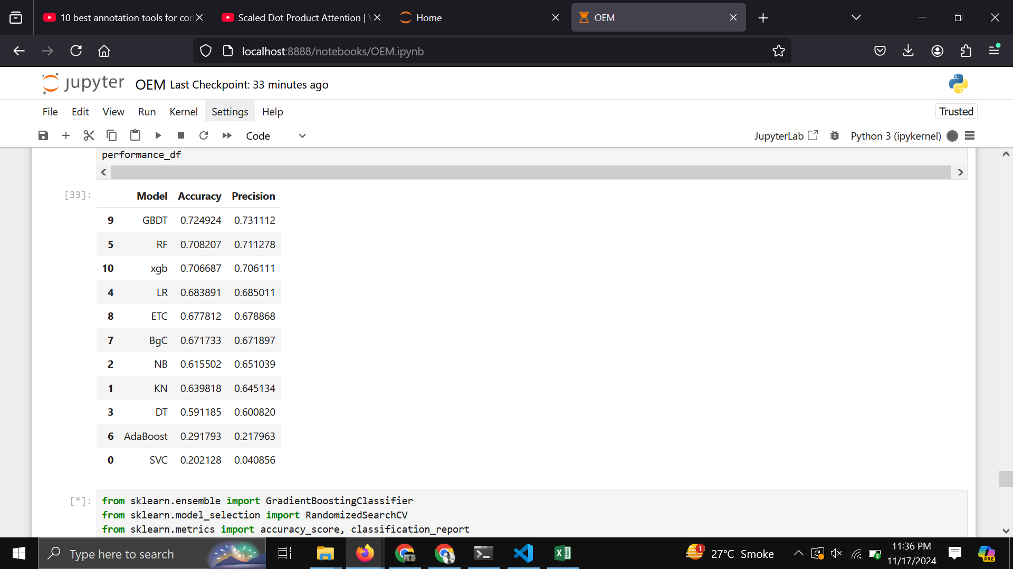
RESULTS

Slide 6
CONCLUSIONS
Our current model has achieved an accuracy of 72%, which is a promising start. However, we believe there is significant potential for improvement. With access to enhanced resources such as higher-quality data, advanced computational tools, and refined techniques, we can optimize the model further, pushing towards greater accuracy and reliability in real-world applications.

Slide 7
THANK YOU

