Slide 1
Applied Data dcience capstone
Ibrahim alatyan

Slide 2
Executive summary
Capstone Project: Predicting Falcon 9 First Stage Landings
In this project, we use machine learning to predict whether the SpaceX Falcon 9 first stage will land successfully.
Main Steps:
Collect, clean, and format data
Analyze and visualize key patterns
Explore interactive graphs
Train and test machine learning models
Our analysis shows that certain launch features affect success rates. Based on our results, the decision tree algorithm appears to be the best for predicting successful landings.

Slide 3
introduction
Capstone Project: Predicting Falcon 9 First Stage Landings
SpaceX offers Falcon 9 launches for $62 million, much cheaper than competitors ($165M+) due to reusability. Predicting whether the first stage will land successfully helps estimate launch costs, which is useful for competitors bidding against SpaceX.
Key Insights:
Many unsuccessful landings are intentional (e.g., controlled ocean landings).
We aim to predict successful landings based on features like payload mass, orbit type, and launch site.

Slide 4
Methodology Overview
Data Collection & Processing
Sources: SpaceX API, Web Scraping
Tools: Pandas, NumPy, SQL
Exploratory Data Analysis (EDA)
Identify patterns and trends in the data
Data Visualization
Tools: Matplotlib, Seaborn, Folium, Dash
Machine Learning Prediction
Algorithms: Logistic Regression, SVM, Decision Tree, KNN
This structured approach helps us analyze Falcon 9 launch data and predict successful landings effectively.

Slide 5
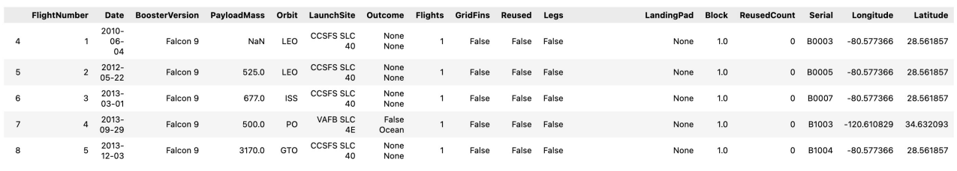
SpaceX API Data Collection
API Used: SpaceX API
Filtering: Only Falcon 9 launches are included.
Handling Missing Data: Missing values are replaced with the column mean.
Final Dataset:
90 rows (instances)
17 columns (features)

Slide 6
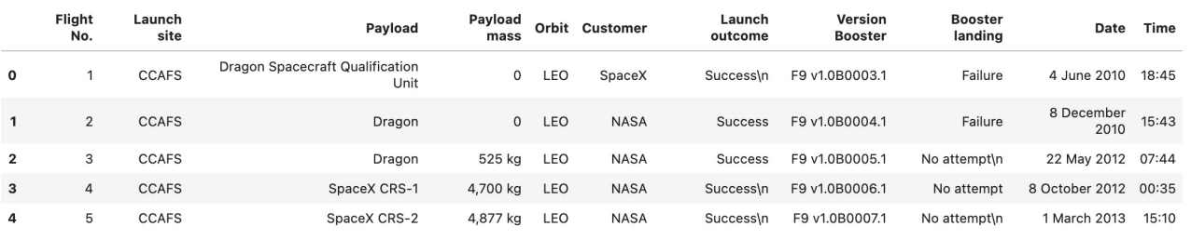
Web Scraping
Source: Wikipedia - Falcon 9 & Falcon Heavy Launches
Data Focus: Only Falcon 9 launches
Final Dataset:
121 rows (instances)
11 columns (features)

Slide 7
Data collection and warpiling
Missing Entries: All missing data is filled.
Categorical Features: Categorical columns are encoded using one-hot encoding.
Additional Column:
A new ‘Class’ column is added, where:
0 = Failed Launch
1 = Successful Launch
Final Dataset:
90 rows (instances)
83 columns (features)

Slide 8
EDA
1. Pandas & NumPy: Using Pandas and NumPy functions, we explore basic data insights, such as:
Launches by Site: The number of launches for each site
Orbit Occurrences: Frequency of each orbit type
Mission Outcomes: The number and occurrence of successful vs. failed missions
2. SQL: SQL queries help answer specific data questions, including:
Unique Launch Sites: Names of all launch sites used
Payload Mass (NASA - CRS): Total payload mass carried by NASA boosters
Average Payload Mass (F9 v1.1): Average payload mass for Falcon 9 v1.1 booster version

Slide 9
Data visualization
Data Visualization
1. Matplotlib & Seaborn: Using these libraries, we visualize relationships between different features with:
Scatterplots: Show correlations between variables like flight number vs. launch site.
Bar Charts: Used for visualizing features like launch site vs. payload mass.
Line Charts: To analyze trends like success rate vs. orbit type.
Key Visualizations:
Flight number vs. Launch site
Payload mass vs. Launch site
Success rate vs. Orbit type
2. Folium: Folium is used for creating interactive maps to visualize geographic relationships:
Launch Sites: Mark all Falcon 9 launch sites on a map.
Success/Failure by Site: Display succeeded and failed launches for each site.
Distances: Show distances from launch sites to nearby cities, railways, and highways.

Slide 10
Interactive Visualization with Dash
Dash Functions are used to create an interactive web interface with:
Dropdown Menu & Range Slider: Allow users to select and adjust input parameters.
Visualizations in the Interactive Site:
Pie Chart: Displays the total successful launches from each launch site.
Scatterplot: Shows the correlation between payload mass and mission outcome (success or failure) for each launch site.

Slide 11
Machine Learning Prediction
1. Data Preparation:
Standardization: The data is standardized to ensure all features are on the same scale.
Data Split: The data is divided into training and test sets.
2. Model Creation: We use models from Scikit-learn:
Logistic Regression
Support Vector Machine (SVM)
Decision Tree
K-Nearest Neighbors (KNN)
3. Model Training & Hyperparameter Tuning:
Fit the Models: We train each model using the training set.
Hyperparameter Optimization: Find the best hyperparameters for each model to improve performance.
4. Model Evaluation:
Accuracy Scores: Assess the overall performance of each model.
Confusion Matrix: Evaluate the models in terms of true positives, false positives, true negatives, and false negatives.

Slide 12
Results
SQL (EDA with SQL):
Queries and insights derived from SQL, such as unique launch sites and payload masses.
Matplotlib & Seaborn (EDA with Visualization):
Graphs to visualize relationships between various features (e.g., flight number vs. launch site, success rate vs. orbit type).
Class 0 represents failed launches, and class 1 represents successful launches.
Folium:
Interactive maps displaying launch sites, and the success/failure of launches with distances to nearby points of interest.
Dash:
An interactive dashboard with pie charts and scatterplots to explore launch success rates and payload mass correlations.
Predictive Analysis:
Machine learning models (Logistic Regression, SVM, Decision Tree, KNN) trained to predict the success of rocket landings, evaluated with accuracy scores and confusion matrices.
In all graphs, class 0 indicates a failed launch and class 1 indicates a successful launch.

Slide 13
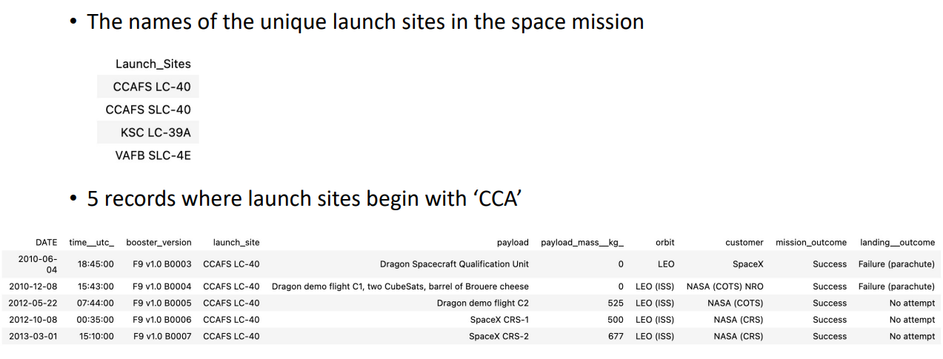
Results

Slide 14
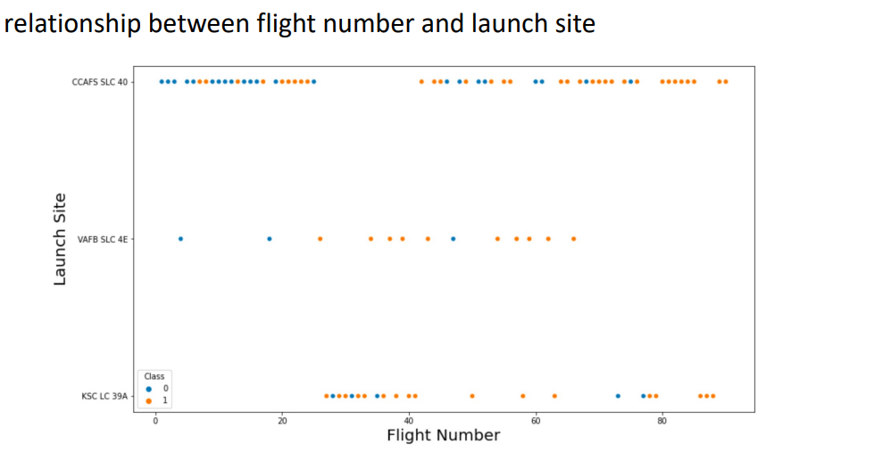
Results

Slide 15
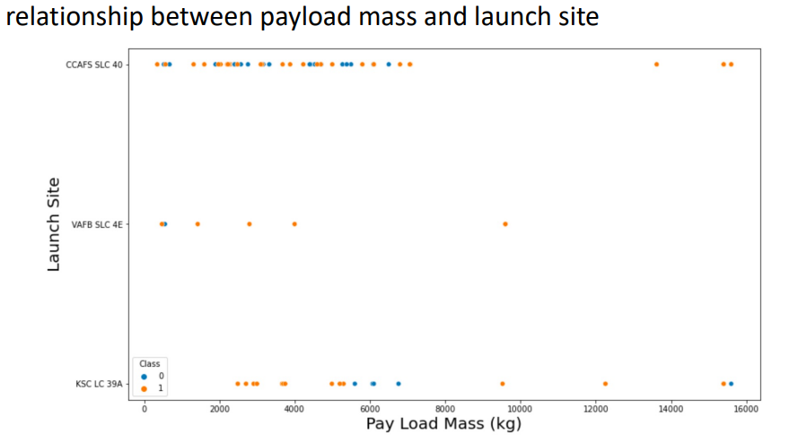
Results

Slide 16
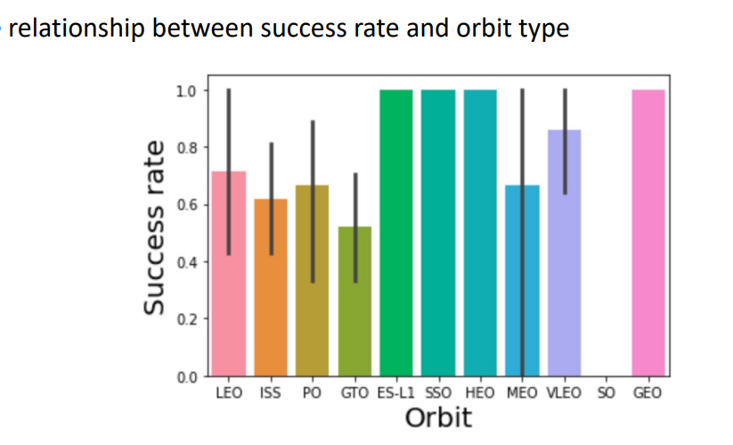
Results

Slide 17
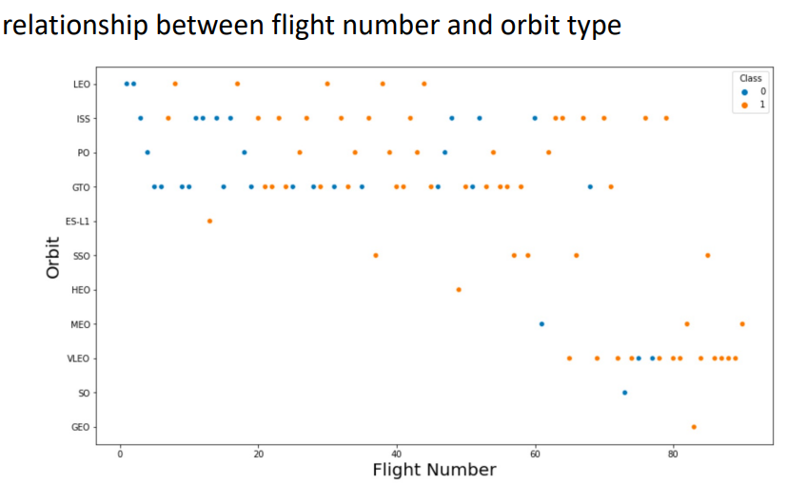
Results

Slide 18
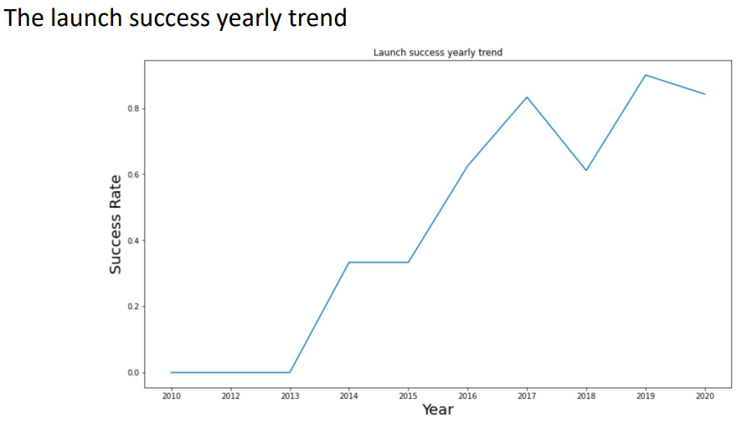
Results

Slide 19
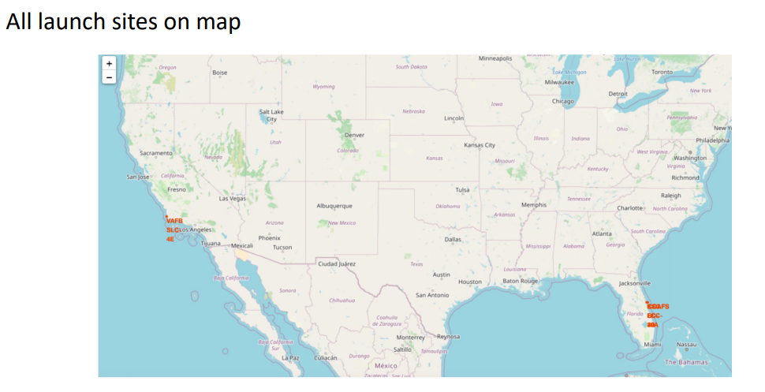
Results

Slide 20
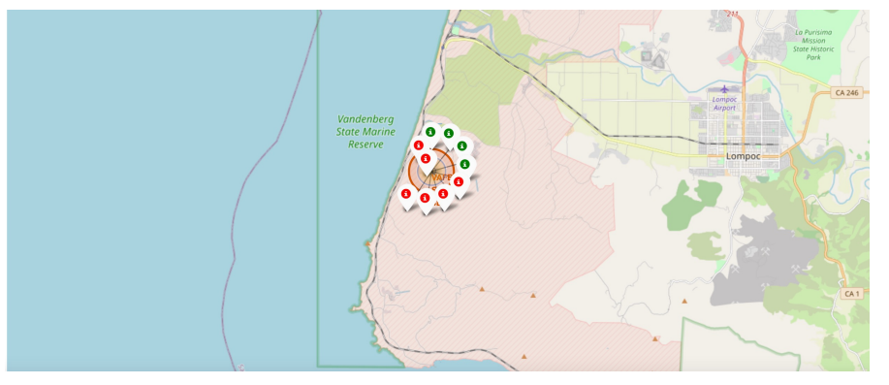
Results

Slide 21
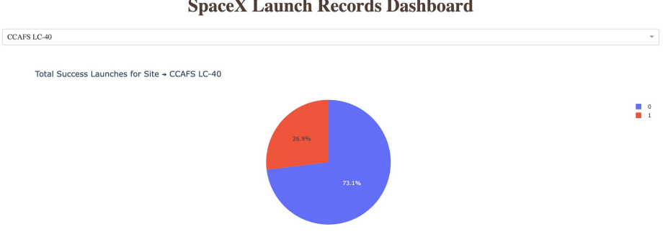
Results

Slide 22
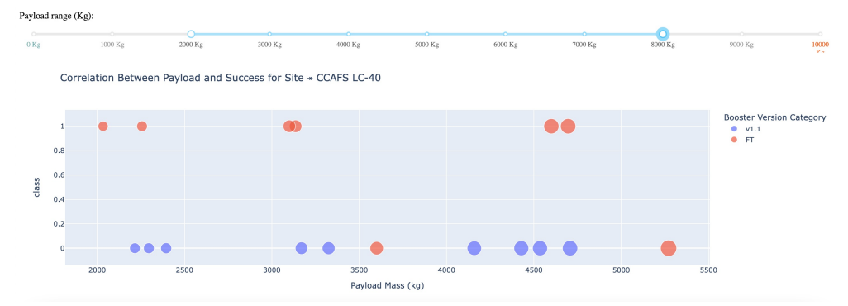
Results

Slide 23
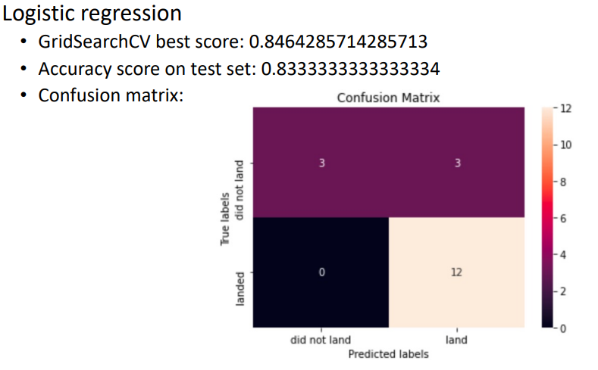
Results

Slide 24
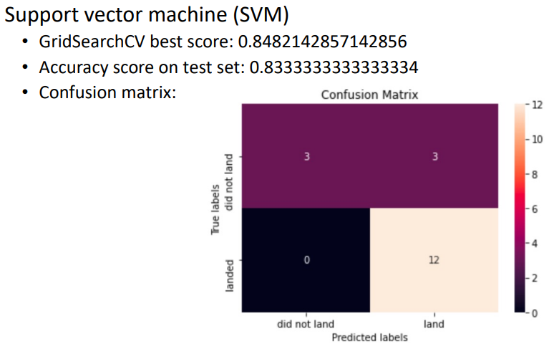
Results

Slide 25
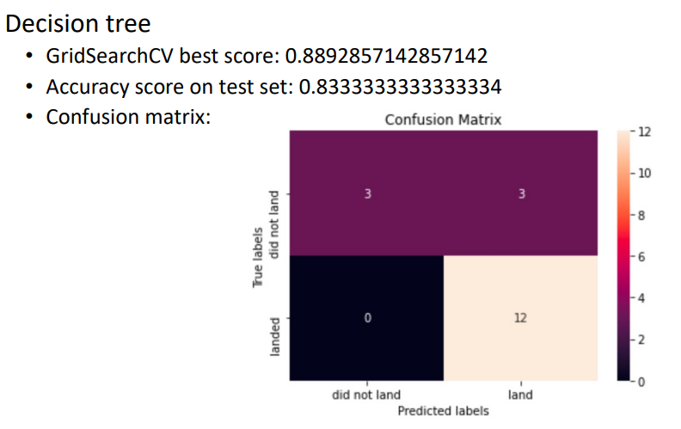
Results

Slide 26
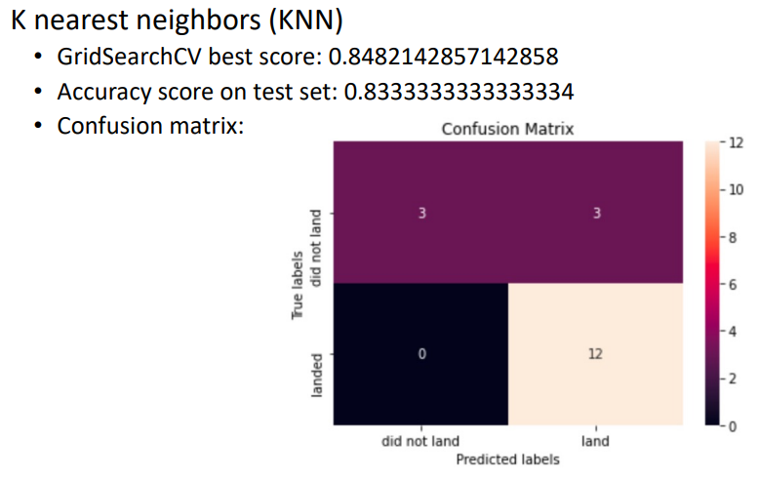
Results

Slide 27
Model Comparison and Ranking
When comparing the results of all four models, we see that they have the same accuracy score and confusion matrix on the test set. As a result, we use their GridSearchCV best scores to rank them.
Ranking of Models (based on GridSearchCV best scores):
Decision Tree
Best Score: 0.8893
K-Nearest Neighbors (KNN)
Best Score: 0.8482
Support Vector Machine (SVM)
Best Score: 0.8482
Logistic Regression
Best Score: 0.8464
The Decision Tree model performs the best, followed by KNN and SVM with nearly identical scores, while Logistic Regression ranks last.

Slide 28
Feature Correlations & Impact on Mission Outcome
Data visualizations show some correlations:
Heavy payloads lead to higher success rates for Polar, LEO, and ISS orbits.
GTO orbit shows both successful and unsuccessful missions, making predictions harder.
Using Machine Learning for Prediction
Features like orbit type and payload mass affect mission outcomes.
Machine learning can help identify patterns in past data to predict future mission success based on these features.

Slide 29
Conclusion
In this project, we predict if the Falcon 9 first stage will land to estimate launch costs.
Features like payload mass and orbit type may influence the mission outcome.
Several machine learning algorithms were used to identify patterns in past launch data and create predictive models.
The Decision Tree model performed the best among the four algorithms tested.

