Slide 1
The Relationship Between Education Level and Crime Rate
İBRAHİM BANCAR 150220313
HASAN KAN 150220332

Slide 2
Problem definition
Crime is a significant issue that impacts the safety, economic
development, and social societies worldwide. While numerous factors contribute to criminal behaviors, low education can be seen among the top reasons. Therefore, identifying the relationship between education level and crime rate is essential to take effective precaution techniques for countries.
Notes:
Sununun izleyicilere sağlayacağı faydalar: Yetişkin öğreniciler, konunun nasıl olduğunu veya onlar için neden önem taşıdığını biliyorsa, konuya daha fazla ilgi gösterir.
Sunucunun konuya dair uzmanlık düzeyi: Bu alandaki yeterliliğinizi kısaca açıklayın veya katılımcıların neden sizi dinlemesi gerektiğini ifade edin.

Slide 3
Datasets and Sources​
Notes:
Ders açıklamaları kısa olmalıdır.

Slide 4
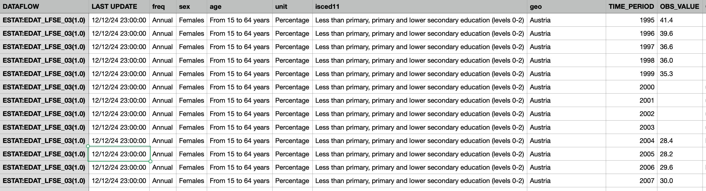
Education Data: Statistics on education levels categorized as 0-2, 3-8, and 5-8 years, broken down by countries, gender, and time period
Population by educational attainment level, sex and age (%) - main indicators (Eurostat)
https://ec.europa.eu/eurostat/databrowser/view/edat_lfse_03/default/bar?lang=en
Notes:
Ders açıklamaları kısa olmalıdır.

Slide 5
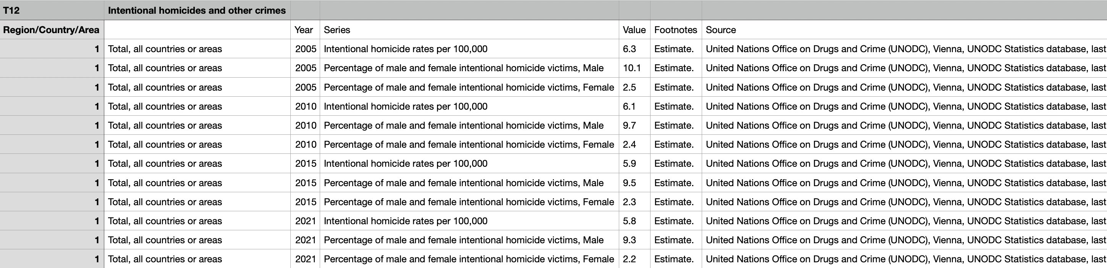
2. Crime Data: Rates of theft, assault, kidnapping, sexual violence, and intentional homicides over time by countries.
Data has been sourced from credible organizations and merged based on country identifiers.
Crime Rate (Data Bank)
https://databank.worldbank.org/Crime-rate/id/e67da82
Notes:
Ders açıklamaları kısa olmalıdır.

Slide 6
Exploratory Data Analysis

Slide 7
Are countries with lower education levels more prone to higher crime rates?
Hypothesis
Higher education participation correlates with lower crime rates.
Notes:
Örnek hedefler
Bu dersin ardından şunları yapabileceksiniz:
Dosyaları ekip Web sunucusuna kaydetme.
Dosyaları Web sunucusu üzerinde farklı konumlara taşıma.
Dosyaları ekip Web sunucusunda paylaşma.

Slide 8
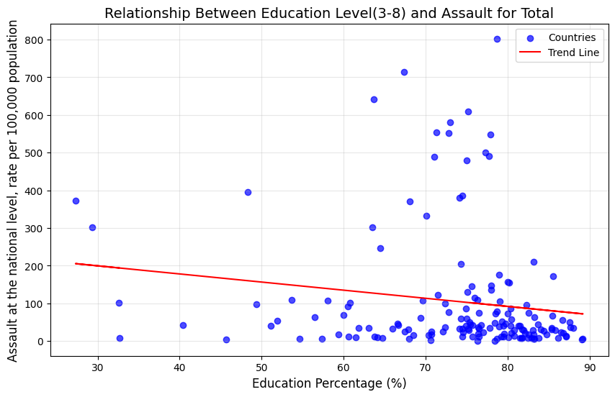
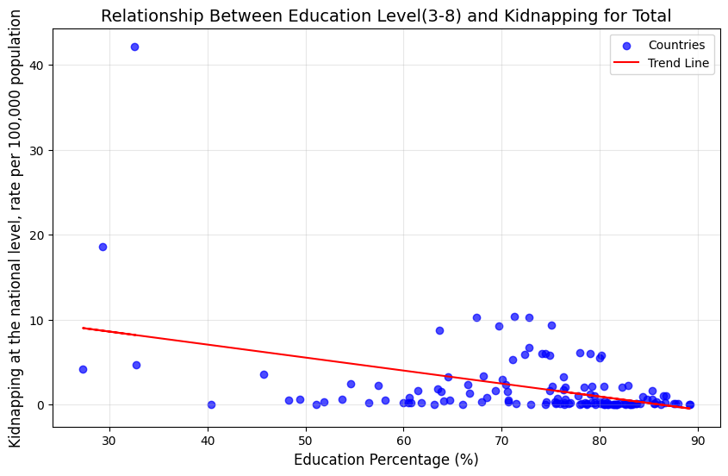
The relationship between education level and various crime rates
The more education people get, the lower the crime rates become

Slide 9
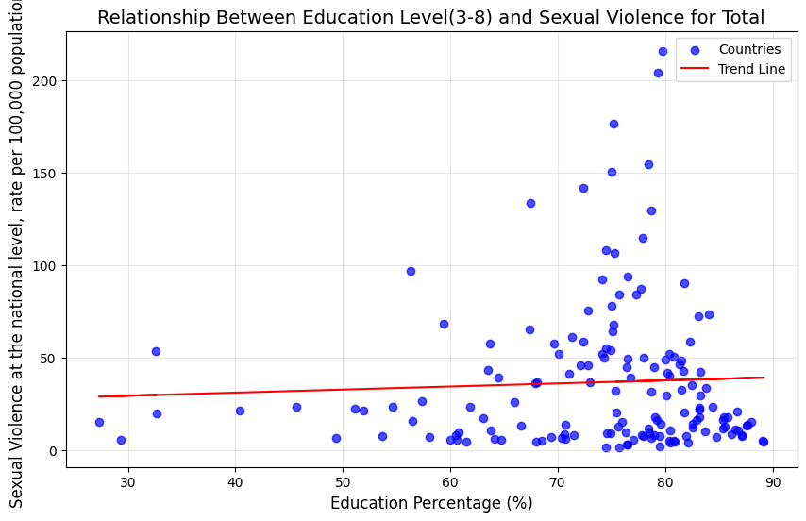
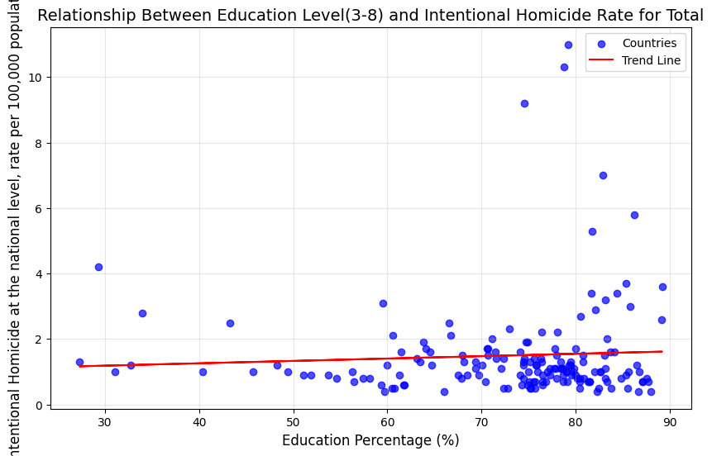
The relationship between education level and various crime rates
The more education people get, the more the crime rates become

Slide 10
Is there external factor (e.g. gender) that affects the relationship between
education level and crime rate?
Hypothesis​
Gender moderates the relationship between education level and crime rates

Slide 11
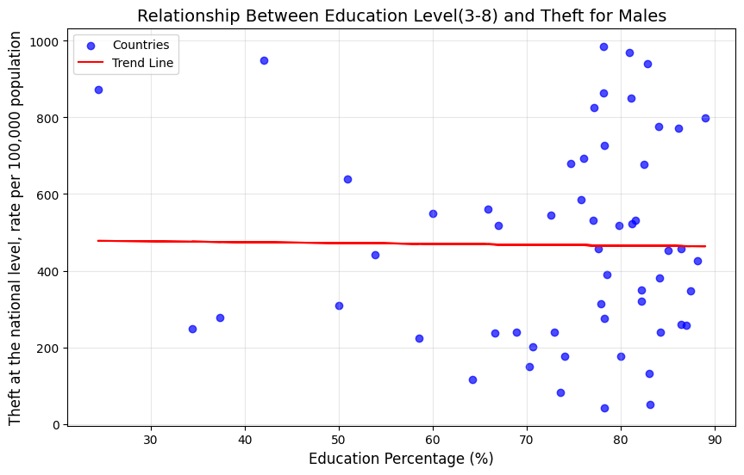
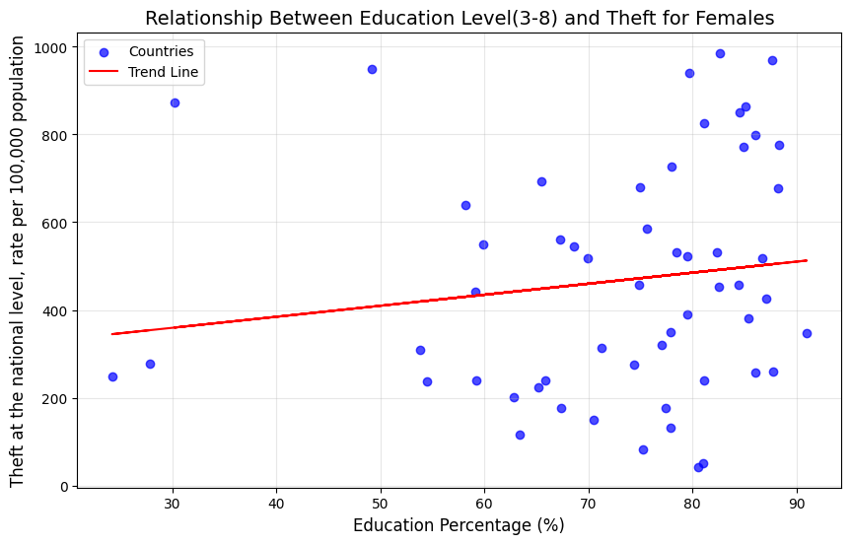
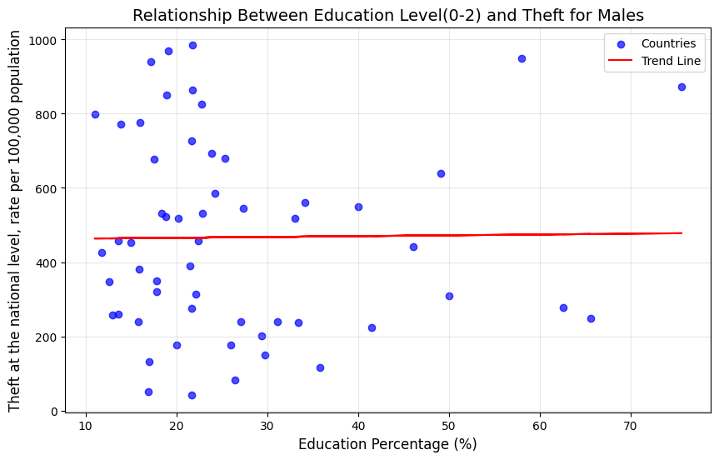
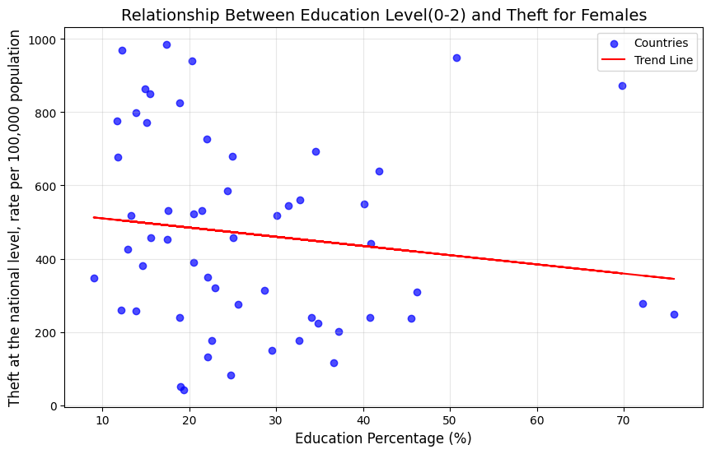
The Gender Effect on Crime Rates
Males
Females
3-8 Education Level ->
0-2 Education Level ->

Slide 12
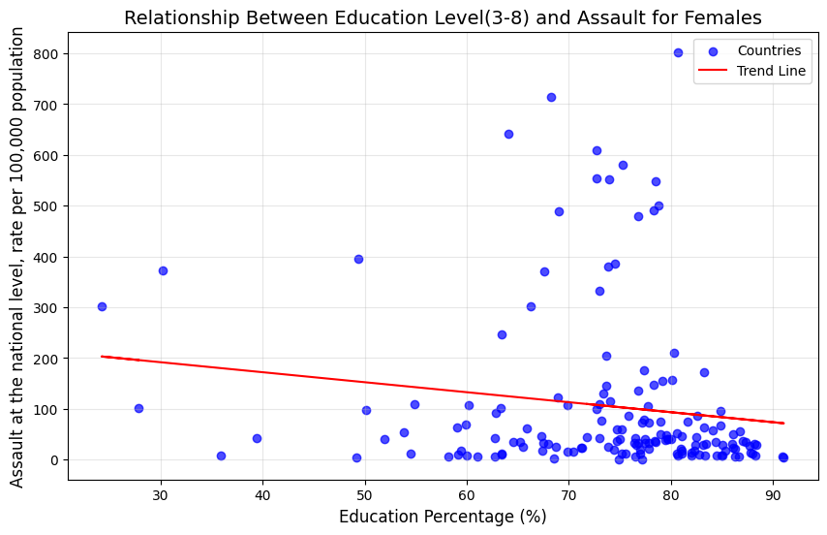

The Gender Effect on Crime Rates
A Little Change

Slide 13
Does an increase in education levels correlate with a reduction in specific types of crimes?
Hypothesis​
An increase in education levels correlates with a reduction in specific types of crimes

Slide 14
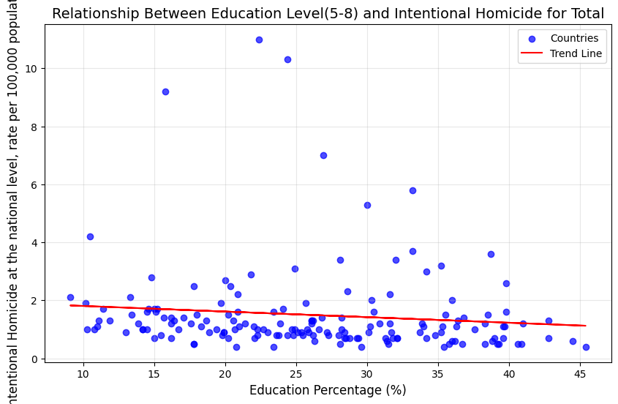
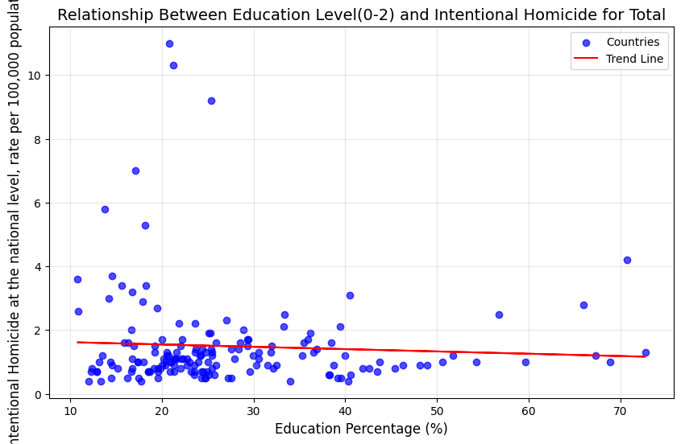
Intentional Homicide Rates by Education Level
Inverse
Relationship

Slide 15
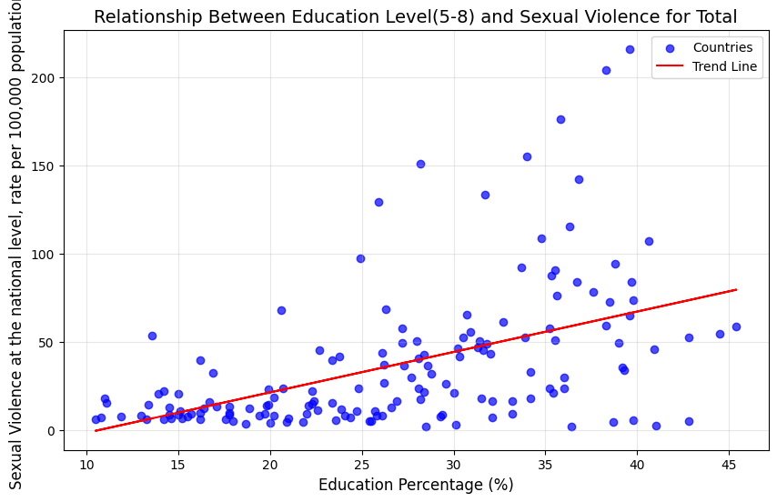
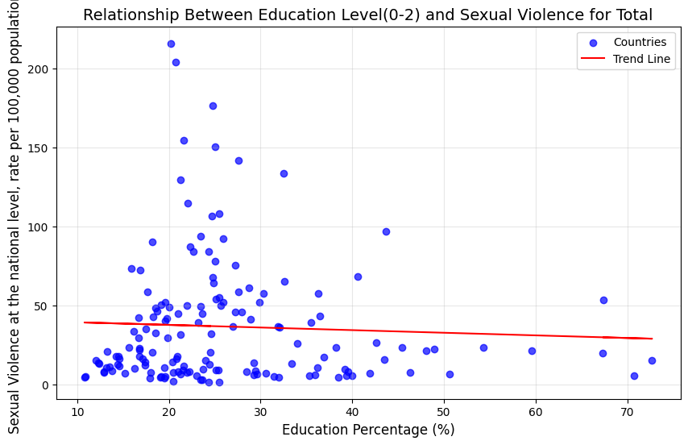
Sexual Violence Rates by Education Level
Direct
Relationship

Slide 16
Which education level (e.g., secondary or bachelor) has the most significant impact
on reducing crime rates?
Hypothesis​
An increase in education levels correlates with a reduction in specific types of crimes, such as kidnapping, intentional homicides

Slide 17
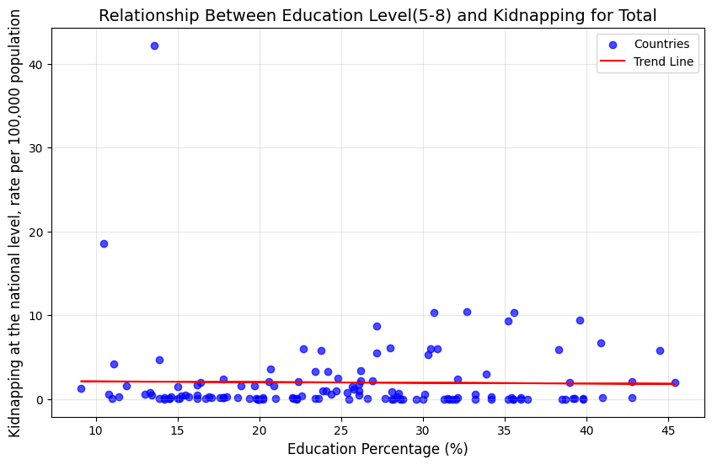
For kidnapping

Slide 18
For intentional homicides

Slide 19
Potential Service: Data-Driven Policy Dashboard for Governments
• A web-based dashboard that visualizes real-time relationships between education levels and crime rates.
• Allows policymakers to evaluate the impact of education policies on crime reduction.

Slide 20
Challenges
Challenge:
• Combining datasets from different sources (e.g., Eurostat, World Bank) with varying formats, structures, and schemas.
Our Solution:
• Use different reading methods for each data set
• Identifying common country names

Slide 21
Challenge:
• Analyzing Crime Rates date set because of incomplete and inaccurate column names
Our Solution:
• Renaming columns

Slide 22
Ethical Issues
Privacy Protection:
• Using only general statistics to ensure no personal data is exposed.
Data Bias:
• Explaining any limitations or inaccuracies in crime and education data.
Permission for Data:
• Following Eurostat and World Bank rules for data usage.
Avoid Misuse:
• Adding clear explanations to prevent misinterpretation of results.

Slide 23
CONCLUSİON
• Data Preparation
Collected and cleaned datasets from Eurostat and the World Bank.
Merged education and crime data for analysis.
• Analysis
Visualized trends and tested hypotheses showing the link between education and crime.
• Future Application
Designed a dashboard concept to help policymakers reduce crime through education strategies.

Slide 24
Thank you for listening

