Slide 1
Semantic Similarity Search in PostgreSQL Using pgvector
YZV 322E – Applied Data Engineering İbrahim Bancar – 150220313 April 2026

Slide 2

What Is pgvector?
pgvector is an open-source PostgreSQL extension that enables vector storage and similarity search inside PostgreSQL
Adds a vector data type to PostgreSQL
Supports exact and approximate nearest-neighbor search
Lets developers keep vector search inside an existing PostgreSQL system
Released 2021
Text / document -> embedding vector -> PostgreSQL + pgvector -> nearest results
Maintainer: Andrew Kane
License: PostgreSQL License

Slide 3
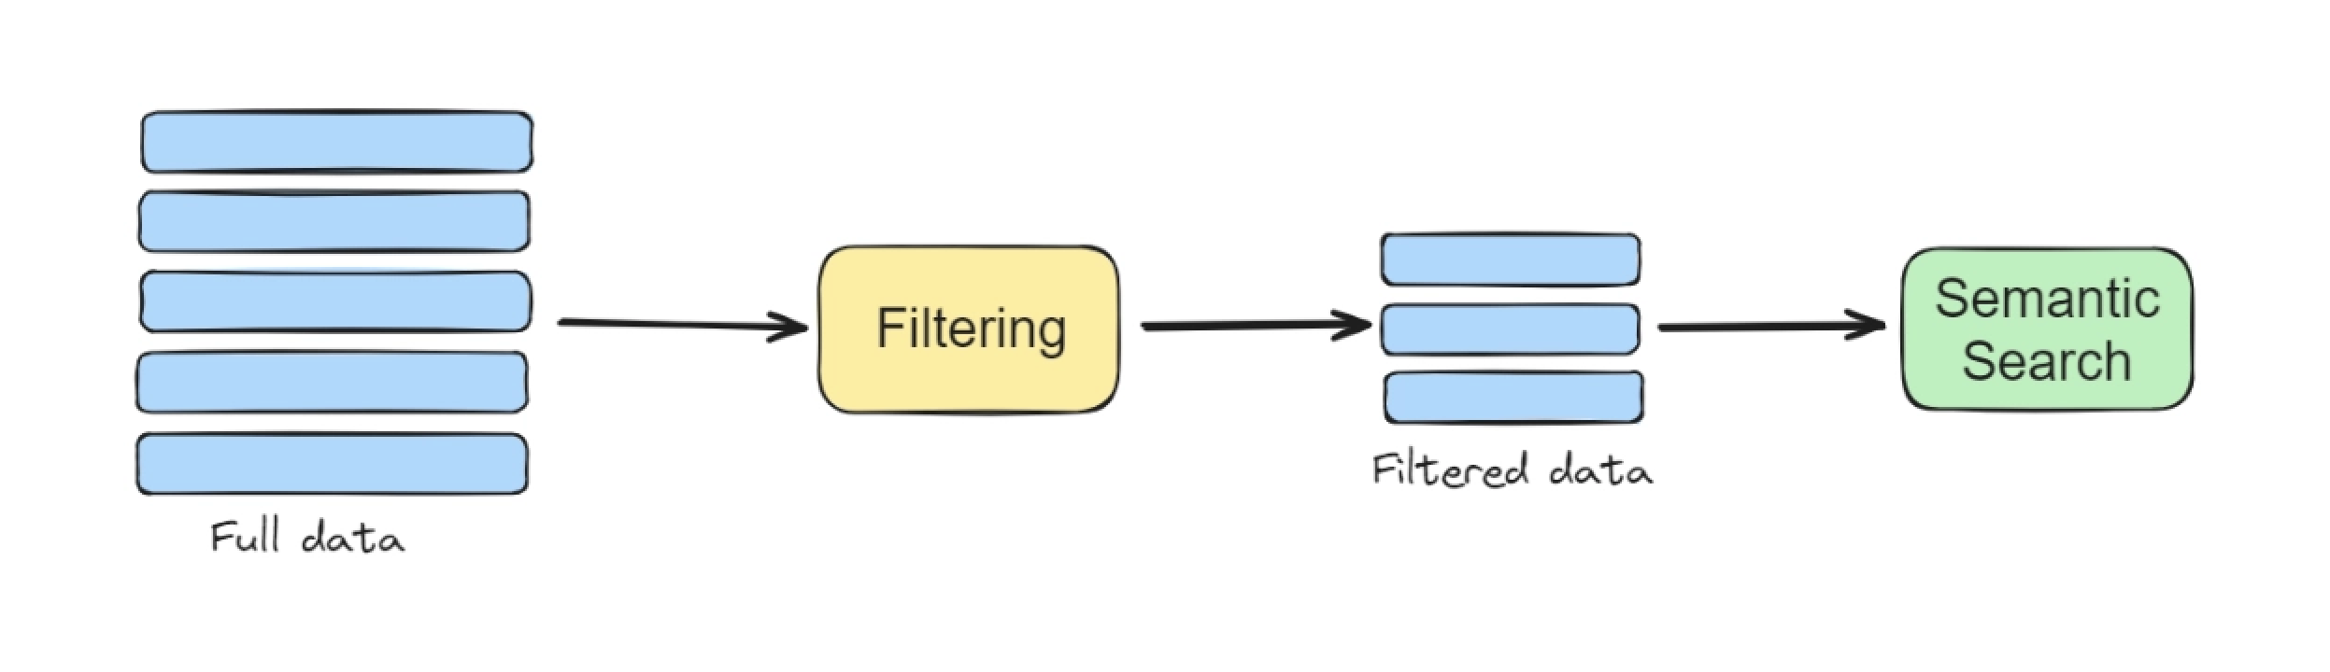
What Problem Does pgvector Solve?
SQL is strong for exact matching
It is weak for meaning-based search
pgvector enables semantic similarity search

Slide 4
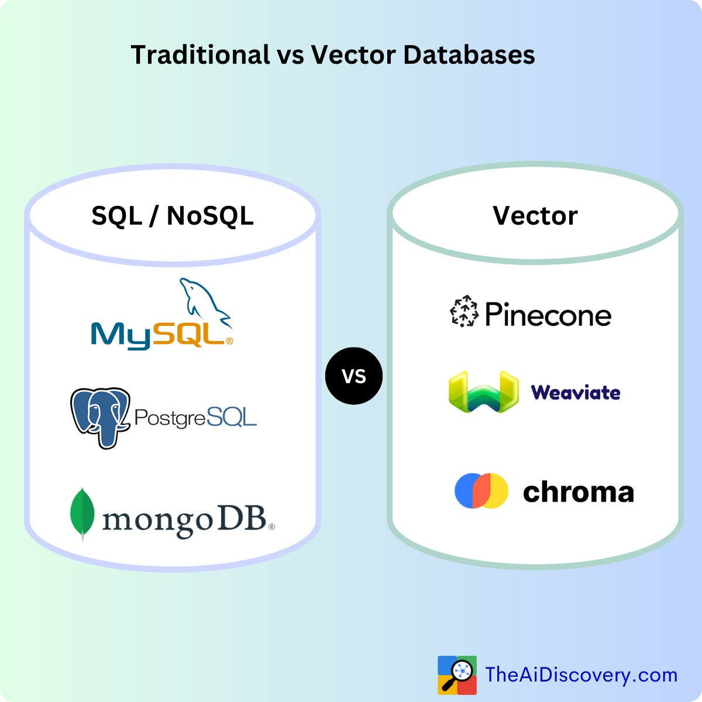
Comparison with Alternatives
Why use pgvector over a separate vector DB or plain PostgreSQL?
Separate vector DBs add extra infrastructure
Plain PostgreSQL lacks native vector search
pgvector keeps everything inside PostgreSQL
Easy to combine with SQL, filters, and joins

Slide 5
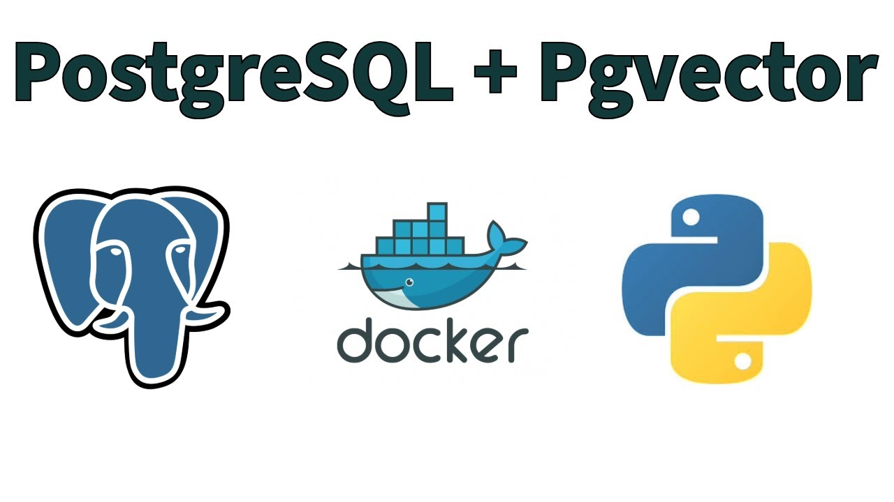
Why It Fits Applied Data Engineering
Uses a real production-style database
Combines Docker, SQL, and Python
Shows indexing and query workflow
Demonstrates reproducible engineering
Connects databases with AI-style retrieval

Slide 6
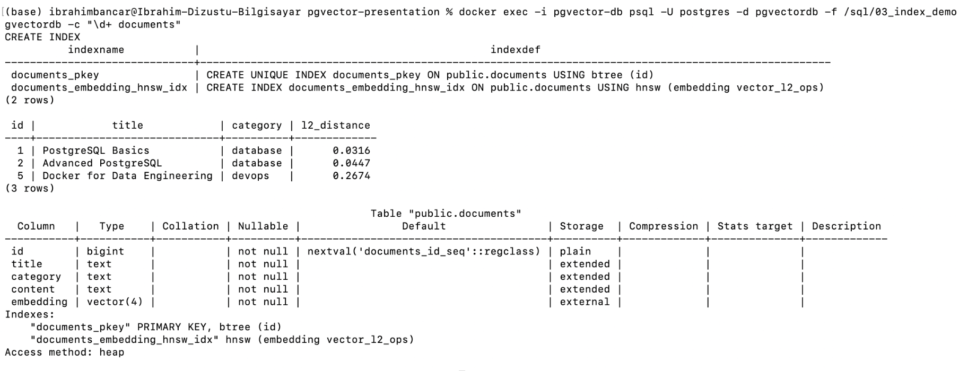
Demo Setup and Workflow
Docker runs PostgreSQL with pgvector
SQL scripts load sample embeddings
L2 distance uses <->
HNSW speeds up vector search
Python returns top matches

Slide 7
Advantages and Limitations
Advantages
Works inside PostgreSQL
Simple Docker-based setup
Supports similarity search
Combines SQL and vectors
Easy to reproduce
Limitations
Small demo dataset
Uses 4D sample vectors
Not real production embeddings
Limited scale in this demo
Approximate search may vary

Slide 8
Conclusion
Adds vector search to PostgreSQL
Supports semantic retrieval
Integrates with SQL workflows
Easy to demo with Docker and Python
Useful for applied data engineering

Slide 9

References
https://www.tigerdata.com/blog/implementing-filtered-semantic-search-using-pgvector-and-javascript-2
https://www.blackslate.io/articles/how-to-install-and-configure-pgvector-a-detailed-guide
https://medium.com/data-and-beyond/sql-vs-vector-databases-choosing-the-right-tool-for-your-ai-powered-application-eb3bef40921b
https://github.com/pgvector/pgvector
GitHub Repository: ibrahim-bancar/pgvector-presentation

