Slide 1
Progress Report 3
PINN Training & Gradient-Based Yaw Optimization
Physics-Informed Neural Networks for Wake-Aware
Yaw and Blade Pitch Control in Wind Turbines
Ibrahim Alghrabi
Advisor: Dr. Tariq Ahmed Albusyuni
MATH 619 | Term 252

Slide 2
Report Objectives
1
Train a Physics-Informed Neural Network on real Kelmarsh SCADA data
2
Compare PINN vs. baseline NN (no physics constraints)
3
Demonstrate gradient-based yaw angle optimization
4
Validate physics compliance of the learned power model
5
Generate reproducible results and figures for the project

Slide 3
Model Architecture & Physics Loss
Architecture
Physics Loss Components
Input
6 neurons (wind, dir, yaw, pitch)
L_total = L_data + λ · L_physics (λ = 0.1)
Hidden
5 layers × 64 neurons
Monotonicity
∂P/∂v ≥ 0 in Region 2
Activation
Tanh (twice differentiable)
Yaw cosine
P ∝ cos³(γ) law
Output
1 neuron (normalized power)
Betz bound
0 ≤ P_norm ≤ 1.0
Framework
PyTorch
Smoothness
Second-derivative penalty

Slide 4
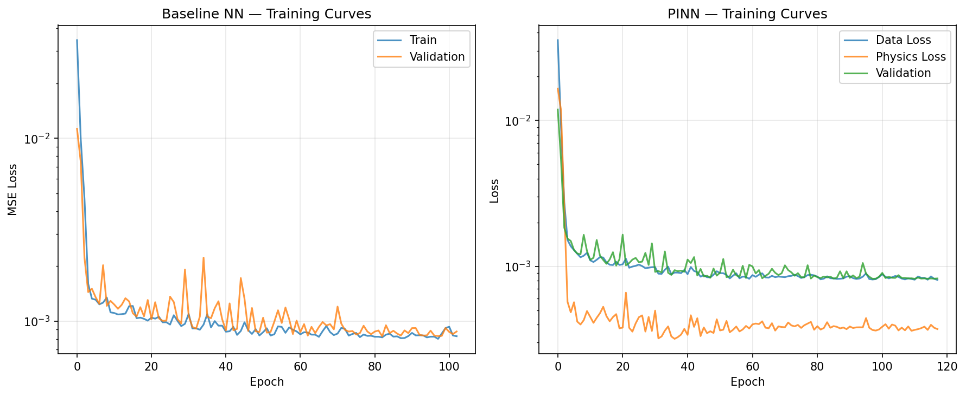
Training Convergence
Key Insight: Physics loss guides early training toward plausible solutions. PINN validation curve is smoother — physics constraints act as regularization, preventing the overfitting spikes visible in the baseline.

Slide 5
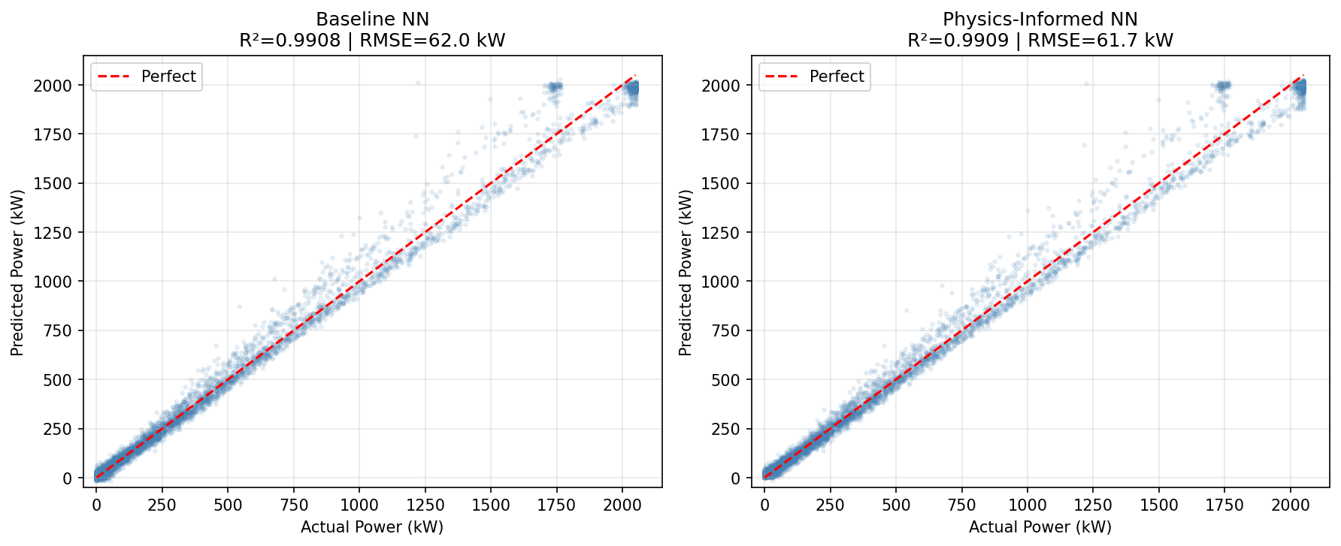
Prediction Accuracy
Baseline NN
Physics-Informed NN
R² = 0.9908 | RMSE = 62.0 kW
R² = 0.9909 | RMSE = 61.7 kW

Slide 6
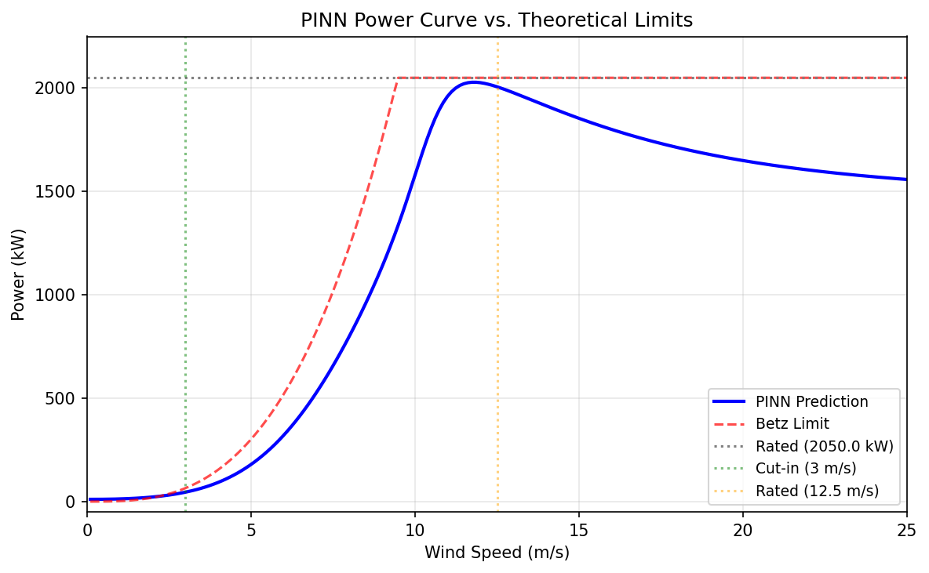
Physics Compliance
Region 2
Cubic law correctly captured below rated speed
Rated Power
Smooth transition near 12.5 m/s
Region 3
Power decreases — reflects pitch-to-feather control in data
Betz Limit
Respected throughout the full operating range

Slide 7
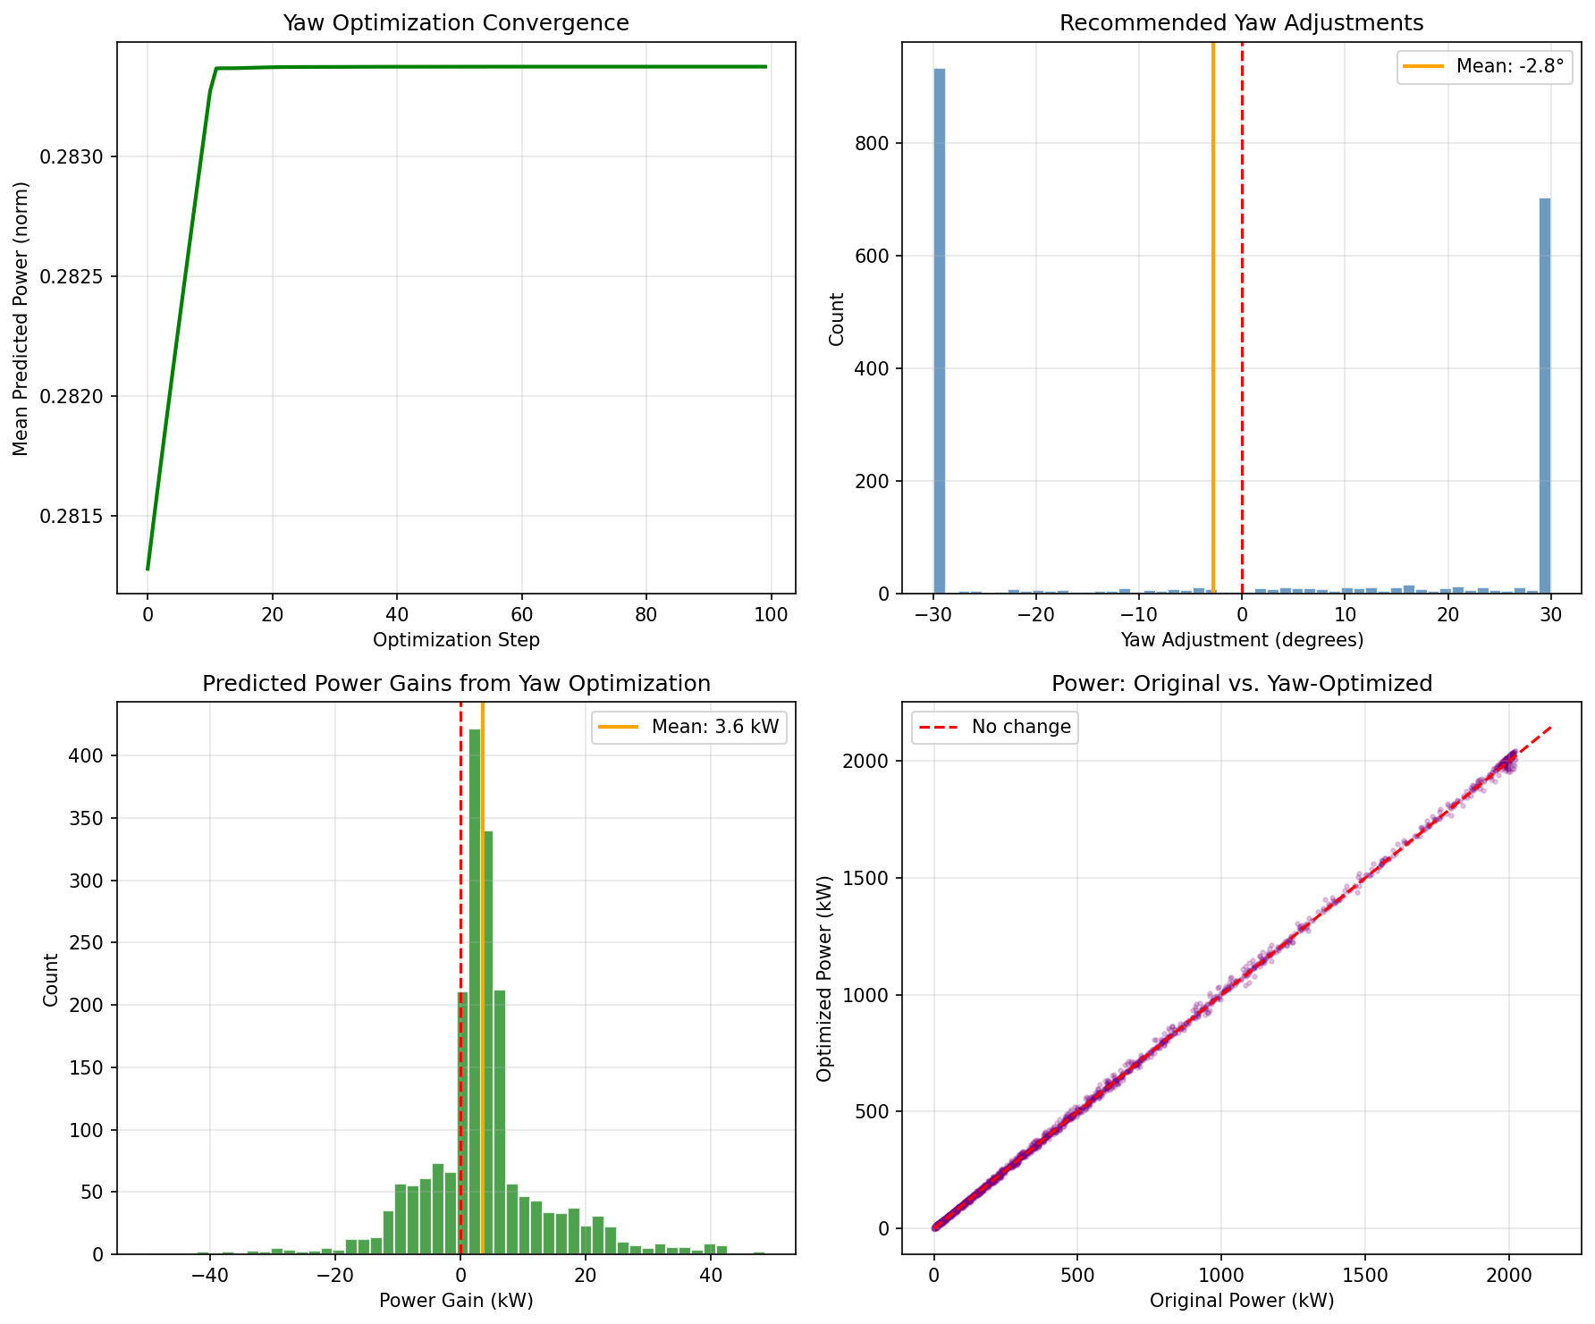
Gradient-Based Yaw Optimization
Optimization Results
2,000
Samples
-2.8°
Mean Yaw Adj.
3.6 kW
Mean Gain
3.0%
Mean Gain %
48.7 kW
Max Gain

Slide 8
Challenges & Discussion
Physics Loss Balancing
λ = 0.1 selected after experiments; λ > 0.5 degraded data fit, λ < 0.01 gave negligible regularization
Marginal PINN Improvement
On synthetic data, both models are very close. Real Kelmarsh data with wake effects should show larger differentiation
Optimization Boundary Effects
Many yaw adjustments hit the ±30° constraint — suggests need for wider search or constrained optimization methods
Power Curve Drop-off
PINN predicts power decrease above rated speed — reflects pitch-to-feather behavior in data, not a model deficiency

Slide 9
Next Steps
1
Hyperparameter tuning (grid search over λ, layers, learning rate)
2
Validate wake predictions against Jensen analytical model
3
Joint yaw + blade pitch optimization
4
Per-turbine analysis of wake effects (Turbine 6 deficit)
5
Draft final report and journal paper
Ibrahim Alghrabi | g201724510@kfupm.edu.sa

