Slide 1
Progress Report 2
Data Pipeline & Exploratory Analysis
Ibrahim Alghrabi | Advisor: Dr. Tariq Ahmed Albusyuni | MATH 619

Slide 2
Report Objectives
• Build functional data pipeline for real SCADA data
• Analyze Kelmarsh Wind Farm operational data (UK)
• Design PINN architecture with physics constraints
• Prepare training-ready datasets for PINN
• Select implementation framework (pinnstorch)

Slide 3
Data Source: Kelmarsh Wind Farm
Farm Details
Dataset
• Location: Northamptonshire, UK
• 6 × Senvion MM92 turbines
• Rated power: 2.05 MW each
• Rotor diameter: 92 m
• Hub height: 68.5-78.5 m
• Source: Zenodo (Open Access)
• Period: Jan - Jul 2021
• Resolution: 10-min averages
• Records: 135,068 (cleaned)
• Variables: wind, power, yaw, pitch

Slide 4
Dataset Statistics (Real Kelmarsh Data)
Variable | Mean | Std Dev | Min | Max
Wind Speed (m/s) | 5.91 | 2.96 | 0.13 | 22.42
Power (kW) | 611.0 | 668.4 | -17.8 | 2077.5
Yaw Angle (°) | 186.0 | 100.8 | 0.0 | 360.0
Pitch Angle (°) | 7.06 | 16.3 | -170 | 92.5
Rotor Speed (RPM) | 10.09 | 4.35 | 0.0 | 15.3

Slide 5
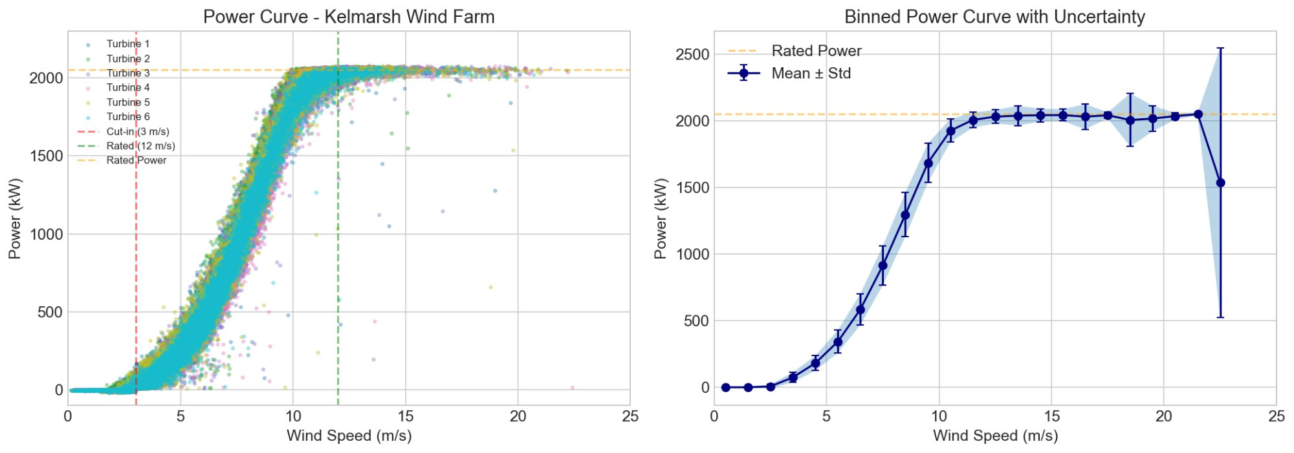
Power Curve Analysis
Left: All turbines scatter. Right: Binned mean with uncertainty. Rated power = 2050 kW.

Slide 6
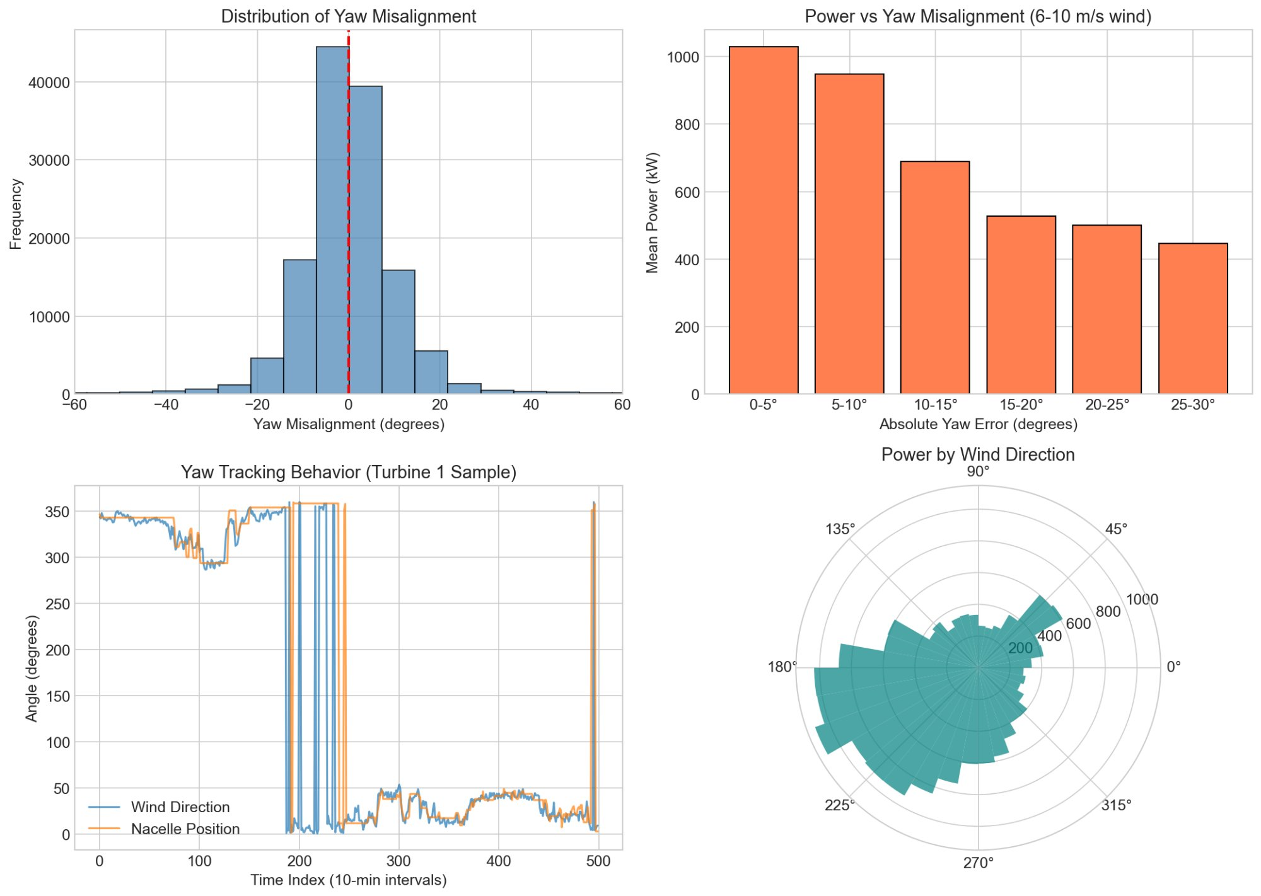
Yaw Misalignment Analysis
Power drops from ~1000 kW at 0-5° misalignment to ~450 kW at 25-30° (6-10 m/s wind).

Slide 7
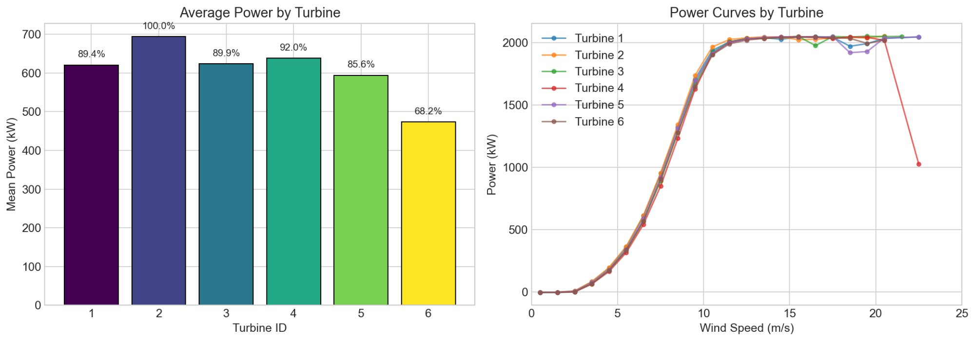
Inter-Turbine Variation
Turbine 6 shows 68% of peak output — possible wake effects or operational differences.

Slide 8
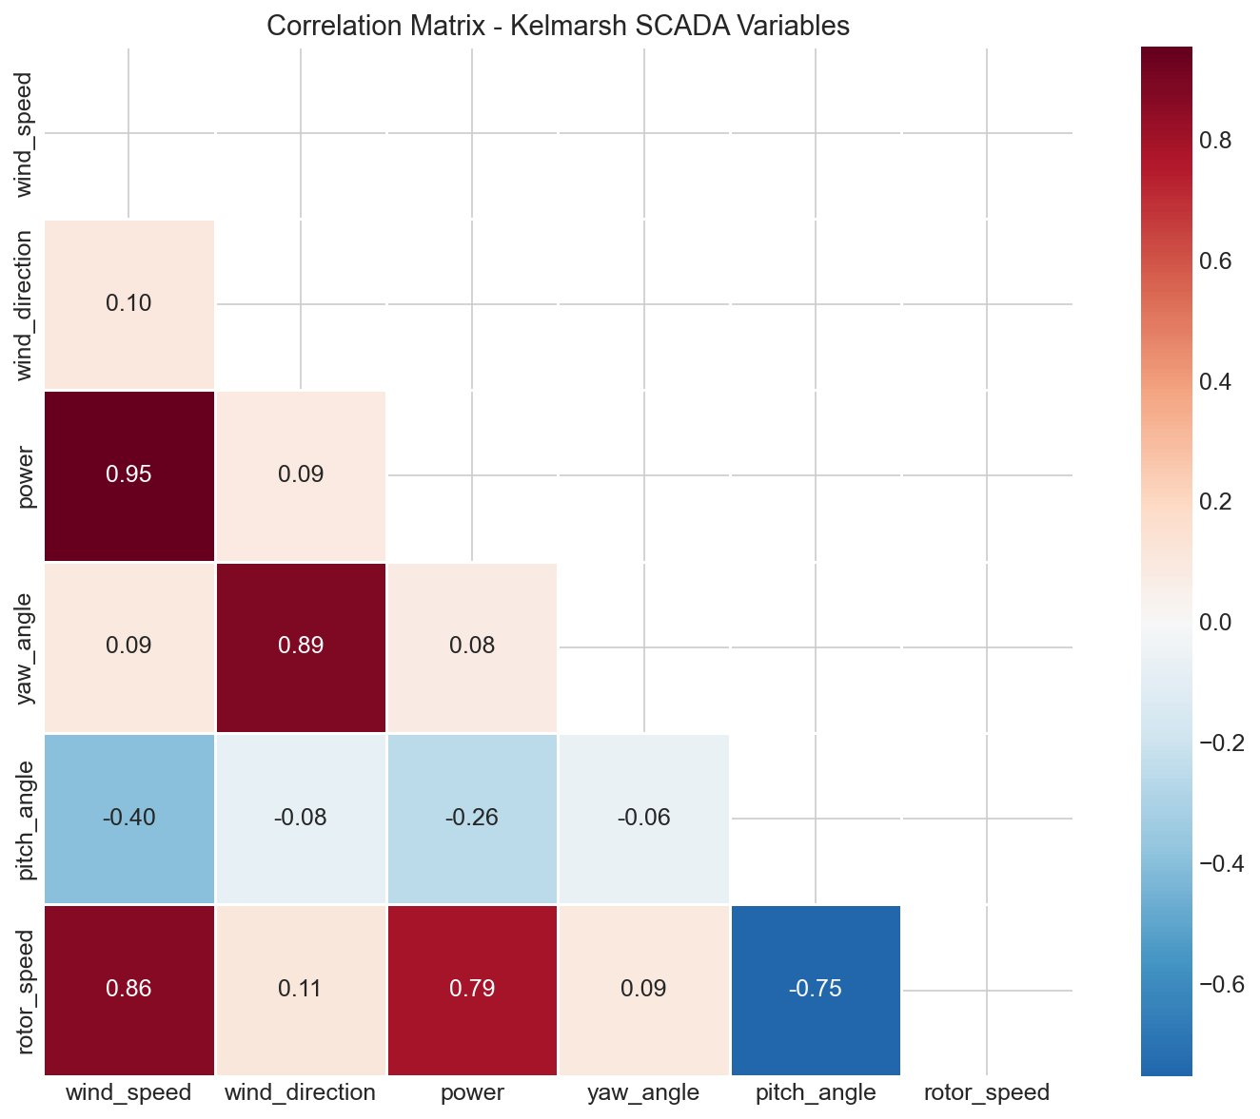
Variable Correlations
Wind-power: 0.95 | Yaw-direction: 0.89 | Pitch-rotor: -0.75 (pitch-to-feather control)

Slide 9
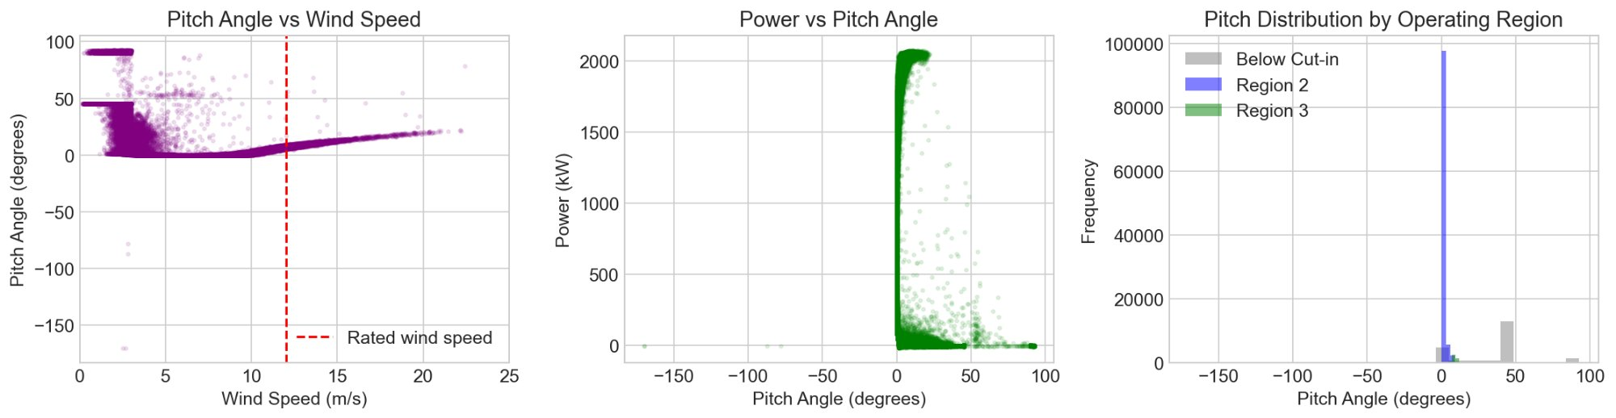
Pitch Angle Behavior
Pitch near 0° in Region 2, increases in Region 3 for power regulation.

Slide 10
PINN Architecture Design
Component | Specification | Notes
Input Layer | 4 neurons | wind speed, direction, yaw, pitch
Hidden Layers | 5 × 64 neurons | Tanh activation
Output Layer | 3 neurons | velocity (u,v), power
Framework | pinnstorch | PyTorch-based, Raissi group
Physics Loss | Navier-Stokes residual | Continuity + momentum

Slide 11
Key Findings
• Power curve matches expected 3-region behavior (cut-in → cubic → rated)
• Yaw misalignment causes measurable power loss (up to 55%)
• Turbine 6 underperforms — wake effects or site conditions
• Strong wind-power correlation (r=0.95) validates data quality
• Pitch-rotor anticorrelation confirms active power regulation

Slide 12
Challenges & Solutions
Challenges
Solutions
• Anomalous pitch values in raw data
• 360°/0° wraparound in angles
• Framework selection complexity
• Curtailment periods in data
• Filtering pipeline removes outliers
• Modular yaw error calculation
• Selected pinnstorch (Raissi group)
• Filter low-power, high-wind periods

Slide 13
Next Steps (Progress Report 3)
• Install pinnstorch and validate Navier-Stokes example
• Adapt PINN for yaw/pitch control inputs
• Train on Kelmarsh dataset
• Compare PINN vs vanilla neural network
• Demonstrate gradient-based yaw optimization

Slide 14
Questions?
Ibrahim Alghrabi | g201724510@kfupm.edu.sa
Ibrahim Alghrabi | Advisor: Dr. Tariq Ahmed Albusyuni | MATH 619

