Slide 1
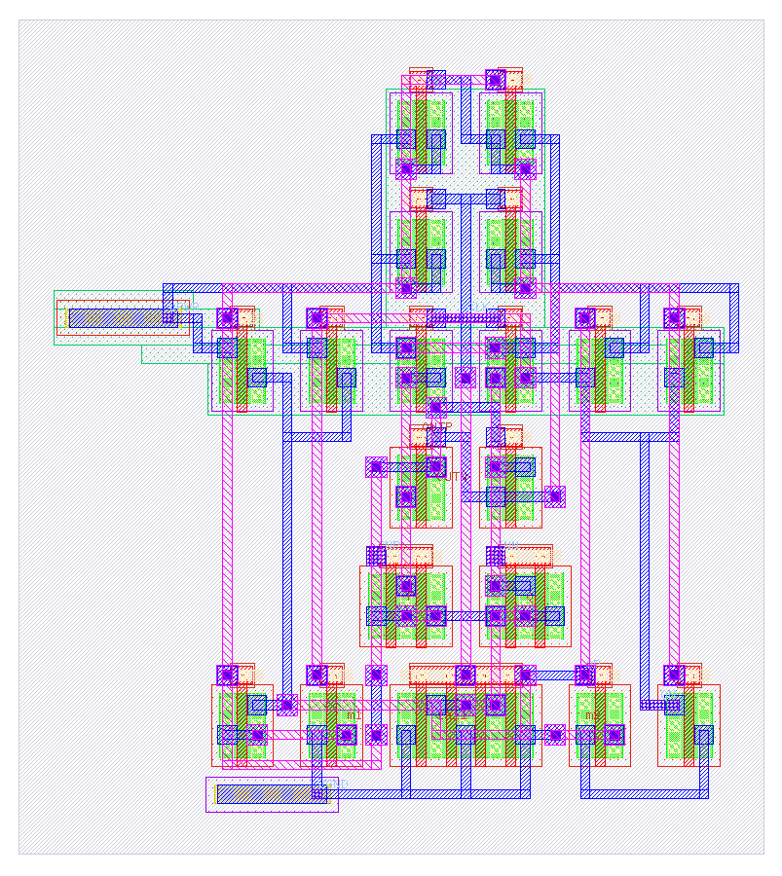
ICL: a layout language for AI agents
Benchmarks, harnesses and what actually helps: SKY130 standard cells and analog blocks, built by Nemotron (free), Haiku and Sonnet
comparator + SR latch, 19 transistors, 9 mirror-symmetric pairs (drawn in ICL by Haiku)
Notes:
ICL is a layout language that lets AI agents draw SKY130 layouts at the level of abstraction the task needs, with every result signed off by magic DRC and netgen LVS. This deck covers the language, the benchmarks built to test it, the techniques and harnesses that made a free model work, the three-model comparison against raw GDS, and the tool fixes that came from reading the agents' logs.

Slide 2
What we found
3 → 12/14
0 → 3/4
14 → 20/20
20+
standard cells built from scratch by the free model, as feedback, lessons, examples and an agent loop were added
hard tasks for the free model: raw coordinates vs ICL with its docs preloaded (Haiku 2 → 4/4)
parameter-sweep points Haiku keeps clean when the techniques are added
language and tool fixes found by reading the agents' logs
Strong models can draw small cells from raw coordinates; the language matters more as the model gets weaker and the cell gets denser. The techniques mostly buy robustness, size and cost for Claude, and decide success for the free model.
Models: nvidia/nemotron-3.5-super-vl (free, OpenRouter), Claude Haiku 5.5 and Sonnet 5.5 (as subagents). All results re-checked by an independent checker.
Notes:
Four headline numbers. The free model's progress on the 14-cell standard-cell benchmark; the hard-task comparison where raw coordinates fail for weaker models; the robustness gain from the techniques; and the number of fixes that reading the agents' logs produced.

Slide 3




One syntax, four levels of abstraction
Level 1 stdcell
Level 2 cell
Level 3 floorplan
Level 4 route
Shapes defined relative to shapes: enclose, cross, right_of, min (the rule minimum)
PCells + placement + matching patterns: interdigitate, common centroid, pair, guard rings
Finished blocks and PDK cells, DRC-aware abutment and spacing
Router under constraints: width, keep-out, symmetry, shielding, resistance, coupling
gc = contact licon cx=g.cx bottom=cb
interdigitate M1 M2 pattern=ABBA
place AMP right_of=DIF gap=min
route OUT width=0.3 avoid=INN:0.6
A cell built at one level is instantiated by the next. Every result is signed off by magic DRC (full) and netgen LVS.
Notes:
ICL is one language with four libraries. Level 1 is geometric but relative - no raw coordinates. Level 2 assembles parametric transistors with placement relations and matching patterns. Level 3 places finished blocks with DRC-aware spacing. Level 4 is the router, which any block can use with constraints such as width, keep-out distance and symmetry.

Slide 4
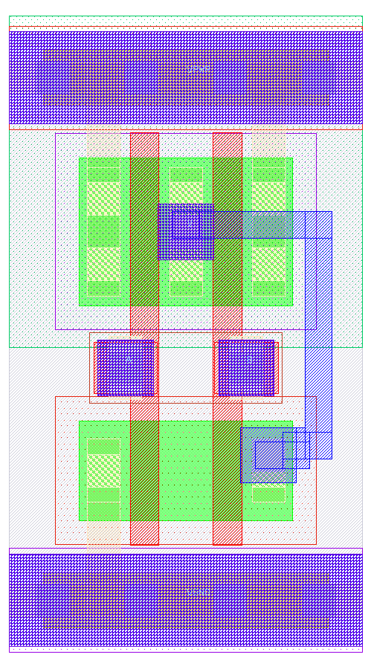




Write, check, fix: the loop every agent runs
stdcell nand2_p width=4 height=H
device MNA nmos w=WN l=L d=n1 g=A s=VGND
...
nd = rect diff w=dw h=WN cx=cell.cx above=ptap
ga = cross [nd, pd] poly w=L left=(nd.left + 0.265)
sn = array licon in=nd left_of=ga
snl = enclose sn li
gnd = strap li from=snl to=vgnd_li
cb = max(nd.top + 0.19, snl.top + 0.25)
gca = contact licon cx=(ga.cx - 0.1) bottom=cb
route Y layers=m1
port A in on=ap
end
Write the cell in ICL
bin/icl check: magic DRC + netgen LVS (+ the judge)
Diagnosis names the statement, line and the fix
Edit and check again until clean, then sweep W / L / H
Positions derive from the parameters, so one file stays clean across the sweep (this NAND2: 22 of 22 points).
Notes:
A level-1 cell is written relative to other shapes and parameters (WN, WP, L, H), so the same file is checked at the nominal point and across a sweep. The check returns magic DRC, netgen LVS and - in the benchmark - geometric constraint checks; the diagnosis is written in terms of the agent's own statements.

Slide 5
Benchmarks: SkyWater cells and analog blocks
Level 1: standard cells
Level 2: analog assembly
Ground truth
14 cells with sky130_fd_sc_hd netlists: inv … xor2, mux2i
4 harder cells: maj3, ha (14T), dlxtp (18T), fa (28T)
Sweep: 6 points of L, W and cell height; cells must tile
Tasks: from scratch, repair one injected bug, compact
13 blocks: mirrors, diff pair, 5T / 2-stage / folded-cascode OTAs, StrongARM, comparator + latch
Matching, symmetry, guard-ring, spacing, width and area constraints
Sweep: 4 points of L and W
Every task has a verified reference (generator or hand-written)
LVS against an independent netlist; matching dummies ignored
Same checker for every model and condition
dlxtp and fa are left out of the comparisons: no verified reference yet (the generator cannot route them).
Notes:
Level-1 tasks reuse the real SkyWater hd netlists, scaled for cells that carry their own taps. Level-2 tasks are textbook analog blocks with explicit layout constraints. Each task has a verified reference, and LVS always compares against an independent netlist so a model cannot pass by changing the circuit.

Slide 6
The judge measures the geometry, not the statements
Every transistor finger found as poly crossing diffusion, assigned to a device by its nets
Interdigitation and common centroid from finger positions
Mirror symmetry of every pair about one shared axis
Closed guard rings, wire spacing outside pin escape zones, area budget
Standard cells: rails, and a row of copies must stay DRC clean (tiling)
Negative tests pass: an AABB 'interdigitation' and the old row-based StrongARM (pairs on different axes) are rejected.
Notes:
Writing 'interdigitate' is not enough - the judge recomputes everything from the drawn shapes. The same judge scores raw GDS, so ICL and raw layouts are compared on identical terms.

Slide 7
The free model went from 3 to 12 of 14 standard cells
Lessons
My reviews of failed attempts, written as general rules: 5 → 10
Agent loop
Tools alone were worse (6): weak models stop early. Nudges + examples: 12
Level 2
12 / 12 analog blocks, sweep-clean, mostly at the first attempt
Notes:
Each bar adds one technique. The biggest single jump came from distilling the reviewer's observations into general lessons. Moving to an agentic harness first made things worse - the model ended its turn without calling a tool - until the harness nudged it to continue and gave it two verified similar cells. Level 2 analog assembly was much easier: the PCells, patterns and router carry the design rules.

Slide 8




Techniques that made the difference
Ranked diagnosis
Retrieved examples
Names the statement and line, the measured gap vs the rule, and a concrete edit
Two verified layouts of similar cells
Connectivity in object names
Keep-best
SHORT / OPEN by object, 'the column labelled n3 should be n5'
Continue from, and finally keep, the best verified version
Lessons
Continuation nudges
Reviewer notes rewritten as general rules; per-cell notes did not beat a control
A model that stops before a clean check is told what still fails
Images of the layout were about neutral (10/14 with, 9/14 without): the text diagnosis carries the information.
Notes:
These are the techniques that measurably helped the free model. The control experiment matters: per-cell coaching notes were no better than simply more attempts, but the same insights written as general lessons doubled the score.

Slide 9


Chat vs agentic harness: same success, better compaction
Benchmark | Chat-only | Agentic | Model calls
L1 from scratch (14) | 11 | 12 | 38 / 241
L1 repair (14) | 12 | 12 | 23 / 182
L1 compact (8) | 3 narrower | 6 narrower | 24 / 154
L2 analog (12) | 12 | 12 | 19 / 122
Chat-only
One model call per attempt: return a file, the harness checks it and replies with the report.
Agentic (deepagents)
LangGraph deepagents: file tools, planning, check_layout, check_sweep, inspect_layout; the model decides when to read, check and stop.
About 6× the requests (reading docs, self-checks, sweeps). Compaction gains most: the agent can try a narrower version, sweep it and back off. The harness also keeps the agent's best verified version, since its last file is not always its best.
Notes:
Same pass rates within run-to-run variance on scratch, repair and level 2, a clear win on compaction, at roughly six times the requests - which matters with a 1000-requests-per-day free quota.

Slide 10


Hard tasks: three models, three conditions, one checker
maj3
ha
folded cascode
comp + latch
14T majority gate, standard cell
14T half adder, two outputs
11T OTA, five matched groups + keep-out
19T StrongARM + SR latch, 9 symmetric pairs
Raw GDS
ICL
ICL + techniques
Draw coordinates (Python + KLayout, or a rectangle list for the free model); rule summary and layer map
The language reference, one basic example, the plain checker
Lessons, 2 verified similar cells, ranked diagnosis, sweep and inspect tools, keep-best
Same task text and the same checker for everyone: magic DRC, netgen LVS vs the reference, the geometric judge, tiling. Claude ran as subagents; Nemotron in the deepagents harness. Final files re-scored independently.
Notes:
Two dense standard cells and two complex analog blocks, each with a verified reference. 36 runs in total: 3 models x 3 conditions x 4 tasks.

Slide 11
The language matters more the weaker the model
Sonnet
Clean in every condition. Raw GDS took ~3x the time of ICL and gave wider standard cells
Haiku
Raw: both dense standard cells failed; one gave up after drawing the frame. ICL: 4/4
Nemotron
Raw: hundreds of DRC errors in every run. ICL: both analog blocks; with its docs preloaded also the half adder (3/4)
Notes:
Sonnet draws everything even from raw coordinates. Haiku needs the language for dense standard cells. The free model cannot draw any of them from raw coordinates and solves the analog blocks only with the language; once the documentation was put into its prompt it also solved the half adder.

Slide 12
Techniques buy robustness, size and cost
9.66 → 5.06 µm
Haiku's maj3 cell width
533 → 196 µm²
Nemotron's folded cascode area
402k → 344k
Haiku tokens for the 4 tasks
Notes:
For Claude the techniques do not change the nominal pass rate - it is already at the ceiling - but layouts follow the parameters (without them, cells were clean at L = 0.15 and broke at 0.18 and 0.25), come out smaller and cost fewer tokens.

Slide 13
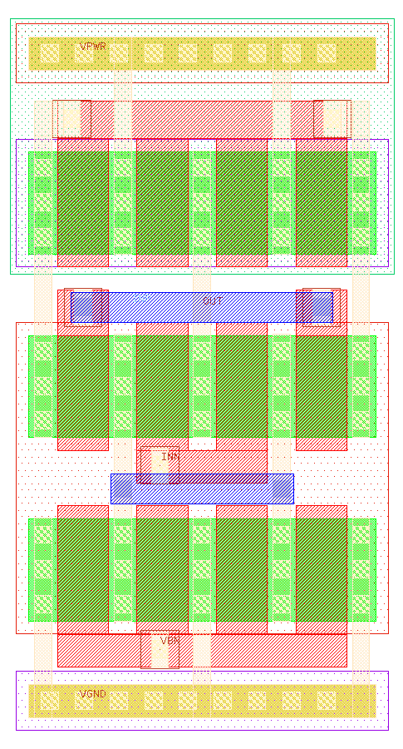
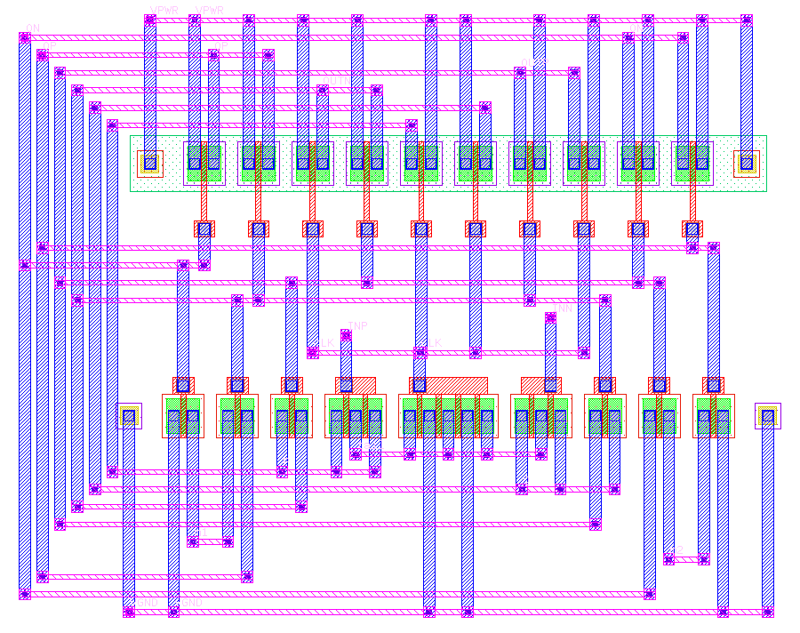
Raw GDS can be tight, but it is fragile
3 of 4 raw standard cells broke when tiled next to copies of themselves; every ICL cell tiled
Raw cells are fixed geometry: no parameter sweep
Hidden conventions cost iterations: ports need pin-datatype shapes, GDS database units
Dense 14T cells: Haiku ran out of routing tracks; the free model never got close
Haiku, raw coordinates: comparator, clean but 372 µm² (ICL: 118 µm²)
Sonnet, raw coordinates: 5T OTA in 22.8 µm² (ICL runs: 45–61 µm²)
Notes:
Hand-placed coordinates can beat the language's generators on area, as Sonnet's 22.8 µm² OTA shows, but raw layouts broke when tiled, cannot follow parameter changes, and depend on conventions the language handles automatically.

Slide 14
Reading the agents' logs fixed the tools
Seen in an agent's log | Change
Router took the only landing spot of another pin | Pin access reserved first; unroutable nets reported, cell still built
Notch fills exploded to 35,000 shapes; met1 slivers below min width | Fill frontier + dedupe; sliver repair after routing
Devices with no common net could not be interdigitated | Automatic diffusion breaks in patterns
Guard rings did not fit; wide wires could not land on columns | Rings push dependent placements; wires neck down at pins
enclose [list] poly silently shorted gates; wire ends got no via | Compile error with hint; vias added automatically
Latch-up only seen as an opaque DRC at double width | Compile-time latch-up check naming the device
row gap=min crashed; vague 'no routed metal' port error | Accepted; error now gives the exact three lines
Plus checker fixes: GDS database units, li wiring in spacing checks, a tiling check. All regressions stay clean (11/11).
Notes:
Every row came from an agent hitting a wall: a router that took another pin's only landing spot, a geometry engine that produced slivers, language constructs that silently did the wrong thing. Fixing the tool helps every model at once.

Slide 15
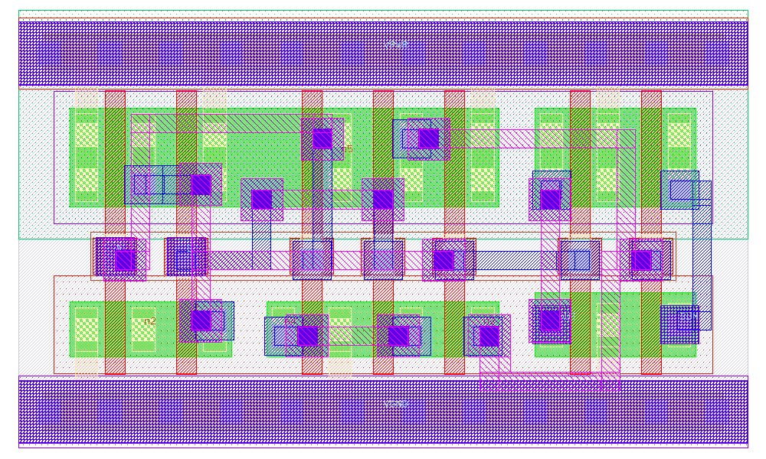

Knowledge up front: the free model solves a 14T cell
Log: 36 model calls, only 2 checks
Most of the budget went into reading the reference, lessons and examples
Change: put them in the prompt
Task, language reference and lessons preloaded; 60 calls; tool fixes from the logs
Result
ha clean and sweep-clean: the free model's first dense standard cell; maj3 reached 0 DRC, LVS still open
Half adder by Nemotron: 5.52 µm wide, clean at all 6 sweep points
Notes:
The free model's limit on dense cells was partly its budget: it spent most calls reading files. Preloading the knowledge into its prompt let it finish the half adder. maj3 is now blocked by the router's pin access in dense cells.

Slide 16

Open issues and next steps
Still limiting
Next
Router pin access in dense standard cells (maj3, one Sonnet sweep point)
Rows give clean cells but not the 2.72 µm standard-cell frame
Generator cannot route the 18T latch or 28T full adder yet
Free tier: 1000 requests / day; Gemma 4 rate-limited upstream
Pin-access-aware routing for dense cells
Let rows target the standard-cell frame: an easier level for weak models
Level-3 floorplan benchmark with the same judge
Move the best configuration into your LangGraph deepagents harness
Notes:
The main remaining tool limit is the router's pin access in dense standard cells. The most promising language step is letting the row template produce standard cells in the 2.72 µm frame, which the free model already tried on its own.

Slide 17
Takeaways
A layout language lets weaker and free models do what only strong models can do from raw coordinates.
Diagnosis in the agent's own terms, distilled lessons and examples move the free model most.
For strong models, techniques buy robustness, size and cost rather than pass rate.
Agent logs are the best source of tool fixes.
Code and results: ~/claude-workspace/icdsl (agents/README.md, agent_compare2/RESULTS.md)
Notes:
Four takeaways, and where to find the code and the detailed results.

