Slide 1
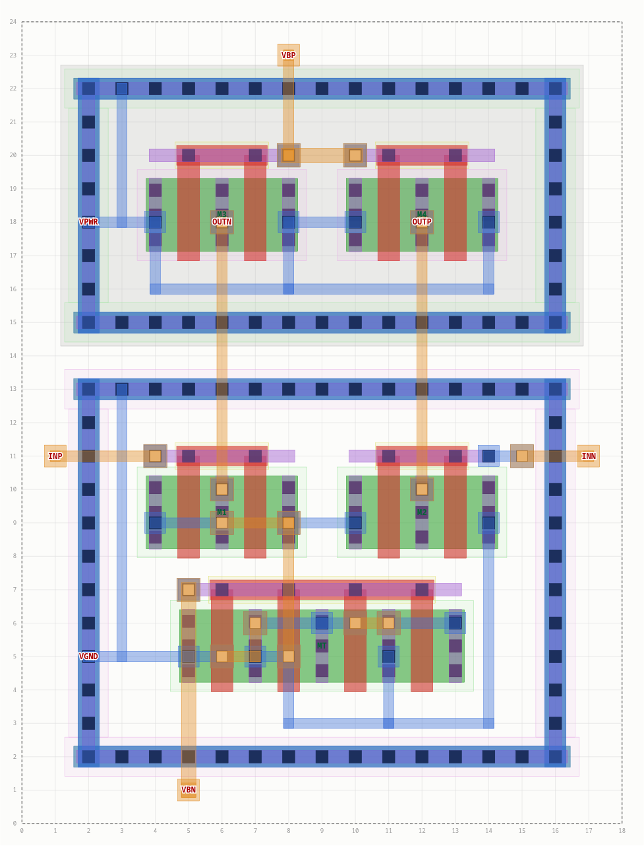
ICL: one layout language, four levels
SKY130 layout that AI agents can drive to DRC- and LVS-clean results
Magic DRC · Netgen LVS · sky130A
Notes:
ICL is a layout language for SKY130. One syntax, four libraries: hand-drawn standard cells, circuits from transistor PCells, floorplans of finished blocks, and routing control everywhere. Every result goes through Magic DRC and Netgen LVS. The picture is a real generated cell.

Slide 2
Why a layout language for agents
1
2
3
Relationships, not coordinates
The rules live in the tool
Every result is signed off
Agents are poor at geometry. Shapes and devices are placed relative to each other: above=ptap, right_of=M1, enclose nd nsdm.
min resolves to the SKY130 rule for the layers involved. Device generators and the router are correct by construction.
Magic DRC and Netgen LVS run on each check, and errors come back against your statements and net names.
Intent in the file, rule numbers in the tool.
Notes:
Three design choices. Positions are relationships, so an agent never computes coordinates. Rule numbers live in the tool behind the word min. And nothing is trusted until Magic and Netgen agree.

Slide 3
Four levels, one grammar
L3
floorplan
places finished blocks (your cells or PDK std cells) with DRC-aware spacing
L4 route
routing control inside every block: width, keep-out, symmetry, shields, resistance, coupling
L2
cell
builds circuits from transistor PCells: placement, symmetry, matching patterns
L1
stdcell
hand-draws shapes, each defined relative to other shapes
[name =] verb arg arg ... key=value ... # every statement, every level
Notes:
Three block types nested by abstraction, plus routing statements usable inside all of them. A stdcell is instantiated in a cell, a cell in a floorplan, with inst. Same statement shape everywhere.

Slide 4
The shared grammar
param WN=0.52 L=0.15 H=2.72 # file level
stdcell inv_p width=3 height=H
dw = 2*L + 0.53 # value binding
nd = rect diff w=dw h=WN cx=cell.cx above=ptap
g = cross [nd, pd] poly w=L # endcaps = min
sn = array licon in=nd left_of=g
end
$ bin/icl check f.icl --param L=0.25
min
the rule minimum for the layers involved; min+0.1 also works
References
attributes of things already made: nd.top, M1.d, AMP.OUT, MT.cx
Parameters
param at file level; sweeps override it with ‑‑param
Bindings
name = expression, reused in later statements
Notes:
Values are expressions in micrometres. min is the key word: it becomes the right rule for each layer pair. Parameters make whole cells parametric, so a sweep is just --param on the command line.

Slide 5
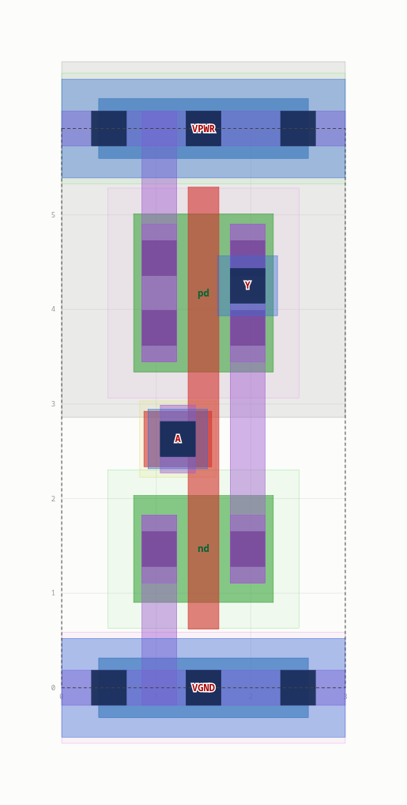
Level 1 · stdcell: relative shapes
L1
stdcell inv_p width=3 height=H
device MN nmos w=WN l=L d=Y g=A s=VGND
nd = rect diff w=(L+0.53) h=WN above=ptap
nim = enclose nd nsdm # rule enclosure
g = cross [nd, pd] poly w=L
sn = array licon in=nd left_of=g
gnd = strap li from=snl to=vgnd_li
gc = contact licon bottom=max(...)
well y=((nd.top + 0.34 + pd.bottom - 0.18)/2)
port A in on=ap
22/22
parameter sweep points DRC + LVS clean (W, L, cell height)
The template supplies rails, taps and the n-well. A fast pre-check reports rule issues by statement line.
Notes:
Every shape has a name and a relationship. Because positions are derived, changing W, L or height keeps the cell legal: this inverter passes all 22 sweep points with full Magic and Netgen checks.

Slide 6
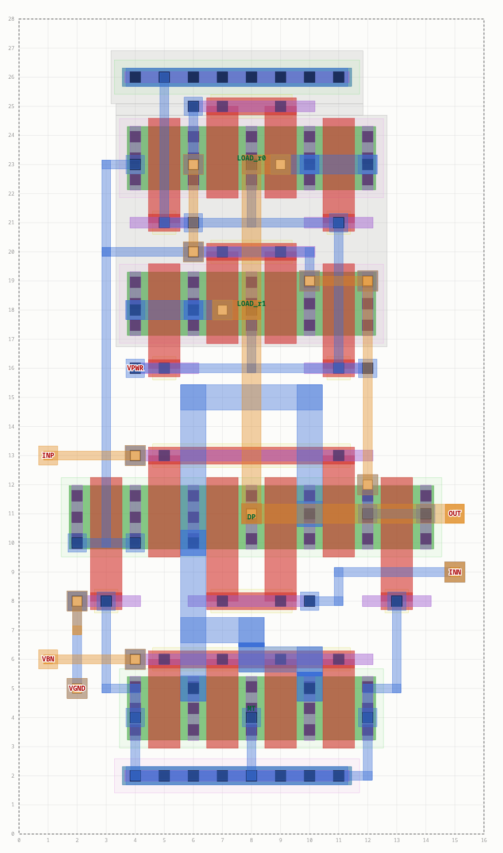
Level 2 · cell: devices + matching
L2
nmos M1 w=1.0 l=0.5 nf=2 d=x g=INP s=tail
nmos M2 w=1.0 l=0.5 nf=2 d=OUT g=INN s=tail
interdigitate M1 M2 pattern=ABBA dummies=1
common_centroid M3 M4 pattern=AB/BA
place MT above=TP align=center
place DP above=MT align=center
place LOAD above=DP gap=0.8
route tail width=0.4 maxres=10
gap=min slides an object until every layer pair sits at its rule
Patterns source/drain columns and gate-strap sides are solved for you
Notes:
Here you declare transistors and say how they relate. The OTA has an ABBA input pair with dummies, a 2x2 common-centroid load, and a 0.4 micrometre tail with a resistance limit.

Slide 7
Level 2 · symmetry and guard rings
L2
place MT at=(0, 0)
pair M1 M2 axis=MT.cx above=MT
pair M3 M4 axis=MT.cx above=M1 vgap=2.0
guardring GN around=[MT, M1, M2] kind=ptap
guardring GP around=[M3, M4] kind=ntap
route OUTN OUTP symmetric axis=MT.cx
pair M2 is the mirror image of M1, at the minimum legal distance
guardring checks its own clearance and says how much room it needs
symmetric OUTP is routed as the exact mirror of OUTN
Notes:
Analog intent is first-class: mirrored placement, guard rings that check their own fit, and symmetric routing. The outputs on the picture are exact mirror images.

Slide 8
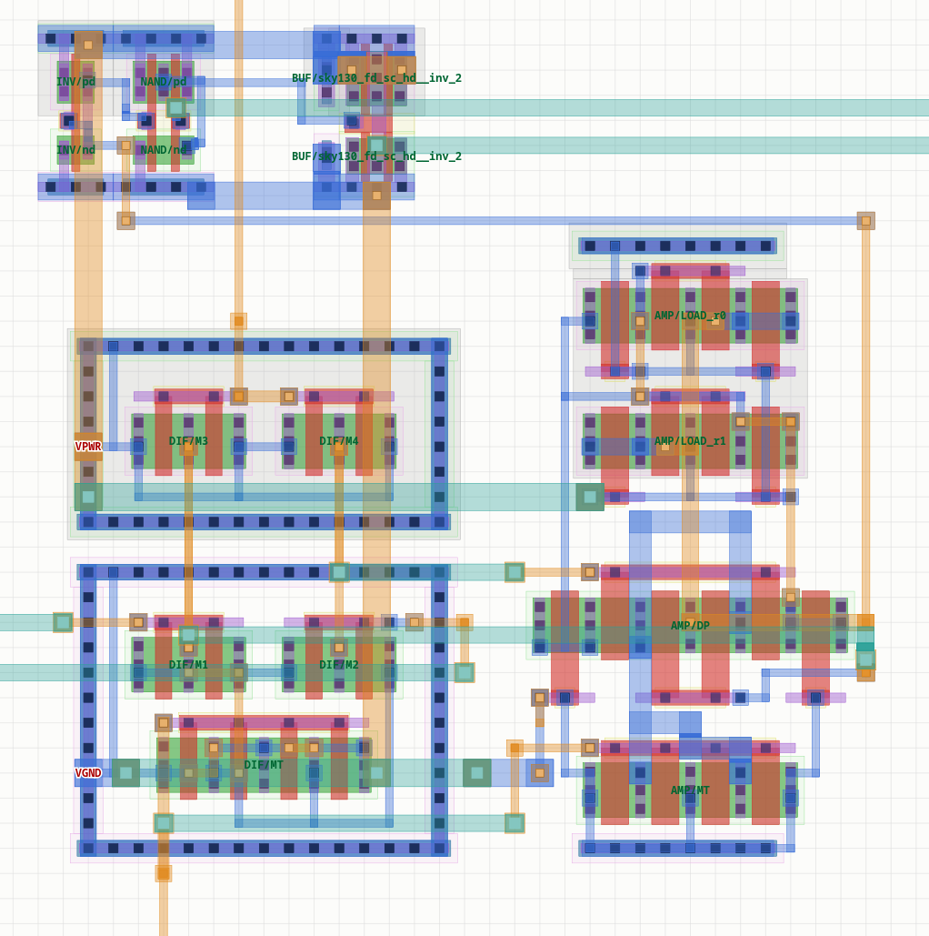
Level 3 · DRC-aware floorplans
L3
inst AMP ota_matched INP=dp INN=dn
inst BUF pdk:sky130_fd_sc_hd__inv_2
place AMP right_of=DIF align=bottom
place BUF right_of=TAP
proximity NAND TAP
What the tool decided
AMP abutted DIF: facing layers merge legally
TAP cannot abut NAND: nsdm 0.24 < 0.38 µm, moved to the 1.84 µm minimum
BUF abutted TAP: wells merge, the buffer is tapped
Floorplan render, cropped to the placed blocks
Notes:
Blocks can be your cells or real PDK standard cells. The placer abuts blocks only when every facing layer merges legally; otherwise it moves to the smallest legal gap and records the binding rule.

Slide 9
Level 4 · routing intent, verified
L4
0.20 µm
route VBN width=0.2 avoid=OUTN:1.0
route OUTN OUTP symmetric axis=MT.cx
route VBN shield=VGND
route tail width=0.4 maxres=10
limit coupling OUT INN max=0.05
wire VBP layer=m2 width=0.2 from=M3.g to=M4.g
wire Y layer=m2 path=[N1.d, (N1.d.x, 1.84)]
keepout aout INP dist=1.0
VBN width as drawn (asked 0.2)
1.06 µm
closest VBN to OUTN approach (asked at least 1.0)
3.2 Ω
The router checks every wire, via and pad against real shapes with the spacing for that pair of nets, so constraints cannot create DRC errors.
tail resistance (limit 10 Ω, width kept at 0.4)
Notes:
Auto routing by default; constraints only where they matter. The numbers on the right were measured from the generated geometry, not taken from the request.

Slide 10
One command, feedback in your terms
Write
Compile
Build
Magic
Netgen
.icl file
line + hint on error
GDS + reference netlist
full DRC deck
LVS vs netlist
Compile errors: line number and a suggested fix
DRC: the DSL objects under each error box
LVS: reported with your net names
Warnings: dangling nets, unreachable pins
$ bin/icl check examples/l3_chip.icl --top chip
== chip 30.00 x 26.00 um -> CLEAN (9.4s)
DRC (magic drc(full) sky130A): 0 violation(s)
LVS (netgen): MATCH devices [5, 5] nets [13, 13]
Exit code 0 means clean · --json for machine-readable reports · PNG with errors boxed in red
Notes:
bin/icl check does everything in a few seconds. The point is the feedback: every error is translated back to the statement or net the agent wrote, so the next attempt knows what to change.

Slide 11
Why the layouts stay DRC-clean
Rule-aware compaction
Correct-by-construction PCells
gap=min slides objects until every layer pair (diffusion, poly, implants, wells, metals) sits at its rule.
MOS arrays, taps, guard rings; patterns solve source/drain columns and gate-strap sides.
Geometric router
Automatic wells and implants
pair-specific spacing, notch fills for wide wires, off-grid pin stubs, min-area repair, rip-up and retry.
merged across devices, narrow necks repaired, missing body ties reported as errors.
Notes:
Four mechanisms carry the rule knowledge. The result: routing can fail with a clear message, but it does not produce spacing errors.

Slide 12
Results so far
11/11
79/79
22/22
example cells across all four levels pass DRC and LVS
random designs that compiled came out DRC + LVS clean (geometric router)
sweep points for each hand-written parametric cell
L1
inv1 · nand2 (hand-drawn, hd footprints)
L2
inv · nand2 · ota5t · strongarm · dff · ring5 · ota_matched · diff_stage
L3
chip: diff stage → OTA → inverter → NAND → PDK inv_2, 30 × 26 µm
Notes:
All example cells pass signoff. Random designs exercise the generators and router: every one that compiled was clean; the rest were refused up front with an explanation.

Slide 13
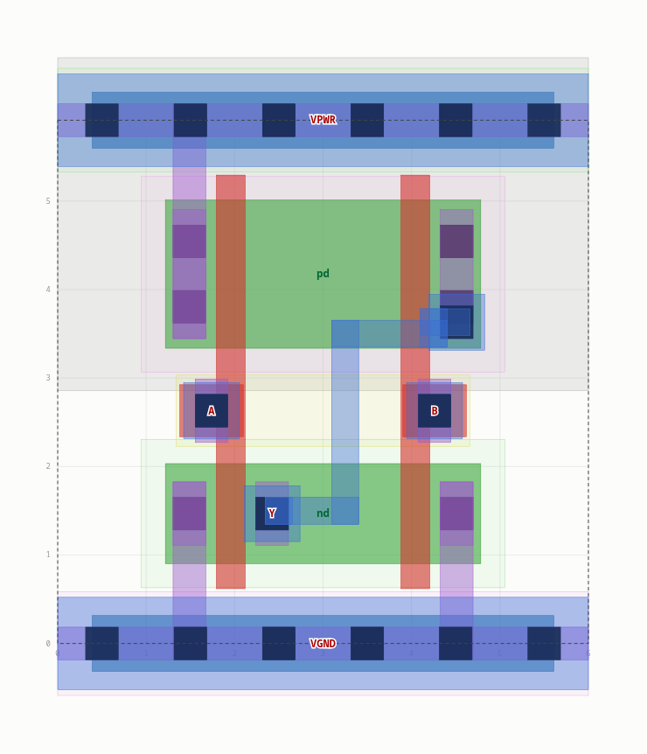
A free model driving ICL
nvidia/nemotron-3.5-super-vl:free · 41 calls · $0 · LVS against an independent netlist
nand2
nor2
buf
aoi21
Run 1 · reference + 1 example
fail
fail
fail
fail
Run 2 · + method, 2nd example
example
clean 22/22
26 DRC, LVS ok
fail
Run 3 · 5 attempts
DRC 0, LVS fail
fail
Run 4 · + series-node hint
fail
The biggest gain came from the prompt (method + second example), not from more attempts.
Nemotron's NOR2: clean on the first try, clean at all 22 sweep points
Notes:
The model wrote parametric cells; the harness checked each with an independent reference netlist and swept W, L and height. NOR2 succeeded; BUF got close; AOI21 did not converge. Results vary between runs.

Slide 14
What the experiment changed
Model mistakes → language fixes
Bugs the sweeps found → fixed
nd_w = 2*L + 0.72 now a supported value binding
gap= in stdcells accepted as an alias of space=
cross ... yspan= was silently ignored, now an explained error
Uncontacted shared column LVS feedback names the series node
n-well split fixed at 1.305 µm now scales with height, plus well y=
met1 pin overhang of 0.04 µm pin access needs a full wire width
Gate-contact li spacing at W=0.42 max() rule in the worked example
Notes:
The experiment improved the language: agent mistakes became features or clearer errors, and the parameter sweeps found three real bugs in the generators and router.

Slide 15
Limits, and what came next
Limits of the ICL language
What came next: the canvas
1.8 V transistors only; no resistors or capacitors
Routing on met1 to met4
Resistance and coupling are estimates
SKY130 only; magic is the only DRC judge
No antenna or density checks; nothing simulated
Plain Python scripts: any layer, any polygon, resistors and MIM capacitors
Three PDKs from one script: sky130A, gf180mcuD and freepdk45 (45 nm)
The PDK's own KLayout deck as a second DRC judge
A larger benchmark: 8 tasks, up to 768 transistors
See icl_canvas.pptx and CANVAS.md (status 2026-11-11)
Notes:
The limits on the left are those of the ICL language: MOS only, SKY130 only, estimates for R and C, and no simulation. The right side is what was added later as a second interface, the canvas. It lifts the first, second and fourth limit; the deck icl_canvas.pptx describes it.

Slide 16
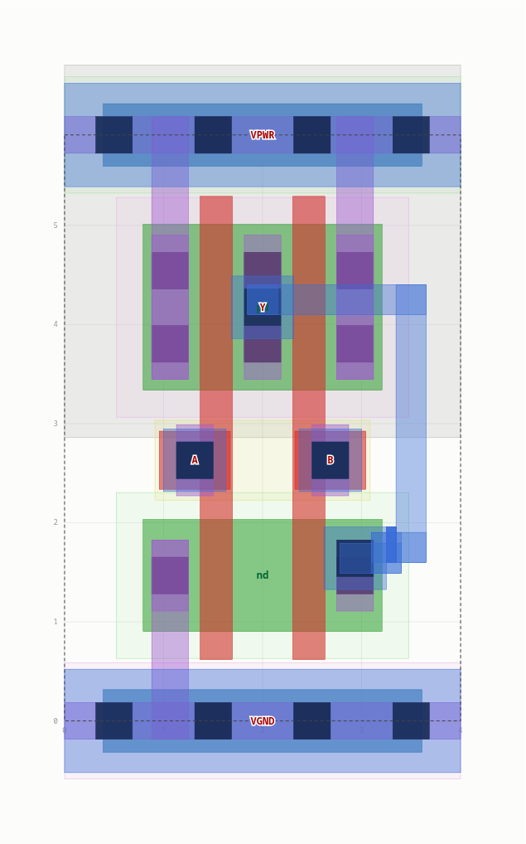
Try it
Reference: AGENTS.md · CANVAS.md · examples/ · agents/README.md
bin/icl check examples/l2_analog.icl --top diff_stage
bin/icl inspect examples/l3_chip.icl --top chip
bin/icl check tests/canvas/strip.py --pdk freepdk45
Notes:
Three commands to start: two on ICL files, one on a canvas script with another PDK. AGENTS.md is the reference of the ICL language and CANVAS.md that of the canvas; the examples go level by level.

