Slide 1
Northwind Roadmap Review
Prepared by the Test Team - code PPTX-ALPHA-3141

Slide 2
Priorities
Ship the mobile app
  Pilot with two departments
Cut onboarding time to 5 days
Consolidate vendor contracts
  Confirm the shortlist by June

Slide 3
Regional Sales
Region | Q1 | Q2 | Q3 | Q4
North | 1200 | 1350 | 1100 | 1500
South | 900 | 980 | 1020 | 1100
East | 1450 | 1600 | 1580 | 1720
West | 800 | 875 | 910 | 990
Central | 1010 | 1090 | 1150 | 1230

Slide 4
Team Size

Slide 5
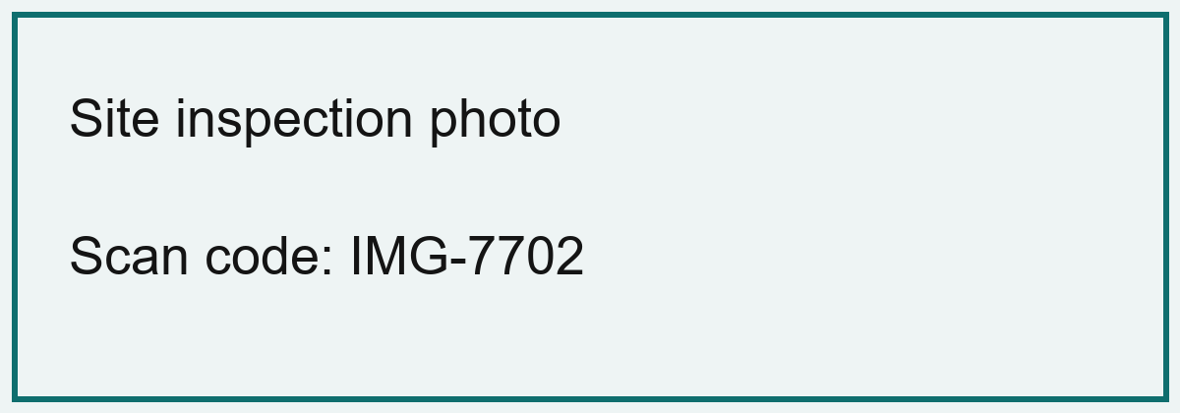
Site Photo

Slide 6
Next Steps
Confirm budget with Finance
Book the launch review
Notes:
Speaker notes: the launch date is 14 March 2027. Internal code PPTX-OMEGA-9926.

