Slide 1
UNSUPERVISED MACHINE LEARNING
IBRAHIM RADWAN

Slide 2
OUTLINE
What is Machine Learning?
Types of Machine Learning
Why Unsupervised Machine Learning?
Contents of the Subject
Resources
Tools
Assessments

Slide 3
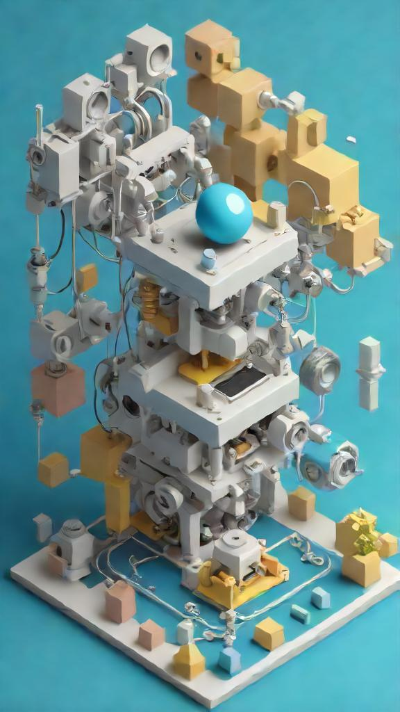
WHAT IS MACHINE LEARNING?
Machine learning is a subset of AI that focuses on developing algorithms and models that enable computers to learn from and make predictions or decisions based on data.
It's a key driver of AI applications, including natural language processing, image recognition, and recommendation systems.

Slide 4
CASE Studies
HEALTHCARE
FINANCE
RETAIL
Predicting Disease Outcomes
Algorithmic Securities Trading
Personalized Recommendations & Cart Management
MANUFACTURING
TRANSPORTATION
ENERGY
Predictive Tools Maintenance
Autonomous Vehicles (Hybrid)
Energy Consumption Optimization

Slide 5
REAL WORLD APPLICATIONS
2025
2030
2035
2040
Radiologists and healthcare professionals employed deep learning algorithms to analyse medical images such as X-rays, MRIs, and CT scans.
An educational platform uses AI to provide personalised learning experiences for students as well as assessments suited to learning.
A smart grid system utilized AI to optimize energy consumption in urban areas. The system adjusted energy distribution to reduce waste and costs.
By using natural language processing, the chatbot understood and responded to customer queries, reducing response times.

Slide 6
Types of machine learning
Supervised Learning
The machine “learns” from the training data set {(Input Data, Labels)}
It requires upfront human intervention to label the data appropriately
For example, weather condition prediction, object detection, etc.
Unsupervised Learning
The machine “discovers” the inherent structure of unlabelled data {(Input Data)}
It requires some human intervention for validating output variables
For example, discovering online shoppers’ habits, etc.
Reinforcement Learning
RL involves learning through experience
In RL, an agent learns to achieve a goal in an uncertain, potentially complex environment by performing actions and receiving feedback through rewards or penalties
RL mimics the try-and-error learning process
For example, chess game

Slide 7
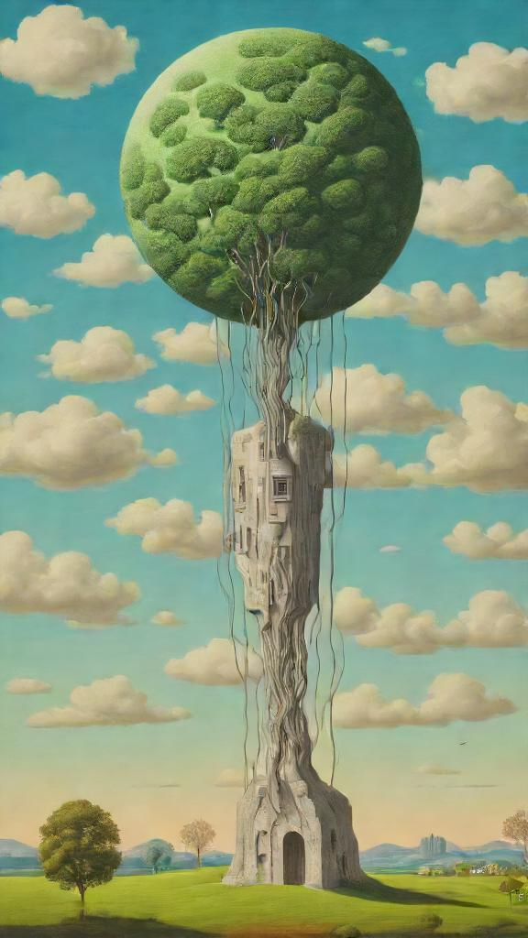
Why Unsupervised Machine Learning?
Unsupervised learning is where we have only input data {(x)}, and correspond output variable {(y)}
The goal is to model the underlying structure or distribution of the data to learn more about the data
It is unsupervised, as there is no correct answer to guide the learning process of how to discover the structure of the data
Unsupervised learning techniques can be further grouped into:
Clustering: it is where we try to discover the inherent grouping in the data, such as grouping customers based on shopping habits
Association: It is where the focus is on building mining rules to describe data structures, such as people that buy X products tend to buy Y products

Slide 8
Why Unsupervised Machine Learning?
A Scenario: Imagine arriving on Earth with no cooking knowledge, given 100 days, a stove, and a fridge full of food, but without instructions on cooking.
Exploration Process: Over time, random trial and error may lead you to discover how to use the kitchen tools and eventually make an edible meal.
Challenges of Random Exploration: The lack of structured information leads to noisy, irrelevant data and a long, inefficient learning process.
Role of Unsupervised Learning: By reviewing data from the 100 days, unsupervised learning (e.g., clustering) can identify patterns on the days, where you successfully made meals.
Potential Insight: Clustering can help recognise what worked on certain days, allowing you to learn from those patterns.
Limitations of Clustering: Unsupervised learning may still group irrelevant or unhelpful data together, making it not a perfect solution.
Benefit of Using Unsupervised Learning: Despite limitations, it helps identify useful patterns in otherwise chaotic data, making the process more efficient.

Slide 9
Contents of the unit
Clustering
Dimensionality Reduction
Association Rules
AutoEncoder

Slide 10
RESOURCE PAGE
Recommended Books
Hands On Unsupervised Learning With Python, Giuseppe Bonaccorso, (Link to Download)
Applied Unsupervised Learning with Python, Benjamin Johnston, Aaron Jones, and Christopher Kruger (Link to Download)
Practical Activities:
https://github.com/aapatel09/handson-unsupervised-learning
https://github.com/TrainingByPackt/Applied-Unsupervised-Learning-with-Python

Slide 11
Tools
The following tools are required to be installed on your computer, if possible:
VSCode (https://code.visualstudio.com/download)
Python (can be installed as an extension from VSCode)
Jupyter Notebook (can be installed as an extension from VSCode)
Git (https://git-scm.com/downloads)
Create an account on www.GitHub.com

Slide 12
Assessment
Type: Project-based
Group Size: Individual or 3-5 members
GitHub Repo: Upload all code & documentation organised into separate files
Tasks:
Clustering
Dimensionality Reduction
Association Rules
Autoencoders
Requirements:
Document all steps clearly
Explain methods & results
Organize everything in GitHub
Evaluation: Based on correct implementation, clarity, and insights

Slide 13
Q&A

