Slide 1
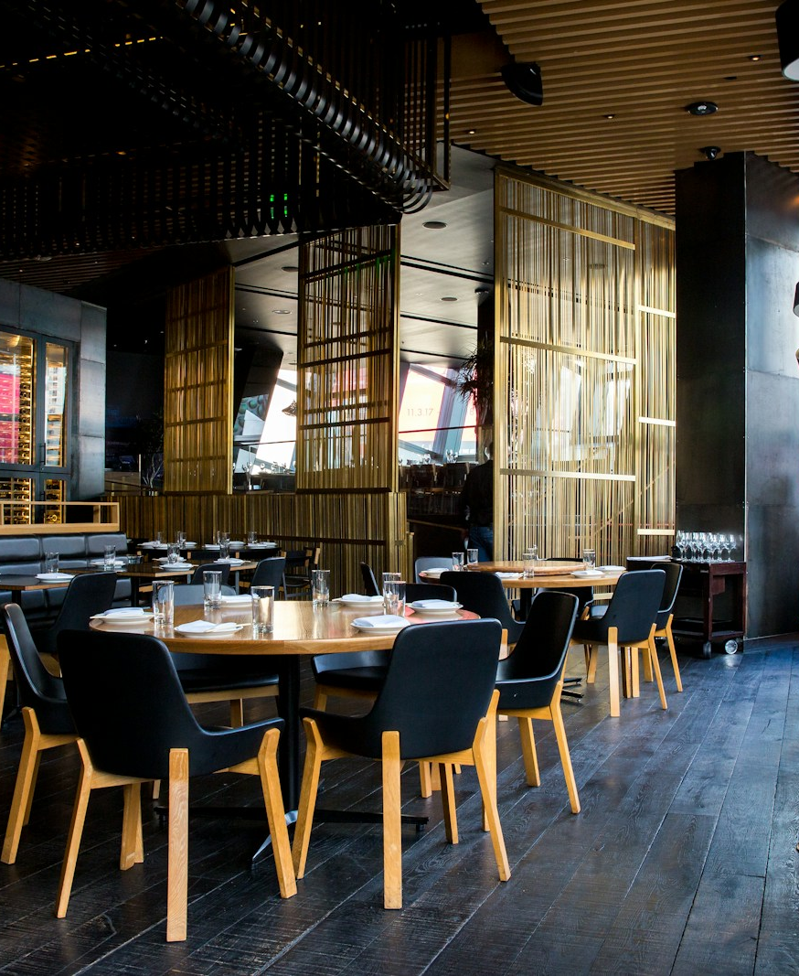
IBRAHIM STUDIO
Restaurant websites
A thoughtful path from first impression to a table request.
Ember Table demonstration
25 October 2026
Notes:
Illustrative photograph used on the Ibrahim Studio demo. Source: https://images.unsplash.com/photo-1517248135467-4c7edcad34c4. Not a real Ibrahim Studio client property.

Slide 2
Essential
A clear business presence
01
Menu categories and dish information
Production scope
A real restaurant supplies its menu, authorised photos, dietary information, booking rules and a defined reservation provider.
02
Venue story, gallery and contact details
03
Reservation enquiry with clear policies
Ibrahim Studio / 02
Notes:
Feature statements reflect the existing source routes. Demos are fictional and all business transactions are local simulations. Package scope is defined separately and does not include every demonstration feature.

Slide 3
Interactive
Useful tools for choosing
01
Tasting selections and visual seating
02
Dish reviews, ratings and helpful votes
03
Local reservation and concern history
Ibrahim Studio / 03
Notes:
Existing implementation source and demo routes at https://ibrahim-services-studio.rockyox34.chatgpt.site/demos/restaurant/interactive . Browser-local persistence. No real operational integration is implied.

Slide 4
3D Signature
01
Scroll from arrival into the dining room
Model context
Original conceptual restaurant. It is not a scan of a client venue. Live reservations, allergy information and operational policies need the restaurant’s approval.
02
Move the camera to a physical wall menu
03
Inspect dishes and select suitable tables
WebGL quality depends on the device. A non-3D path remains available.
Ibrahim Studio / 04
Notes:
Original conceptual restaurant. It is not a scan of a client venue. Live reservations, allergy information and operational policies need the restaurant’s approval.
Source: existing demo implementation and visible asset credits. AURA: https://sketchfab.com/3d-models/vr-apartment-fb1b717d457540129c6bf45315aa2612 CC BY 4.0. Furniture: https://github.com/KhronosGroup/glTF-Sample-Assets/tree/main/Models/SheenChair CC0 and /GlamVelvetSofa CC BY 4.0. Ferrari: https://sketchfab.com/models/57bf6cc56931426e87494f554df1dab6 CC BY 4.0. Cloud QA cannot verify live GPU rendering.

Slide 5
Scoped starting prices
Edition | One-time build fee | Planning basis
Essential | INR 14,999 | Supplied content
Interactive | INR 34,999 | One agreed workflow
3D Signature | INR 1,49,999 | Suitable supplied 3D assets
One supplied venue model, up to five zones, wall-menu interaction and one enquiry flow.
Asset creation, visits, travel, paid services and applicable taxes are additional. Written scope controls the total. Prices reviewed 25 October 2026.
Ibrahim Studio / 05
Notes:
Ibrahim Studio proposed rate card, not a market average. Benchmarks reviewed 25 October 2026: https://www.webdesignerindia.in/packages/website-design-plans/
https://launchroom.in/pricing
https://www.studiokalex.com/blog/3d-website-cost-india-2026-pricing-guide
https://www.studiokalex.com/blog/3d-product-rendering-cost-india-2026-pricing-guide
Scope and fees match lib/studio.ts and the PDF guide.

Slide 6
The work behind the experience
3D production and site visits
A clear working agreement
Half-day on site: INR 7,500
Full-day on site: INR 12,500
Travel, scanner rental and specialist capture are separately approved. Models and reconstruction receive their own quote.
40% kickoff, 40% prototype, 20% handover
Two consolidated revision rounds
30 days of agreed-scope defect fixes
Cancellation accounts for completed work and approved costs. Unearned balances are refundable under the agreement and applicable law.
Ibrahim Studio / 06
Notes:
Ibrahim Studio commercial guidelines. Location visits require owner permission and a capture plan. No guarantee of a perfect scan. See /terms and PDF for complete conditions. Terms do not waive statutory consumer rights.

Slide 7
Your project brief
Shaik Ibrahim
contact@ibrahimshaik.com
Share your business goal, target launch window and budget.
For 3D, include existing models, plans and the location city.
Explore demos and prepare an enquiry
Future domain: services.ibrahimshaik.com. Publication and DNS setup are separate launch steps.
Ibrahim Studio / 07
Notes:
Current deployment preserves owner-private access. Shareable domain access needs an explicit audience choice and DNS configuration. Studio contact form prepares a brief locally for the visitor to send through email. No server mail delivery is configured. Planned domain is not presented as a verified live URL.

