Slide 1
Sticky-Notes
Team :
Ibrahim AbuSamrah Abed Al-Fattah Hroub

Slide 2
Content :
What is Sticky-Notes ?
What is operating system run the Sticky-Notes ?
How to use Sticky-Notes ?
What is Future Plans ?

Slide 3
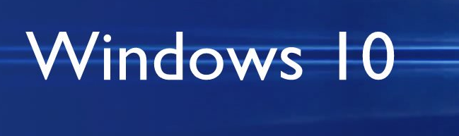


What is operating system run the Sticky-Notes ?

Slide 4
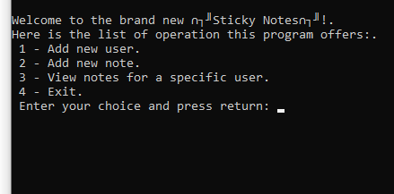
How to use Sticky-Notes ?

Slide 5
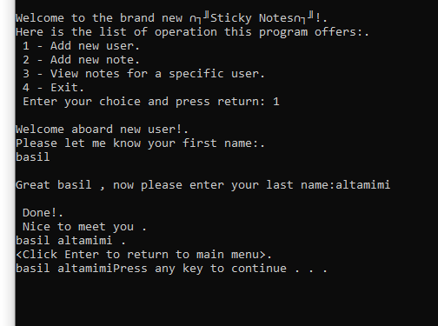
Add user name

Slide 6
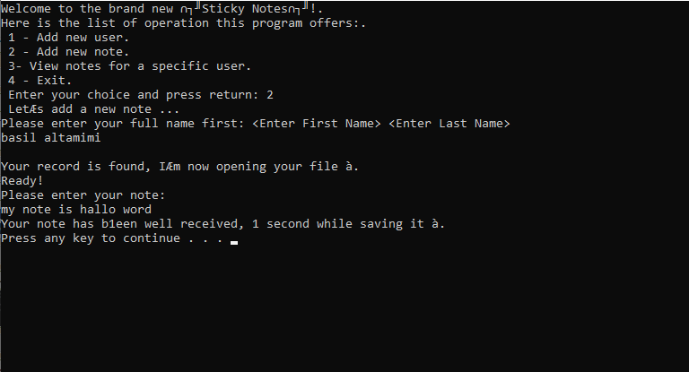
Add user note

Slide 7
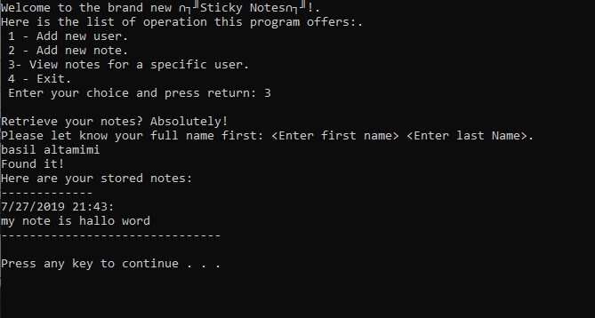
View notes for a specific user

Slide 8
What is Future Plans ?
Compatible with all systems
Online
Edit the note and user
Notification
GUI interface

