Slide 1

Sticky-Notes
Team :
Ibrahim AbuSamrah Abed Al-Fattah Hroub

Slide 2
Content :
What is Sticky-Notes ?
Beginning
Tool
Programming language
Team management
How to use Sticky-Notes ?
problem
What is Future Plans ?

Slide 3
What is Sticky-Notes ?
Is a simple interface that contains several options that help the user store his or her notes in a file that is specific to his / her name .
Contains several options including adding a new user And add new notes in addition to displaying all the notes stored with a specific user name
Offline
What is operating system run Sticky-Notes ?

Slide 4



What is operating system run the Sticky-Notes ?

Slide 5



Beginning

Slide 6
Tool
git
github “https://github.com/ibrahim123abusamrah/Sticky-Notes”
github Destop
Trello “https://trello.com/b/YovZ72BL/project-sticky-notes”
clion A cross-platform IDE for C and C++

Slide 7
Programming language
c++

Slide 8
Team management
Trello :
https://trello.com/b/YovZ72BL/project-sticky-notes

Slide 9
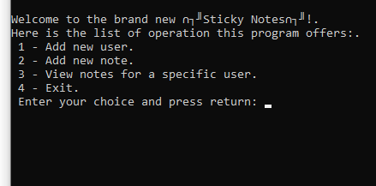
How to use Sticky-Notes ?

Slide 10
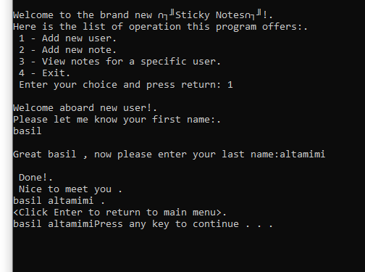
Add user name

Slide 11
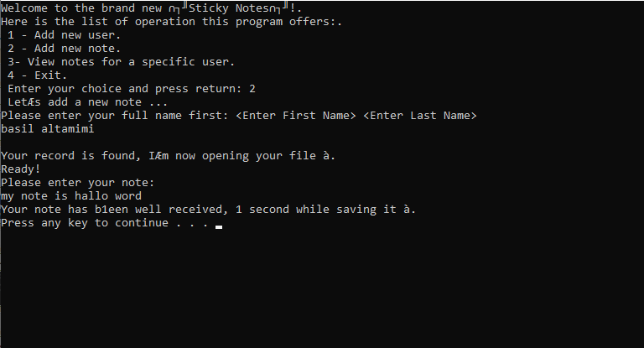
Add user note

Slide 12
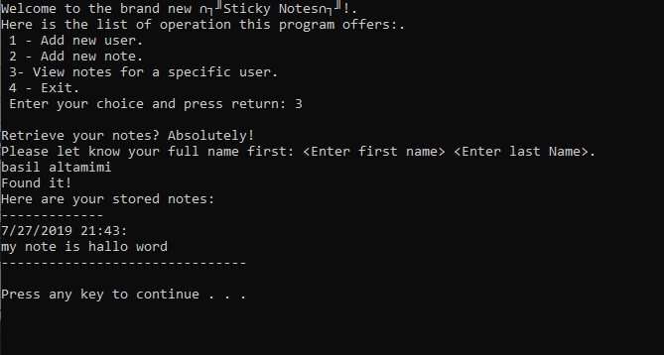
View notes for a specific user

Slide 13
Problem
Configure work environment
Merge in github
Path for data base

Slide 14
What is Future Plans ?
Compatible with all systems
Online
Edit the note and user
Notification
GUI interface

